Slide 1
The Role of NGOs in Rural Development
Md. Fouad Hossain Sarker
Associate Professor
Department of Development Studies
Daffodil International University

Slide 2
Objectives and Outcomes of the Session
Conceptual understanding of NGOs and its essentials
Understand the Linkage between NGOs and Rural Development
Make a brief introduction to different NGOs in terms of Rural Development
Evaluate the initiatives and activities of NGOs that prevail in the rural areas of the country and their success and achievements
Make a debate on the multidimensional approaches of NGOs in rural areas.

Slide 3
WHAT IS NGO?
A non-governmental organization (NGO) is any non-profit, voluntary citizens' group that is organized on a local, national, or international level.

Slide 4
Rural Development
Rural development is the betterment in the totality of life for rural people. It is the process of improving the quality of life and economic well-being of people living in relatively isolated and sparsely populated areas. Its actions are mainly aimed to the social and economic development of the rural areas.
Indicators of Rural Development
Changes in agricultural productivity.
Changes in rural employment, unemployment and under employment
Changes in the income of different income groups
Changes in the distribution of power, influence and participation.
Changes in literacy, schooling, literacy rate and life expectancy
Changes in values, believes and attitudes of members of state agencies as well as the rural policymaking.

Slide 5
Reasons for the Emerging of NGOs and their Essentials

Slide 6
Essentials of NGOs
Development of money economy
Increasing the size of the state and organizations
Socio-cultural Development
Technological advancement
Acceptability and Flexibility
Responsiveness and tangibility
Red tapism and presence corruptions
Promoting a better service delivery

Slide 7
15 Reasons Why NGOs Are Important
The growth in the number and influence of NGOs in the last ten years is astounding. As the quotation from UN Secretary-General Kofi Annan suggests, NGOs increasingly work as advisors to national governments, international agencies, and the UN.
https://www.humanrightscareers.com/issues/why-ngos-are-important/

Slide 8
NGO’s Role
NGOs cover a wide range of rural development activities including:
development of income and employment, health and sanitation, agriculture and rural craft, vocational education, relief and rehabilitation, family planning, mother and childcare.
Prominent NGOs are:
The Bangladesh Rural Advancement Committee (BRAC), Grameen Bank, Proshika, Manobik Unnayan Kendra, ASA, KARITAS, Proshika, Bureau Bangladesh, Rangpur-Dinajpur Rural Service etc.
https://www.sciencedirect.com/topics/earth-and-planetary-sciences/non-governmental-organisation

Slide 9
NGO’s Role
Currently, NGOs are critical contributors to global efforts to achieve the UN’s Millennium Development Goals. These goals include the eradication of extreme poverty and hunger, universal primary education, gender equality, and women’s empowerment, the reduction of child mortality, improvement of maternal health, environmental sustainability, advancements in the fight against diseases such as HIV/AIDS and malaria, and the establishment of global partnerships for development.
- Harvard Law School

Slide 10
Make a brief introduction to different NGOs in terms of Rural Development

Slide 11
BRAC
BRAC is the largest non-governmental development organization in the world.
BRAC started its journey in 1972 and has introduced itself as “a pioneer in recognizing and tackling the many different realities of poverty.”
Their vision is of just, enlightened, healthy, and democratic societies free from hunger, poverty, environmental degradation, and all forms of exploitation based on age, sex, religion, and ethnicity.

Slide 12
What does BRAC Do?
Microfinance
Dabi - Poverty alleviation for poor landless women
Unnoti - Microenterprise development for marginal farmers
Progoti - Small enterprise development for businesses
Program Support Enterprise
-Aarong -Dairy and Food Project
-Vegetable Export -Nurseries -Feed Mills
-Poultry Farms & Disease Diagnosis Lab
-Broiler Production & Marketing
-Seed Enterprise -Fisheries Enterprise

Slide 13
Education
-Pre-Primary School
-Primary School
-Children with Special Needs(CSN)
-Education for Indigenous Children
-Community and Formal School
-Partnership with Mainstream Primary Schools
-Secondary School
-Continuing Education Program(CE)
-Adolescent Development Program
Health Program
-Essential Health Care
-EHC-STUP
-WASH
-MNCH-Rural
-Manoshi-MNCH Urban
-Tuberculosis Control
-Malaria Control
-HIV/AIDS
-Shushasthya
-BRAC Limb and Brace Centres
-Pilot Initiatives

Slide 14
Human Rights & Legal Services
-Human Rights and Legal Education
-Capacity Building of Sheboks/shebikas
-Local Community Leaders Workshop
-Human Rights Implementation Committees
-Legal Assistance and Legal Aid Clinics
-Human Rights Violation Cases
Social Development
-Polli Shomaj-ward level federations
-Union Shomaj- union level federation
-Capacity Development of Local Government
-Popular Theatre
-Human Rights Violation Issues

Slide 15
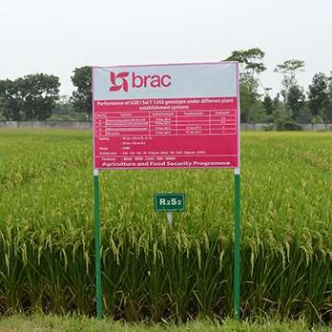
Agriculture
-Support Programs and business
-Poultry and Livestock Program
-Support Enterprise for Livestock and Poultry farming
-Support Enterprises for Agriculture
-Fisheries Program
-Support Enterprise for Fisheries
-Social Forestry Program
-Support Enterprises for Social Forestry
-Sericulture

Slide 16
Caritas Bangladesh
Caritas Bangladesh works in integrated development, disaster management, and human resource development. They started their journey in 1967 as Caritas East Pakistan. In 1976 they were re-introduced their name as Caritas.
Caritas Bangladesh is implementing ongoing projects relating to these six goals/sectors:
Improvement of the Quality of Life of the Extremely Poor and Vulnerable Communities.
Promote Education Rights and Inclusive Quality Education.
Improve Health Education, Care, and Public Health Services.
Strengthen Disaster Response and Community Resilience.
Strengthen Ecological Sustainability.
Improvement of the Living Standards of Indigenous Peoples.

Slide 17
Proshika
Established in 1976
Proshika was founded by social workers trained in BRAC who decided to concentrate mainly on human development training. The rural development activities of PROSHIKA can be grouped into three broad categories :
Building self-awareness and confidence
Promotion of income
Development of education

Slide 18
ASA
Established in 1978.
Rural development programs taken by ASA like as-
Loan
Savings
Insurance
Health awareness
Primary education
Higher education
Partnership building among rural people

Slide 19
Evaluate the initiatives and activities of NGOs that prevail in the rural areas of the country and their success and achievements!!!

Slide 20
The Contribution of NGOs in Social Change in Bangladesh, Somalia, Nigeria : Microfinance
In countries like Bangladesh, Somalia, and Nigeria, women are disproportionately disadvantaged.
Women constitute the overwhelming majority of the microfinance beneficiaries.
Microfinance helps women acquire assets of their own and exercise power in household decision making.
Microfinance programs taken by NGOs promote investment in human capital and raise awareness of reproductive health issues among poor families.
Grameen Bank, BRAC, ASA in Bangladesh; Salaam Financial Services, Kabaa Microfinance Institution (K-MFI) in Somaliland provide short loans to poor women.

Slide 21
Women Empowerment
Microfinance
Targeting Women

Slide 22
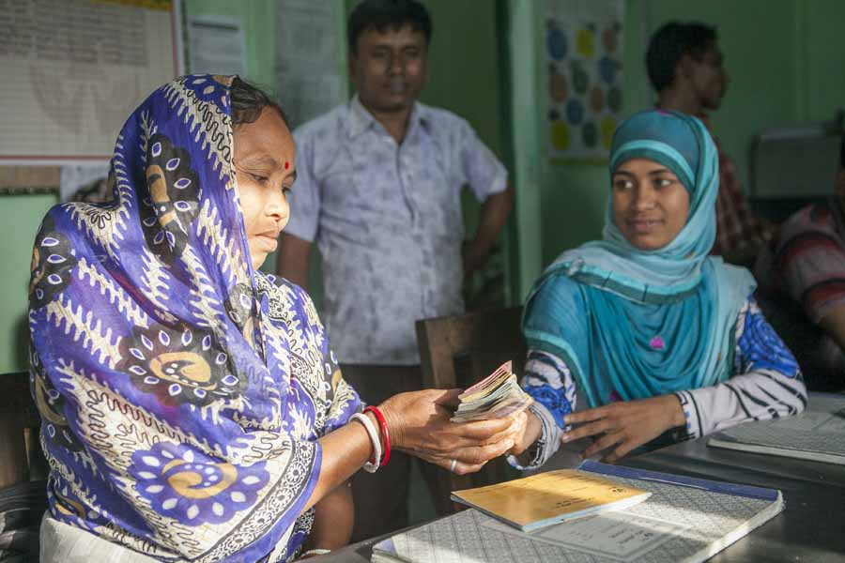

Slide 23
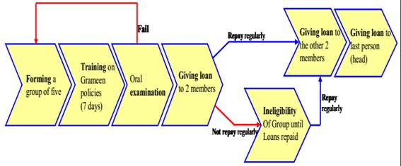
Figure: Grameen Bank Loan Distribution System

Slide 24
The Contribution of NGOs in Social Change in Bangladesh, Somalia, Nigeria : Education
BRAC’s Non-Formal Primary Education Program is an initiative for the rural areas of Bangladesh to provide basic education to the large numbers of children who were not being reached through government efforts.
In comparison with the teachers in the formal education system, BRAC teachers have smaller classes (30 students only), teach fewer subjects, address fewer objectives and provide an estimated 500 additional hours per year of engaged instructional time.
Similarly Association for Social Advancement-ASA in Bangladesh, Plan International, Teach for India these are working for ensuring basic education for drop out students.

Slide 25
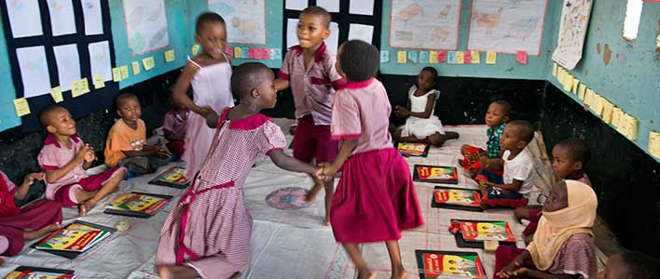

Slide 26
The Contribution of NGOs in Social Change in Bangladesh, Somalia, Nigeria : Health
The Lancet documented in 2013 that Bangladesh achieved a great success in health especially in the improvements in the survival of infants and children under 5 years of age, life expectancy, immunization coverage and tuberculosis.
BRAC’s WASH (Water, Sanitation, and Hygiene) program is another hallmark initiative in health sector.
Under this program extreme poor people get financial cooperation in construction of sanitary latrine and also obtain awareness about sanitation system.
African Childhood Care Network in Nigeria, Society for Telemedicine and E-Health in Nigeria, Oxfam International in Somalia are working for ensuring health facilities.

Slide 27
The Contribution of NGOs in Social Change in Bangladesh, Somalia, Nigeria : Women Empowerment
NGOs, as the development partners of government, are working towards women empowerment and implementing a series of development intervention for eradicating gender discrimination.
Following the continuation of initiatives, NGOs have arranged many income generating activities like apiculture, silk production, embroidery, fishnet matching, poultry and livestock to increase the socio economic condition of women.
In 2012, CARE Bangladesh provided a list of 81 NGOs including BRAC, CARE-Bangladesh, Hitaishi Bangladesh, Manusher Jonno, Mohila Porishad, Oxfam, have been launching project on issues pertaining to violence against women, either through direct services or advocacy. Action Aid Nigeria, African Girls Empowerment working for the women empowerment.

Slide 28
The Contribution of NGOs in Social Change in Bangladesh, Somalia, Nigeria : Raising Awareness
Democratization
Local Decision Making
Transparency

Slide 29
The Contribution of NGOs in Social Change in Bangladesh, Somalia, Nigeria : Access to Government Resources
Many NGOs have created the unconventional opportunity to use the khas (unused) land by introducing social forestation and group irrigations system for landless people usage.
Particularly, NGOs are organizing the landless people, establishing village based nursery, assisting in social forestation and tree plantation, taking lease to khas land and dry riverbed to make use of shared fish culture.
Action Aid Nigeria, Association for Grassroots Development (AGD) are working for the urban-rural peoples development.

Slide 30
The Contribution of NGOs in Social Change in Bangladesh, Somalia, Nigeria : Environment
The major environmental problems in Bangladesh include deforestation, desertification arsenic problem and damage to the genetic and aquatic environment.
The NGOs undertake various programs to contest deforestation and to improve the conditions of deforestation as well as in a forestation program, improving sanitation facilities and ensuring the supply of safe drinking water through the distribution of water-sealed latrines and tube-wells among the beneficiaries.
Green Peace, BELA, World Wildlife Fund, 1% For The Planet, and Friends of Earth are working to protect the environment.

Slide 31
The Contribution of NGOs in Social Change in Bangladesh, Somalia, Nigeria: Relief and Rehabilitation
At the time of natural disasters like flood, drought, famine, storm, contaminated diseases, the NGOs have been planning a momentous role in distributing relief and substantial help among the wounded people along with government and after disaster, and then they would also undertake different rehabilitation activities for the betterment of disaster affected people.
African Refugee Foundation (AREF) in Nigeria, Islamic Relief and Mercy Corps in Somalia have been working for a long time in the crisis areas.

Slide 32
The Contribution of NGOs in Social Change in Bangladesh, Somalia, Nigeria: Employment Generation
NGOs are playing significant role to encourage the rural poor to participate in different economic activities and to increase their income through employment generation.
Some large organizations launches very effective professional training for higher official and unemployed people that generate job facilities.
On the other hand, they provide loans and management assistance to individuals, which create new employment opportunity.
Action Aid for the Unemployed in Nigeria has been working for the unemployed people.

Slide 33
The Contribution of NGOs in Social Change in Bangladesh, Somalia, Nigeria: Non-traditional Agricultural Extension and Food Security
Under taking the program of agriculture and food security, BRAC works with government to ensure food security by keeping direct contribution in producing, distributing and marketing quality seeds, conducting research to develop better varieties.
In 2012, under share croppers development project, total borrowers was 2, 00,000 and more than 1, 50,000 farmers got training on their agricultural works as the extension of non-traditional agriculture.
Some NGOs undertake unique programs of technology involving innovative fertilizer usage and waste management. Advocacy Committee Against Hunger in Nigeria is like that.

Slide 34
The Contribution of NGOs in Social Change in Bangladesh, Somalia, Nigeria: Family Planning
NGOs have made momentous contributions on family planning.
Specifically, Bangladesh’s national policies and NGOs include a highly developed outreach program that offers family planning services through a program of direct education and distribution of contraceptives in the homes and motivational activities as well as reproductive health care and surgical services of rural women and urban slums in Bangladesh.

Slide 35
Make a debate on the multidimensional approaches of NGOs in rural areas!!

