Slide 1
CE 413
Lesson-07
Introduction to Shear Wall
Md. Abu Hasan
Sr. Lecturer
Department of Civil Engineering
Daffodil International University

Slide 2
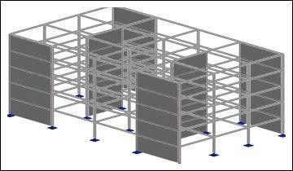
Shear Wall
In structural engineering, a shear wall is a vertical element of a system that is designed to resist in-plane lateral forces, typically wind and seismic loads.
These may be added solely to resist horizontal forces, or concrete walls enclosing stairways or elevator shafts may also serve as shear walls.

Slide 3
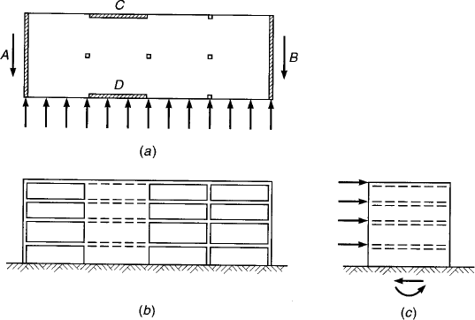
Shear Wall
FIGURE 18.13
Building with shear walls
subject to horizontal loads:
Typical floor
Front elevation
End elevation

Slide 4
Shear Wall
Figure 18.13 shows a building with wind or seismic forces represented by arrows acting on the edge or each floor or roof. The horizontal surfaces act as deep beams to transmit loads to vertical resisting elements A an
B. These shear walls, in turn, act as cantilever beam fixed at their base to carry loads down to the foundation.
They are subjected to
a variable shear, which reaches a maximum at the base.
A bending moment, which tends to cause vertical tension near the loaded edge and compression at the
far edge.
A vertical compression due to ordinary gravity loading from the structure.
For the building shown, additional shear walls C and B are provided to resist loads acting in the long direction of the structure.
Shear is apt to be critical for walls with a relatively low ratio to length . High shear walls are controlled mainly by flexural requirements.

Slide 5
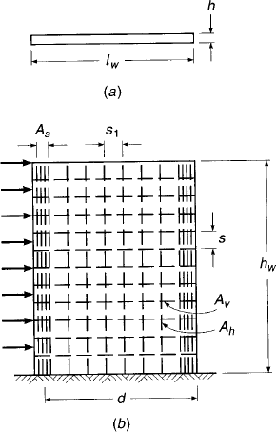
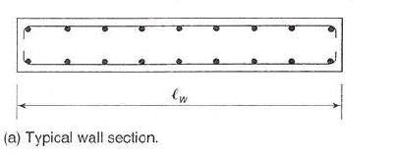
Shear Wall
FIGURE 18.14
Geometry and reinforcement of a typical
shear wall:
Cross section
Front elevation

Slide 6
Shear Wall
Figure 18.14 shows a typical shear wall with height ℎ_{𝑤}, length 𝑙_{𝑤}, and thickness h. It is assumed to be fixed at its base and loaded horizontally along with its left edge. Vertical flexural reinforcement of area 𝐴_{𝑠} is provided at the left edge, with its centroid a distance d from the extreme compression face. To allow for reversal of load, identical reinforcement is provided along the right edge. Horizontal shear reinforcement with area 𝐴_{𝑣}, at spacing s provided, as well as vertical shear reinforcement with area 𝐴_{ℎ} at spacing 𝑠₁. Such distributed steel normally placed in two layers, parallel to the faces of the wall.

Slide 7
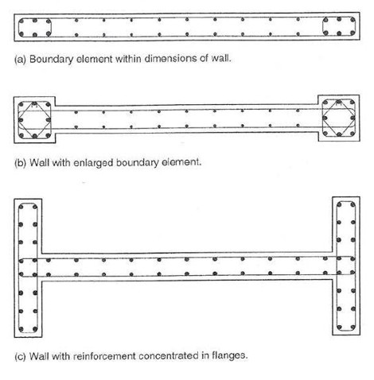
Shear Walls
FIGURE 18.16
Structural wall with concentrated
reinforcement with their edges.
Boundary element within dimensions of wall.
Wall with enlarged boundary element.
Wall with reinforcement concentrated in flanges.

Slide 8
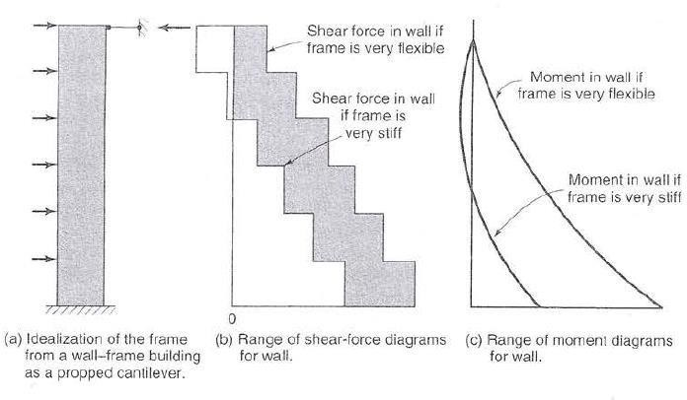
Shear Wall
FIGURE 18.17
Effect of frame stiffness on shear and moment in the shear wall.
Idealization of the frame from a wall-frame building as a cantilever.
Range of shear force diagrams for wall.
Range of moment
diagrams for wall.

Slide 9
Shear Wall

Slide 10
Shear Wall

Slide 11
Shear Wall
For deformed bars not larger than No. 5, ACI Code Section 14.3 requires
minimum areas for distributed vertical reinforcement in walls to be equal to 0.0012Ag
the minimum area of distributed horizontal reinforcement in walls to be equal to 0.0020Ag. This steel can be placed in two layers or curtains of distributed vertical and horizontal reinforcement with the bars in the two curtains tied together at intervals, but not enclosed in ties.
A single reinforcement curtain is allowed at the mid plane of walls having thicknesses of 10 in. or less (ACI Code Section 14.3.4).
ACI Code Section 14.3.5 requires that distributed vertical and horizontal bars be spaced not further apart than three times the wall thickness or 18 in., whichever is less.
ACI Code Section 11.9.9.3 allows the maximum spacing of horizontal shear reinforcement to be the smallest of lw/5, 3h, and 18 in.
ACI Section 11.9.9.5 allows the maximum spacing of vertical shear reinforcement to be the smallest of lw/3, 3h, and 18 in.

Slide 12
Shear Wall

Slide 13
Shear Wall

Slide 14
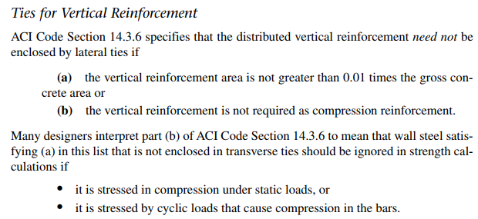
Shear Wall

