Slide 1
Chapter 13
Marketing

Slide 2
Marketing
Marketing is the activity, set of institutions, and processes for creating, communicating, delivering, and exchanging offerings that have value for customers, clients, partners, and society at large.

Slide 3
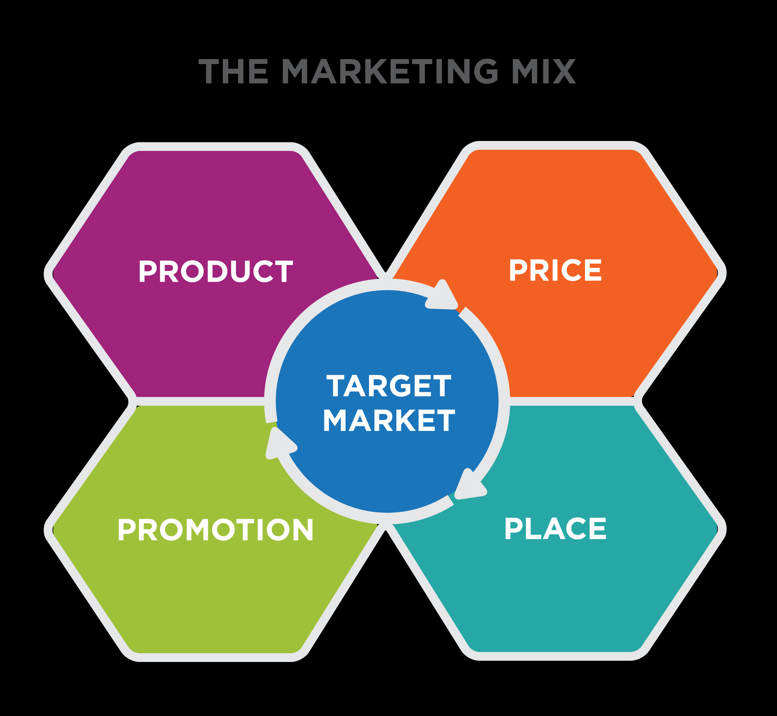
Marketing Mix

Slide 4
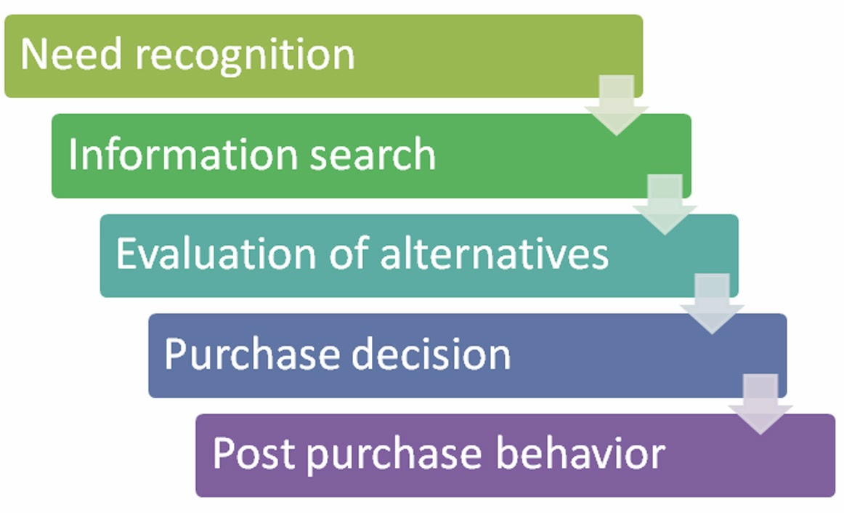
Consumer Buying process

