Slide 1
Introduction to Assembly language

Slide 2
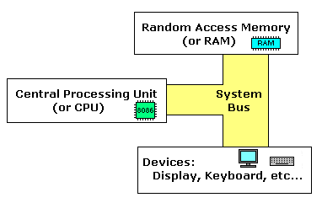
What is an assembly language?
Assembly language is a low level programming language. You need to get some knowledge about computer structure in order to understand anything.
The simple computer model as I see it:

Slide 3
What is an assembly language?
The system bus (shown in yellow) connects the various components of a computer.
The CPU is the heart of the computer, most of computations occur inside the CPU.
RAM is a place to where the programs are loaded in order to be executed.

Slide 4
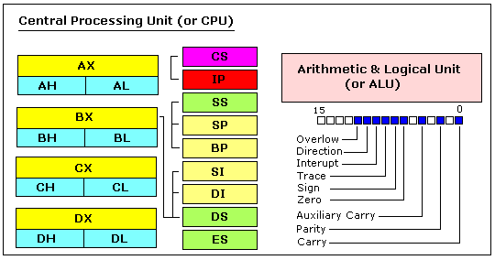
Inside the CPU

Slide 5
General Purpose Registers
8086 CPU has 8 general purpose registers, each register has its own name:
AX - the accumulator register (divided into AH / AL).
BX - the base address register (divided into BH / BL).
CX - the count register (divided into CH / CL).
DX - the data register (divided into DH / DL).
SI - source index register.
DI - destination index register.
BP - base pointer.
SP - stack pointer.
[N.B. The size of the above registers is 16 bit]

Slide 6
General Purpose Registers
4 general purpose registers (AX, BX, CX, DX) are made of two separate 8 bit registers. For example,
if AX = 0011000000111001b,
then AH = 00110000b and AL = 00111001b.
Therefore, when you modify any of the 8 bit registers 16 bit register is also updated, and vice-versa.
The same is for other 3 registers, "H" is for high and "L" is for low part.

Slide 7
Segment & Special Purpose Registers
CS - points at the segment containing the current program.
DS - generally points at segment where variables are defined.
ES - extra segment register, it's up to a coder to define its usage.
SS - points at the segment containing the stack.
IP - the instruction pointer.
Flags Register - determines the current state of the processor.

Slide 8
Variables
Variable is a memory location.
It is much easier to have some value be kept in a variable named "var1" then at the address 5A73:235B, especially when you have 10 or more variables.
DB - stays for Define byte(s).‏
DW - stays for Define word(s)‏.
DD - stays for Define double word(s)‏.
DQ - stays for Define quad word(s)‏.
Syntax for a variable declaration:-
name DB value
name DW value

Slide 9
Defining Data
Numeric data values
100 - decimal
100B - binary
100H - hexadecimal
'100' - ASCII
"100" - ASCII

Slide 10
Data Transfer Instructions
MOV target, source
reg, reg
mem, reg
reg, mem
mem, immed
reg, immed
Sizes of both operands must be the same.
reg can be any non-segment register except IP cannot be the target register.

Slide 11
Memory Models
.Model memory_model
tiny: code+data <= 64K (.com program)‏
small: code<=64K, data<=64K, one of each
medium: data<=64K, one data segment
compact: code<=64K, one code segment
large: multiple code and data segments
huge: allows individual arrays to exceed 64K

Slide 12
Program Structure
.MODEL…. // selects a standard memory model for the programs.
.STACK 100H //sets the size of the program stack which may b any size up to 64kb
.DATA // all variables pertaining to the program are defined in the area.
.CODE // identifies the part of the program that contains instructions. MAIN PROC //creates a name and a address for the beginning of a procedure.
……………. define main procedures.
…………….
MAIN ENDP // indicates the end of the procedure.
END MAIN // terminates assembly of the program.

Slide 13
Example (Print Hello World!)
.MODEL SMALL
.STACK 100H
.DATA
message db “Hello World! $” ; Message to be displayed
.CODE
MAIN PROC
mov ax,@data
mov ds,ax
mov ah,9h ; function to display a string
mov dx,offset message ; offset of Message string
int 21h ; Dos Interrupt (initiate the process)
mov ax,4C00h ; function to terminate
int 21h ; Dos Interrupt
MAIN ENDP
END MAIN

Slide 14
The End

