Slide 1
The Contribution of NGOs in Social Change
Mohammad Faisal Akber
Department of Development Studies
Daffodil International University

Slide 2
Social Change: Perceiving the Concept
Change means a differentiation in anything observation over some time. If we feel that there's some alteration we call it changes. It this change is in a contest to social structure, institution, etc, i.e. social context then it is social change.
Social change may refer to the notion of social progress or socio-cultural evolution, the philosophical idea that society moves forward by evolutionary means. It may refer to a paradigmatic change in the socio-economic structure, for instance, a shift away from feudalism and towards capitalism.
Social Change is the modification of mechanisms within the social construction, characterized by changes in cultural symbols, rules of behavior, social organizations or value systems.

Slide 3
Social Change: Perceiving the Concept
Ginsberg,
By social change I understand a change in the social structure.
Kingsley Doris,
"By social change is meant only such alternations as occur in the social organization i.e. the structure & functions of society.”
Social change can originate from either within a society, or from outside of society.
Internal sources of social change are those factors that originate within a specific society that singly or in combination with other factors produce alterations in social institutions and social structure.
External sources of social change are events that originate outside of a society to bring about change to social institutions or structures

Slide 4
Social Change: Key Characteristics
The key Characteristics of Social
Change are:
1. Change is Social
2.Universal
3. Continuous
4. Inevitable
5. Temporal
6. Degree or rate of change is not uniform
7. Social Change may be planned or unplanned
8. Social change is multi-causal
9. Social change creates chain-reactions
10. Prediction is uncertain

Slide 5
Indicators of Social Change
Social Progress or Socio-cultural evolution
A paradigmatic change in the socio-economic structure (From feudalism towards Capitalism)
Social revolution (Socialist Revolution presented in Marxism)
Social Movements (Women’s suffrage or civil rights movement)
Social change may be driven by cultural, religious, economic, environment, demographic scientific, or technical forces.

Slide 6
How Does Social Change Occur
Social System rest on three bases:
The interaction of three bases of change determines how different forms of power are exercised in society.
Economic Power - expressed in the distribution of productive assets and the workings of markets and firms;
Social Power – expressed in the status and position awarded to different social groups;
Political Power – defines each person’s voice in decision making in both the private sphere and public affairs

Slide 7
Social Change in Bangladesh
1. Rural power structure: Among older persons toward living alone or only with their spouses, and recently there is growing preference for separate residence in some developing countries as well.
2. Market economy and globalization: Market economy and globalization has an enormous impact on the rural society in Bangladesh.
3. Modernization instead of traditional and local convention: Another important macro feature of change is the initiative aiming modernization and westernization. In the 1960’s in all over the developing countries, modernization was an important campaign.
4. Democracy and democratization: In the changing process of a society, the function of politics is important as it is the ultimately agent of change in a society. Democracy worked as a milestone in the society of Bangladesh.
5. Economic condition: In the early 1970’s immediately after the liberation the country’s economic image was severely negative which has significantly changed over the course of years. At present Bangladesh achieved a significant progress in respect of economic progress.

Slide 8
Social Change in Bangladesh
6. Gender relation and women’s empowerment: Patriarchal norms still shape the gender relations of the country to a significant extent. However, it has encountered challenges both in urban and rural areas. It may be said that in the post-independence Bangladesh the change in patriarchy based gender relation or creating a balance in the gender relation.
7. Entertainment: In the process of acculturation the effect of television programs is commonly endorsed. The vulnerability of the children to cultural change through television is given attention.
8. Politics and culture: The effect of globalization and cultural intrusion may be noted in Bangladesh.
9. Family system: The average family size has decreased; young people are getting married at a later age; the average age of mothers at first birth has increased; infant mortality rates have. The rate of divorce has increased.
10. Marriage in changing family pattern: In Bangladesh, marriage is a civil contract between two adult persons of opposite sexes. The traditional marriage pattern is also changing day by day.

Slide 9
Defining NGOs: What the UN Says
From the UN Department of Public Information:
NGO refers to a non-profit citizens’ voluntary entity organized nationally or internationally. Thus, professional associations, foundations, trade unions, religious organizations, women’s and youth groups, cooperative associations, development and human rights associations, environmental protection groups, research institutes dealing with international affairs and associations of parliamentarians are considered NGOs.

Slide 10
Role of NGOs in Development Agenda
Enhancing the knowledge base
Advocacy and lobbying
Membership in national delegations
Contribution to compliance review and enforcement as well as dispute settlement procedures
Ensuring transparency
Supporting international secretariats
Broader functions of NGOs in international environmental governance
Promote Socio-economic Development
Well-being of people
Social change and social development

Slide 11
The Contribution of NGOs in Social Change in Bangladesh, Somalia, Nigeria : Microfinance
In countries like Bangladesh, Somalia, and Nigeria, women are disproportionately disadvantaged.
Women constitute the overwhelming majority of the microfinance beneficiaries.
Microfinance helps women acquire assets of their own and exercise power in household decision making.
Microfinance programs taken by NGOs promote investment in human capital and raise awareness of reproductive health issues among poor families.
Grameen Bank, BRAC, ASA in Bangladesh; Salaam Financial Services, Kabaa Microfinance Institution (K-MFI) in Somaliland provide short loans to poor women.

Slide 12
Women Empowerment
Microfinance
Targeting Women

Slide 13
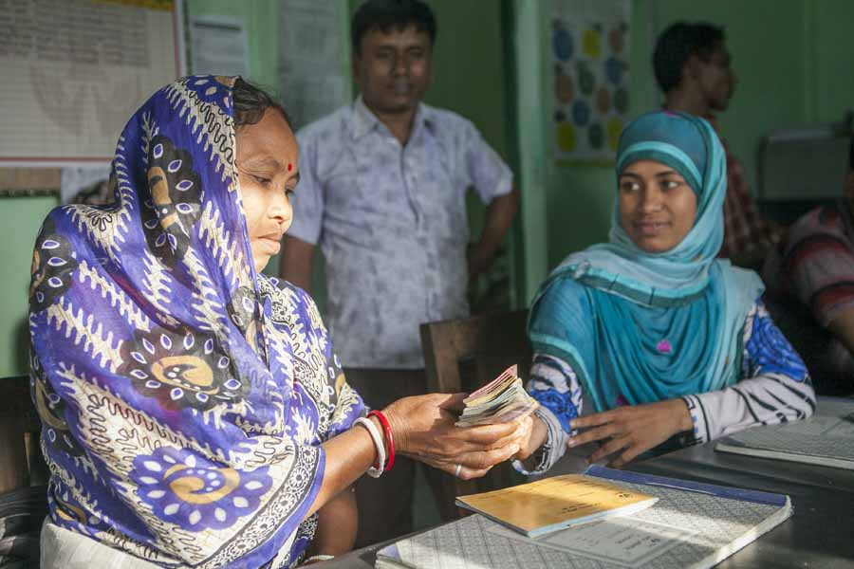

Slide 14
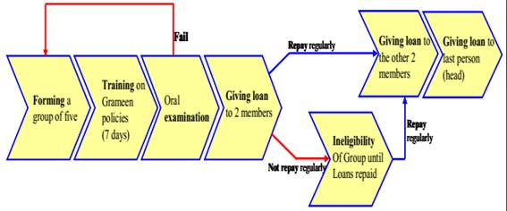
Figure: Grameen Bank Loan Distribution System

Slide 15
The Contribution of NGOs in Social Change in Bangladesh, Somalia, Nigeria : Education
BRAC’s Non-Formal Primary Education Program is an initiative for the rural areas of Bangladesh to provide basic education to the large numbers of children who were not being reached through government efforts.
In comparison with the teachers in the formal education system, BRAC teachers have smaller classes (30 students only), teach fewer subjects, address fewer objectives and provide an estimated 500 additional hours per year of engaged instructional time.
Similarly Association for Social Advancement-ASA in Bangladesh, Plan International, Teach for India these are working for ensuring basic education for drop out students.

Slide 16
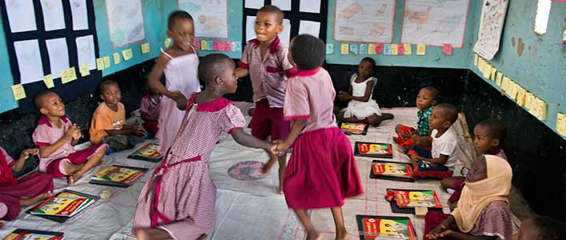

Slide 17
The Contribution of NGOs in Social Change in Bangladesh, Somalia, Nigeria : Health
The Lancet documented in 2013 that Bangladesh achieved great success in health, especially in the improvements in the survival of infants and children under 5 years of age, life expectancy, immunization coverage and tuberculosis.
BRAC’s WASH (Water, Sanitation, and Hygiene) program is another hallmark initiative in the health sector.
Under this program, extremely poor people get financial cooperation in the construction of sanitary latrines and also obtain awareness about sanitation systems.
The African Childhood Care Network in Nigeria, the Society for Telemedicine and E-Health in Nigeria, and Oxfam International in Somalia are working to ensure health facilities.

Slide 18
The Contribution of NGOs in Social Change in Bangladesh, Somalia, Nigeria : Women Empowerment
NGOs, as the development partners of government, are working towards women empowerment and implementing a series of development intervention for eradicating gender discrimination.
Following the continuation of initiatives, NGOs have arranged many income generating activities like apiculture, silk production, embroidery, fishnet matching, poultry and livestock to increase the socio economic condition of women.
In 2012, CARE Bangladesh provided a list of 81 NGOs including BRAC, CARE-Bangladesh, Hitaishi Bangladesh, Manusher Jonno, Mohila Porishad, Oxfam, have been launching project on issues pertaining to violence against women, either through direct services or advocacy. Action Aid Nigeria, African Girls Empowerment working for the women empowerment.

Slide 19
The Contribution of NGOs in Social Change in Bangladesh, Somalia, Nigeria : Raising Awareness
Democratization
Local Decision Making
Transparency

Slide 20
The Contribution of NGOs in Social Change in Bangladesh, Somalia, Nigeria : Access to Government Resources
Many NGOs have created the unconventional opportunity to use the khas (unused) land by introducing social forestation and group irrigation systems for landless people's usage.
In particular, NGOs are organizing the landless people, establishing village-based nurseries, assisting in social forestation and tree plantation, and taking lease of khas land and dry riverbed to make use of shared fish culture.
Action Aid Nigeria and the Association for Grassroots Development (AGD) are working for urban-rural people's development.

Slide 21
The Contribution of NGOs in Social Change in Bangladesh, Somalia, Nigeria : Environment
The major environmental problems in Bangladesh include deforestation, desertification arsenic problem and damage to the genetic and aquatic environment.
The NGOs undertake various programs to contest deforestation and to improve the conditions of deforestation as well as in a forestation program, improving sanitation facilities and ensuring the supply of safe drinking water through the distribution of water-sealed latrines and tube-wells among the beneficiaries.
Green Peace, BELA, World Wildlife Fund, 1% For The Planet, Friends of Earth are working for protecting the environment.

Slide 22
The Contribution of NGOs in Social Change in Bangladesh, Somalia, Nigeria: Relief and Rehabilitation
At the time of natural disasters like floods, droughts, famines, storms, and contaminated diseases, NGOs have been planning a momentous role in distributing relief and substantial help among the wounded people along with the government and after the disaster, they would also undertake different rehabilitation activities for the betterment of disaster-affected people.
The African Refugee Foundation (AREF) in Nigeria, Islamic Relief and Mercy Corps in Somalia have been working for a long time in the crisis areas.

Slide 23
The Contribution of NGOs in Social Change in Bangladesh, Somalia, Nigeria: Employment Generation
NGOs are playing a significant role in encouraging the rural poor to participate in different economic activities and to increase their income through employment generation.
Some large organizations launch very effective professional training programs for high-ranking officials and unemployed people that generate job facilities.
On the other hand, they provide loans and management assistance to individuals, which creates new employment opportunities.
Action Aid for the Unemployed in Nigeria has been working for the unemployed people.

Slide 24
The Contribution of NGOs in Social Change in Bangladesh, Somalia, Nigeria: Non-traditional Agricultural Extension and Food Security
Under taking the program of agriculture and food security, BRAC works with government to ensure food security by keeping direct contribution in producing, distributing and marketing quality seeds, conducting research to develop better varieties.
In 2012, under share croppers development project, total borrowers was 2, 00,000 and more than 1, 50,000 farmers got training on their agricultural works as the extension of non-traditional agriculture.
Some NGOs undertake unique programs of technology involving innovative fertilizer usage and waste management. Advocacy Committee Against Hunger in Nigeria is like that.

Slide 25
The Contribution of NGOs in Social Change in Bangladesh, Somalia, Nigeria: Family Planning
NGOs have made momentous contributions to family planning.
Specifically, Bangladesh’s national policies and NGOs include a highly developed outreach program that offers family planning services through a program of direct education and distribution of contraceptives in the homes and motivational activities, as well as reproductive health care and surgical services for rural women and urban slums in Bangladesh.

Slide 26
How do NGOs benefit society?
NGOs impact and uplift society as a whole and continue to work for its betterment. The following are some of the critical roles that an NGO plays:
NGOs play a significant role in developing society, improving communities, and promoting citizen participation.
NGOs' contributions to the GDP of the economy is not much, but their overall part in improving the human development index or social progression index is irrefutable.
NGOs also act as a bridge amongst essential stakeholders, especially those who are most affected by government inaction and wish to appease the policymakers.
Lastly, several small and large-scale NGOs have successfully brought about a difference in the lives of the beneficiaries through their tireless and philanthropic efforts.

Slide 27
Critical Evaluation of NGOs in Bangladesh
NGOs in Bangladesh have increasingly become subject to criticism about their role and functions by the government, political parties, professionals, and the public in general.
NGOs have been critically evaluated on several issues, like actual effectiveness, issues of accountability, commercialization, and taking shelter of political figures for project procurement.
NGO functioning is fully dependent on external funding. To collect funds, NGOs’ management bodies are compelled to maintain donors' policies, though it can be harmful to society.
Political parties, particularly the leftist parties, criticize NGOs for taking funds mostly from western donors and from the national institutes of capitalistic governments. Leftist parties argue that this is one kind of patron-client relationship that increases dependency and hinders the social revolution.

Slide 28
Critical Evaluation of NGOs in Bangladesh
The most serious allegation against the NGOs is that, in spite of hundreds of NGOs working in Bangladesh for years together, the reduction of poverty is not visible.
NGOs are taking funds from donor agencies for poverty alleviation, but they use 50% for luxury cars, 25% for employee salaries, and 25% for full-filling their mission.
It is believed that the personnel working in foreign fund NGOs are highly paid and enjoy better facilities compared to those working in government organizations.
Sometimes NGOs work with the government without any coordination. It creates duplication of activities. Some NGOs are related to politics, which is against the law.

