Slide 1
Problem solving on steam Power Plant

Slide 2
%ⴄ = $\frac{\text{Y}\text{∗ 860}}{\text{C}\text{∗ }M}$ = Output/ input
= Heat equivalent to electric energy/ heat from coal
M= Mass of coal (Kg or ton)
C= Calorific value of coal (Kcal/kg or ton)
Y= Amount of electrical energy production (KWh)
ⴄ= Overall Efficiency

Slide 3
Example 2.1. A steam power station has an overall efficiency of 20% and 0·6 kg of coal is burnt per kWh of electrical energy generated. Calculate the calorific value of fuel. %n=Y*860/M*C .2=1*860/0.6*C

Slide 4
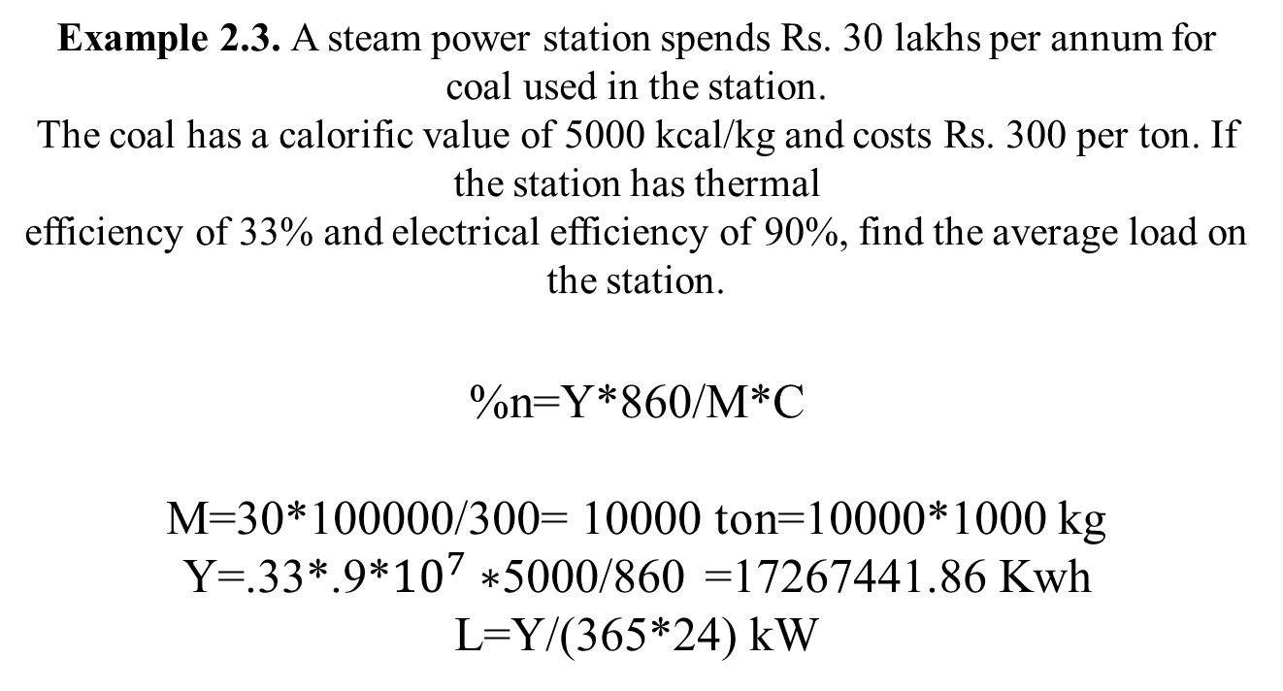
Example 2.3. A steam power station spends Rs. 30 lakhs per annum for coal used in the station. The coal has a calorific value of 5000 kcal/kg and costs Rs. 300 per ton. If the station has thermal efficiency of 33% and electrical efficiency of 90%, find the average load on the station. %n=Y*860/M*C M=30*100000/300= 10000 ton=10000*1000 kg Y=.33*.9*${10}^{7}∗$5000/860 =17267441.86 Kwh L=Y/(365*24) kW

Slide 5
Example 2.5. A 100 MW steam station uses coal of calorific value 6400 kcal/kg. Thermal efficiency of the station is 30% and electrical efficiency is 92%. Calculate the coal consumption per hour when the station is delivering its full rated output. %n=Y*860/M*C .3*.92=100*1000*860/(M*6400)

