Slide 1
Topic-5
Describing Data: Measures of Dispersion

Slide 2
Dispersion
Why Study Dispersion?
A measure of location, such as the mean or the median, only describes the center of the data. It is valuable from that standpoint, but it does not tell us anything about the spread of the data.
For example, if your nature guide told you that the river ahead averaged 3 feet in depth, would you want to wade across on foot without additional information? Probably not. You would want to know something about the variation in the depth.
A second reason for studying the dispersion in a set of data is to compare the spread in two or more distributions.

Slide 3
Measures of Dispersion
Range: The simplest measure of dispersion is the range. It is the difference between the largest and the smallest values in a data set.
A defect of the range is that it is based on only two values, the highest and the lowest; it does not take into consideration all of the values.

Slide 4
EXAMPLE – Range
The number of cappuccinos sold at the Starbucks location in the Orange Country Airport between 4 and 7 p.m. for a sample of 5 days last year were 20, 40, 50, 60, and 80. Determine the range for the number of cappuccinos sold.
Range = Largest – Smallest value
= 80 – 20
= 60

Slide 5
Measures of Dispersion
Mean Deviation: The arithmetic mean of the absolute values of the deviations from the arithmetic mean.
The mean deviation does. It measures the mean amount by which the values in a population, or sample, vary from their mean.

Slide 6
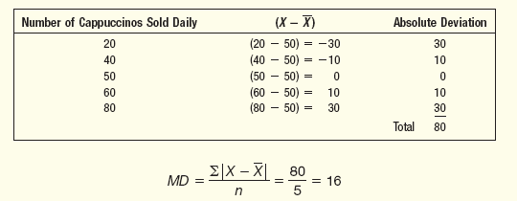
EXAMPLE – Mean Deviation
The number of cappuccinos sold at the Starbucks location in the Orange Country Airport between 4 and 7 p.m. for a sample of 5 days last year were 20, 40, 50, 60, and 80. Determine the mean deviation for the number of cappuccinos sold.

Slide 7
Measures of Dispersion
Variance: The arithmetic mean of the squared deviations from the mean. The variance is non-negative and is zero only if all observations are the same.
Where,
Sigma is the population variance. It is read as “sigma squared.”
X is the value of an observation in the population.
µ is the arithmetic mean of the population.
N is the number of observations in the population

Slide 8
Measures of Dispersion
Process of computing the variance:
Begin by finding the mean
Find the difference between each observation and the mean, and square that difference.
Sum all the squared differences.
Divide the sum of the squared differences by the number of items in the population

Slide 9
Measures of Dispersion
The population variance is the mean of the squared difference between each value and the mean.
For populations whose values are near the mean, the variance will be small.
For populations whose values are dispersed from the mean, the population variance will be large.
The variance overcomes the weakness of the range by using all the values in the population, whereas the range uses only the largest and the smallest.
We overcome the issue of negative values by squaring the differences, instead of using the absolute values. Squaring the differences will always result in non-negative value.

Slide 10
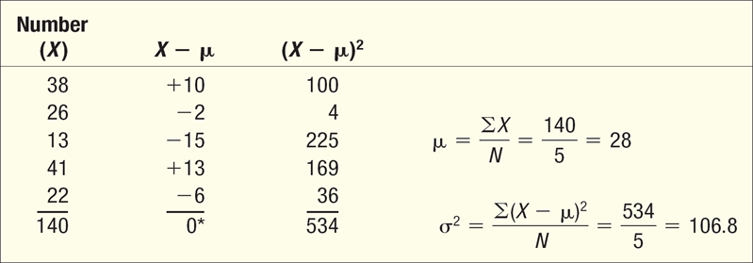
EXAMPLE – Variance and Standard Deviation
The number of traffic citations issued during the last five months in Beaufort County, South Carolina, is 38, 26, 13, 41, and 22. What is the population variance?

Slide 11
Measures of Dispersion
Standard Deviation: The square root of the variance.
Both the range and the mean deviation are easy to interpret.
The range is the difference between the high and low values of a set of data, and the mean deviation is the mean of the deviations from the mean.
However, the variance is difficult to interpret for a single set of observations.
There is a way out of this difficulty. By taking the square root of the population
variance, we can transform it to the same unit of measurement used for the original data

Slide 12
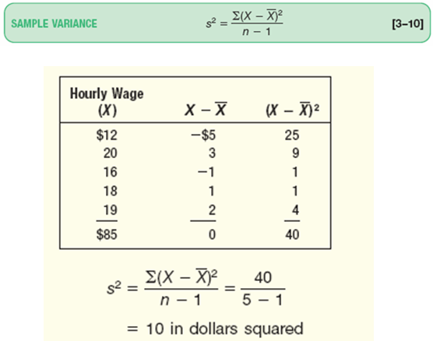
EXAMPLE – Sample Variance
The hourly wages for a sample of part-time employees at Home Depot are: $12, $20, $16, $18, and $19. What is the sample variance?

Slide 13
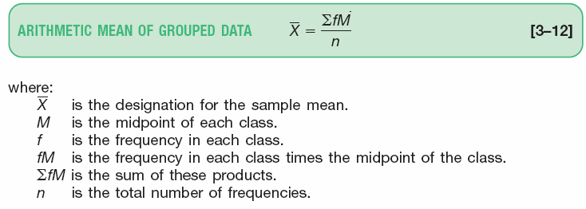
The Arithmetic Mean of Grouped Data

Slide 14
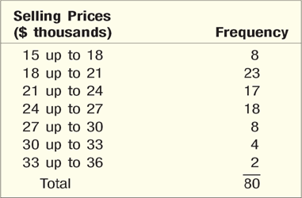
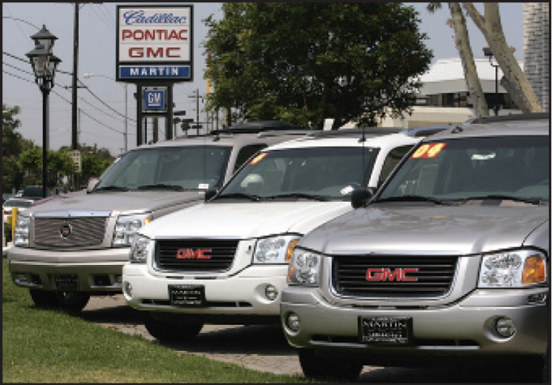
The Arithmetic Mean of Grouped Data - Example
Recall in Chapter 2, we constructed a frequency distribution for the vehicle selling prices. The information is repeated below. Determine the arithmetic mean vehicle selling price.

Slide 15
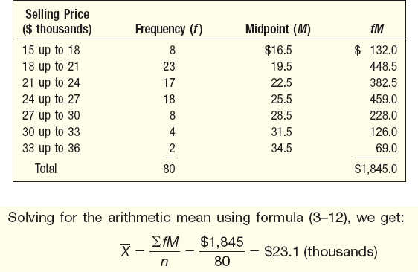
The Arithmetic Mean of Grouped Data - Example

Slide 16
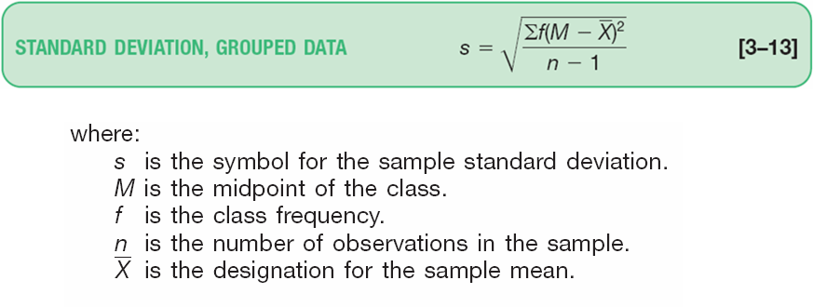
Standard Deviation of Grouped Data

Slide 17
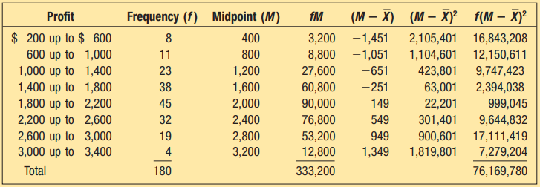
Standard Deviation of Grouped Data - Example

Slide 18
Thank You!

