Slide 1
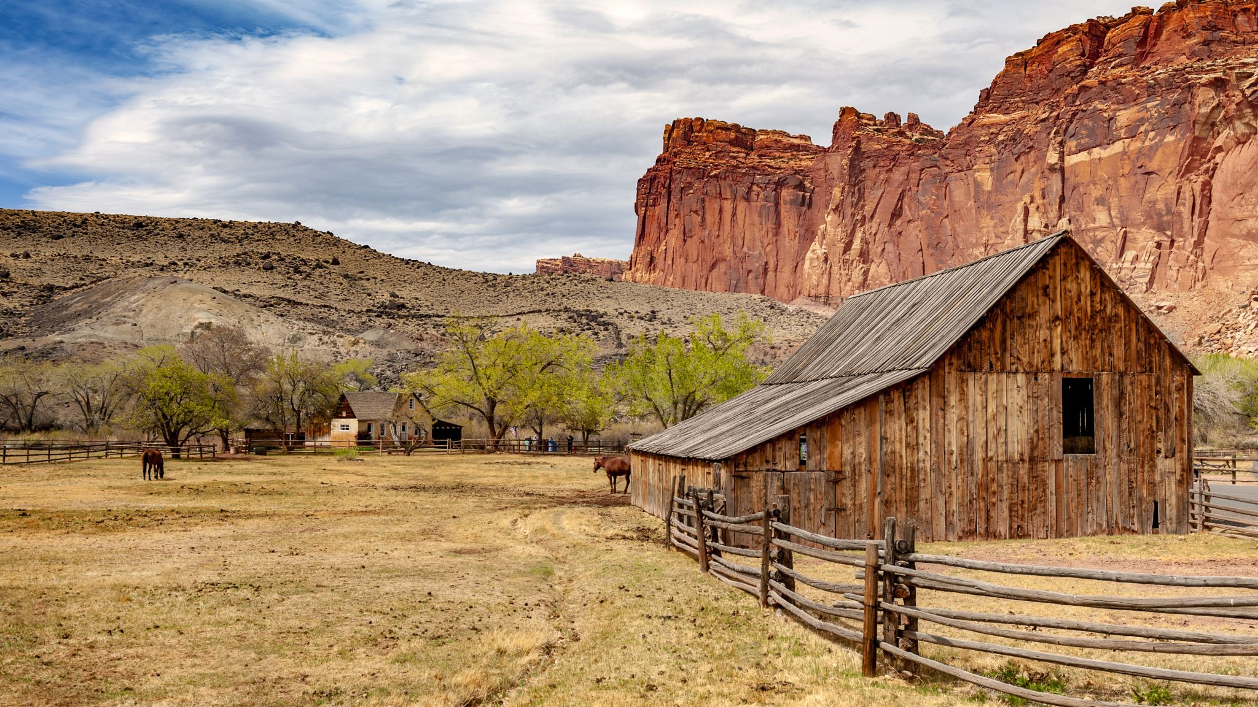
Rural Social Movements: In the Context of Bangladesh
Md. Fouad Hossain Sarker
Associate Professor and Head
Department of Development Studies
Daffodil International University

Slide 2
Objectives of the Lecture
Providing
Providing the major idea about historical and contemporary rural social movements.
Exploring
Exploring reasons and consequences of land reform movements and land right.
Identifying
Identifying some environmental movements in rural areas.
Analyzing
Analyzing the role of social media in mobilizing rural communities.

Slide 3
Defining Rural Social Movements
A rural social movement refers to a collective, organized effort by people in rural areas to bring about social, economic, political, or cultural change.
These movements typically arise in response to perceived injustices, inequalities, or issues affecting rural communities.
The goals of rural social movements can vary widely and may include advocating for land rights, environmental conservation, agrarian reforms, improved access to education and healthcare, or addressing other specific concerns relevant to rural populations.

Slide 4
Factors Behind Rural Social Movements
Economic Injustices: Rural social movements often arise in response to economic disparities and injustices. Issues such as unequal distribution of land, inadequate access to credit, and unfair agricultural policies can motivate rural communities to mobilize for economic reforms.
Land Rights and Agrarian Reforms: Disputes over land ownership and the lack of secure land tenure can be significant drivers of rural social movements.
Environmental Concerns: Rural social movements may be sparked by environmental issues affecting rural areas, such as deforestation, pollution, or the degradation of natural resources.
Access to Resources and Services: Limited access to essential resources and services, such as education, healthcare, and infrastructure, can be a catalyst for rural social movements.

Slide 5
Some Rural Movements In Bangladesh
Tebhaga Movement (1946-1947): Land Reform Movement
The Tebhaga Movement was a peasant movement that emerged in Bengal, including the territory that is now Bangladesh, in the late 1940s. It aimed at addressing the issues of land tenure and sharecropping. Peasants, who were often landless or had very small landholdings, demanded a two-thirds share of the crop instead of the half-share they were receiving from landlords.
The movement involved widespread protests and demonstrations by sharecroppers, and it gained momentum in 1946. Despite facing opposition and repression, the movement ultimately led to concessions by the provincial government, which agreed to a two-thirds share for sharecroppers.

Slide 6
Reasons Behind of this Movement
Sharecropper Exploitation: Sharecroppers, who cultivated land owned by landlords, faced oppressive conditions, with landlords taking a significant portion of the produce as rent.
Post-Partition Economic Strain: The aftermath of the partition of India in 1947 led to economic difficulties, and sharecroppers found themselves burdened by increased demands from landlords.
Inspiration from Global Movements: The Tebhaga movement drew inspiration from global agrarian movements and leftist ideologies.
Leadership by Communist Party: The Communist Party of India played a significant role in organizing and leading the Tebhaga movement.
Social Injustice and Peasant Solidarity: The movement was fueled by a sense of social injustice and a desire for greater solidarity among peasants.

Slide 7
Outcomes of this Movements
Land Reform Policies:
After gaining independence in 1971, Bangladesh implemented various land reform policies to address issues such as landlessness, sharecropping, and unequal land distribution. The government aimed to enhance agricultural productivity and improve the socio-economic condition of rural communities.
Khas Land Distribution:
The distribution of Khas land (government-owned land) has been a key component of land reform initiatives. The government has undertaken efforts to distribute Khas land among landless and marginalized communities, providing them with access to agricultural resources.
Land Rights for Indigenous Communities:
Land rights for indigenous communities, especially in the Chittagong Hill Tracts, have been a focal point. The Peace Accord of 1997 aimed at resolving conflicts in the Hill Tracts included provisions for the protection of the land rights and cultural identity of indigenous groups.

Slide 8
Khetmajur Movement (1974)
The Khetmajur Movement of 1974 was a notable rural social movement in Bangladesh that focused on the rights of agricultural laborers. Agricultural workers, facing poor working conditions, low wages, and exploitation by landlords, mobilized to demand better treatment and improved living standards. The movement called for fair wages, reasonable working hours, and social justice for rural laborers.
The Khetmajur Movement gained traction through organized protests and strikes in various parts of the country. The demands of the movement were centered around the recognition of the rights and dignity of agricultural laborers. As a result of the movement, the government was compelled to address some of the grievances of the agricultural laborers, leading to improvements in their working conditions and wages.

Slide 9
Indigenous Rights Movements
Bangladesh is home to various indigenous communities, and movements have emerged to address their rights and cultural preservation.
These movements focus on issues such as land rights, cultural autonomy, and recognition of indigenous identity. Organizations like the Hill Women's Federation have been active in advocating for the rights of indigenous people, particularly in the Chittagong Hill Tracts.

Slide 10
Movement against Rampal Power Plant
The Rampal Power Plant, located near the Sundarbans mangrove forest in Bangladesh, has been a subject of environmental concern and has prompted protests from various groups.
Formation of National Committee (2013): The National Committee to Protect Oil, Gas, Mineral Resources, Power, and Ports was established in 2013, leading the charge against the Rampal Power Plant near the Sundarbans in Bangladesh.
2016 Long March: In January 2016, a significant long march from Dhaka to Rampal aimed to raise awareness about the environmental threats posed by the coal-fired power plant, emphasizing the potential impact on the Sundarbans.
Global Day of Protest (2016): Activists globally participated in a coordinated protest on February 26, 2016, expressing solidarity and concern over the potential ecological consequences of the Rampal Power Plant on the Sundarbans.
National Hearings (2017): In 2017, the National Committee organized national hearings to discuss the environmental impact of the Rampal Power Plant, providing a platform for dialogue and opposition against the project.
UNESCO's Concerns (2017): UNESCO voiced concerns in June 2017 about the potential impact of the Rampal Power Plant on the Sundarbans, recommending a thorough environmental assessment to safeguard the UNESCO World Heritage Site.

Slide 11
Consequences of Rural Social Movements
Land Reforms and Redistribution: Rural social movements in Bangladesh, such as the Tebhaga Movement, have contributed to land reforms, aiming for more equitable land distribution among farmers and addressing issues of landlessness and tenancy.
Empowerment of Marginalized Groups: These movements have sought to empower marginalized groups, including farmers, laborers, and indigenous communities, by addressing social inequalities, advocating for their rights, and challenging economic exploitation.
Political Representation and Governance Changes: Successful rural social movements have influenced political structures, demanding increased representation and decision-making power for rural populations. This has led to changes in governance to better address the needs of rural communities.
Improved Labor Rights and Working Conditions: Movements like the Khetmajur Movement have focused on improving the rights and working conditions of agricultural laborers, resulting in policy changes to ensure fair wages, reasonable working hours, and enhanced living standards.
Environmental Awareness and Conservation: Movements opposing environmental threats, such as the Save the Sundarbans movement, have raised awareness about sustainable practices and conservation, influencing policies to protect natural resources and ecosystems in rural areas.

Slide 12
Role of Social Media in Mobilizing Rural Community-1
Information Dissemination: Social media serves as a powerful tool for spreading information about movements and protests in rural areas. For instance, Twitter and Facebook can be used to share details about the purpose, goals, and schedule of a protest, reaching a wide audience. Hashtags can also be employed to create a trending topic and amplify the message.
Community Engagement and Mobilization: Platforms like WhatsApp and local community forums allow organizers to engage directly with rural community members. They can use these platforms to share updates, address concerns, and build a sense of solidarity. Organizers can create groups or broadcast lists to efficiently communicate with participants.
Real-time Reporting and Documentation: Social media enables real-time reporting of events during a protest or movement. Platforms like Instagram and Snapchat can be used to share photos and videos, providing a visual narrative of the activities. This documentation can be crucial for both participants and those observing the movement from afar.

Slide 13
Role of Social Media in Mobilizing Rural Community-2
4. Campaign Visibility and Support: Social media platforms increase the visibility of rural movements and protests on a global scale. Platforms like YouTube can be used to share videos that showcase the impact of the movement, the stories of participants, and the reasons behind their mobilization. This visibility can attract support from individuals and organizations beyond the local community.
5. Advocacy and Awareness: Social media serves as a space for advocacy and raising awareness about the issues driving rural movements. Platforms like Facebook and Twitter allow organizers to share articles, infographics, and other content that educates the public about the cause. Online campaigns can help generate public support and influence opinion.

Slide 14
Example (Role of Social Media)
Farmers' Protest in India (2020-2021):
The farmers' protest in India saw widespread use of social media, especially Twitter and Facebook, to mobilize farmers from rural areas. Farmers used these platforms to share updates, coordinate logistics, and raise awareness about their concerns related to agricultural policies. Hashtags like #FarmersProtest became central to the online discourse, garnering international attention and support. Social media played a pivotal role in amplifying the voices of farmers and connecting them with a broader audience.

Slide 15
Chapter Related Questions
1. Briefly define rural social movements with examples.
2. Discuss the factors and consequences of rural social movements in the context of Bangladesh.
3. Analyze the some of the major rural movements in the context of Bangladesh.
4. Assess the role of social media with a relevant examples to mobilize rural community.

Slide 16
References
Sociology : C. N. Shankar Rao; 2007.
Introduction to Rural Sociology by Paul L. Vogt.
Rural Sociology by S.L. Doshi.
Introduction to Rural Sociology by Musa Dantani Baba.
Rural Sociology by Shambhu Lal Doshi.

