Slide 1
Chapter -2: Micronutrients (A)
Professor Dr. Arif Chowdhury Apou Assistant Professor PH/DIU

Slide 2
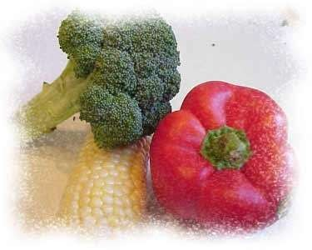
Introduction
Source
Daily allowance
Deficiency
Treatment
Toxicity

Slide 3
1. Micronutrients play a central part in metabolism and in maintenance of tissue function.
2. Vitamins and minerals.

Slide 4
BACKGROUND
Vitamins are organic
substances that
are essential for several enzymatic functions in human metabolism
A compound is called vitamin when it cannot be synthesized in sufficient quantities by an organism, and must be obtained from the diet.

Slide 5
Functions
Acts as hormones (vitamin D)
Acts as antioxidant (vitamin E)
Acts as mediators of cell signalling and regulators of cell and tissue growth and differentiation(vitamin A)
Acts as precusors for enzyme cofactor biomolecules(coenzymes) that help act as catalysts and substrates in metabolism

Slide 6
VITAMINS
Vitamins are classified according to solubility into fat soluble & water soluble.
13 vitamins are known, 4 fat soluble (KEDA) & 9 water soluble (C, Folate & the B group).

Slide 7
VITAMINS
water soluble-dissolve easily in water readily excreted from the body.
fat soluble-absorbed through the
of
intestinal tract with the help
lipids(fats).

Slide 8
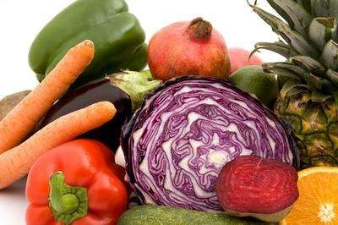
VITAMIN A-Vitamin A is a generic term for many related compounds.
Retinol (alcohol), Retinal (aldehyde) are often called preformed vitamin A.
Retinal can be converted by the body to retinoic acid which is known to affect gene transcription.
Body can convert β-carote
ne to retinol, thus called provitamin A.

Slide 9
FUNCTIONS
Immunity: important for activation of T lymphocyte, maturation of WBC & integrity of physiological barrier.
Vision: integrity of eye & formation of rodopsin necessary for dark adaptation.
Regulation of gene expression: vital to cell differentiation & physiologic processes
Growth & development

Slide 10
RICH DIETARY SOURCES
Animal Foods | Plant Foods
Cod liver oil | Sweet potato
Liver & kidney | Carrots
Egg | Cantaloupe
Butter | Spinach
Milk & cheese | Apricot
Fish & meat | Papaya

Slide 11
Recommended Allowance
Life stage | μg/day
Infants | 300-400
Children | 400-600
Adolescent | 900M- 700F

Slide 12
Vitamin A deficiency
Deficiency of vitamin A leads to:
Ocular change-Night blindness & xerophthalmia
Extra ocular changes
Growth retardation
Acquired immune deficiency
Keritinization of epithelia in RT, GIT & UT with increased risk of
RTI, malabsorption & UTI.

Slide 13
WHO CLASSIFICATION OF XEROPTHALMIA
SECONDARY SIGNS
XN Night blindness
XF Fundal changes
XS Corneal scarring
^{P}⚫^{R}X^{I}1^{M}A ^{A}c^{R}o^{Y}nj^{S}u^{I}n^{G}c^{N}ti^{S}val xerosis
X1B Bitot’s spot
X2 Corneal xerosis
X3A Corneal ulceration
X3 B Keratomalacia

Slide 14
Rhodopsin-protein scotopsin and 11-cis retinal.
light sensitive- rodopsin decomposed
11-cis retinal--- >11-trans retinal and splits off from scotopsin
In dark-retiene isomerase– reverse reaction
11-cis retinal combines with scotopsin te regenerate rhodopsin (vit. A dependent)
Xeropthalmia-pigmentation of caruncle with loss of normal lusture and moist apperance of palpebral conjunctiva-dry and wrinlked.
Bitots spot-chalky grey spots on the temporal side of corneas -cleral junction
Keratomalacia-cornea is soft and ulcerated. Eventually infected and perforation of cornea occurs resulting in opacification and blindness.

Slide 15
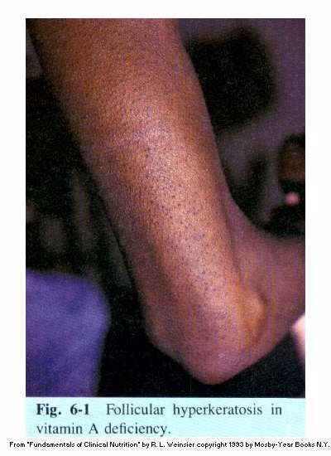

Slide 16
Treatment
For treatment of xerophthalmia, according to WHO guidelines.
>1 year-2,00,000 IU orally on presentation
the following day. 1 to 4 weeks later.
6mths-1yr 1,00,000 IU
<6mths-50,000 IU

Slide 17
TOXICITY- Children and adults ingesting
>50,000 IU/day for several month.
Vitamin A in excess leads to:
Dermatitis with xanthosis cutis
Hepatosplenomegaly
Fatigue, malaise, anorexia, vomiting
Bone pain & increased risk of fracture
Pseudotumor Cerebri
Xray-hyperostosis of the shafts of long bones

Slide 18
PREVENTION
The National vitamin A prophylaxis programme
1-5 yrs , every 6 mths
2,00,000 IU
Fortification of food(wai wai, dalda ghee).

Slide 19
VITAMIN D
Vitamin D comprises a group of sterols; the most important of which are cholecalciferol (vitamin D3) & ergosterol (vitamin D2).
Humans & animal utilize only vitamin D3 & they can produce it inside their bodies from cholesterol.
Cholesterol is converted to 7-dehydro- cholesterol (7DC), which is a precursor of vitamin D3.

Slide 20
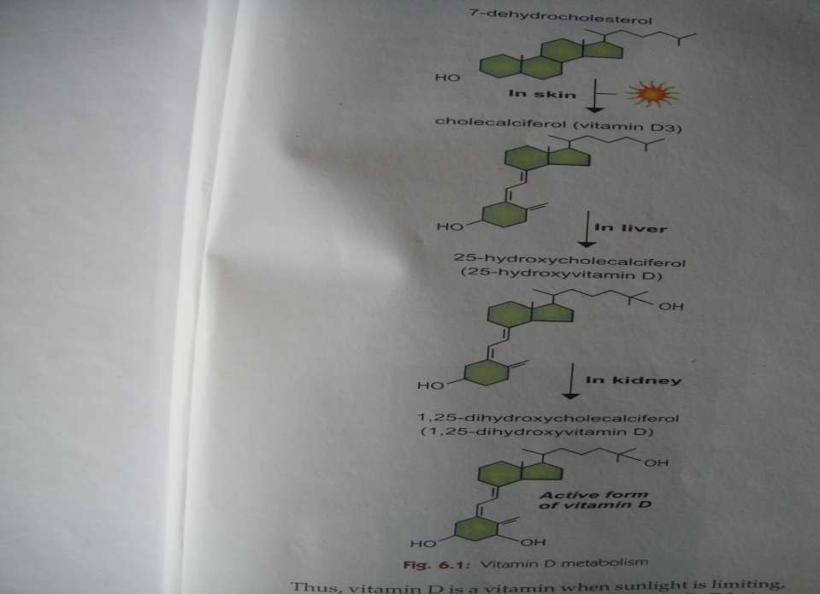

Slide 21
VITAMIN D
Exposure to the ultraviolet rays in the sunlight convert 7DC to cholecalciferol.
Vitamin D3 is metabolically inactive until it is hydroxylated in the kidney & the liver to the active form 1,25 Dihydroxycholecalciferol.
1,25 DHC acts as a hormone rather than a vitamin endocrine & paracrine properties.

Slide 22
FUNCTIONS
Calcium metabolism: vitamin D enhances ca absorption in the gut & renal tubules.
Cell differentiation: particularly of collagen & skin epithelium
Immunity: important for Cell Mediated Immunity & coordination of the immune response.

Slide 23
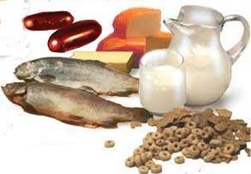
Sources of Vitamin D
Sunlight is the most important source
Fish liver oil
Fish & sea food (herring & salmon)
Eggs
Plants do not contain vitamin D3
Human milk deficient in vit. D, contains only 30-40 IU per liter mostly from 25(OH)D3

Slide 24
Vitamin D deficiency
Deficiency of vitamin D leads to:
Rickets in small children.
Osteomalacia
Osteoporosis

Slide 25
TOXICITY
Hypervitaminosis D – infants-2,000-3,000 IU/day, adults-10,000 IU/day for several months.
causes hypercalcemia,hyperphosphatemia, hypertension which manifest as:
Nausea & vomiting
Excessive thirst & polyuria
Severe itching
Joint & muscle pains
Azotemia, nephrolithiasis, ectopic calcification.
Disorientation & coma.

Slide 26
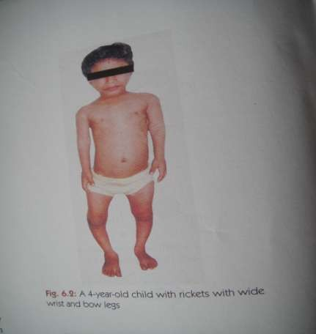
RICKETS
Lack of adequate mineralisation of growing bone

Slide 27
RICKETS
Sign and symptoms-
Skeletal deformity-bowed legs(genu varum) in toddlers, knock knees (genu valgum) in older children, craniotabes (soft skull), spinal and pelvic deformities, growth disturbances, costochondral swelling(rickety rosary), harrisons groove, double malleoli, greenstick fractures, bone pain and tenderness, muscle weakness and dental problems.

Slide 28
Radiologic changes-loss of normal zone of provisional calcification adjacent to metaphysis.
Widening of the growth plate.
Splaying and cupping of metaphysis.
Generalised reduction in bone density.
Low circulating levels of 25(OH)D3.
Elevated serum alkaline phosphate.
Calcium level may be normal or low
Phosphate level usually are unchanged or low.

Slide 29
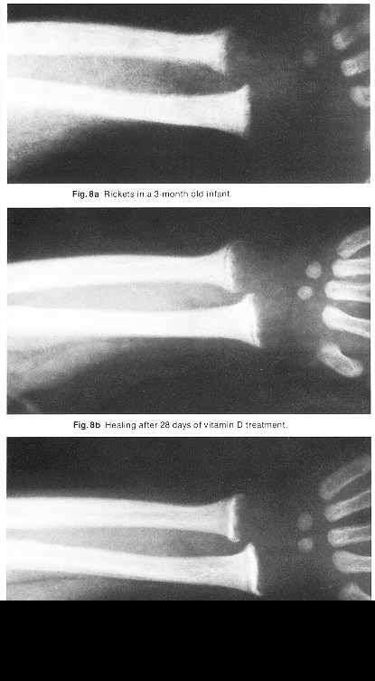
RICKETS

Slide 30
TREATMENT
-Vitamin D administered orally either in a single dose of 60,000 or over 10 days(60,000 IU daily for 10 days) followed by a maintenance dose of 400 IU/day.
Oral calcium suppliments(50- 75mg/kg/day)

Slide 31
Vitamin E
Anti oxidant
Free radical scavanger
Antineoplastic effect and may raise the concentration of high density lipoprotein cholesterol.
Transported in the body by lipoprotein.
sources-nuts, seeds, whole wheat grain.
Recommended daily allowance-15-25 IU/day- 6wks(preterm),infants-3mg alfa-tocopherol, adults- 10mg/day.

Slide 32
Deficiency
Observed in low birth weight infants.
Anemia, reticulocytosis, thrombocytopenia, and abnormal erythrocyte metabolism.
Low levels of vitamin e in premature infants is associated with hemolytic anemia, hyperbilirubinemia and intraventricular hemorrhage.
Prophylaxis reduces retinopathy of prematurity.
Clinical menifestation-loss of reflexes, ataxia of trunks and limbs, dimnished priopioception, muscle weakness, ptosis, pes cavus, scoliosis and dysarthria.

Slide 33
Vitamin K
It is a cofactor of the enzyme that catalyzes one step in the formation of prothrombin.
Needed for the generation of several clotting factors in the liver.
Source- green leafy vegetables.
Deficiency-coagulation defect due to hypoprothrombinemia and deficiency of factor VII resulting in hemorrhagic disease of the newborn.
1mg IM –newborn.
In severe deficiency-2.5 to 5 mg parenterally.

Slide 34
The B Vitamins
B-1, B-2, B-3, B-6, B-12

Slide 35
WATER SOLUBLE VITAMINS
VITAMIN B GROUP
Thiamine(Vitamin B1)-SOURCES-
Unrefined or fortified cereal grains, enriched bakery products, organ meats (liver, kidney) and legumes
Thiamine content of human milk is relatively low compared to cow’s milk. Pork
Fish, Liver, Legumes, Nuts, Whole grain or enriched breads and cereals

Slide 36
B-1 Thiamin
Important in:
Producing energy from carbohydrates
proper nerve function
stabilizing the appetite
promoting growth and good muscle tone
ATP production

Slide 37
Recommendations
Men 14+
1.2 mg/day
Women 14-18
1.0 mg/day
Women 19+
1.1 mg/day
1 broiled pork chop,
1.25 cups corn flakes
OR
1 baked potato (w/
skin)
0.5 cup of lentils
1 cup raisin bran

Slide 38
Warnings
B-1 is nontoxic even at high dosages

Slide 39
B-1 Deficiency(beri beri)
Occurs in adults when the intake drops below 1mg/day.
Three forms-dry, wet, acute
Dry-no edema, severe muscle wasting, and cardiomegaly.
Wet-peripheral edema, ocular paralysis, ataxia and mental impairment.
Infantile beriberi more subtle than adults occurs in breastfed infants of thiamine deficient mothers.
Cardiac involvement with
cardiomegaly, cyanosis, dyspnea, and aphonia if untreated
results in death.

Slide 40
Diagnosis of thiamine deficiency
Suspected in all cases of malnutrition.
The diagnosis may be confirmed by measurement of 24hrs urine thiamine excretion-normal 40-100 microgram/day.
<15/day-deficient range.
Can also be based on response of red cell transketolase to the adition of thiamine in vitro. An increase in transketolase activity of <15%-normal.
15%-25%- mild deficiency.
>25%-severly deficient.

Slide 41
Thiamine requirements
Functions primarily in the metabolism of carbohydrate.
RDA-0.4mg/1000 kcal consumed.
TREATMENT OF BERIBERI
Resolution of neurologic and cardiac symptoms within 24-48 hrs.
Mild beriberi-5mg/day PO.
Severly ill-10mg iv BD.
In presence of heart failure treatment of heart failure.

Slide 42
SCURVY (VIT. C DEFICIENCY)
Prolonged vitamin c deficiency results in scurvy.
Usually occurs in those who are deprived of citrus fruit, fresh vegetables, or vitamins.
IN INFANCY- clinical features-
Anorexia, diarrhea, pallor, irritability and increased susceptibility to infections, sub-periosteal hemorrhages and long bone tenderness can occur.
OLDER CHILDREN-hemorrhagic sign predominate.
Bleeding of gums, conjunctiva and the intestinal tract.

Slide 43
diagnosis
By characteristric physical findings and history of inadequate dietary intake.
X-ray of long bones-infantile scurvy
TREATMENT
Supplimentation of vitamin c resolves symptoms in 24- 48hrs.
RDA-30-40 mg /day-infants 40-70 mg/day- children.

Slide 44
Folic acid
Essential for the normal growth and maintenance of all cells .
Vital for the reproduction of the cells within fetus.
Deficiency affects normal cell division and protein synthesis impairing growth.
Reduces blood levels of homocysteine so lowers risk of heart disease.
Also maintains nervous system integrity and intestinal tract functions.
Involved in the production of serotonin.

Slide 45
SOURCES
Leafy vegetable- spinach, turnip, lettuce, dried beans and peas, fortified cereal products, sunflower seeds certain other fruits and vegetables.
DEFICIENCY- limits cell function( cell division and protein synthesis).
Megaloblastic anemia
Memory problems.
Deficiency in pregnant women-neural tube defect.
RDA-
1-3 yrs--100
7-9 yrs– 200
13-15 yrs-300
infants--70 microgram/day 4-6 yrs---150
10-12 yrs--250
pregnant and lactating-400
⚫

Slide 46
Who’s at Risk?
Homeless & Malnourished
Alcoholics
People with malabsorption conditions

Slide 47
B-2 Riboflavin
Important in:
energy production
carbohydrate, fat, and protein metabolism
formation of antibodies and red blood cells
cell respiration
maintenance of good vision, skin, nails, and hair
alleviating eye fatigue

Slide 48
Sources of B-2
Large amounts in
dairy
eggs
meats
Small amounts in
leafy green vegetables
enriched grains

Slide 49
Recommendations
Men 14-70
1.3 mg/day
Women 14-70
1.0 mg/day
71+
Larger doses
1 cup raisin bran
1 cup milk
1 egg
OR
1 small extra lean hamburger
1 cup plain yogurt
0.5 cup fresh cooked spinach
1 cup cottage cheese

Slide 50
B-2 Deficiency
Itching and burning eyes
Cracks and sores in mouth and lips
Bloodshot eyes
Dermatitis
Oily skin
Digestive disturbances

Slide 51
Warnings
B-2 is nontoxic at supplemental and dietary levels.
Light can destroy riboflavin, so purchase milk in opaque containers.

Slide 52
Who’s at Risk?
People with cataracts
People with Sickle Cell Anemia
Alcoholics

Slide 53
B-3 Niacinamide & Niacin
Important in:
energy production
maintenance of skin and tongue
improves circulation
maintenance of nervous system
health of the digestive track

Slide 54
B-3 Niacinamide & Niacin
Two Types
Niacinamide (Nicotinamide)
does not regulate cholesterol
Niacin (Nicotinic Acid)
highly toxic in large doses
Inosital Hexaniacinate is a supplement that gives the cholesterol regulation without high toxicity

Slide 55
Recommendations
Men 14+
16 mg/day
Women 14+ mg/day
1 cup rice
4 oz. broiled salmon
1 tbsp peanut butter
1 bagel
OR
1 small extra lean hamburger
0.5 cup grape nuts cereal
14

Slide 56
Warnings
In doses of only 50-100 mg nicotinic acid can cause dilation of blood vessels and potentially painful tingling (“niacin flush”), diarrhea, nausea, vomiting, and long term liver damage.
Nicotinamide is almost always safe to take, although a few cases of liver damage have been reported in doses of over 1000 mg/day.

Slide 57
B-3 Deficiency
Pellegra
disease caused by B-3 deficiency
rare in Western societies
gastrointestinal disturbance, loss of appetite
headache, insomnia, mental depression
fatigue, aches, and pains
nervousness, irritability

Slide 58
Who’s at Risk?
Most people get plenty of B-3 from their diet because it is added to white flour.

Slide 59
B-6 Pyridoxine
Important in:
Production of red blood cells
conversion of tryptophan to niacin (B-3)
immunity
nervous system functions
reducing muscle spasms, cramps, and numbness
maintaining proper balance of sodium and phosphorous in the body

Slide 60
Recommendations
Men 14-50
1.3 mg/day
Men 50+
1.7 mg/day
Women 14-18
1.2 mg/day
Women 19-50
1.3 mg/day
Women 50+
1.5 mg/day
1 chicken breast
0.5 cup cooked spinach
1 cup brown rice
OR
1 baked potato with skin
1 banana
4 oz. lean sirloin

Slide 61
Warnings
High doses of B-6 may be recommended to treat carpal tunnel syndrome, and sleep disorders, but continued use of high doses may result in permanent nerve damage.
Pregnant women should always consult their doctor before taking this supplement and all others.

Slide 62
B-6 Deficiency
nervousness, insomnia
loss of muscle control, muscle weakness
arm and leg cramps
water retention
skin lesions

Slide 63
Who’s at Risk?
very rare
alcoholics
patients with kidney failure
women using oral contraceptives

Slide 64
B-12 Cobalamin
Important in:
proper nerve function
production of red blood cells
metabolizing fats and proteins
prevention of anemia
DNA reproduction
energy production?

Slide 65
Recommendations
Men and Women
14+
2-3 mcg/day
1 chicken breast
1 hard boiled egg
1 cup plain low fat yogurt
OR
1 cup milk
1 cup raisin bran

Slide 66
Warnings
Vegetarians need to look for fortified sources (soy milk, supplements).
Elderly often have trouble absorbing.

Slide 67
B-12 Deficiency
anemia
nerve damage
hypersensitive skin

Slide 68
Who’s at Risk?
pernicious anemia
B-12 injections often taken regularly
HIV
Chronic Fatigue Syndrome

Slide 69
Calcium and magnesium
Calcium
most abundant mineral in the body.
Located primarily in bone tissue(98%)
Coagulation cascade, nerve conduction, and muscle stimulation.
Absorption depends on intake and Vitamin D .
Absorption is decreased by fiber, phytate, oxalate, fat and lactose.

Slide 70
SOURCE-
milk and dairy products, grains and fruits.
Deficiency –vegeterians, steatorrhea, chronic malabsorption syndromes, or intestinal and renal abnormalities.
Requirement
1-10yrs
Purberty
500-800mg/day 1000-1200 mg/day
Pregnant and lactating women 400mg/day.

Slide 71
DEFICIENCY
Tetany- muscle cramps, numbness and tingling in limbs.
Rickets and osteoporosis –chronic deficiency

Slide 72
MAGNESIUM
Essential for bioenergic reactions controlling fuel oxidation, membrane transport, and signal transmission.
Over 80% in bone and skeletal muscle.
SOURCES- legumes, nuts banana and whole grains.
Regulation of magnesium balance depends on renal tubular absorption.

Slide 73
Deficiency –secondary to intestinal malabsorption, excessive gastrointestinal losses through fistulae or continuous suction or renal disease affecting tubular reabsorption.
Manifestations –irritability, tetany, hypo or hyper reflexia.
Requirement –
0-6mths
6-12mths
>12mths
40-50mg/day 60mg/day 200mg/day

Slide 74
Trace elements
ZINC
COPPER
SELENIUM
CHROMIUM
IODINE
IRON

Slide 75
ZINC
FUNCTIONS- functions as an intracellular hormone contributing to the regulation of cellular growth and also impacts on nucleic acid metabolism and protein synthesis
ABSORPTION AND METABOLISM-
Absorbed throughout the small intestine.
Metabolises in liver – transported in portal system attached to albumin or transferrin.
Distributed in most tissues, 90% of total body zinc is localised in bone and skeletal muscle.
Excreted through feces.

Slide 76
DEFICIENCY
Develops as a part of malnutrition or malabsorption syndrome due to low intake or intestinal disease.
FEATURES
Poor physical growth
Delayed sexual maturation
The typical syndrome of zinc deficiency consists of- growth retardation, hypogonadism, anemia
Other symptoms consists of-diarrhea, hair
loss, anorexia, dermatitis, impaired immune function and skeletal abnormalities.
Acrodermatitis enteropathica.
Eye lesions-photophobia, blepharitis, corneal opacities.

Slide 77
requirement
3.5-5.0 mg/day.
TREATMENT-0.5-1 mg elemental zinc/kg/day for several weeks or months.
1 mg elemental zinc=4.5 mg zinc sulphate or 3 mg zinc acetate.
IV 50 microgram of elemental zinc/kg body weight /day.
TOXICITY-relatively nontoxic
Acute ingestion of large amounts may cause liver and kidney failure.
Competitive interaction of zinc with other minerals may lead to copper deficiency in person receiving chronic zinc supplementation at high doses.

Slide 78
COPPER
Is a component of several metalloenzymes that are required for oxidative metabolism
ABSORPTION AND METABOLISM-
40% of ingested copper is absorbed in the stomach and small intestine.
Transported to the liver attached to albumin. Excreted via biliary system to feces and urine. SOURCES- meats, liver, seafood, nuts and seeds.
use of copper-containing pesticides, contamination of water by copper pipes and copper cooking utensils.
DEFICIENCY-primary deficiency infrequent
Secondary deficiency in –malabsorption syndrome, liver disease, peritoneal dialysis.

Slide 79
CLINICAL MENIFESTATIONS
Microcytic, hypochromic anemia unresponsive to iron therapy, neutropenia, and osteoporosis.
Periosteal elevation, cupping and flaring of long bones metaphysis with spur formation
, submetaphyseal fractures, flaring of anterior ribs, and spontaneous fractures of the ribs.
Pallor, depigmentation of skin and hair, prominent dilated superficial veins, skin lesions resembling seborrheic dermatitis, anorexia, diarrhea, and failure to thrive.
Copper transport is disrupted-wilson disease and menkes disease-defect in copper transporting membrane protein.

Slide 80
toxicity
Acute ingestion of large doses of copper cause diarrhea, abdominal pain, and may lead to liver and kidney failure.
Chronic intoxication occurs from copper released from water piping , by extensive use of topical copper containing medications, or hemodialysis with solutions that have high copper content.

Slide 81
IODINE
iodine deficiency during pregnancy can result in stillbirth, spontaneous abortion, congenital abnormalities such as cretinism, increased perinatal mortality, endemic cretinism
In neonate-neonatal goiter, neonatal hypothyroidism, endemic mental retardation
Child and adolescent-goiter, subclinical hypothyroidism, impaired mental function and retarded physical development.

Slide 82
Recommended daily intake
90 microgram for preschool children (0-59 mth)
120 microgram for school children (6-12 yrs)
150 microgram for adults (above 12 years)
200-250 microgram for pregnant and lactating women.

