Slide 2
Chapter: 2
Offer and Acceptance
Proposal/offer
Promisor/offeror
and promise/offeree

Slide 3
Example of offer
Special offer: Kobul
Specific offer: Class (group)
General offer: All people

Slide 4
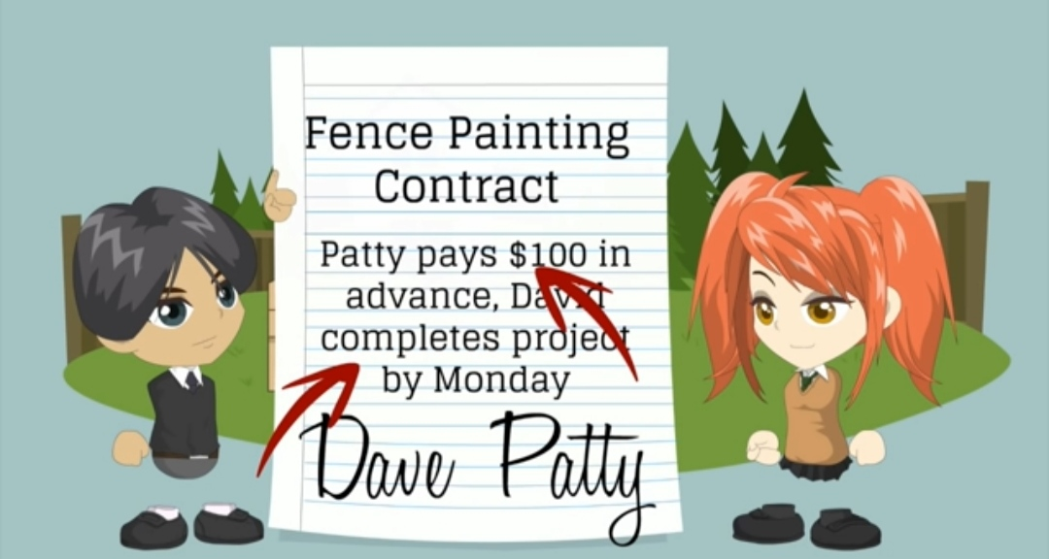
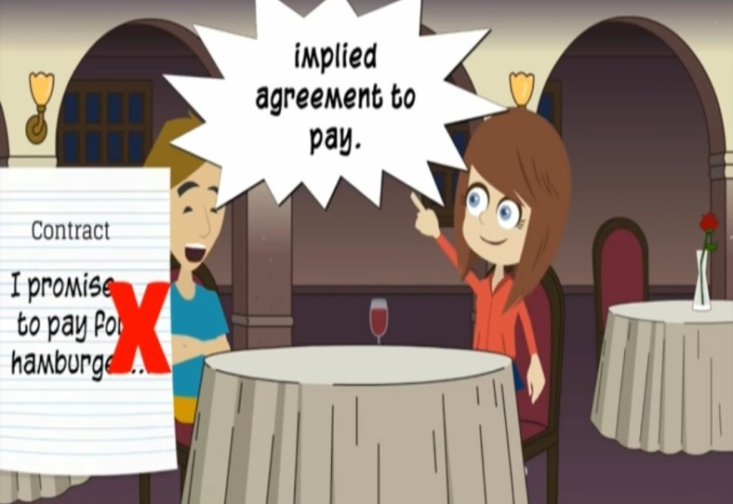
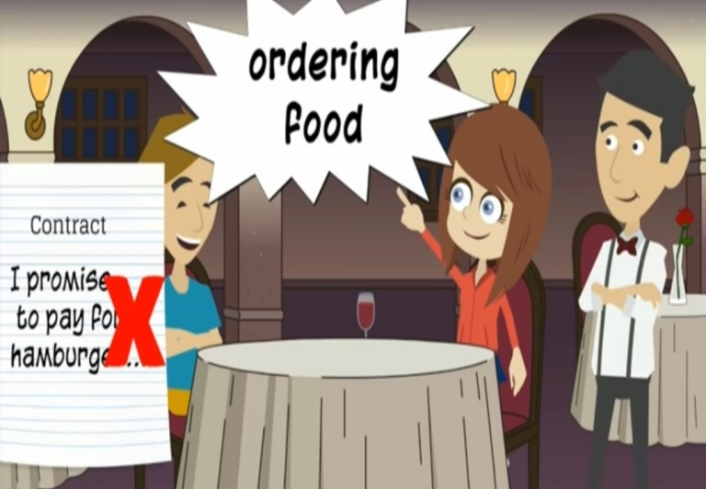
Rule regarding offer
Express:
Implied:

Slide 5
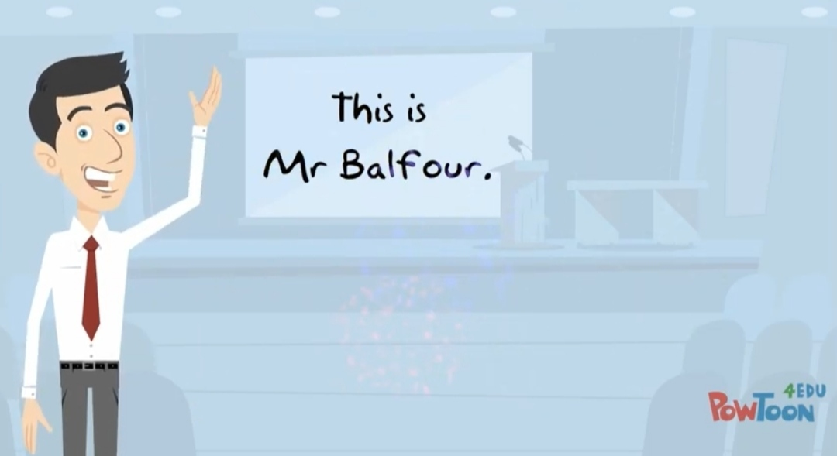
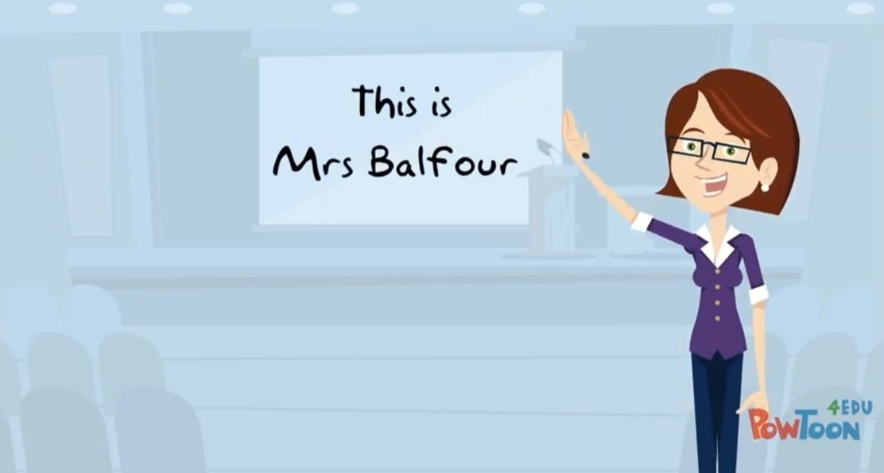
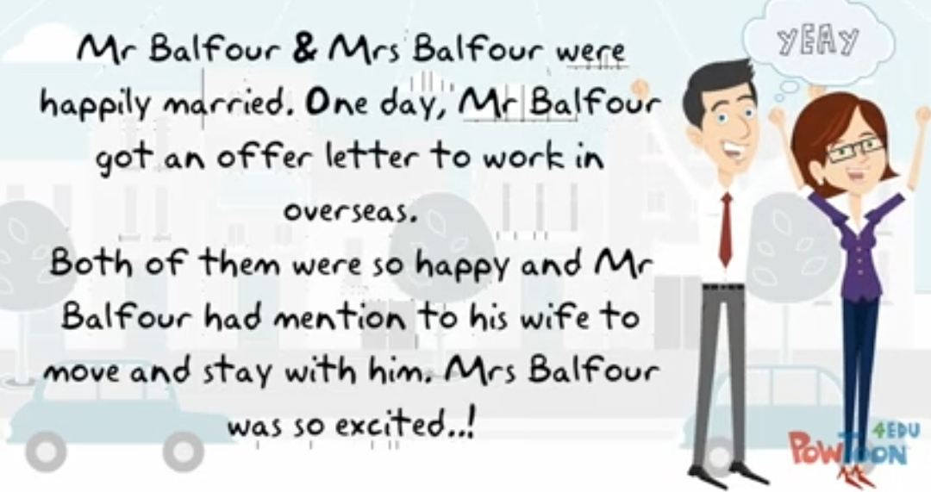
Definite person/class and world: Same as offer example.
Legal relationship is required:

Slide 6
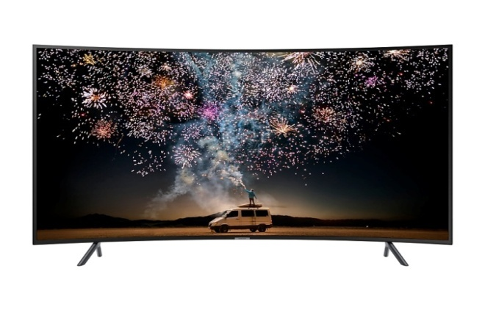
The terms of the offer must be certain: if the price of the product is not mention, there will be no contract. if price mention then it will be a contract.
A mere statement of intention is not an offer:
Price 55000 tk
price 50000 tk

Slide 7
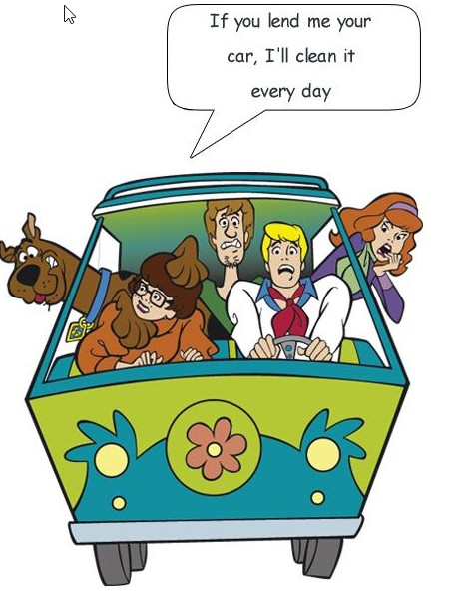
An offer must be communicated to the offeree:
An offer maybe conditional:

Slide 8
Acceptance

Slide 9
Rules regarding acceptance
It must be an absolute and unqualified acceptance of all the terms of the offer:
20000tk
10000tk

Slide 10
Conditional acceptance:
rani said accepted 10000tk
jony offered to sell his house for 12000tk

Slide 11
Clarification:

Slide 12
The acceptance must be expressed in some usual or reasonable manner:

Slide 13
Mental acceptance or uncommunicated assent does not result in a contract:

Slide 14
The mode of acceptance: if the offeror says, “acceptance to be sent by telegram”, the offeree must send a telegram
Time of acceptance: Time is prescribed. if no time is prescribed the acceptance must be done within reasonable time .

Slide 15
When acceptance is complete: A proposes, by letter, to sell a house to b at a certain price . The communication of the proposal is complete when b receives the letter

Slide 16
Revocation of offer
:By notice: sending a massage to another person.
By lapse of time: give someone a specific time and cancel the offer if not within the time.

Slide 17
After expiry of reasonable time: wait a few days after the time is up.
By failure of a condition precedent: condition to sale or give something .for example, the grandfather will give the land to the grandson if he gets married.
By death or insanity: if someone dies or goes crazy after the offer then the offer will no longer exist.
Counter offer: you have to buy with whatever they say. if not ,there will be no offer.
By refusal: at first the offer price was not accepted and say another price ,if the sales man are agree then come back the 1st price.

Slide 18
Revocation of acceptance

