Slide 1
Skimming & Scanning
Jannatul Ferdous Himika
Lecturer (English)
Business Administration
Daffodil International University

Slide 2
Skimming & Scanning
Skimming and scanning are both speed reading techniques used when a reader wants to get information from a text as quickly as possible. However,skimming and scanning are different processes, which are used to obtain different kinds of information.
Skimming and scanning are reading techniques that use rapid eye movement and keywords to move quickly through text for slightly different purposes.

Slide 3
What is skimming?
‘To skim’ means ‘to take a quick glance’.
Skimming can be understood as the technique of speedy reading wherein the reader pays attention to the main point or essence within the passage only, so as to get a general concept of the content.
Skimming is reading rapidly in order to get a general overview of the material.
In skimming, the text containing unnecessary details, stories, examples or other data is purposefully skipped.

Slide 4
What is skimming?
This technique is generally used while reading newspaper, mails and messages.
Skimming is said to be effective when the reader is able to grasp the main information correctly and clearly.
With skimming a lot of time of the reader is saved, because you don’t have to spend hours to read the entire material in full.

Slide 5
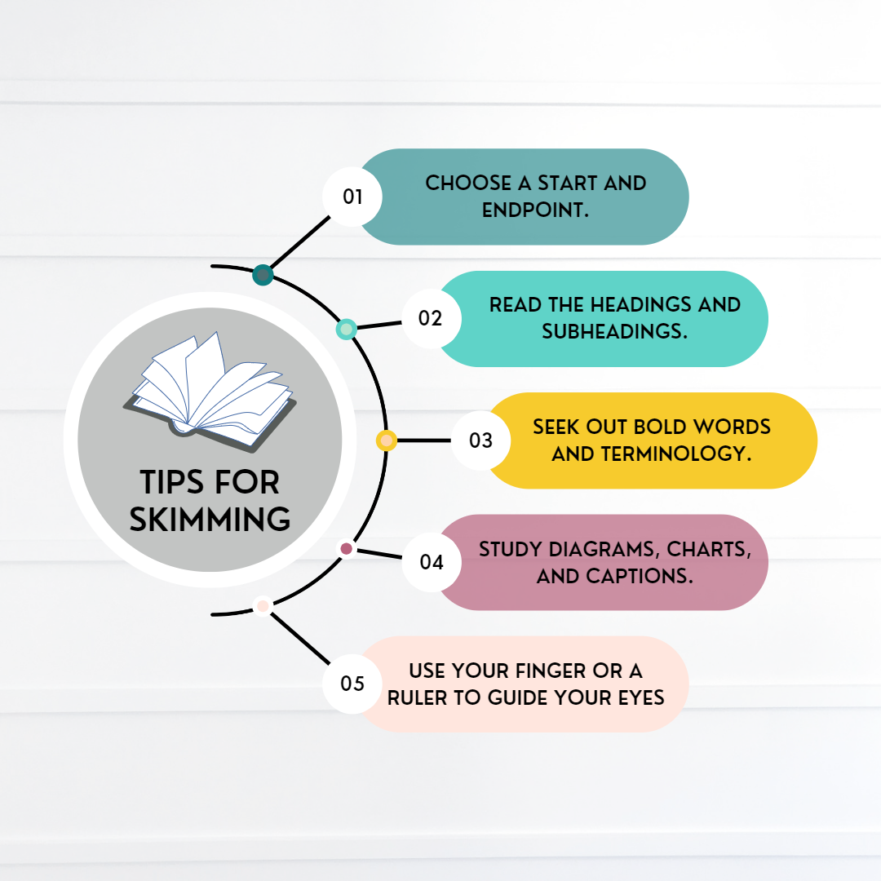

Slide 6
What is scanning?
‘To scan’ means ‘to look for something’.
Scanning refers to a selective reading method generally used by the reader when he/she is in search of some specific information or text, contained in the passage, without reading the text thoroughly.
When you scan some material you already know what are you looking for, you just have to spot it down.
While performing perform scanning, there is a specific purpose or question at hand, and you go through with the given

Slide 7
What is scanning?
text so as to find the answer to that question and thus avoid reading the text which is irrelevant to your purpose or question.
Scanning is commonly used in everyday life, for example when looking up a word in a dictionary or finding your friend's name in the contacts directory of your phone.

Slide 9
Skimming vs Scanning
SKIMMING
SCANNING
Skimming is a way of reading something in a fast manner so as to grasp the main points.
The reader is not familiar with the text.
‘To skim’ means ‘to take a quick glance’.
Scanning means to look carefully and quickly at the written material so as to locate something.
The reader knows what he is searching for.
‘To scan’ means ‘to look for something’.

Slide 10
Reading comprehension
Reading comprehension is the ability to process written text, understand its meaning, and to integrate with what the reader already knows.
Reading comprehension relies on two abilities that are connected to each other: word reading and language comprehension.

Slide 11
What kind of questions do we expect from Reading comprehension?
Fill in the blanks ( with or without clues)
True/ False
Question Answer
Multiple choice
Summary

Slide 12
Read the following text carefully to answer
One day in the forest a fox chased after a rabbit. The rabbit hid behind a tree and the fox kept running. “Where are you rabbit?” called the fox, “I want to be your friend.” The rabbit knew that this was one of the fox’s tricks so he called, “I’m over here next to the bee hive.” The hungry fox raced to the bee hive but there was no rabbit....only a big swarm of bees. The fox sped off as fast as he could, with the bees buzzing right behind him.
1.Who hid behind a tree?
2. Who was hungry?
4. What was at the beehive?
5. What did the fox see when it got to the bee hive?
6. What did the bees do?

Slide 13
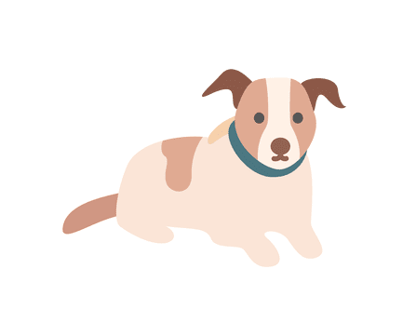
Anna has a little pup. The pup’s name is Rollo. Rollo is white with brown spots. Anna gave Rollo a toy bone to play with. When Anna throws the bone Rollo runs to get it as fast as he can. Rollo brings the bone to Anna and they play the game again.
1. The name of Anna’s pup is a. Rocky b.Rollo c.Robby
2. Rollo’s spots are a.brown b.black c.white
3. Anna gave Rollo a toy a.bone b.car d.dog
4. Anna throws the a.ball b.bone c.bowl
5. Rollo runs after the a.bone b.Anna c.a cat

Slide 14
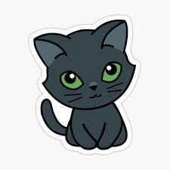
Has anyone seen Tara’s pet cat? She has grey fur and green eyes. Her name is Silky. The last time Tara saw Silky was on Sunday when she gave her some milk to drink. That was at 2 o’clock, just after lunch. Nobody knows where Silky went after that. Wait, I can see someone coming...it’s Tara. She has a big smile on her face and she’s holding something in her arms.
1. Silky’s fur is __ __ __ __ and her eyes are __ __ __ __ __.
2. Tara gave Silky some milk just after __ __ __ __ __.
3. On her face Tara had a big __ __ __ __ __.
4. Tara was holding Silky in her __ __ __ __.

Slide 15
Any other questions?

