Slide 1
KhatIYAN

Slide 2
Generally Document for identification of land is called Khatian. Khatiyan is a “Persian”word, in English it is Called “Records of Rights” but we commonly know it as Sottolipi or Porcha. But in legal points of view Document which has been prepared through survey or mutation for the purpose of determination of Possession; Ownership & Assessing Land Development Tax; is called Khatian. SoKhatiyan (Records of Rights) actually contains record of rights but this is not a deed of ownership. No one can claim ownership of any land just based on Khatian.

Slide 3
Contents of Khatiyan
• Rule, Tenancy Rules,
– Plot No. ---partial or complete.
– Name, father’s name, address of the owner or owners.
– Portion of a owner, total amount of land, class and nature of land, location, easement right, amount of Land Development Tax payable, mode of paying tax, rights and obligations of the tenants, rent free status etc.

Slide 4
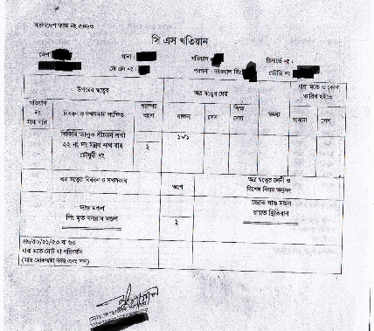
CS khatiyan
Cadastral survey or CS Khatiyan was initiated in Ramu Thana of Cox’s Bazar in 1888-89 and completed in Dinajpur. The survey was conducted entirely by the Survey Department under the Bengal Tenancy Act, 1885 and completed in 1940.

Slide 5
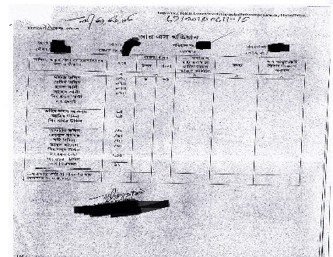
RS khatiyan
After the CS Khatiyan, a lot of complaints had been filed against the inaccuracy of CS Khatiyan. But it took 50 years to issue a revision. RSKhatiyan or Rivisional survey was conducted to revise the C.S. record. It was started in the Chittagong district and the purpose of this survey is to update the amount of land, owner’s name, and possessor’s name. Which in turn made it more authentic than the CS khatiyan.

Slide 6
SA khatiyan
This Khatiyan was done under the State Acquisition and Tenancy Act, 1950, that is why it is called State Acquisition Survey. It is also known as Pakistan Survey (P.S.) because it was conducted in the Pakistan Period. However, neither this is a practical survey nor based on a field survey. This khatiyan was made on the information given by the Zamindar or Landlord. The survey was concluded within a remarkably short time from 1956 to 1964 through province-wise state acquisition settlements. This khatiyan is not considered to be accurate.

Slide 7
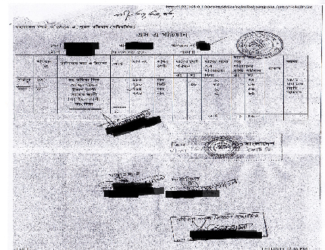

Slide 8
BS Khatiyan
Bangladesh Survey (B.S.) Khatian was prepared after the independence of Bangladesh but started before the independence. The survey operation conducted during 1970-1990 under the State Acquisition and Tenancy Act, 1950 and B.S. Sheet was prepared during 1970-1985. The survey is still underway. That is why this is the more accurate khatiyan of all. This survey is known as Bangladesh Survey and the khatiyan made from BS survey is known as BS Khatiyan or Bangladesh Survey Khatiyan.

Slide 9
Namjari
There is another special kind of Khatiyan also known as “Namjari”. This is really important for two different reasons. Number one, Khatiyan is always prepared through a survey but as it turns out, it doesn’t always happen. And if the property is transferred or inherited in-between two surveys then it is mandatory that you mutate and replace the current owner’s name with the old owner in the Khatiyan. Number two, it is necessary for a holding to be created to pay the land tax (Khajna).

Slide 11
How to identify Different types of Khatiyan :
RS Khatiyan : 1. Vertical and it has two pages.
2. The name of the district, Mouja and number of khatiyan is witten on the top of the first page of this Khatiyan.
3. “According to Section 105/106/108/109…” this is written at the bottom of the first page.
4. “Possessor of north frontier” is the second column of second page.
5. The owners are mentioned in different groups and this groups are marked by Bengali alphabet.
SA Khatiyan : 1. Vertical and it has two pages.
2. The name of the district, Mouja and number of khatiyan is witten on the top of the first page of this Khatiyan. Besides RS Khatiyan number is mentioned over the SA Khatiyan number.
3. “According to Section 49/50/51/52 or 53…” this is written at the bottom of the first page.
BS Khatiyan : 1. Horizontal and it has one page.
2. All Columns are mentioned in the front page of this khatiyan.

Slide 12
All in all, khatian is a very important piece of documentation that is absolutely necessary when validating the authenticity of a property’s ownership. But one thing to remember is that this document alone by any means doesn’t determine the ownership of any property. It may be a good document for possession but doesn’t create ownership or title.

