Slide 1
Soft skills for your career

Slide 2
Soft Skills are personal attributes essential for success in the career. Soft Skills make your hard skills SALEABLE
What are SOFT SKILLS
Soft skills help you manage reality. And the reality is, things don’t always go as planned.
Hiring managers typically look for job candidates with soft skills because they make someone more successful in the workplace.﻿ Someone can be excellent with technical or job-specific skills, but if they can't manage their time or work within a team, they may not be successful in the workplace.

Slide 3
How Soft Skills Work
Soft skills are also important to the success of most employers. After all, nearly every job requires employees to engage with others in some way.
Another reason hiring managers and employers look for applicants with soft skills is that soft skills are transferable skills that can be used regardless of the person's job. This makes job candidates with soft skills very adaptable employees.
Soft skills are particularly crucial in customer-based jobs. These employees are in direct contact with customers. It takes several soft skills to be able to listen to a customer and provide that customer with helpful and polite service.

Slide 4
The Pillars of Soft Skills
Proactive / Initiative
Global Awareness
Creativity and imagination
Collaboration and teamwork
Critical Thinking
Flexibility and adaptability
Leadership
Problem Solving & Decision-Making
Negotiation
Self Motivation
Emotional Intelligence
Communication
Life means soft skills. In a word, if we want to understand soft skills, then different experienced people call positive attitude as soft skills.
However, according to most experts, there are 12 pillars of soft skills.

Slide 5
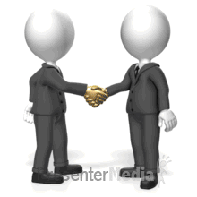
1st Pillar
Communication

Slide 6
5% by your academic credentials
15% by your Professional Experiences
80% by your communication Skills
No matter what JOB you have in life, your success will be determined

Slide 7
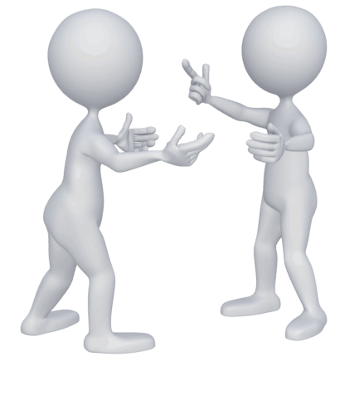
Communication
Communication is called the heart of soft skills. Every branch of Soft Skills has communication involvement. The success of our careers depends on how we communicate with people. Similarly, failure is also due to not communicating properly.
If you can say that “I am good in communication” we will understand you are able to clearly express the what, Why when, where, who, and how. That is the reason many of the experts say “Good Communication is the bridge between Confusion and Clarity”

Slide 8
People
Message
Context
Listen
Communication
Good Communication is the center point of your Leadership traits, Teamwork ability, Negotiation skills, Problem Solving skills, Decision Making capability etc.
Research shows that strong communication is the cornerstone for successful career, healthy relationships, and your ensures sustainability.
There are major 4 Pillars of Communication

Slide 9
4 Pillars of Communication
People
When communicating with another person, we should consider the Think, Feel, Do model
Message
It's the nonverbal signals we deliver
Context
Communication never happens in a vacuum. Location, timing, and relationships are all part of our third communication Pillar, the Context.
Active Listening
What do I want someone to THINK?
What do I want someone to FEEL?
What do I someone to DO?
As the sender, when you plan your message, keep in mind not only how you word or you write something, but also the channel that you use to send it.
For example Email, Fax, SMS, Voice Message through WhatsApp, Facebook Messengers, Official Letter etc.
Bad timing, bad location makes for a horrible communication.
We should always be sure about the Context, Timing, Location, and Relationship
According to the U.S. Department of Labor, listening is such an activity that takes up to 55% of our working time.
Between interacting at work, talking to our families, taking in information through radio, TV, video clips, we listen more than we speak daily.
When you are the sender of a message and you're getting feedback from your receiver, you have to listen with your ears, your eyes, your heart.

Slide 10
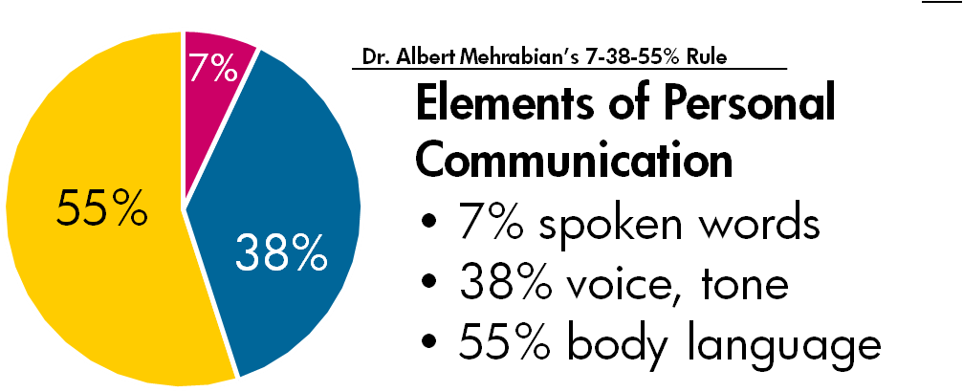

Slide 11
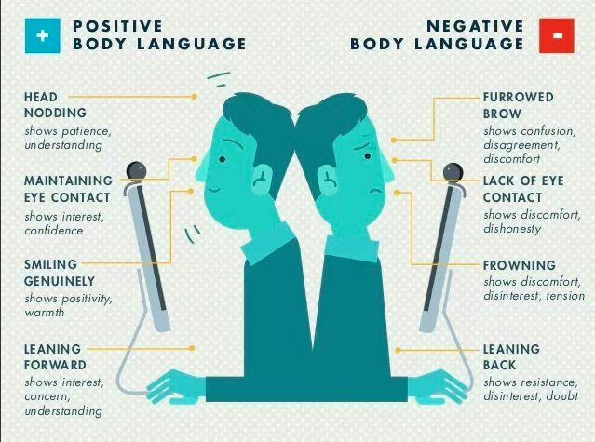
Body Language is more powerful than Words

Slide 12
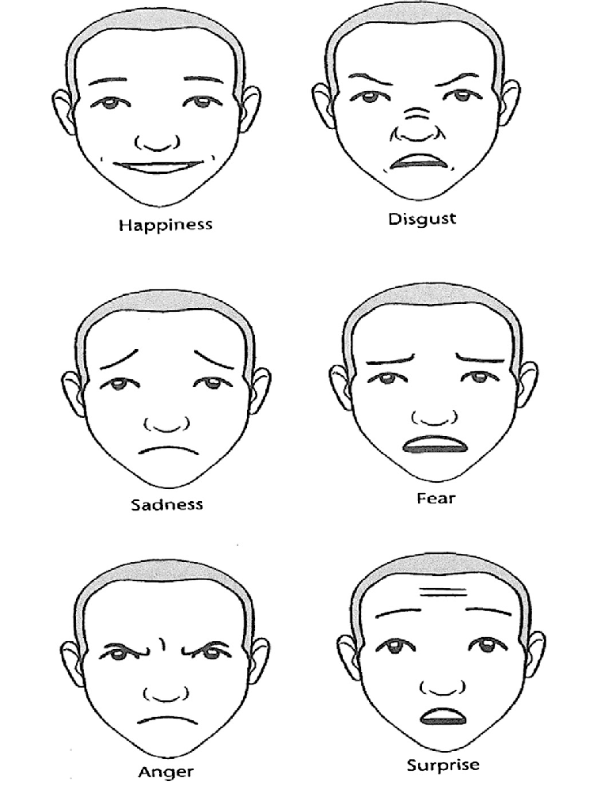
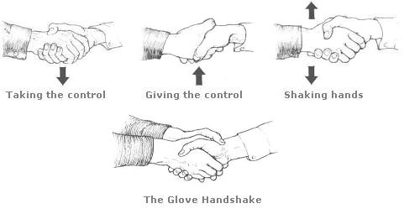
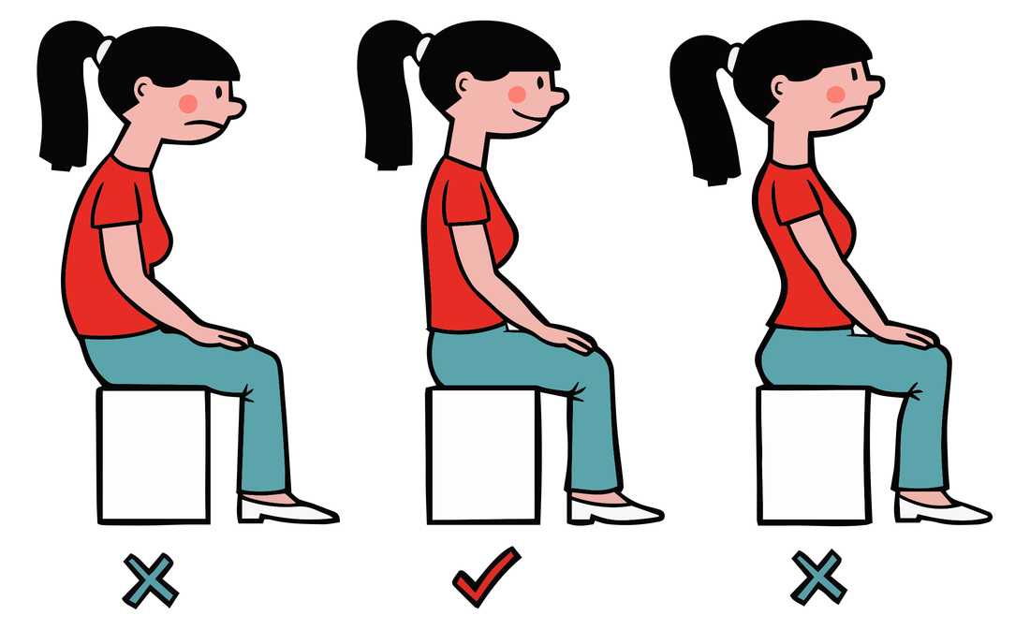
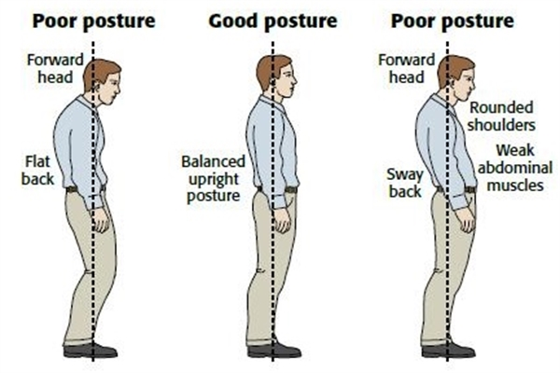
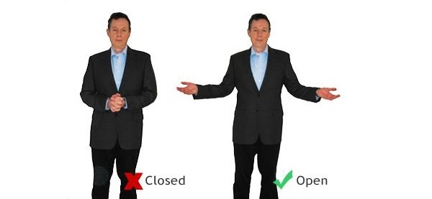
Posture & Gesture

Slide 13
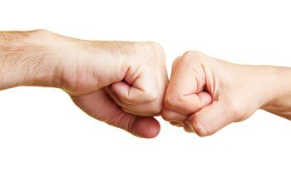
COVID-19 Redefined Hand Shakes

Slide 14
2nd Pillar
Leadership

Slide 15
Leadership is not a POSITION, a TITLE, and a STATUS in the organization it’s a RESPONSIBILITY, a ABILITY, and an HONOR.
“If your actions Inspire others to dream more, learn more, do more & become more, you are a leader.” John Quincy Adams, 6th President of USA

Slide 16
Leadership
is not determined by age or time. This has created a kind of misconception among all of us.
Leaders encourage others to take the actions they need to succeed. To be a great leader, it is necessary to learn and cultivate the skills it takes to be effective.

Slide 17
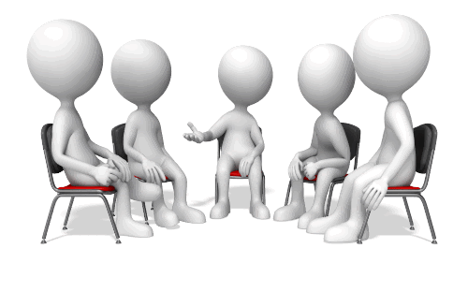
Good Character
Vision Creator & Courageous
Effective Communicator & Listener
Self Aware & Know others
Motivator
Curious & can Involve People
Decision Maker
LEADERSHIP TRAITS

Slide 18
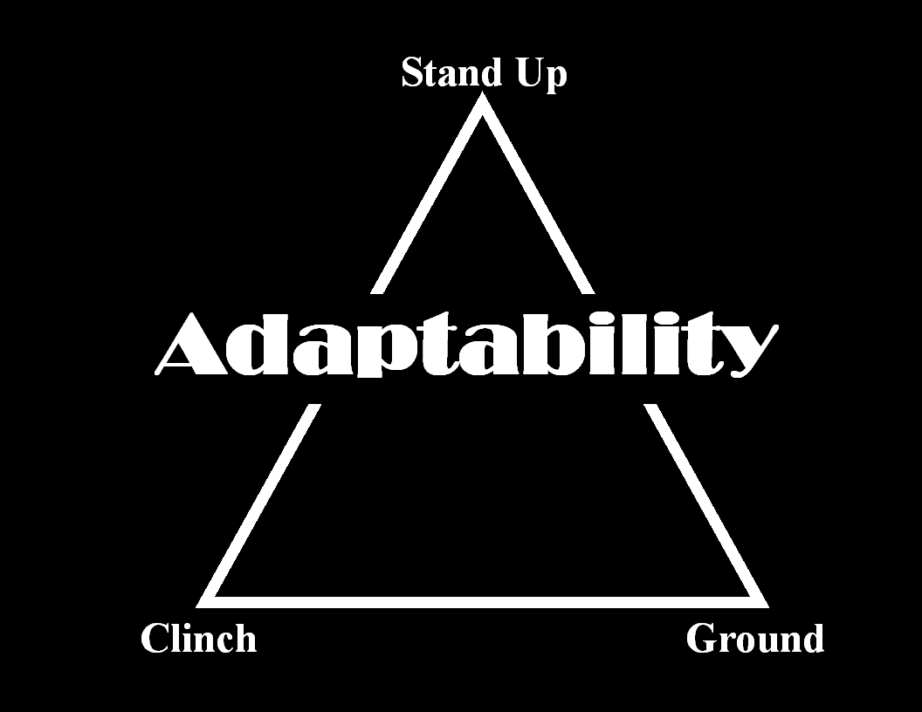
3rd Pillar
Adaptability

Slide 19
means to adjust to changes in their environment.

Slide 20
Adaptability is when a person can be flexible and have the ability to adapt to changing work conditions.
To hold challenges better
To become a better leader
to be relevant always
It helps

Slide 21
ADAPTABLE person can Redefine their motivation
Non ADAPTABLE person says ‘I have to do this because my boss said to
Don’t Think in Such Way

Slide 22
Find alternative solutions
Stay calm and confident
Get new skills
Accept Mistakes
Are you an Adaptable Person?
Adaptable person can

Slide 23
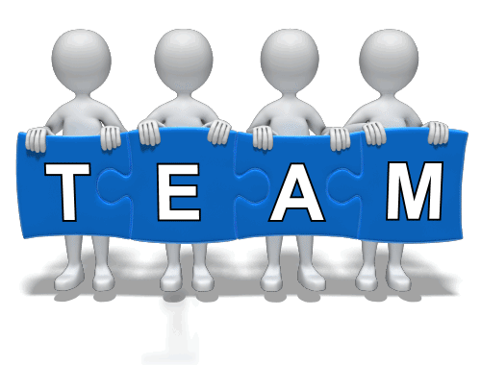
4th Pillar
TEAM WORK

Slide 24
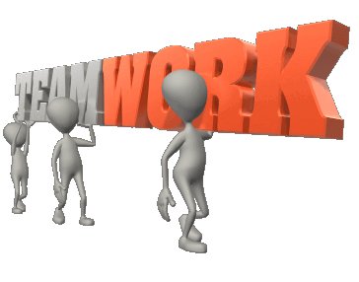
Together Everyone Achieves More
being able to collaborate well with co-workers strengthens the quality of your work.
The Simple Rule Getting work done with everyone through the use of the right emotions

Slide 25
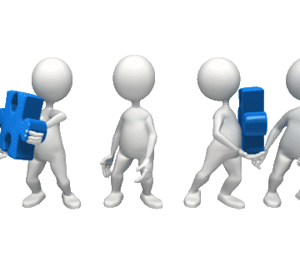
Commitment to team success
Everyone is responsible for everything
Good Communicator
Giving & Accept Feedback
Everyone knows who will do what
Accountability
6 key attributes of successful teamwork

Slide 26
Increased efficiency
Less employee turnover
One moves forward with the help of the other
It is possible to make a person work by increasing his new skills in the workplace. New appointments are not required.
Advantages of Teamwork
Since teamwork provides mutual moral support and a greater sense of accomplishment, it is obvious that it very beneficial.

Slide 27
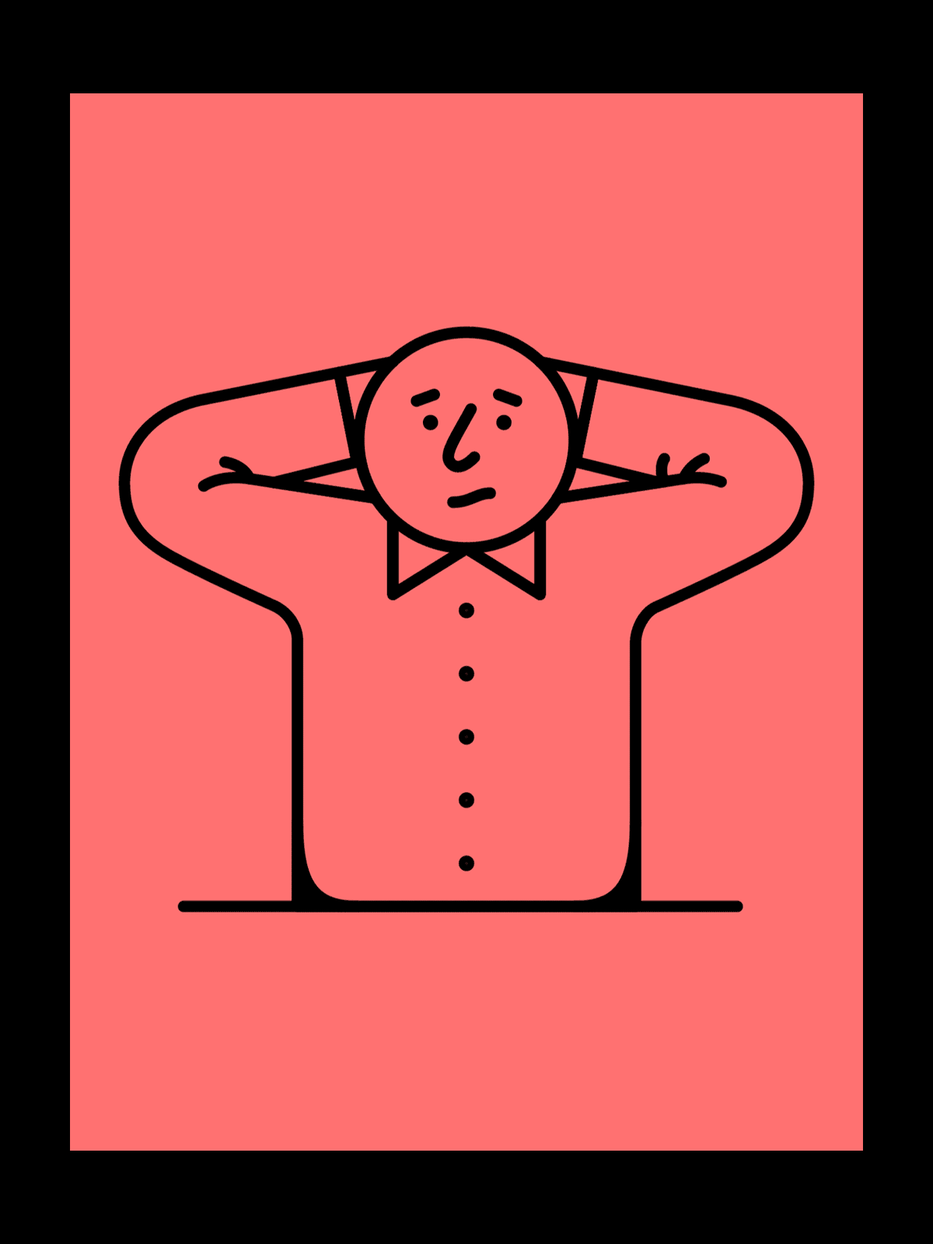
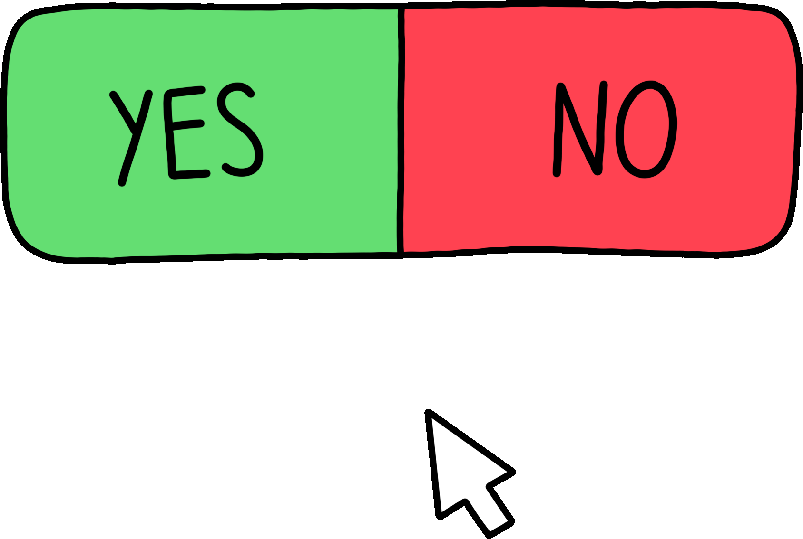
5th Pillar
Problem solving &
Decision Making
When something goes wrong, you can either complain or take action.

Slide 28
It’s not a work of Alone. It requires TEAM
Implementing a solution and follow up on the solution.
Defining a problem through determining the cause of the problem
Identifying, prioritizing, and selecting alternatives for a solution
Generate new ideas
Process of
Problem solving & Decision Making

Slide 29
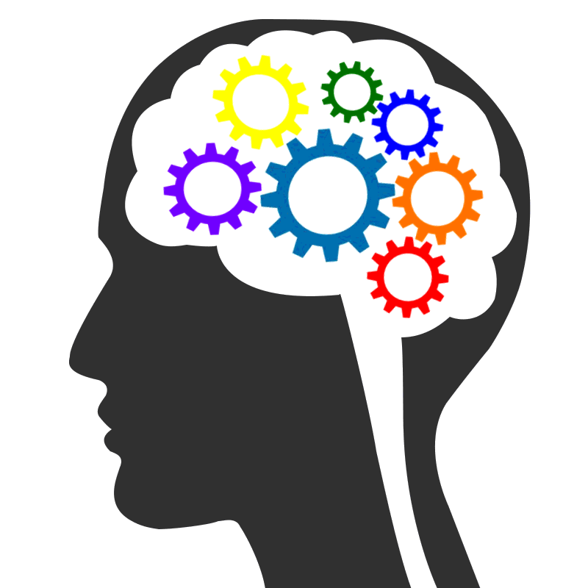
6th Pillar
Critical thinking
“The ability to think critically is more important now than it has ever been. Everything is at risk if we don’t all learn to think more critically. If people cannot think critically, they not only reduce their prospects of climbing the ladder in their respective industries, but they also become easily helpless to things like fraud and manipulation.

Slide 30
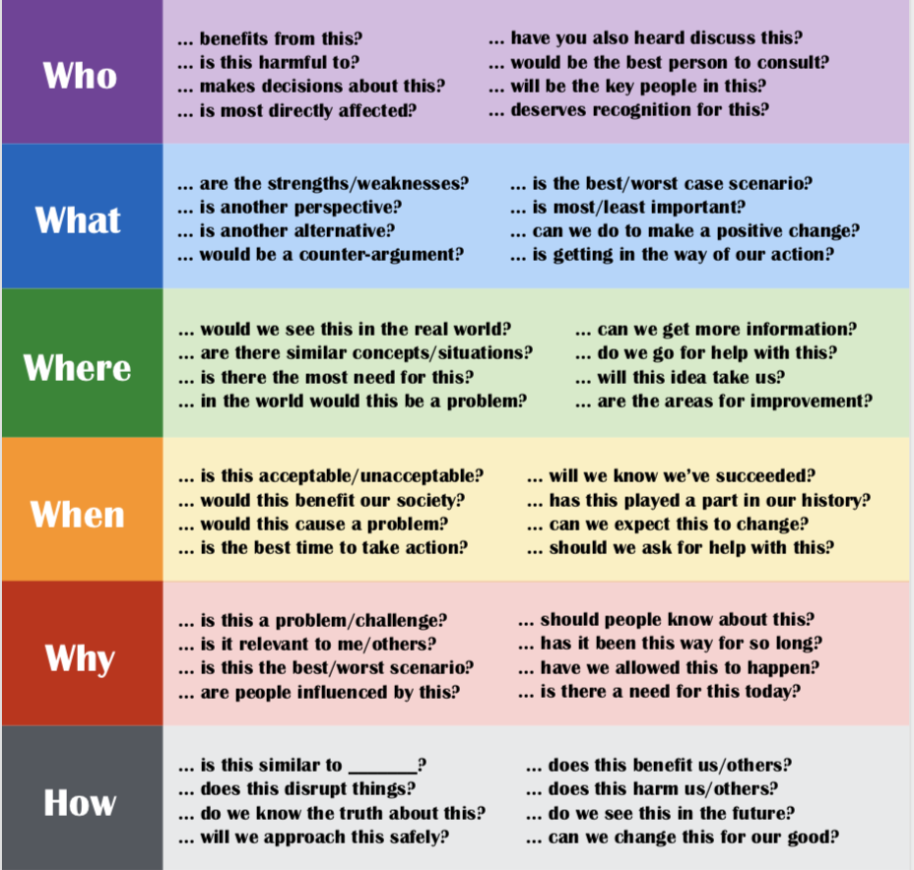
Critical thinking
Diagnosis anything, everything before action

Slide 31
7th Pillar
CREATIVITY (WHAT)
Creativity is defined as the tendency to generate or recognize ideas, alternatives, or possibilities that may be useful in solving problems, communicating with others, and entertaining ourselves and others.

Slide 32
CREATIVITY (WHY)
Being creative helps you become a better problem solver in all areas of your life and work. Creativity helps you see things differently and better deal with uncertainty.

Slide 33
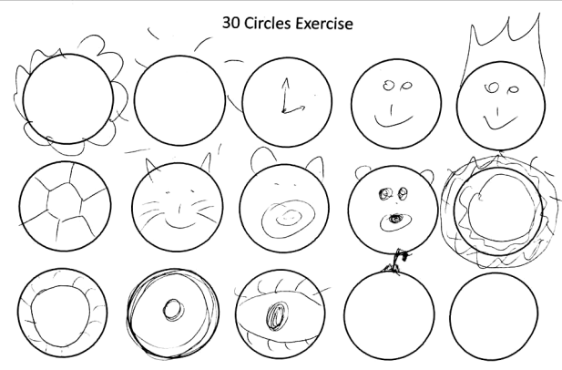
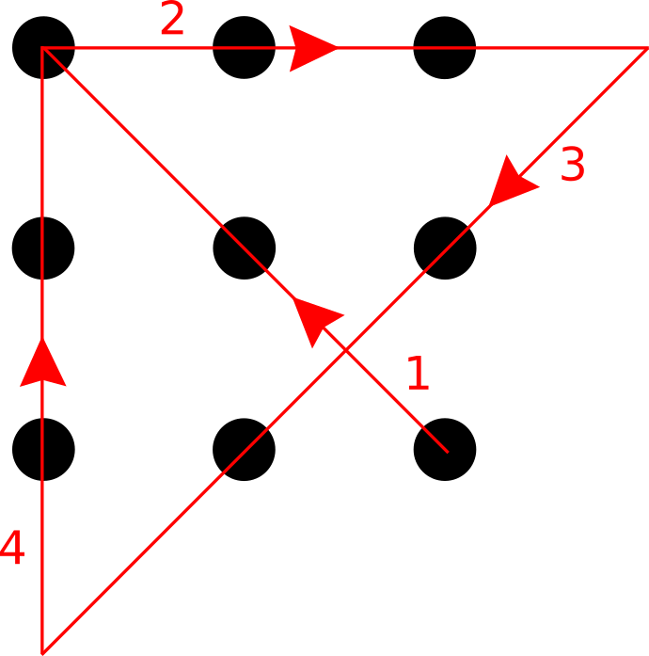
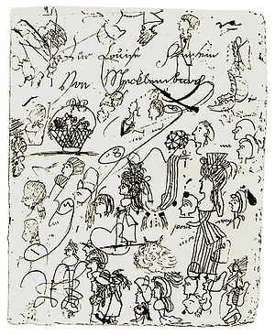
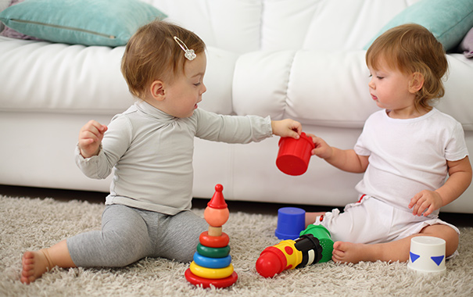
Challenging Yourself with Creative Exercises
Doodle in your spare time
Write something on anything
Socialize with creative Office
Make something with your hands
Listen to music

Slide 34
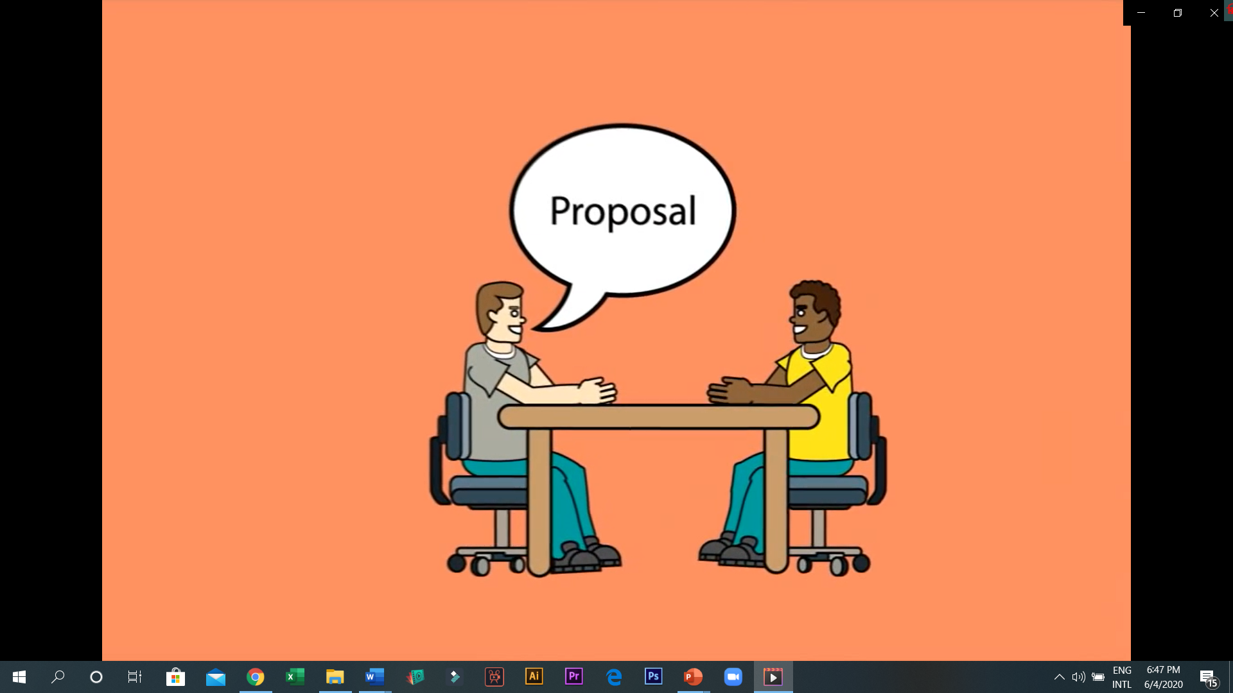
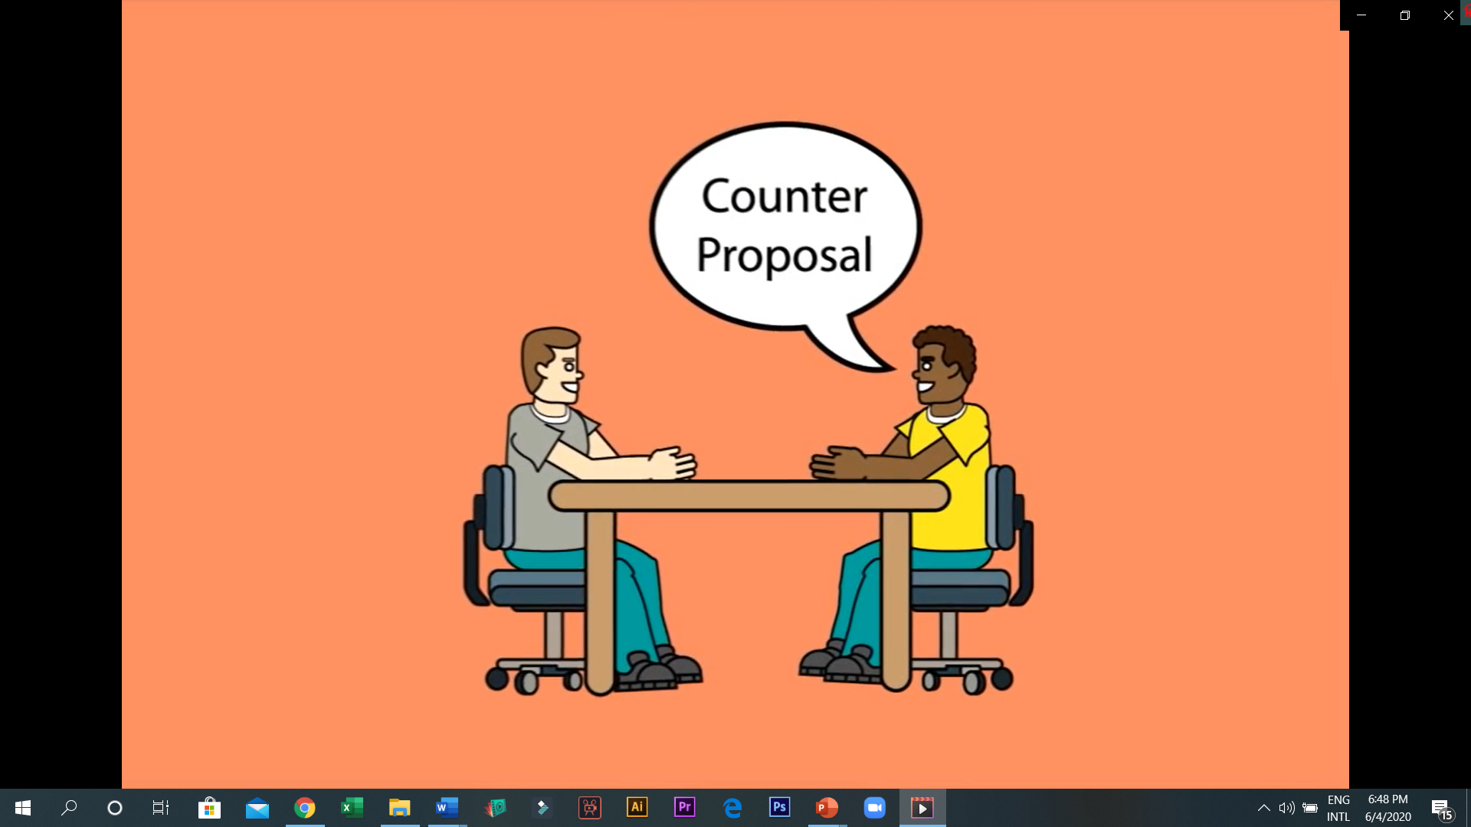
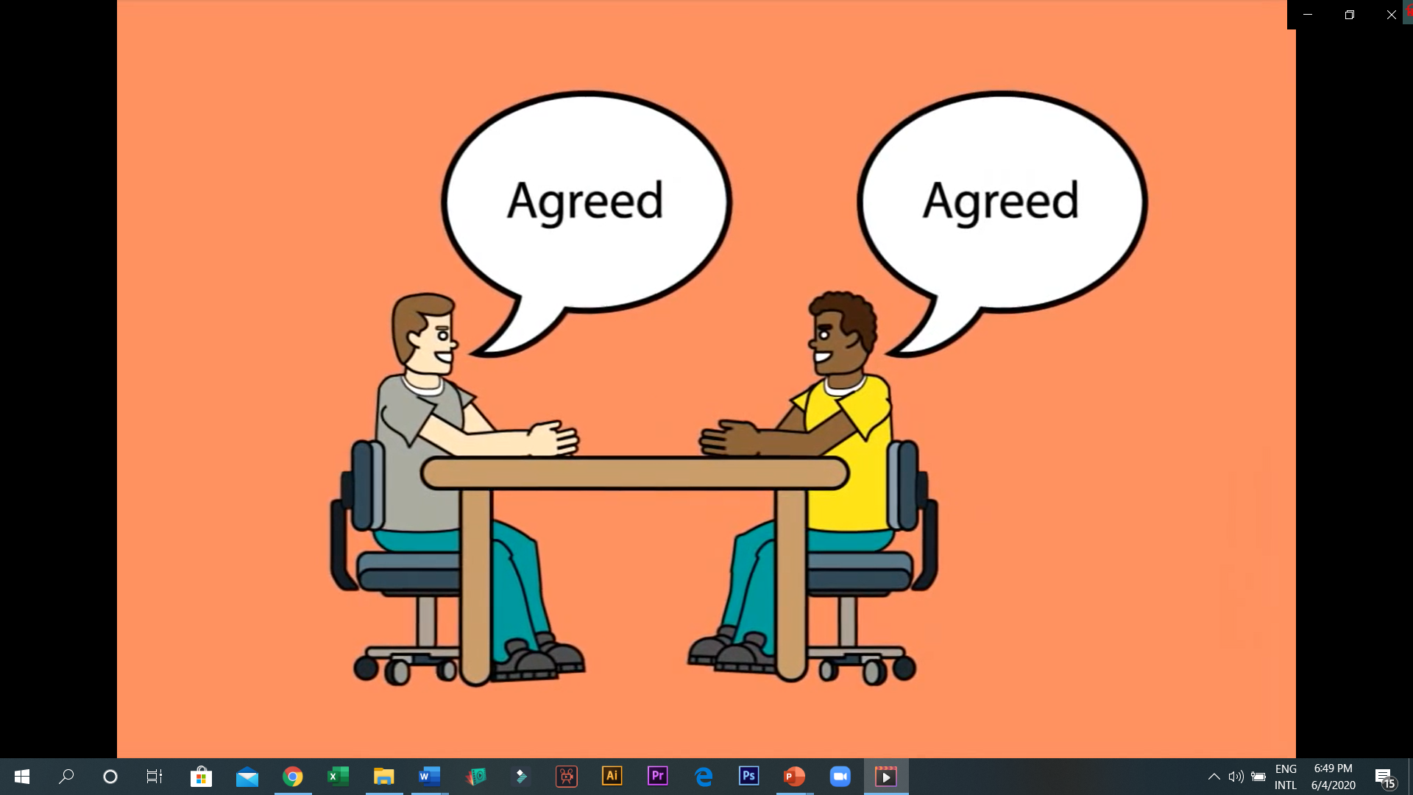
When it comes to NEGOTIATION, shifting your mindset from "A BATTLE TO BE WON" to "A PROBLEM-SOLVING CONVERSATION" can improve your results dramatically.
is not a WAR
8th Pillar
NEGOTIATION

Slide 35
NEGOTIATION SHOULD BE
WIN-WIN

Slide 36
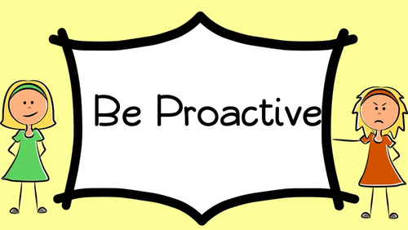
9th Pillar
Proactive/Initiative

Slide 37
Proactive behavior involves acting in advance of a future situation, rather than just reacting. It means taking control and making things happen rather than just adjusting to a situation or waiting for something to happen. There are two type s of people. Proactive and Reactive.

Slide 38
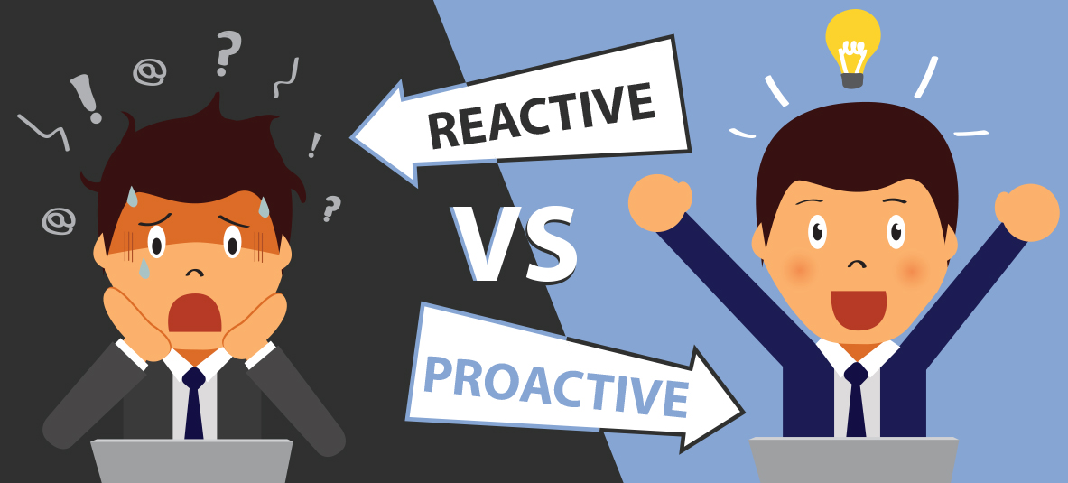
Reacting to a problem after it arises
Blame circumstances and conditions
Wants to see everything as it is
Everything sees negatively at first
Reactive people like rowboat, they go wherever winds and waves take them. So they might sink if storms come.
Preventing problems before they arise
Do not blame anything or anyone
They adjust to change
Everything sees positively.
Proactive people like Motorboat, they can control their way. So they will not sink if storms come.

Slide 39
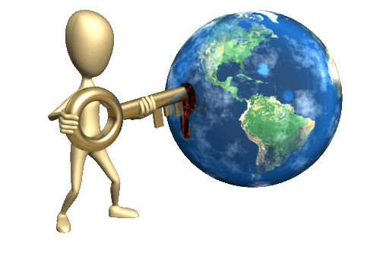
10th Pillar
GLOBAL AWARENESS
is an understanding of the different cultures and norms that are found across the world, which is very important to have, particularly in the humanitarian sector.
Global Awareness is a necessity for the 21st Century learner. Global awareness enables people to understand the links between their own lives and those of people throughout the world. It increases understanding of the economic, cultural, political and environmental influences which shape our lives.

Slide 40
11th Pillar
EMOTIONAL INTELLIGENCE
(otherwise known as Emotional Quotient or EQ) is the ability to understand, use, and manage your own emotions in positive ways to relieve stress, communicate effectively, empathize with others, overcome challenges and defuse conflict.

Slide 41
Social management
This involves the ability to manage relationships, build networks, find common ground and build rapport.
Self Awareness
This is the ability to recognize and understand personal moods and emotions.
Self Management
This is the ability to control or re- direct upsetting emotional needs and moods.
Social Awareness
This relates to the ability to understand the emotional make-up of others and the skill to treat people according to their emotional reactions
The 4 Categories of Emotional Intelligence

Slide 42
12th Pillar
SELF MOTIVATION
is the ability to drive oneself to take initiative and action to pursue goals and complete tasks. It's an inner drive to take action — to create and to achieve.
It is what pushes you to keep going on tasks, especially those you're pursuing because you want to, not because someone told you to.

Slide 43
8 ways to be remain self Motivated
Start Simple. Keep motivators around your work area – things that give you that initial spark to get going. ...
Keep Good Company. ...
Keep Learning. ...
See the Good in Bad. ...
Stop Thinking. ...
Know Yourself. ...
Track Your Progress. ...
Help Others.

Slide 44
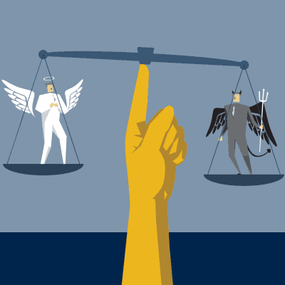
Most Important and mother of all
ETHICS is a system of moral principles. Ethics is concerned with what is good for individuals and society and is also described as moral philosophy.
The term is derived from the Greek word ethos which can mean custom, habit, character or disposition.

Slide 45
How to improve your soft skills
Be open to feedback
Communicate regularly with new people
Join Teams
Build positive relationships
Step outside of your comfort zone
Get ready to learn everyday
Adapt to changes, don’t react
Observe others intentionally
Face the problem, don’t run away
Take on a leadership role
Arrive on time anywhere
Most importantly “Gain work experience during student life”

