Slide 1
Food, nutrition, health and diseases

Slide 2
Nutrition and health
Nutrition may be defined as the science of food and its relationship to health. It is concerned primarily with the part played by nutrients in body growth, development and maintenance .
The importance of nutrition in the primary prevention of disease has long been recognised in the public sector.
The influence of food intake on health and wellbeing has drawn many research interests and continues to develop.

Slide 3
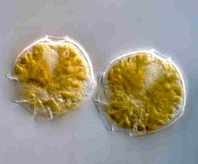
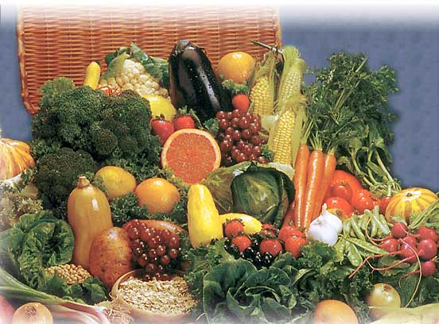
Good Food v.s. Bad Food
A food that is beneficial to the body is regarded as a Functional Food, in that, it is one claiming to have additional benefits other than nutritional value.
Foods may also contain substances that are harmful to health, these are regarded as Naturally Occurring Toxicants.

Slide 4
Chronic Disease
Chronic diseases/conditions characterized by:
A long-term condition
e.g., obesity, diabetes, and cardiovascular disease
May be prevented or delayed with lifestyle changes
e.g., healthier eating and more physical activity
Long course of illness.
Slow recovery.
Rarely cured completely.
Multiple contributing factors to their onset.
Having a long development period, for which there may be no symptoms.
May lead to other health complications.
Associated with functional impairment or disability.

Slide 5
Nutrition for Chronic Disease: Prevention and Treatment
Nutrition is a widely accepted tool for prevention of chronic diseases
Nutrition is also very important for management and treatment of a chronic diseases
At this lecture we will discuss cardiovascular diseases (e.g., heart disease and stroke), obesity and diabetes, and how they can be prevented and treated with nutrition
Notes:
Each year at least:
1.9 million people die as a result of physical inactivity;
2.7 million people die as a result of low fruit and vegetable consumption;
2.6 million people die as a result of being overweight or obese
WHO, 2005

Slide 6
Nutrition for Obesity
Nutraceuticals are a growing sector of the supplements market for weight loss.
There are a wide variety of products, formulated into capsules or tablets, or even incorporated into foods or convenience style foods such as snack bars.
The major examples include
L-carnitine and acetyl-L-carnitine,
Dehydroepiandrosterone (DHEA),
Green tea
Conjugated linoleic acid (CLA).

Slide 7
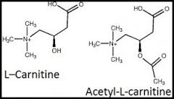
L-Carnitine and acetyl-L-carnitine
L-Carnitine is an endogenous product found in the kidneys and liver; can also be obtained from dairy products and red meat.
It is a co-factor in the process of fat oxidation for cellular energy production.
Fat oxidation in muscle tissue is reduced in obesity due to a reduction of L-carnitine-mediated enzyme activity.
For this reason carnitine is purported to be of benefit in obese people by increasing fat oxidation, and ‘fat burner’.
However, it has not been tested for its effectiveness or safety over prolonged periods of time.

Slide 8
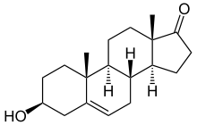
Dehydroepiandrosterone
DHEA is an adrenal hormone found naturally in the body.
Blood levels of DHEA in humans peak at around the age of 20, and decrease rapidly after 25 years of age.
DHEA plays a role in receptor and enzyme adaptations that are thought to favor increased fat oxidation and decreased fat deposition.

Slide 9
Green tea
Green tea contains catechin polyphenols, which have been shown to inhibit catechol-O-methyltransferase (COMT).
COMT is responsible for the degradation of noradrenaline, noradrenaline has an important role in the control of thermogenesis and fat metabolism.
Tea catechins (epigallocatechin gallate, EGCG) is effective in reducing the body weight.

Slide 10
Green tea
Body weight loss has been found to be reversible, and the animals regain body weight when EGCG administration is stopped.
The in vitro thermogenic effect of green tea extract on adipose tissue can be mimicked by EGCG, giving credence to the belief that EGCG is the important component of green tea.

Slide 11
Conjugated linoleic acid
CLA is a collective term used to describe a mixture of positional and geometric dienoic linoleic acid isomers with conjugated double bonds.
In dietary supplements, various combinations of the different isomers are found.
CLA isomers can be obtained from normal dietary components such as dairy and meat products.
CLA reduced body weight or promoted repartitioning of body fat in humans.
It only reviewed trials that had lasted for longer than four weeks, and concluded that the CLA isomer trans-10, cis-12 may produce liver hypertrophy and insulin resistance.

Slide 12
Diabetes
Characterized by increased blood glucose (sugar) levels Due to
a lack of insulin (a hormone), which controls blood glucose levels
And/Or
an inability of the body’s tissues to respond properly to insulin (a state called insulin resistance)
The most common type of diabetes is type 2
Diabetes can benefit from good nutrition
Notes:
Type 2 accounts for about 90% of all diabetes

Slide 13
Types of Diabetes
Type 1 diabetes
an autoimmune condition resulting in the need for lifelong insulin therapy
Type 2 diabetes
Progressive disease related to insulin resistance
May be managed with just diet and exercise, or may require oral medication and/or insulin injections
Most commonly seen in overweight/obese people, but can also develop in normal weight people
Gestational Diabetes
Diabetes that develops during pregnancy
Notes:
“Today, there is no cure for diabetes, but effective treatment exists.”
International Diabetes Federation
http://www.idf.org/node/1057?unode=3B96FF34-C026-2FD3-8735F3091A4A9414

Slide 14
Nutrition for Diabetes
Goal of nutrition therapy
To help people with diabetes learn how to make healthy food choices, which will optimize glycemic control and prevent complications
A healthy, well-balanced diet
There is no one “diabetic diet”
Healthy eating for diabetes includes whole grain cereals, lean protein foods, fruits, generous portions of non-starchy vegetables
Ideally, a person with diabetes receives an individualized meal plan from a nutritionist or dietitian
Notes:
Diabetes outcome is closely tied to the management strategies and resources available in the various regions of the world. International Diabetes Federation
“A well-balanced, healthy eating plan is the cornerstone of good blood sugar control for all people with diabetes. Whether you are being treated with insulin or tablets, you still need to follow a sensible eating plan. The so-called "diabetic diet" is not in fact a diet, but rather a healthy eating plan ideal for the whole family. Eating healthily not only helps to control blood sugar levels (thus also delaying the onset of diabetes-related complications), but also helps to maintain body weight and prevent heart disease. The old saying ‘you are what you eat’ is exactly right. Your blood sugar levels are affected by everything you eat. Wise food choices are the key to a healthy life and prevention of illness.”
International Diabetes Federation
http://www.idf.org/node/1057?unode=3B96FF34-C026-2FD3-8735F3091A4A9414

Slide 15
Nutrition for Diabetes
The current approach to diabetic management is through a combination of dietary choices and supplements. A new trend in the treatment of diabetes is marketed in the form of nutraceuticals
Nutraceutical Vitamins, Minerals, and Enzymes
• ALA and its reduced derivative, dihydrolipoic acid, improve insulin sensitivity, glucose tolerance in type II DM, and diabetic neuropathy.

Slide 16
Nutrition for Diabetes
Biotin increases glucokinase activity, thereby improving glucose tolerance and insulin sensitivity.
• Carnitine improves glucose metabolism and disposal. The recommended dose is 1–2 g twice daily.
• Chromium is an essential micronutrient acting as a cofactor in numerous insulin regulatory steps. It reduces fasting glucose, and insulin resistance. The recommended dose is 8 mcg/kg/day
• Copper increases insulin sensitivity and improves glucose levels. However, excessive intake of copper may induce or produce insulin resistance.

Slide 17
Nutrition for Diabetes
• Flavonoids enhance insulin secretion, improve insulin sensitivity, and reduce serum glucose.
• Gamma linoleic acid improves glucose tolerance, improves insulin resistance, and protects, diabetic neuropathy.
• Glutathione is the most potent intracellular antioxidant. Decreased levels results in insulin resistance, glucose intolerance, and increased oxidative stress.
Magnesium improves insulin sensitivity and secretion.
• Manganese is an important cofactor in many glycolytic enzymes; it improves insulin synthesis and insulin sensitivity and serves as “insulin.”
• Monounsaturated fats improve glycemic control.

Slide 18
Nutrition for Diabetes
N-acetyl cysteine improves insulin secretion, reduces insulin resistance, lowers serum glucose, and prevents diabetic cataracts.
• Niacinamide improves insulin action and sulfonylurea action. It alone improves glucose tolerance in safe doses.
• Omega 3 fatty acids improve insulin sensitivity and insulin secretion and reduce serum glucose.
• Potassium improves insulin secretion, insulin sensitivity, and glucose tolerance when administered orally or intravenously.
Selenium is an important antioxidant; it serves as an “insulin-mimetic,” The recommended dose is 200 mcg/day.

Slide 19
Cardiovascular disease and nutrition

Slide 20
Cardiovascular Disease
Caused by disease of the blood vessels (atherosclerosis) of the heart, usually as part of the process which affects blood vessels more generally
Stroke and heart disease are the main cardiovascular diseases
Stroke is the main cardiovascular disease in many east Asian countries
Notes:
Coronary heart disease, also known as coronary artery disease or ischaemic heart disease, is the leading cause of death globally. (WHO, 2005)

Slide 21
Nutrition for Cardiovascular Disease
Eat a diet rich in fruits, vegetables and whole cereal grains
This provides potassium and fiber, both clearly linked to reduced chronic disease risk
Don’t add salt during food preparation
Limit use of processed and pre-prepared food items
They are typically very high in salt
Cook with no or very minimal added fats and oils
If fat or oil is used, unsaturated is healthiest option (canola, olive, etc)
Maintain a healthy body weight
Control blood pressure and blood sugar
Notes:
Other important factors include: Don’t smoke, minimize stress at home and at work, and tet at least 30 minutes of physical activity daily.
For overweight and obese people, losing just 5 to 10% of their current body has substantial benefits. For example, someone who is 200 pounds (91 kg) need only lose 10 to 20 pounds (22-44 kg) to increase the chances of reducing blood pressure and blood glucose.
The WHO Atlas of Heart Disease and Stroke. http://www.who.int/cardiovascular_diseases/en/cvd_atlas_20_personal_choices.pdf

Slide 22
Garlic
Allium sativum (garlic) has been studied for a variety of cardiovascular benefits and is the most widely used supplement in the world.
Content and Effects
Garlic lower lipids and blood pressure, reduce atherosclerosis, decrease coagulation and platelet aggregation, and increase fibrinolysis of blood clots.
Garlic contains two different active ingredients: allicin and alliin.

Slide 23
Ginsengs
Ginsengs (Panax ginseng, P. quinquefolius L. [American ginseng], Ginseng Radix Rubra [Korean ginseng]
Family: Araliaceae
Potential Indications
This agent is being studied for use in hypertension
Tree bark
Tree bark (Terminalia arjuna) is derived from Combretaceae family.
Potential Indications
The bark extract is supposed to have cardiotonic, anti-ischemic and anti-heart failure properties.

Slide 24
Lycopene
Lycopene is closely related to beta-carotene and is thought to reduce the risks of coronary heart disease.
High levels of lycopene are present in tomato juice, sauce and other concentrated extracts.
Also found in a number of red fruits and vegetables, watermelons, pink grapefruit and pink guava.

Slide 25
Polyunsaturated Fatty Acids (PUFA)
Major source of omega-6 PUFAs are vegetable oils, salad dressings, and margarines made with the oil
U.S. population intake 7% of calories
Large amounts may increase LDL oxidation

Slide 26
Omega-3 PUFA: EPA, DHA
Consumption of fish and fish oils rich in EPA, DHA will lower cholesterol, LDL, and TG and reduce sudden cardiac death
Found in fish oils, fish oil capsules, and ocean fish (eicosapentaenoic and docosahexaenoic acid)
Do not affect TC; may ↑ LDL-C (5-10%) and decrease TG (25-30%) especially in patients with high TG
Anticoagulant effect
Decrease vasoconstriction
Improve endothelial dysfunction
Reduce inflammation

Slide 27
Fiber
Soluble fibers (pectins, gums, mucilages, algal polysaccharides, some hemicelluloses) in legumes, oats, and fruits lower serum cholesterol and LDL-C
Average decline in LDL-C is 14% for hypercholesterolemics
Soy Protein
Substituting soy protein lowers TC (9%) and LDL-C (13%) and TG (11%) with no effect on HDL-C
Daily intake of 25 g of soy will lower LDL-C by 4 to 8% in hypercholesterolemic persons

Slide 28
Nuts
Tree nuts can reduce risk of CHD via lipid-lowering effects;
Peanuts also cardioprotective
Almonds, hazelnuts, pecans, pistachio nuts, and walnuts modestly reduce serum cholesterol
Nuts are a rich source of fiber, vitamin E, magnesium, and MUFA and PUFA
ALA in walnuts, arginine shows antioxidant and antithrombotic effects
May reduce insulin resistance

Slide 29
Bone and joint diseases
Bone and joint diseases can lead to disability, immobility, pain, and a reduction in activities of daily living.
Two of the most prevalent bone and joint conditions include
osteoporosis and osteoarthritis.
Osteoporosis is defined as a skeletal disorder characterized by compromised bone strength predisposing to an increased risk for fractures.

Slide 30
Vitamin D
Vitamin D is naturally present in few foods but is often added to fortified food products, such as milk and cereal.
It is also produced endogenously through exposure of the skin to ultraviolet rays from the sun.
In the liver, vitamin D is converted to 25-hydroxyvitamin D, also known as calcidiol. In the kidney, it undergoes hydroxylation to 1,25-dihydroxyvitamin D, also known as calcitriol.
Vitamin D is needed for calcium absorption in the gut and maintenance of adequate serum calcium and phosphate concentrations to enable normal bone mineralization.

Slide 31
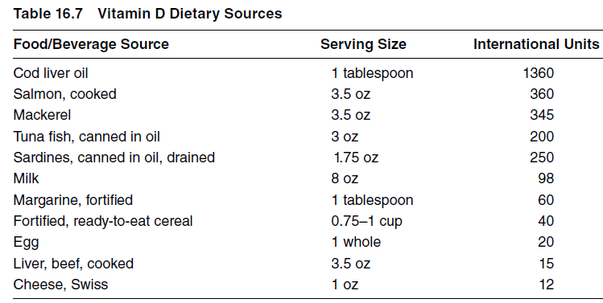
Vitamin D

Slide 32
Osteoarthritis
It is the most common joint disease and a leading cause of pain and physical disability. The knee, hand, and hip are the three most common areas affected by osteoarthritis, and conventional treatment includes exercise, weight loss, pharmacologic management with NSAIDs, and, in severe cases, surgery and/or joint replacement.

Slide 33
Glucosamine and Chondroitin Sulfate
Two of the most widely used and studied supplements for osteoarthritis are glucosamine and chondroitin.
Glucosamine sulfate is proposed to stimulate the cartilage by producing large amounts of glycoproteins and glycosaminoglycans and may exhibit mild anti-inflammatory effects at higher doses.
Chondroitin sulfate claims anti-inflammatory properties and aids in proteoglycan synthesis. The usual dose of chondroitin is 400 mg orally td.

Slide 34
S-adenosylmethionine
S-adenosylmethionine (SAMe) is another agent that has been studied in the treatment of osteoarthritisThe proposed mechanism of action of SAMe in the treatment of osteoarthritis is donation of a methyl group that aids in the reaction that increases chondrocytes and cartilage thickness and may also decrease cytokine-induced chondrocyte damage.

Slide 35
Skin Health
The skin is the most vital and largest organ in the human body.
It is primarily composed of two layers: epidermis, the outer layer, and dermis, the inner layer.
It protects the human body from the damage caused by the external environmental agents such as UV rays, pathogens, and pollutants.
In addition, vitamin D, a fat-soluble vitamin, is synthesized in the skin by the action of UV rays emitted by the sunlight.

Slide 36
Carotenoids
Carotenoids, such as beta-carotene, lutein, lycopene, and zeaxanthin, either alone or in combination, are commonly used as nutraceuticals in skin healthcare.
In a recent study, it was shown that supplementation of carotenoid mixture containing lycopene (3 mg/day), lutein (3 mg/day), and beta-carotene (4.8 mg/day), along with α-tocopherol (10 mg/day) and selenium (75 μg/day), for a period of 12 weeks has improved skin density, thickness, scaling, smoothness, and wrinkling.

Slide 37
Lupeol
Lupeol is a naturally occurring pentacyclic triterpine of plant origin present in several common fruits and vegetables, such as mangoes, figs, strawberries, and olives.
Melatonin
Melatonin (N-acetyl-5-methoxytryptamine) is a naturally occurring hormone secreted by the pineal gland. It is biosynthesized by a series of reactions from indole amino acid tryptophan. It is a highly potent antioxidant that acts by scavenging hydroxyl and lipid peroxidyl free radicals.

Slide 38
Tea
Tea is obtained from the plant Camellia sinensis.
EGCG is one of the main constituents of green tea. In rats, the topical application of EGCG (2%) hydrophilic ointment 30 min before UV-A exposure has decreased skin damage caused by UV-A rays.
In an in vivo study, the aqueous extracts of black tea were formulated as a gel and tested for protection against a broad range of UV radiation (200−400 nm).

Slide 39
Ginger
Ginger rhizome is obtained from Zingiber officinale. The topical application of ethanol extract of ginger on SENCAR mouse skin has resulted in the significant protection against TPA (tissue plasminogen activator)-induced skin tumor.
Aloe vera
The Aloe vera extracts are commonly used in a wide variety of formulations such as skin creams, lotions, gels, and ointments. Topical application of A. vera gel (97.5%) in humans has significantly attenuated UV-induced erythema after 48 h.

Slide 40
Eye health
Eye health is an area in which nutraceutical supplements are increasingly used and they are now widely available at opticians. They are taken to maintain healthy sight, to improve a condition or to delay disease progression.
Numerous age-related disorders, including visual problems, have been linked to the cumulative effects of oxidative stress. The retina is particularly susceptible to cellular damage by reactive oxygen intermediates.

Slide 41
Lutein and zeaxanthin
Lutein and zeaxanthin are usually derived from the diet, particularly dark green leafy vegetables such as kale and spinach.
Foods that are yellow, such as egg yolk, corn, orange juice, honeydew melon and orange pepper, are also good sources.
Lutein and zeaxanthin are naturally found together, with lutein usually in much higher concentrations.
These are unique compared with other dietary carotenoids because they selectively accumulate in the retina of mammals. This pigment may have both acute and chronic effects on visual performance.
Possible roles of lutein and zeaxanthin include antioxidant activity and their ability to filter blue light.

Slide 42
Astaxanthin
Astaxanthin is another carotenoid associated with eye health. It is found in many types of seafood, including lobster, shrimp and salmon, and is responsible for their pink colour when cooked.
Microalgae, specifically Haematococcus pluvialis, is the main source.
Astaxanthin is a powerful antioxidant and is able to cross the blood–brain barrier.
Animal studies have shown it to accumulate in the retina and reduce photobleaching of the retina from exposure to high-intensity light.

Slide 43
Docosahexaenoic acid
This fatty acids have been shown to influence function of the retina and to play a role in many pathological eye conditions.
The bilayer membranes of the outer segments of the light-sensitive rod and cone photoreceptors in the retina contain membrane phospholipids. These are primarily esterified with high concentrations of docosahexaenoic acid (DHA), a long-chain n-3 polyunsaturated fatty acid (PUFA).
The essential n-3 fatty acid -linolenic acid can be converted to DHA in the liver or retinal epithelium.

