Slide 1
Origin of the word ‘Economics’
The word "economics" is derived from a Greek word "okionomia", which means "household management" or "management of house affairs" -i.e., how people earn income and resources and how they spend them on their necessities, comforts and luxuries.
With the passage of time, the word "okionomia" was used for an economy as whole in the sense that how a nation takes steps to fulfill its desires and preferences with the help of scarce means. That's why economics was called political economy in its early ages.

Slide 2
Economics - Definition
From the word ‘okionomia’ the word ’economos’ derived, the meaning of 'eco' is home and 'nomos' meaning accounts.
Economics was first read in ancient Greece. Aristotle, the Greek Philosopher termed Economics as a science of ‘household management’.
But with the change of time and progress of civilization, the economic condition of man changes. As a result, an evolutionary change in the definition of Economics is noticed. Towards the end of the eighteenth century Adam Smith, the celebrated English Economist and the father of Economics, termed Economics as the ‘Science of Wealth’.
Notes:
Adam Smith – Scottish (1723-1790), 67 years life span, Books: The Wealth of Nations, Division of Labour, Alma Mater: University of Glasgow

Slide 3
Economics - Definition
According to him, “Economics is a science that enquires into the nature and causes of the wealth of nations”. In other words, how wealth is produced and how it is used, are the subject-matter of economics.
In the subsequent period Alfred Marshall defined Economics by saying, ‘Economics is the study of humans, in relation to the ordinary business of life. It studies that portion of the personal and social activities, which are closely related to the attainment of material resources, related to welfare and its utilization.’.
In other words, according to Marshall, Economics studies not only the wealth but also the activities centering the wealth.
Notes:
English (1842-1924), Books: Principles of Economics (1890), 81 years, The Economics of the Industry, Alma Mater: St. Jhon’s College, Cambrige

Slide 4
Economics - Definition
In modern times more realistic definitions have been given to economics. In social life human wants are unlimited, but the means to satisfy those wants are scarce. Economics studies how to use the limited resources to satisfy the unlimited wants of men.
According to Benjamin Davis "Economics is the science that studies how scarce resources are allocated to meet competing and unlimited wants and how human beings satisfy their material wants and needs."

Slide 5
Economics - Definition
According to Bradely R. Schiller "Economics is the study of how best to allocate scarce resources among competing uses." According to Jackson and Mclver "Economics is concerned with the efficient use of limited productive resources for the purpose of attaining the maximum satisfaction of our material wants."

Slide 6
Economics - Definition
In simple words, economics can be defined as; "Economics is the study of those natural laws which governs production, distribution and consumption of wealth; in economics we study individual and social behavior of man which satisfy his desires and causes overall economic development."
There is no single definition of economics upon which all the economists are mutually agreed. Every definition is criticized by the different economists from different angles. Therefore it is difficult to describe the subject matter of economics in a few words, and proper definition of economics is still a question mark. That's why, perhaps, Keynes was not far wrong when he said "political economy is said to have strangled itself with definitions’’.

Slide 7
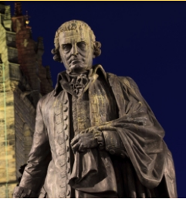
Famous Economists and Their Contributions Adam Smith (1723 - 1790)
Nationality: Adam Smith was a Scottish philosopher and political economist who is widely considered ‘the father of modern economics’
Contribution: World's first free-market capitalist, for he explained how―in a free-market economy―rational self-interest led to economic well-being. He influenced the likes of Karl Marx, John M. Keynes, and Thomas Malthus.
Books: Smith's contribution to economics came in the form of his famous works: The Theory of Moral Sentiments (1759) and The Wealth of Nations (1776)
Education: University of Glasgow, Balloil College, Oxford, UK

Slide 8
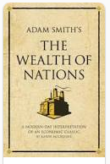
Why read Wealth of Nations?
Adam Smith clearly explains why countries are rich and poor.
Wealth of nations explains why some people are wealthy and others are not.
It will answer your questions, why outsourcing, manufacturing coming to China/Bangladesh.
Adam Smith explain individual’s economic behavior with greater clarity than any psychologist.

Slide 9
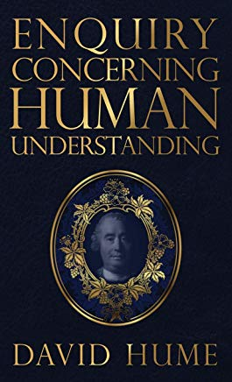
Famous Economists and Their Contributions David Hume (1711 - 1776)
Nationality: David Hume was a renowned philosopher and economist hailing from Edinburgh, Scotland.
Contribution: Even though he was more of a philosopher, he is regarded as one of the most eminent economists of the world, as his discussions on politics led to the development of several ideas that are prevalent in the field of economics even today. He was of the opinion that foreign trade is a stimulus for economic growth, and therefore, is very important for the development of the nation.
Mentor of Adam Smith, the father of economics.
Books: A Treatise of Human Nature(1738),
Human Understanding (1748)
Education: University of Edinburgh, Scotland
Notes:
"Reason is, and ought only to be the slave of the passions"

Slide 10
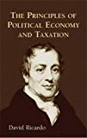
Famous Economists and Their Contributions David Ricardo (1772 - 1823)
Nationality: British political economist.
Contribution: Together with James Mill, founded classical economics.
In his Theory of Profit, Ricardo stated that as real wages increase, real profits decrease because the revenue from the sale of manufactured goods is split between profits and wages. He said in his Essay on Profits, "Profits depend on high or low wages, wages on the price of necessaries, and the price of necessaries chiefly on the price of food." He adamantly supported the implementation of free trade and voted against renewal of the sugar duties in Parliament.
Books: Principles of Political Economy and Taxation (1817).
Education: Homeschool

Slide 11
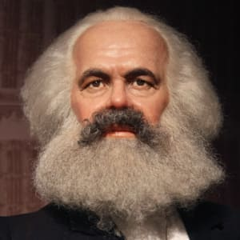
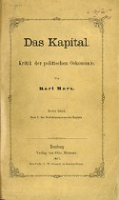
Famous Economists and Their Contributions Karl Marx (1818 - 1883)
Nationality: German philosopher, economist, journalist and revolutionary.
Contribution: one of the most influential figures in history, He was of the belief that humans were not motivated by grand ideas, but by material concerns related to survival. Marx looked at capitalism negatively and in his book ‘Das Kapital’ argued that the capitalist's profits come from exploiting labor. He predicted the end of capitalism and emergence of communism, where people would own the means of production, and thus, there would be no need to exploit labor for profit.
Books: Das Kapital (1867), Critique of Political Economy (1859)
Education: University of Bonn, University of Berlin, Germany

Slide 12
Socialist world
Map of countries that declared themselves to be socialist states under the Marxist–Leninist or Maoist definition between 1979 and 1983, which marked the greatest territorial extent of socialist states

Slide 13
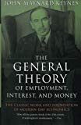
Famous Economists and Their Contributions John Maynard Keynes (1883 - 1946)
Nationality: British
Contribution: His groundbreaking work in the 1930s led to the development of a whole new economic discipline dedicated to macroeconomics. His economic theories, which became known as ‘Keynesianism’ advocated government intervention to end the Great Depression of 1930s.
Books: ‘The General Theory of Employment, Interest and Money’ (1936), The Economic Consequences of Peace (1919). Indian Finance and Currency (1913)
Education: Eton College, Kings College (Math) University of Cambridge, UK

Slide 14
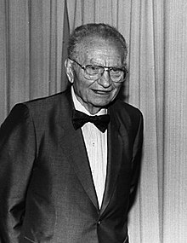
Famous Economists and Their Contributions P. A. Samuelson(1915 - 2009)
Nationality: American
Contribution: The Swedish Royal Academies stated, when awarding the prize in 1970, that he "has done more than any other contemporary economist to raise the level of scientific analysis in economic theory". Economic historian Randall E. Parker has called him the "Father of Modern Economics", and The New York Times considered him to be the "foremost academic economist of the 20th century".
Books: Economics (1948), He is the author of 59 books.
Education: University of Chicago (B.A), Harvard University (Ph.D)

Slide 15
Scope of Economics
As social science, economics deals with the economic activities of human being i.e money earning and money spending activities.
Resources are needed to satisfy people’s wants. So, the availability of resources and their use are important subject matter of economics. Adam Smith has termed economics as the “Science of Wealth”.
People’s wants are unlimited. But the resources to satisfy the wants are scarce. Economics discuss how men can get the maximum satisfaction by using the scarce means to satisfy wants on the basis of priority
Economics discuss production, Exchange, distribution, consumption. currency, banking system, public finance, trade etc
Economic discusses the economic problems and economic activities and indicates proper solution to these problems. Economics also discusses about the value judgment of human actions and behavior.

Slide 16
subject matter of economics with reference to Robbins definition

Slide 17
subject matter of economics with reference to Robbins definition
We know that human wants are unlimited the wants force us to do economic activity in the form of L.L.K.O. As a result on one hand goods + services are produced and on the other hand rewards in the form of R.W.I and profit. These rewards are the income of the people. With this income or limited resources they purchase goods + services to satisfy their unlimited wants. After getting satisfaction people again force with unlimited wants. The cycle goes on and on. Which truly represents the economic life of the people. Hence it is the subject matter of economics.

Slide 18
Importance of the Study of Economics
In the daily life of people: People are confronted with manifold wants in their daily life. But the resources to satisfy those wants are limited. By studying economics we can know to use of limited resources to satisfy alternative wants on the basis of priority.
In the proper use of resources: We can learn about the use of resources with the knowledge of economics. Study of economics helps us to understand about how to produce the maximum output by the proper use of limited resources.
In state management: Politician and Government official need to have proper knowledge of the currency system, banking system, tax system, industrial and trade policy, budgeting etc. The knowledge of economics helps in managing the state affairs.
To social workers: To diagnose and solve the problems of poverty, unemployment, illiteracy, excessive growth of population, lack of housing and medical facilities etc.
To the labor leaders: For improving their bargaining capacity in respect of the formation of trade unions, the increase of wage and other benefits, the improvement of their working condition etc.
Acquisition of knowledge of international issue: The knowledge of economic is necessary to know and understand the socio economic events of different countries, international relationship and commerce etc.

