Slide 1
Synchronous Generator
Mathematical Problem
Md. Zakir Hasan

Slide 2
Mathematical Problem
Example 5-3: A 480-V, 50-Hz, Y -connected, six-pole synchronous generator has a per-phase synchronous reactance of 1.0$ῼ$. Its full-load armature current is 60 A at 0.8 PF lagging. This generator has friction and windage losses of 1.5 kW and core losses of 1.0 kW at 60 Hz at full load. Since the armature resistance is being ignored, assume that the I^2R losses are negligible. The field current has been adjusted so that the terminal voltage is 480 V at no load.
What is the speed of rotation of this generator?
What is the terminal voltage of this generator if the following are true?
I. It is loaded with the rated current at 0.8 PF lagging.
2. It is loaded with the rated current at 1.0 PF.
3.It is loaded with the rated current at 0.8 PF leading.
(c) What is the efficiency of this generator (ignoring the unknown electrical losses) when it is operating at the rated current and 0.8 PF lagging?
(d) How much shaft torque must be applied by the prime mover at full load? How large is the induced countertorque?
(e) What is the voltage regulation of this generator at 0.8 PF lagging? At 1.0 PF? At 0.8 PF leading

Slide 3
Mathematical Problem

Slide 4
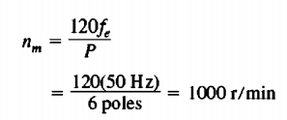
Mathematical Problem
The speed of rotation of a synchronous generator in revolutions per minute is given by Equation
Therefore,
Alternatively, the speed expressed in radians per second is

Slide 5
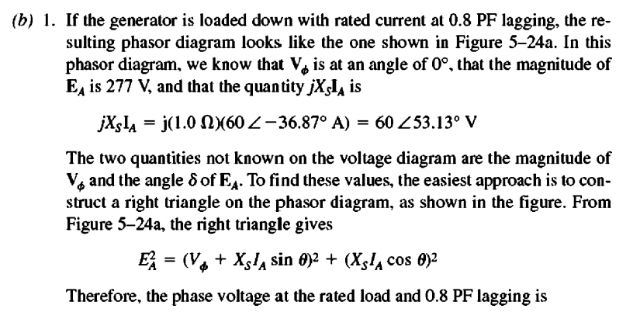
Mathematical Problem

Slide 6
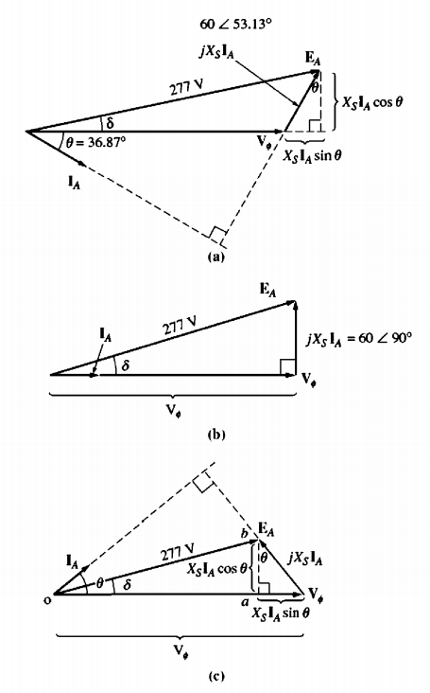
Mathematical Problem
Fig 5.24: Generator phasor diagrams for Example 5- 3. (a) Lagging power factor; (b) unity power factor;

Slide 7
Mathematical Problem

Slide 8
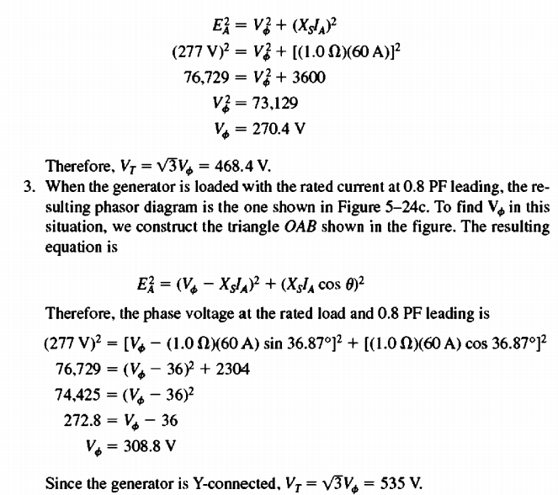
Mathematical Problem

Slide 9
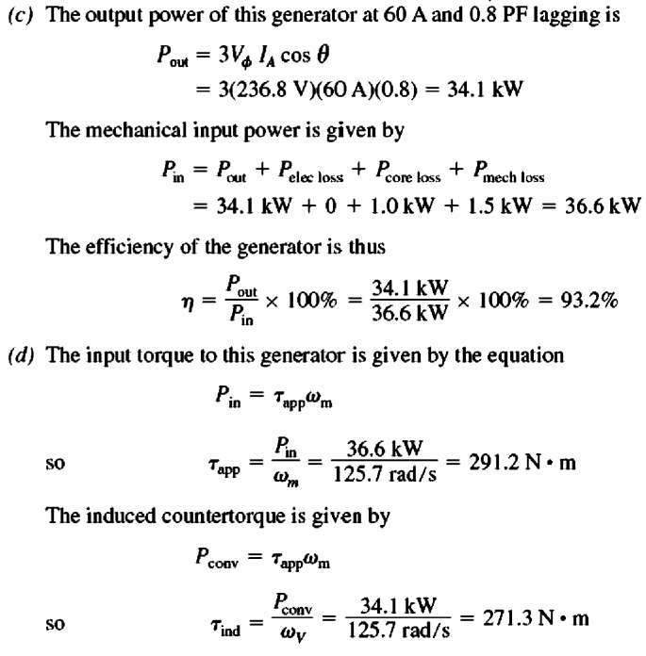
Mathematical Problem

Slide 10
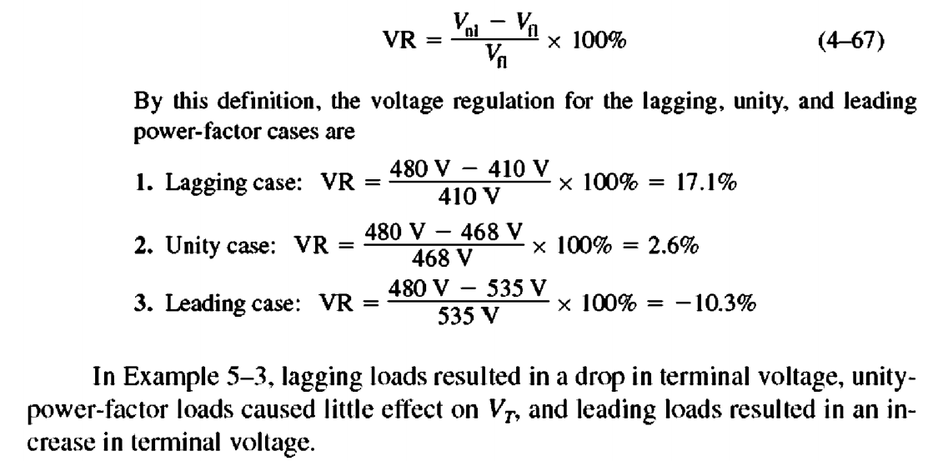
Mathematical Problem
(e) The voltage regulation of a generator is defined as

