Slide 1
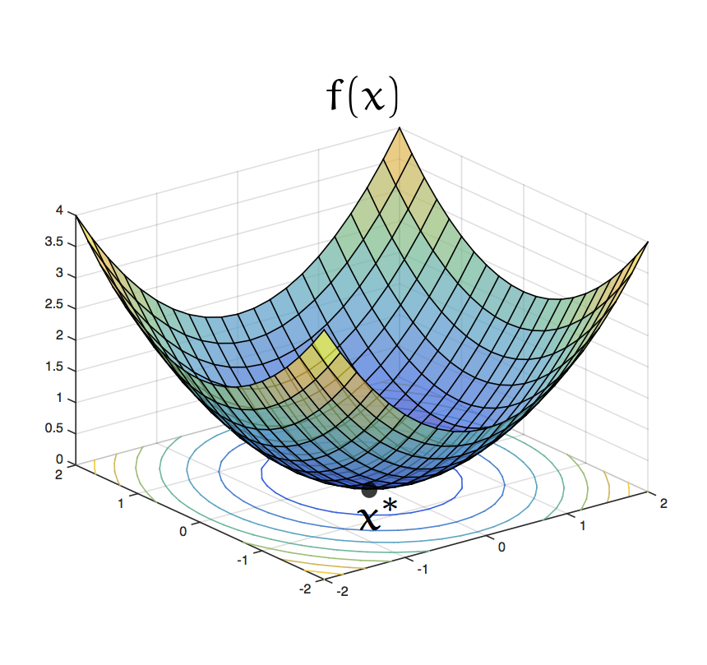
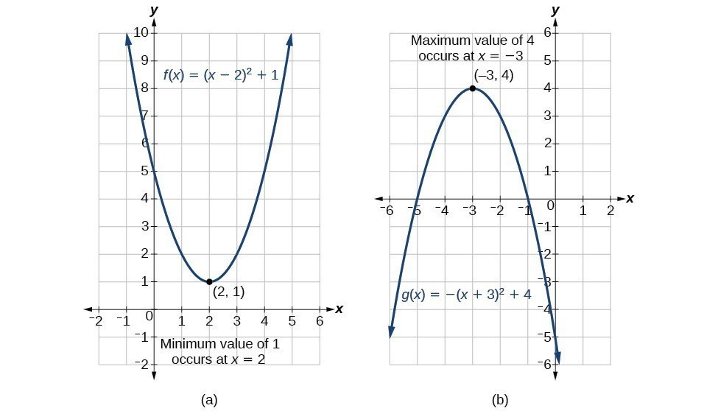
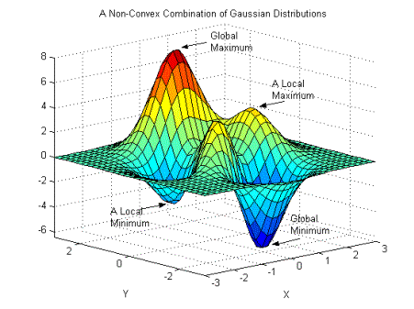

Slide 2
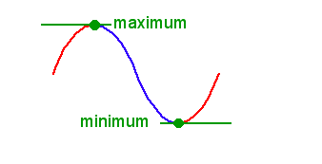
Numerical Differentiation
Part 3 : Maximum and minimum value of a Tabular function .

Slide 3
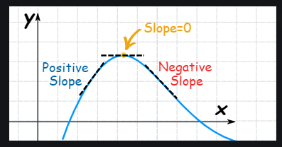
Learning Result
1. How to find out the maximum and minimum value from a tabular function .

Slide 4
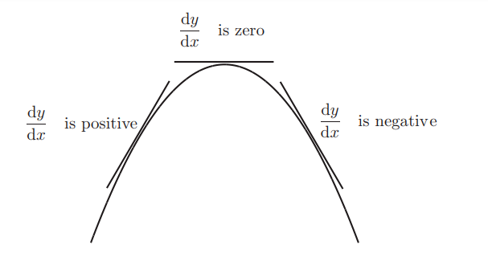

Slide 5
$\frac{dy}{dx}$ $<$ 0
$\frac{dy}{dx}$ $>$ 0
$\frac{dy}{dx}$ = 0

Slide 6
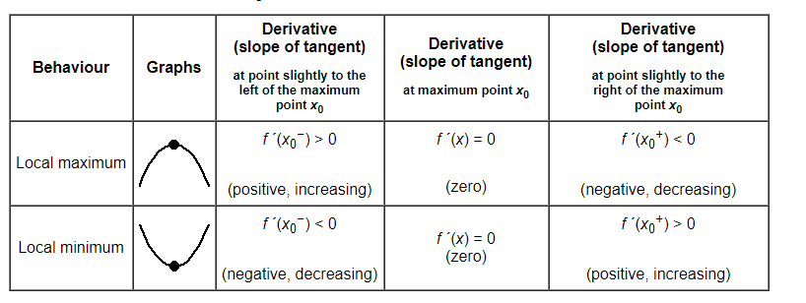
The table is of basic concept of Maxi. And mini.

Slide 7
For Mini. :
$\frac{d^{2}y}{{dx}^{2}}$ $>0$
$\frac{dy}{dx}$ = 0
$\frac{dy}{dx}$ = 0
$\frac{dy}{dx}$ = 0
For Maxi. :
y = b
$\frac{dy}{dx}$ = 0
y = b
y = b
$\frac{dy}{dx}$ = 0
$\frac{d^{2}y}{{dx}^{2}}$ $<0$
$\frac{d^{2}y}{{dx}^{2}}$ $<0$
$\frac{d^{2}y}{{dx}^{2}}$ $>0$
y = b
y = b
$\frac{dy}{dx}$ = 0
$\frac{dy}{dx}$ = 0

Slide 8
Condition of Maximum and Minimum
For Maxi. :
$\frac{d^{2}y}{{dx}^{2}}$ $<0$
$\frac{dy}{dx}$ = 0 and
For Mini. :
$\frac{dy}{dx}$ = 0 and
$\frac{d^{2}y}{{dx}^{2}}$ $>0$

Slide 9
Working Rules of Maximum and minimum

Slide 10
Working Rules of Maximum and minimum
Then
= 0 and solve this equation for x
Let its roots be $a_{1} , a_{2} , a_{3 , ……………………}$
For maximum and Minimum,
= 0

Slide 11
It becomes
And then again

Slide 12
Example:

Slide 13
Example:

Slide 14
Working Rules of Maximum and minimum
And then again
Case 1:
Case 2:
Case 1:

Slide 15
Working Rules of Maximum and minimum

Slide 16
Case 2:
Example :

Slide 18
Problem
For Example:
From the following data, find the maximum and minimum values of y.
x | 0 | 2 | 4 | 6
f(x) | 2 | 0 | -50 | -196

Slide 19
From the above table , we see the difference between of every x values are same, we can use the formula of Newton’s Forward difference .
Now we construct a newton’s forward difference table:

Slide 20
Newton’s forward Difference Table
x | f (x) | $Δ$f | $Δ^{2}$f | $Δ^{3}$f
0 | 2
 |  | -2
2 | 0 |  | - 48
 |  | -50 |  | - 48
4 | -50 |  | - 96
 |  | -146
6 | -196

Slide 21
Here,
$x_{0}$= 0 ,
$y_{0}$= 2,
$$u=\frac{x −{ x}_{0}}{h}$$
= $\frac{x −0}{2}$
= $\frac{x }{2}$ = P(x) (say)
Newton’s forward interpolation formula will be,
$$y\left(x\right)=y_{0}+u Δy_{0}+\frac{u\left(u−1\right)}{2!}Δ^{2}y_{0}+\frac{u\left(u−1\right)(u−2)}{3!}Δ^{3}y_{0}……(1)$$

Slide 22
$$y\left(x\right)=2+p (−2)+\frac{p\left(p−1\right)}{2!}(−48)+\frac{p\left(p−1\right)(p−2)}{3!}(−48)$$
$$=2−2p −24\left(p^{2} −p\right)−8p(p−1)(p−2)$$
$$=2−2p −24\left(p^{2} −p\right)−8p(p^{2}−3p+2)$$
$$=2−2p −24p^{2}+24p−8p^{3}+24 p^{2}−16p$$
$=−8p^{3}+6p+$2
$$∴y\left(x\right)$$
$=−8p^{3}+6p+$2

Slide 23
Now differentiating two times w.r.to p, we get
$$\frac{dy}{dp}=0$$
For maxima and minima,

Slide 24
When p = 0.5 then,
Therefore, y value is maximum at $p=0.5.$
So, the maximum value,
$y_{max}=− 8×\frac{1}{8}+6×\frac{1}{2}+2=−1+3+2=4$.

Slide 25
Again,
When p = - 0.5 then,
Therefore, y value is minimum at $p=− 0.5.$
So, the maximum value,
$y_{max}=− 8×\left(\frac{1}{− 8}\right)+6×\left(−\frac{1}{2}\right)+2=1−3+2=0$.

Slide 26
