Slide 1
CSE450 Data Mining
Week 2: About Data
CSEDIU
‹#›

Slide 2
What is Data?
Attributes
instanceCollection of data objects and their attributes
An attribute is a property or characteristic of an object
Examples: eye color of a person, temperature, etc.
Attribute is also known as variable, field, characteristic, or feature
A collection of attributes describe an object
Object is also known as record, point, case, sample, entity, or
Objects
CSEDIU
‹#›

Slide 3
Attribute Values
Attribute values are numbers or symbols assigned to an attribute
Distinction between attributes and attribute values
Same attribute can be mapped to different attribute values
Example: height can be measured in feet or meters
Different attributes can be mapped to the same set of values
Example: Attribute values for ID and age are integers
But properties of attribute values can be different
ID has no limit but age has a maximum and minimum value
CSEDIU
‹#›

Slide 4
Types of Attributes
There are different types of attributes
Nominal (Categorical)
Examples: ID numbers, eye color, zip codes
Ordinal
Examples: rankings (e.g., taste of potato chips on a scale from 1-10), grades, height in {tall, medium, short}
Interval
Examples: calendar dates, temperatures in Celsius or Fahrenheit.
Ratio
Examples: temperature in Kelvin, length, time, counts
CSEDIU
‹#›

Slide 5
Properties of Attribute Values
The type of an attribute depends on which of the following 4 properties it possesses:
Distinctness: = 
Order: < >
Addition: + -
Multiplication: * /
Attributes with Properties
Nominal attribute: distinctness
Ordinal attribute: distinctness & order
Interval attribute: distinctness, order & addition
Ratio attribute: all 4 properties
CSEDIU
‹#›

Slide 6
Attribute Type
Description
Examples
Operations
Nominal
The values of a nominal attribute are just different names, i.e., nominal attributes provide only enough information to distinguish one object from another. (=, )
zip codes, employee ID numbers, eye color, sex: {male, female}
mode, entropy
Ordinal
The values of an ordinal attribute provide enough information to order objects. (<, >)
hardness of minerals, {good, better, best}, grades, street numbers
median, percentiles
Interval
For interval attributes, the differences between values are meaningful, i.e., a unit of measurement exists. (+, - )
calendar dates, temperature in Celsius or Fahrenheit
mean, standard deviation
Ratio
For ratio variables, both differences and ratios are meaningful. (*, /)
temperature in Kelvin, monetary quantities, counts, age, mass, length, electrical current
CSEDIU
‹#›

Slide 7
Attribute Level
Transformation
Comments
Nominal
Any permutation of values
If all employee ID numbers were reassigned, would it make any difference?
Ordinal
An order preserving change of values, i.e., new_value = f(old_value) where f is a monotonic function.
An attribute encompassing the notion of good, better best can be represented equally well by the values {1, 2, 3} or by { 0.5, 1, 10}.
Interval
new_value =a * old_value + b where a and b are constants
Thus, the Fahrenheit and Celsius temperature scales differ in terms of where their zero value is and the size of a unit (degree).
Ratio
new_value = a * old_value
Length can be measured in meters or feet.
CSEDIU
‹#›

Slide 8
Discrete and Continuous Attributes
Discrete Attribute
Has only a finite or countably infinite set of values
Examples: zip codes, counts, or the set of words in a collection of documents
Often represented as integer variables.
Note: binary attributes are a special case of discrete attributes
Continuous Attribute
Has real numbers as attribute values
Examples: temperature, height, or weight.
Practically, real values can only be measured and represented using a finite number of digits.
Continuous attributes are typically represented as floating-point variables.
CSEDIU
‹#›

Slide 9
Important Characteristics of Structured Data
Dimensionality
Curse of Dimensionality
What is the curse of dimensionality?
Sparsity
Only presence counts
Given me an example of data that is probably sparse
Resolution
Patterns depend on the scale
Give an example of how changing resolution can help
Hint: think about weather patterns, rainfall over a time period
CSEDIU
‹#›

Slide 10
Types of data sets
Record
Data Matrix
Document Data
Transaction Data
Graph
World Wide Web
Molecular Structures
Ordered
Spatial Data
Temporal Data
Sequential Data
Genetic Sequence Data
CSEDIU
‹#›

Slide 11
Record Data
Data that consists of a collection of records, each of which consists of a fixed set of attributes
CSEDIU
‹#›

Slide 12
Data Matrix
If data objects have the same fixed set of numeric attributes, then the data objects can be thought of as points in a multi-dimensional space, where each dimension represents a distinct attribute
Such data set can be represented by an m by n matrix, where there are m rows, one for each object, and n columns, one for each attribute
CSEDIU
‹#›

Slide 13
Document Data
Each document becomes a `term' vector,
each term is a component (attribute) of the vector,
the value of each component is the number of times the corresponding term occurs in the document.
CSEDIU
‹#›

Slide 14
Transaction Data
A special type of record data, where
each record (transaction) involves a set of items.
For example, consider a grocery store. The set of products purchased by a customer during one shopping trip constitute a transaction, while the individual products that were purchased are the items.
CSEDIU
‹#›

Slide 15
Graph Data
Examples: Generic graph and HTML Links
CSEDIU
‹#›

Slide 16
Chemical Data
Benzene Molecule: C₆H₆
CSEDIU
‹#›

Slide 17
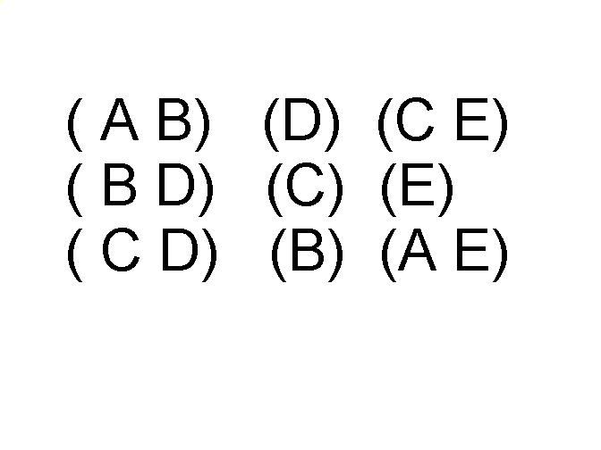
Ordered Data
Sequences of transactions
Items/Events
An element of the sequence
CSEDIU
‹#›

Slide 18
Ordered Data
Genomic sequence data
CSEDIU
‹#›

Slide 19
Ordered Data
Spatio-Temporal Data
Average Monthly Temperature of land and ocean
CSEDIU
‹#›

Slide 20
Data Quality
What kinds of data quality problems?
How can we detect problems with the data?
What can we do about these problems?
Examples of data quality problems:
Noise and outliers
missing values
duplicate data
CSEDIU
‹#›

Slide 21
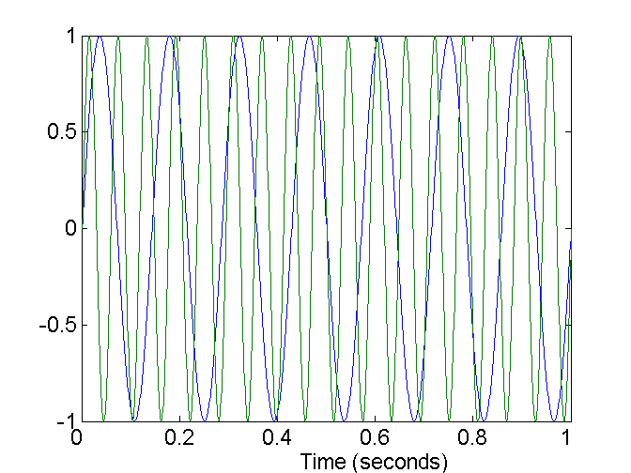
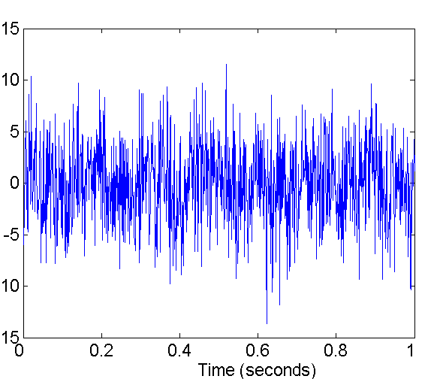
Noise
Noise refers to modification of original values
Examples: distortion of a person’s voice when talking on a poor phone and “snow” on television screen
Two Sine Waves
Two Sine Waves + Noise
CSEDIU
‹#›

Slide 22
Outliers
Outliers are data objects with characteristics that are considerably different than most of the other data objects in the data set
CSEDIU
‹#›

Slide 23
Missing Values
Reasons for missing values
Information is not collected (e.g., people decline to give their age and weight)
Attributes may not be applicable to all cases (e.g., annual income is not applicable to children)
Handling missing values
Eliminate Data Objects
Estimate Missing Values
Ignore the Missing Value During Analysis
Replace with all possible values (weighted by their probabilities)
CSEDIU
‹#›

Slide 24
Duplicate Data
Data set may include data objects that are duplicates, or almost duplicates of one another
Major issue when merging data from heterogeneous sources
Examples:
Same person with multiple email addresses
Data cleaning
Process of dealing with duplicate data issues
CSEDIU
‹#›

Slide 25
Data Preprocessing
Aggregation
Sampling
Dimensionality Reduction
Feature subset selection
Feature creation
Discretization and Binarization
Attribute Transformation
CSEDIU
‹#›

Slide 26
Aggregation
Combining two or more attributes (or objects) into a single attribute (or object)
Purpose
Data reduction
Reduce the number of attributes or objects
Change of scale
Cities aggregated into regions, states, countries, etc
More “stable” data
Aggregated data tends to have less variability
CSEDIU
‹#›

Slide 27
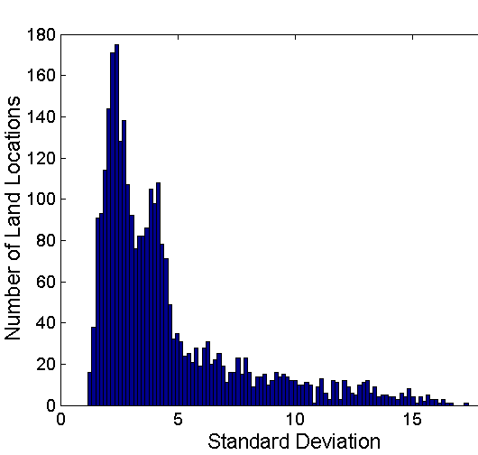
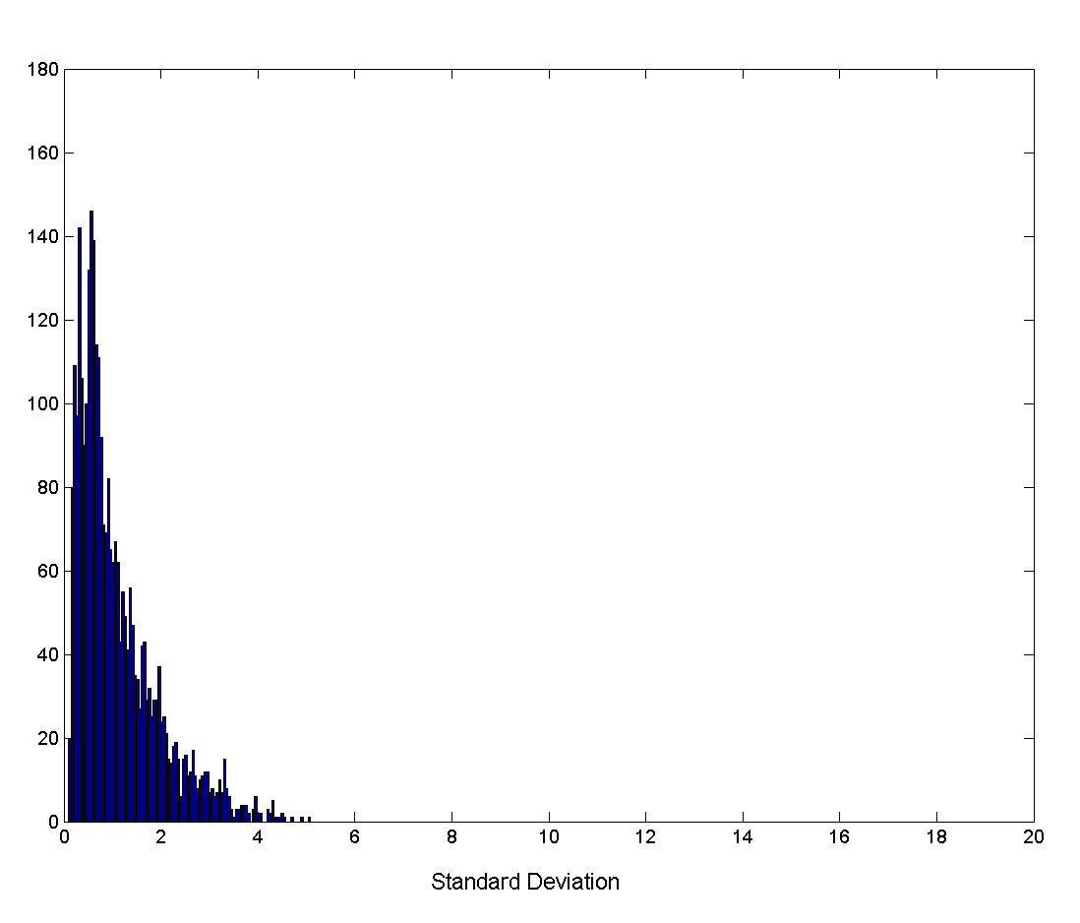
Aggregation
Variation of Precipitation in Australia
Standard Deviation of Average Monthly Precipitation
Standard Deviation of Average Yearly Precipitation
CSEDIU
‹#›

Slide 28
Sampling
Sampling is often used for data selection
It is often used for both the preliminary investigation of the data and the final data analysis.
Statisticians sample because obtaining the entire set of data of interest is too expensive or time consuming
Sampling is used in data mining because processing the entire set of data of interest is too expensive or time consuming
CSEDIU
‹#›

Slide 29
Sampling …
The key principle for effective sampling is the following:
using a sample will work almost as well as using the entire data sets, if the sample is representative
May not be true if have relatively little data or are looking for rare cases or dealing with skewed class distributions
Learning curves can help assess how much data is needed
A sample is representative if it has approximately the same property (of interest) as the original set of data
However, there are times when one purposefully skews the sample
CSEDIU
‹#›

Slide 30
Types of Sampling
Simple Random Sampling
There is an equal probability of selecting any particular item
Sampling without replacement
As each item is selected, it is removed from the population
Sampling with replacement
Objects are not removed from the population as they are selected for the sample.
In sampling with replacement, the same object can be picked up more than once
Stratified sampling
Split the data into several partitions; then draw random samples from each partition
CSEDIU
‹#›

Slide 31
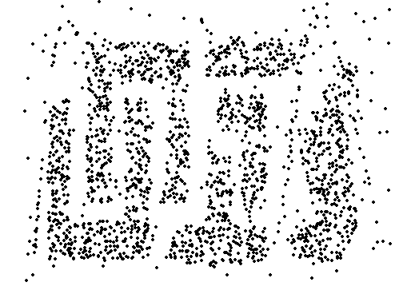
Sample Size
8000 points 2000 Points 500 Points
CSEDIU
‹#›

Slide 32
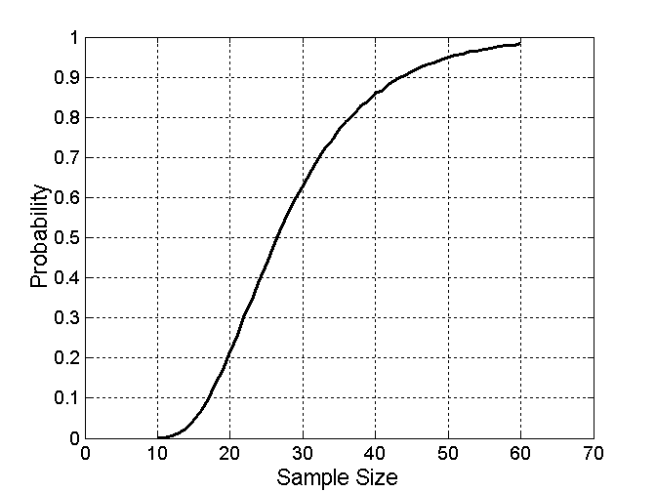
Sample Size
What sample size is necessary to get at least one object from each of 10 groups.
CSEDIU
‹#›

Slide 33
Curse of Dimensionality
When dimensionality increases, data becomes increasingly sparse in the space that it occupies
Definitions of density and distance between points, which is critical for clustering and outlier detection, become less meaningful
Randomly generate 500 points
Compute difference between max and min distance between any pair of points
CSEDIU
‹#›

Slide 34
Dimensionality Reduction
Purpose:
Avoid curse of dimensionality
Reduce amount of time and memory required by data mining algorithms
Allow data to be more easily visualized
May help to eliminate irrelevant features or reduce noise
CSEDIU
‹#›

Slide 35
Feature Subset Selection
Another way to reduce dimensionality of data
Redundant features
duplicate much or all of the information contained in one or more other attributes
Example: purchase price of a product and the amount of sales tax paid
Irrelevant features
contain no information that is useful for the data mining task at hand
Example: students' ID is often irrelevant to the task of predicting students' GPA
CSEDIU
‹#›

Slide 36
Feature Subset Selection
Techniques:
Brute-force approach:
Try all possible feature subsets as input to DM algorithm
Embedded approaches:
Feature selection occurs naturally as part of the data mining algorithm (decision trees)
Filter approaches:
Features are selected before data mining algorithm is run
Wrapper approaches:
Use the data mining algorithm as a black box to find best subset of attributes
CSEDIU
‹#›

Slide 37
Feature Creation
Create new attributes that can capture the important information in a data set much more efficiently than the original attributes
Three general methodologies:
Feature Extraction
domain-specific
Mapping Data to New Space
Feature Construction
combining features
Example: calculate density from volume and mass
CSEDIU
‹#›

Slide 38
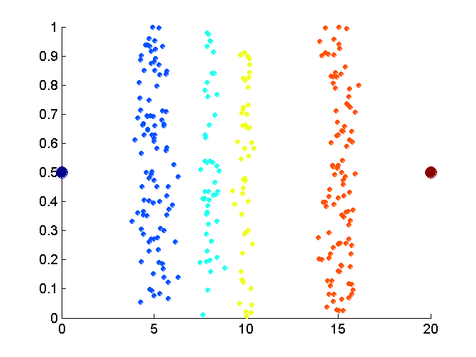
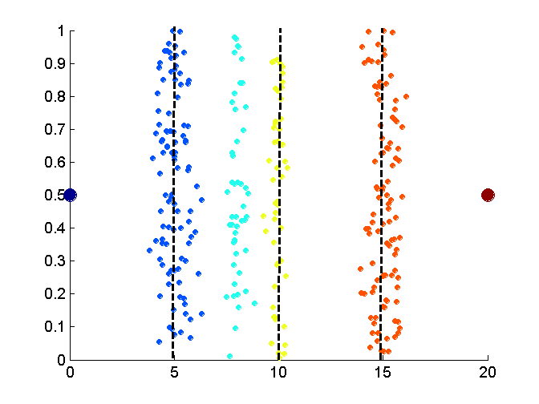
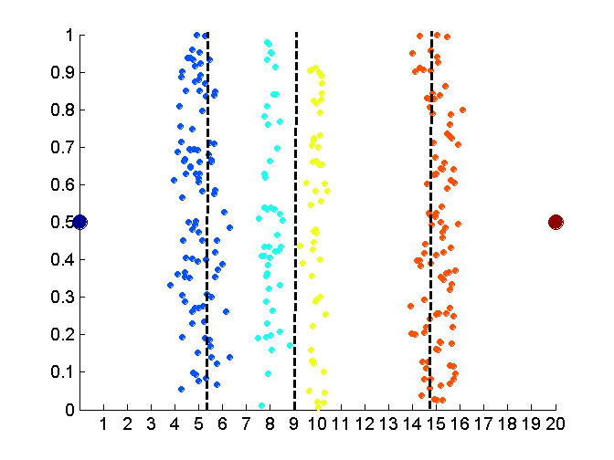
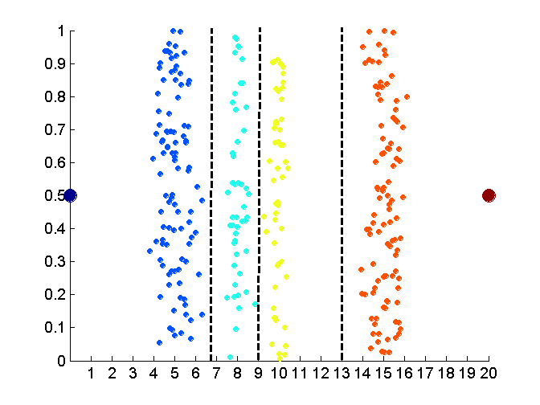
Discretization without using Class Labels
Data
Equal interval width
Equal frequency
K-means
CSEDIU
‹#›

Slide 39
Attribute Transformation
A function that maps the entire set of values of a given attribute to a new set of replacement values such that each old value can be identified with one of the new values
Simple functions: x^{k}, log(x), e^{x}, |x|
Standardization and Normalization
CSEDIU
‹#›

Slide 40
Similarity and Dissimilarity
Why might you need to measure these things?
Similarity
Numerical measure of how alike two data objects are
Is higher when objects are more alike
Often falls in the range [0,1]
Dissimilarity
Numerical measure of how different are two data objects
Lower when objects are more alike
Minimum dissimilarity is often 0, upper limit varies
Proximity refers to a similarity or dissimilarity
How would you measure these?
CSEDIU
‹#›

Slide 41
Euclidean Distance
Euclidean Distance
Where n is the number of dimensions (attributes) and p_{k} and q_{k} are, respectively, the k^{th} attributes (components) or data objects p and q.
Standardization is necessary, if scales differ.
CSEDIU
‹#›

Slide 42
Euclidean Distance
Distance Matrix
CSEDIU
‹#›

Slide 43
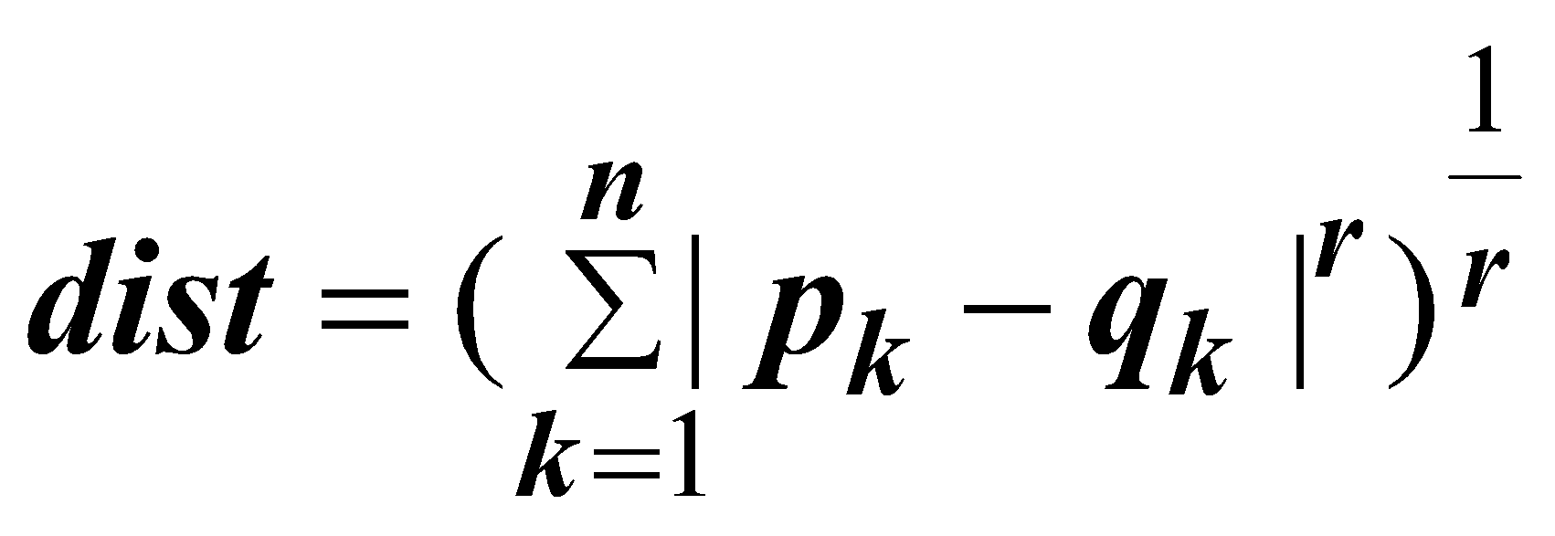
Minkowski Distance
Minkowski Distance is a generalization of Euclidean Distance
Where r is a parameter, n is the number of dimensions (attributes) and p_{k} and q_{k} are, respectively, the kth attributes (components) or data objects p and q.
CSEDIU
‹#›

Slide 44
Minkowski Distance: Examples
r = 1. City block (Manhattan, taxicab, L₁ norm) distance.
A common example of this is the Hamming distance, which is just the number of bits that are different between two binary vectors
r = 2. Euclidean distance
CSEDIU
‹#›

Slide 45
Minkowski Distance
Distance Matrix
CSEDIU
‹#›

Slide 46
Similarity Between Binary Vectors
Common situation is that objects, p and q, have only binary attributes
Compute similarities using the following quantities
M₀₁ = the number of attributes where p was 0 and q was 1
M₁₀ = the number of attributes where p was 1 and q was 0
M₀₀ = the number of attributes where p was 0 and q was 0
M₁₁ = the number of attributes where p was 1 and q was 1
Simple Matching and Jaccard Coefficients
SMC = number of matches / number of attributes
= (M₁₁ + M₀₀) / (M₀₁ + M₁₀ + M₁₁ + M₀₀)
J = number of 11 matches / number of not-both-zero attributes values
= (M₁₁) / (M₀₁ + M₁₀ + M₁₁)
Useful when almost all values are 0, since SMC would always be close to 1
CSEDIU
‹#›

Slide 47
SMC versus Jaccard: Example
p = 1 0 0 0 0 0 0 0 0 0
q = 0 0 0 0 0 0 1 0 0 1
M₀₁ = 2 (the number of attributes where p was 0 and q was 1)
M₁₀ = 1 (the number of attributes where p was 1 and q was 0)
M₀₀ = 7 (the number of attributes where p was 0 and q was 0)
M₁₁ = 0 (the number of attributes where p was 1 and q was 1)
SMC = (M₁₁ + M₀₀)/(M₀₁ + M₁₀ + M₁₁ + M₀₀) = (0+7) / (2+1+0+7) = 0.7
J = (M₁₁) / (M₀₁ + M₁₀ + M₁₁) = 0 / (2 + 1 + 0) = 0
CSEDIU
‹#›

Slide 48
Cosine Similarity
If d₁ and d₂ are two document vectors, then
cos( d₁, d₂ ) = (d₁ • d₂) / ||d₁|| ||d₂|| ,
where • indicates vector dot (aka inner) product and ||d || is the length of vector d (i.e., the square root of the vector dot product)
Example:
d₁ = 3 2 0 5 0 0 0 2 0 0
d₂ = 1 0 0 0 0 0 0 1 0 2
d₁ • d₂= 3*1 + 2*0 + 0*0 + 5*0 + 0*0 + 0*0 + 0*0 + 2*1 + 0*0 + 0*2 = 5
||d₁|| = (3*3+2*2+0*0+5*5+0*0+0*0+0*0+2*2+0*0+0*0)^{0.5} = (42) ^{0.5} = 6.481
||d₂|| = (1*1+0*0+0*0+0*0+0*0+0*0+0*0+1*1+0*0+2*2) ^{0.5} = (6) ^{0.5} = 2.245
cos( d₁, d₂ ) = .3150
A value close to 1 means the vectors are similar and a value near 0 mean they are nearly totally dissimilar.
CSEDIU
‹#›

Slide 49
Ways to Visualize Data
Data visualization tools are not Data Mining, but can be used in the data mining process
What kinds of tools are there?
Bar charts and histrograms, scatter plots, pie charts, etc.
From kdnuggets.com I found this interesting site:
http://services.alphaworks.ibm.com/manyeyes/home
CSEDIU
‹#›

