Slide 1
BER Bit Error Rate

Slide 4
BER Can be reduced by increasing SNR(Signal Power/Noise Power) that means if we
Reduce Noise we can increase SNR and Can reduce BER
Or
if we increase Signal we can increase SNR and Can reduce BER

Slide 7
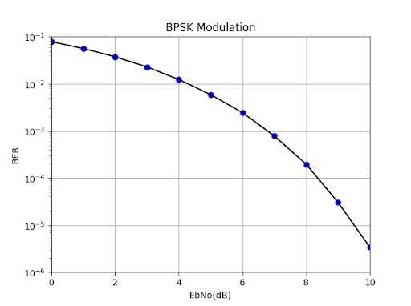
BER Vs SNR Relation (For PSK Modulation)

Slide 8
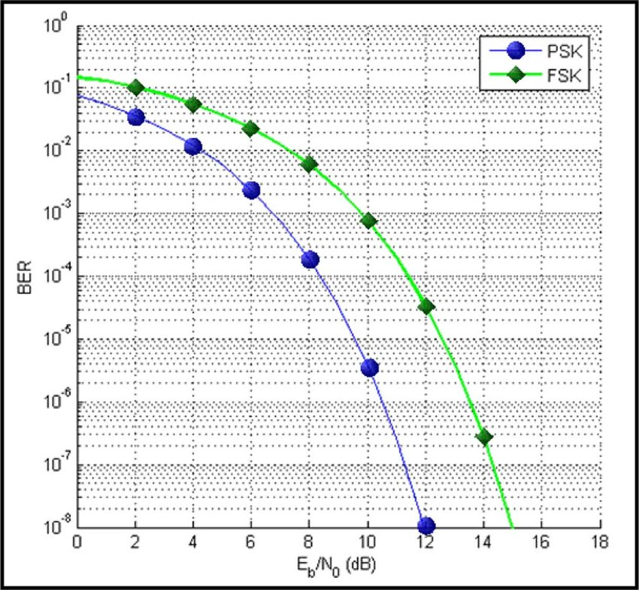
BER Vs SNR Relation (For PSK and FSK Modulation)

Slide 9
