Slide 1
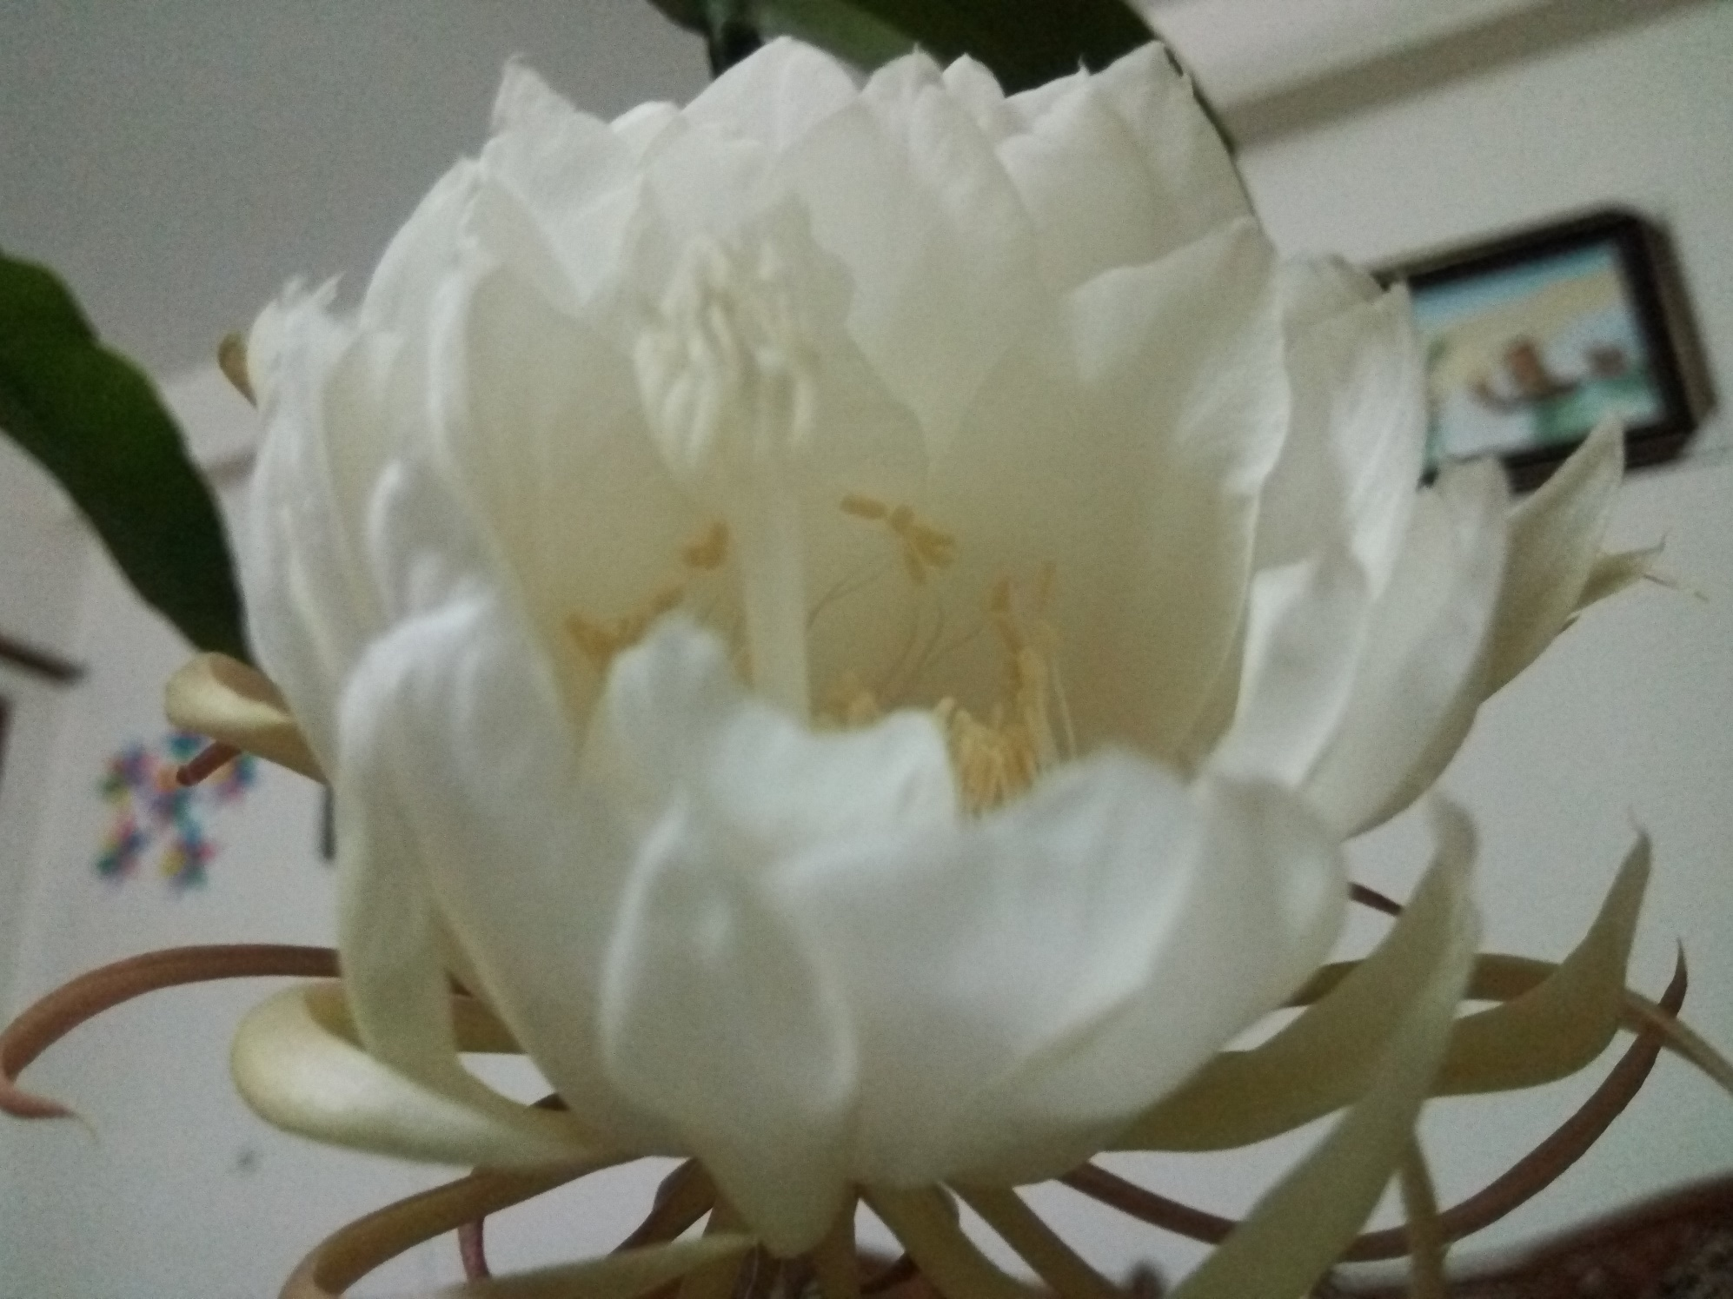
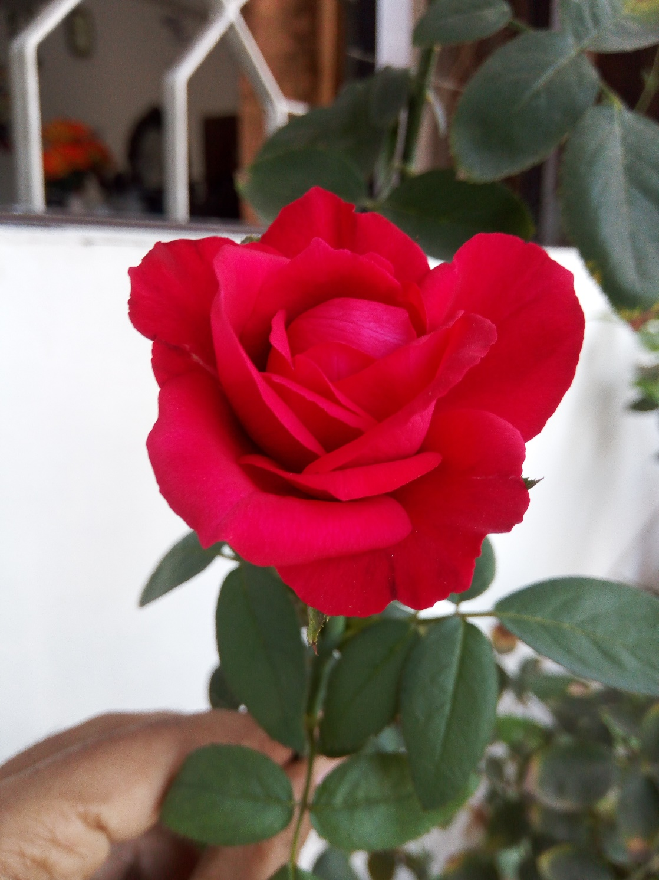
Welcome to the Introductory Class

Slide 2
One Question for You!
Why are you in here?

Slide 3
Research means???

Slide 4
Your Answer!!
Research in common parlance refers to a search for knowledge. Once can also define research as a scientific and systematic search for pertinent information on a specific topic. But some people consider research as a movement, a movement from the known to the unknown.
Redman and Mory define research as a “systematized effort to gain new knowledge” (The Romance of Research, 1923, p.10).
Leedy (1989, p.5) defines the term research from the utilitarian point of view:
Research is a procedure by which we attempt to find systematically, and with the support of demonstrable fact, the answer to a question or the resolution of a problem.
Kerlinger (1970, p. 8) uses more technical words to define it as: ‘the systematic, controlled, emphatical and critical investigation of hypothetical propositions about presumed nexus among natural phenomena’.

Slide 5
Outcomes of the Research

Slide 6
Introduction to Course
Md. Fouad Hossain Sarker
Associate Professor and Head
Department of Development Studies
Daffodil International University (DIU)

Slide 7
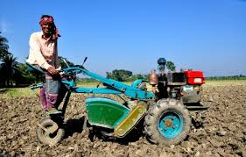
Unlock Your Potentiality!!

Slide 8
Can you define your role??

Slide 9
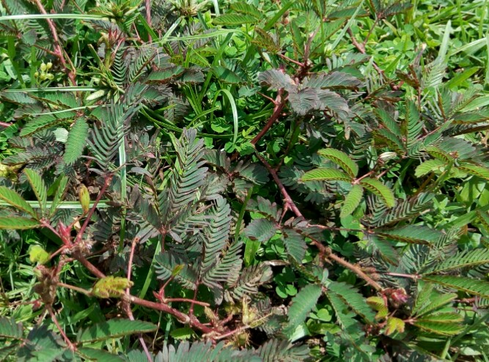
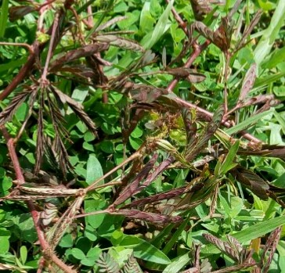
Your Role !!!

Slide 10
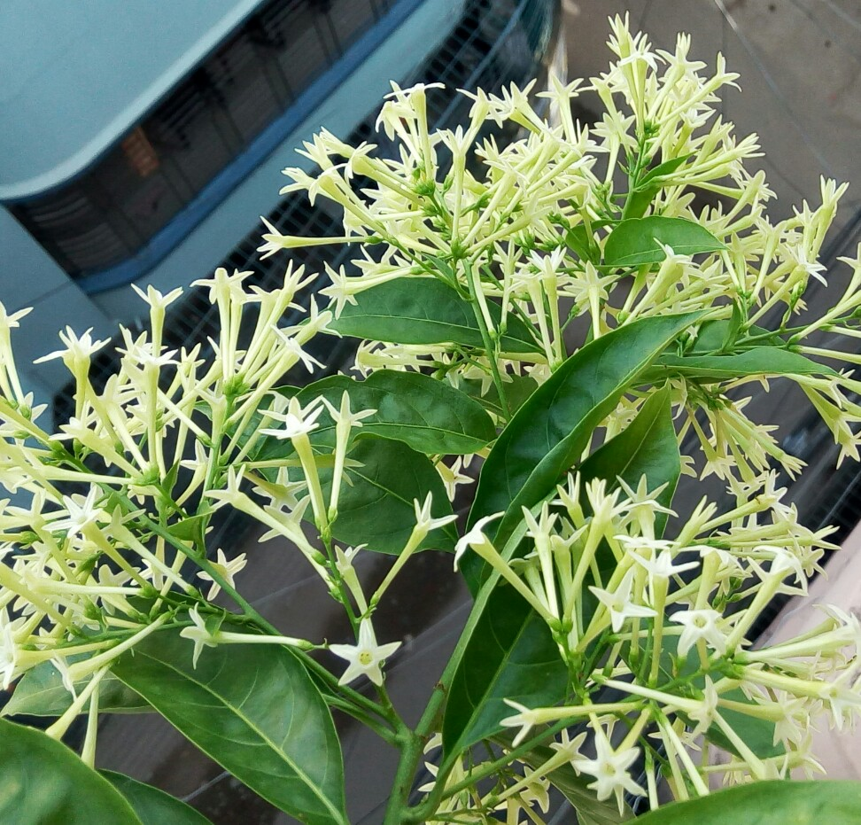
Reveal Yourself !!!!

Slide 11
Insight Values

Slide 12
Can you mention the
objectives of this session??

Slide 13
Objectives of this class
Explore the objectives of this course
Investigate the key issues of course outline
Demonstrate the course approach
Illustrate the way of teaching and learning
Analyze the rules and regulations

Slide 14
Objectives of this class
Identify some references for readings
Understand the students background and
Motivate them for future development
Signify the lecture areas and outcomes of this course

Slide 15
Student’s Observation
Mostak Ahmad 142-15-3800, Aug 8, 2015 (CSE)
First day of the 4th semester. I'm walking along the Dhanmondi 27 road. Usually, I should have a cheerful mind as after a long vacation of the semester break, I was going to meet with my beloved friends. But I didn't do so & the reason was something had been happened wrongly & this was I enrolled myself in the B section. Not because of I enrolled myself in the B section, actually, my mind was full of sorrows since in that section the Bangladesh Studies course would be taken by a Royal Bengal Tiger whose name Fouad Sarker or something else. I didn't know him but the senior brothers informed us that he is not less than as ferocious as a Royal Bengal Tiger.

Slide 16
Student’s Observation (Cont.)
The only difference between Fouad sir and Tiger uncle is, the Tiger uncle lives in the forest where Fouad sir at Daffodil varsity. After hearing this we got feared & we begged suggestion from them how we would be escaped. The senior brother's the only and the just only suggestion was not to be enrolled in the Fouad sir section. I was late as I had already enrolled myself in that section. My fearness grew little more when I had come to know to that lots of students left the section. However, nothing was to do then. I accepted my lot being compelled. I entered the class & did the whole class.

Slide 17
Student’s Observation (Cont.)
U may never believe what was my mind condition after the class. What I heard & what I had just enjoyed. What a fantastic teacher he is! What a wonderful skill to take a class he possesses! I really surprised. I have never seen such kind of ideal teacher in my life before. From the first class , he went to my heart. Nothing is constant in the earth. Beginning is the pre-alarm of the ending. In this flow today I'm going to attend to my last class of Bangladesh Studies. Same to the first class, I'm walking along the Dhanmondi 27 road.

Slide 18
Student’s Observation (Cont.)
But today I'm really feeling lucky to have such kind of teacher ' Fouad Sarker '. In my life I never forget him. He is not only a good teacher, his teaching technique is not only awesome , rather his attitude , his punctuality, his manner , specially his smile attract me most. I not only learn about my course from him , but learn how to possess a good personality , how to be a good human being.
At the last, I can proudly say that Bangladesh Studies teach me more than the course. I will really miss Bangladesh Studies... I will really miss Fouad Sir....

Slide 19
Insight Objective
What do you understand from the above picture?

Slide 20
Your Answer!
A
little
drop
of
water
makes
a
mighty
ocean.
A little drop of water makes a mighty ocean.

Slide 21
Why do you need to carry on your journey with this course??

Slide 22
Objectives of this Course
Attain a comprehensive knowledge, theoretical perspectives, research design and holistic understanding of research approaches to conducting social research in the pragmatic world.
Comprehend different methods, techniques of research conduction in the writing of research proposal, picking off proper methodology, data collection and fieldwork, sampling designs, strategies of analyzing results and writing up a research report.
Build-up depth understanding of theoretical approaches, comparative and critical analysis of literature to resolve challenges in the arena of social sciences.
Develop appropriate strategies of data analysis and learn different types of analysis techniques through ethical consideration.
Assist in developing experts in the areas of social sciences research and applying their understandings, skills through supervision and research project outcomes evaluation through different software packages.

Slide 23
PLOs aligned with the Course
PLO3 | Problem Analysis | Identify, formulate, research the literature and analyze complex developmental challenges faced by both the developing and developed world.
PLO7 | Social Research | Apply appropriate social research methods, tools and techniques and design and conduct own research in the selected domains of interest
PLO12 | Ethics and Morality | Uphold highest standards of ethics and moral code both in professional and personal life

Slide 24
Lecture Plans
Topic:1 Introduction to Course
Topic :2 Basic Foundation of Scientific Research
Topic : 3 Writing a Research Proposal/ Research Design
Task: Class Test/Assignment-1 and Review of the Previous Syllabus
Topic: 4 Statement of the Problem, Setting Research Objectives and Questions
Topic: 5 Literature Review and Criticism
Topic-6 Referencing and Avoiding Plagiarism
Task: Class Test/Assignment-2 and Review of the Previous Syllabus and Presentation
Midterm Examination

Slide 25
Lecture Plans
Topic-7 Paraphrasing and Avoiding Plagiarism
Topic-8 Research Methodology (Quantitative, Qualitative, and Mixed)
Topic-9 Qualitative Data Collection Methods (Part-1)
Topic-10 Qualitative Data Collection Methods (Part-2)
Topic-11 Writing Research Methodology Section and Research Ethics
Task: Class Test/Assignment-3 and Review of the Previous Class
Topic-12 Analyzing Data and Writing Result, Discussion, Conclusion and Implication
Final Examination

Slide 26
Course Approach
The approach of this course highly imparts the neutral or rational tone to streamline the goal and ensure minimal academic jargon. Moreover, this course avoids all sorts of non-judgmental manners that impede to understand the insight values and facts of Bangladesh.

Slide 27
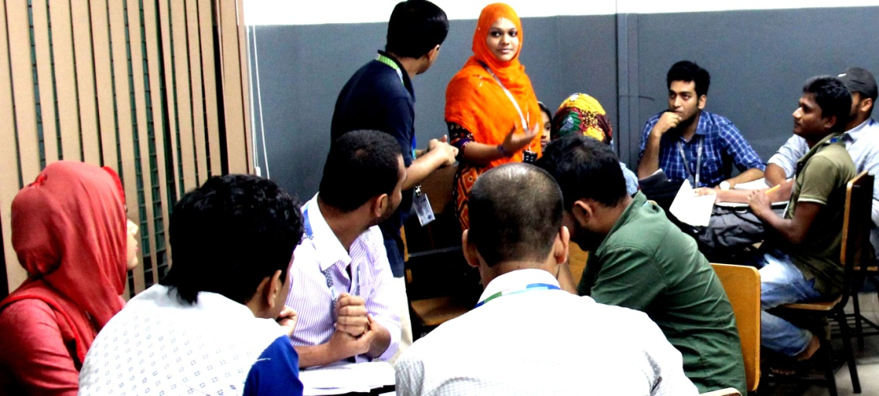
Methods of Teaching & Learning
Teaching will cover the areas of lectures, power point presentations, participative discussions and problem solving. Students are highly encouraged to participate in discussion and problem solving sessions. Active participation in the class will carry credit. On the other hand, Group study/Team work/Peer study method will be followed for better understanding.

Slide 28
Rules and Regulations
Students must wear DIU ID for entering the classroom
Active participation in both physical and digital will be encouraged
60% Class attendance is mandatory for assessing course teacher
University rules and regulations will be followed very strictly
Students must keep silence their mobile phone during the class
No dress code but have to ensure decency
Neat and clean and ensure rational manner in everywhere
If anyone miss any CT Exam, submission their assignment/ presentation in time, never give them any opportunity for future

Slide 29
Marks Distribution
S/N | Distribution Area | Marks
1 | Class Attendance | 07/05
2 | Quiz/ Class Test | 15/10
3 | Midterm Exam | 25/20
4 | Presentation | 08/10
5 | Assignment | 05/15
6 | Final Exam | 40/40

Slide 30
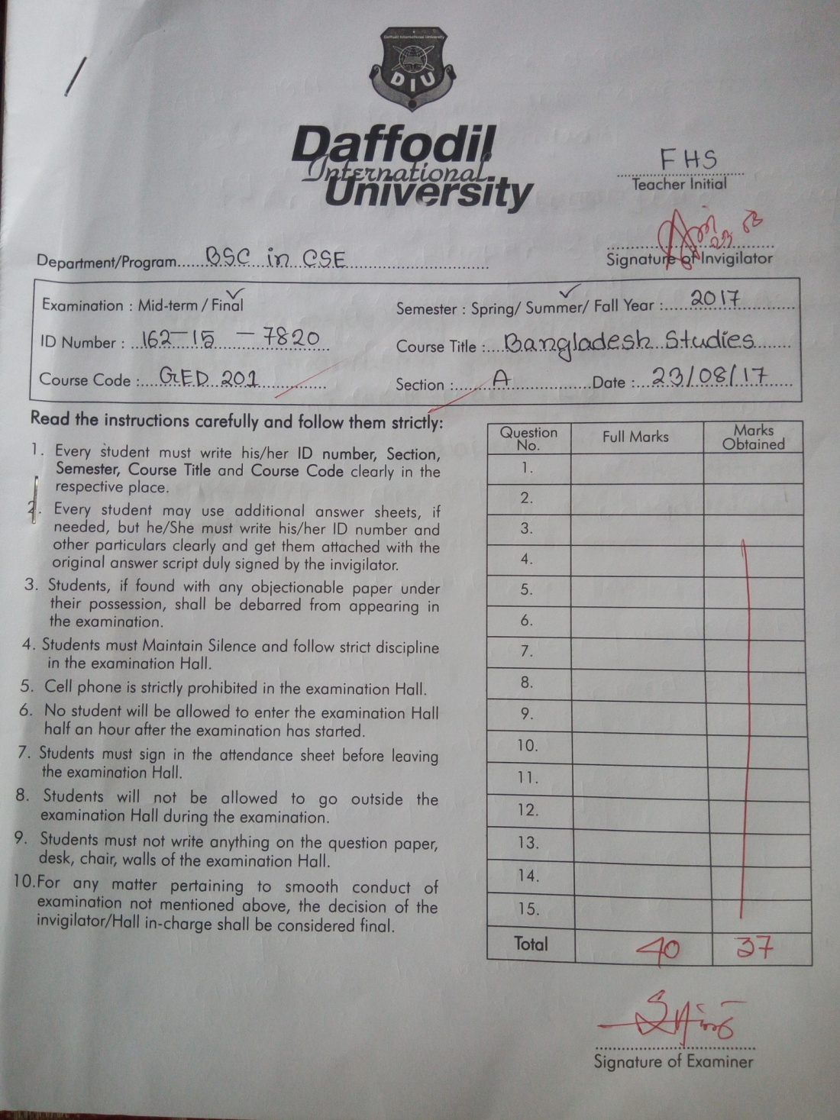
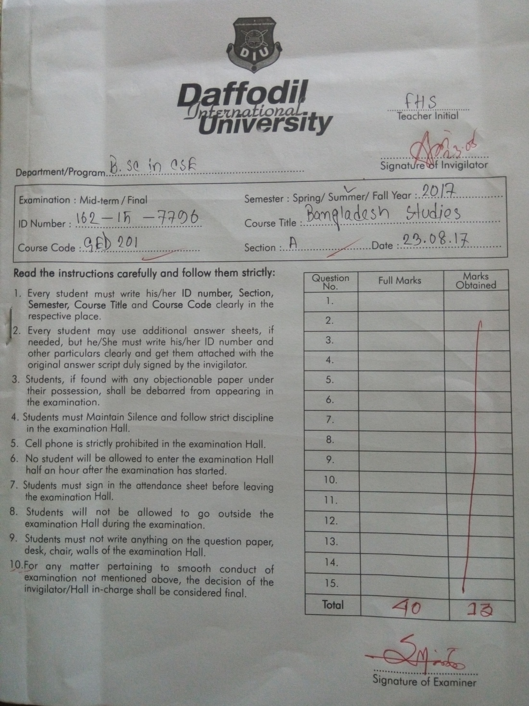
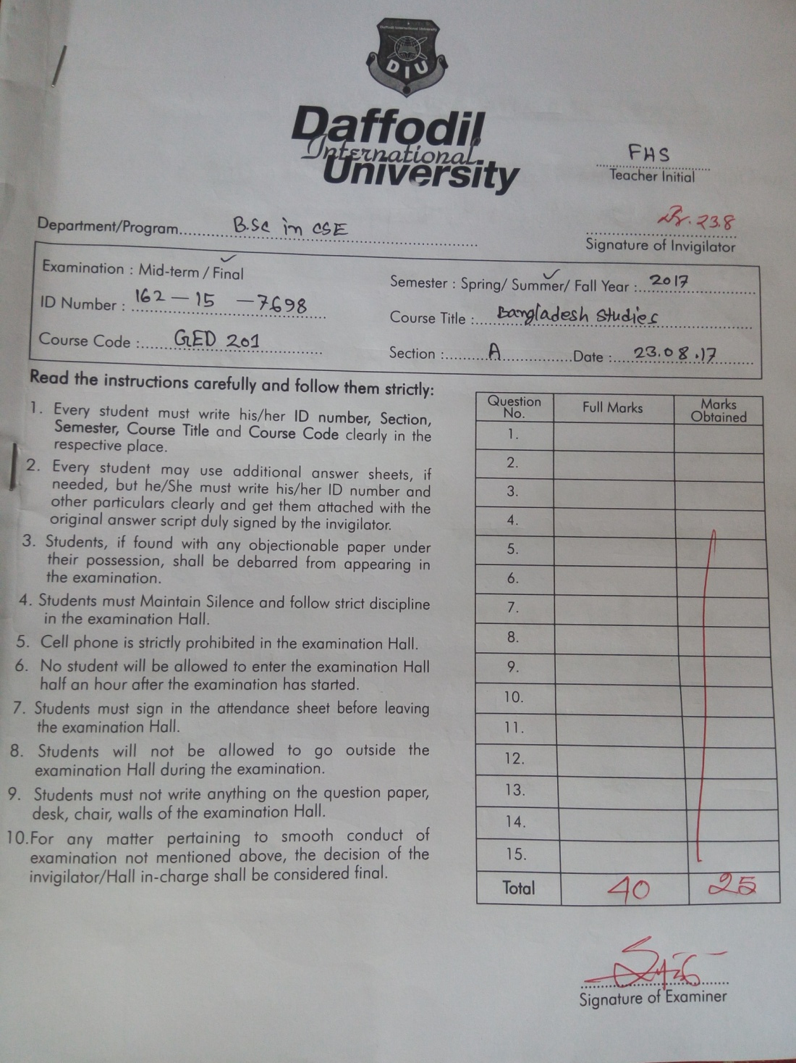
Answer Scripts !!

Slide 31
Reference Books
Aminuzzaman, S. M. (2011). Essentials of Social Research. Osder Publications.
Atkinson, P., Coffey, A. et al. (2003). Key Themes in Qualitative Research: Continuities and Changes. California, AltaMira Press.
Atkinson, P. and M. Hammersley (1994). Ethnography and Participant Observation. Handbook of Qualitative Research. N. K. Denzin and Y. S. Lincoln. Thousand Oaks, Sage: 248–261.
Blaxter, L., C. Hughes, et al. (2001). How To Research? Buckingham. Philadelphia, Open University Press.
Bryman, A. (1988). Quantity and Quality in Social Research. London, Unwin Hyman.
Bryman, A. (2008). Social Research Methods. Oxford Oxford University Press.
Corbetta, P. (2003). Social Research: Theory, Methods and Techniques. London, Thousand Oaks.New Delhi, Sage Publications.
Creswell, J. W. and V. L. P. Clark (2007). Designing and Conducting Mixed Methods Research. Thousand Oaks, London. New Delhi, Sage Publications.

Slide 32
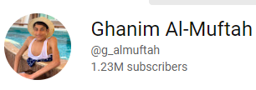
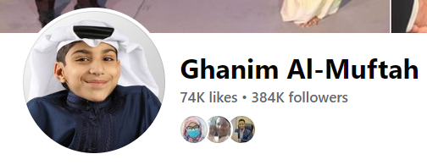
Unleashing Incredible Potential with a Mentor
Please Visit: https://youtu.be/zQSOFSsnE9w

Slide 33
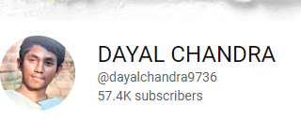
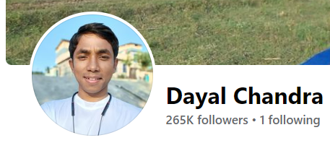
‘Talent is Nothing Without Hard Works’-Dayal Chandra
‘
Please Visit: https://www.youtube.com/watch?v=MN_msjj5nsM
https://www.youtube.com/watch?v=uogUizAgSmA
https://youtu.be/fJjKkTgYQf0
https://www.youtube.com/watch?v=jZs6YTs6Y9I
https://www.youtube.com/watch?v=WrJyVsXfQ6I
Faccbook: https://www.facebook.com/dayalchandra01

Slide 34
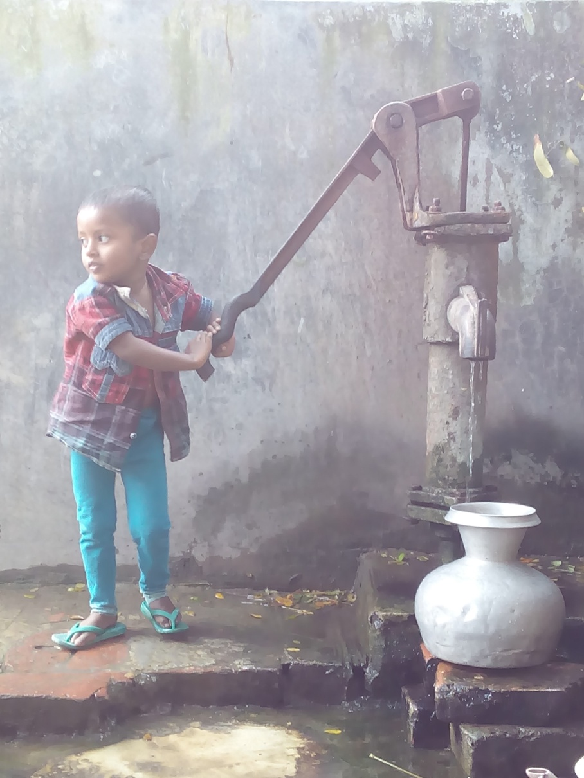
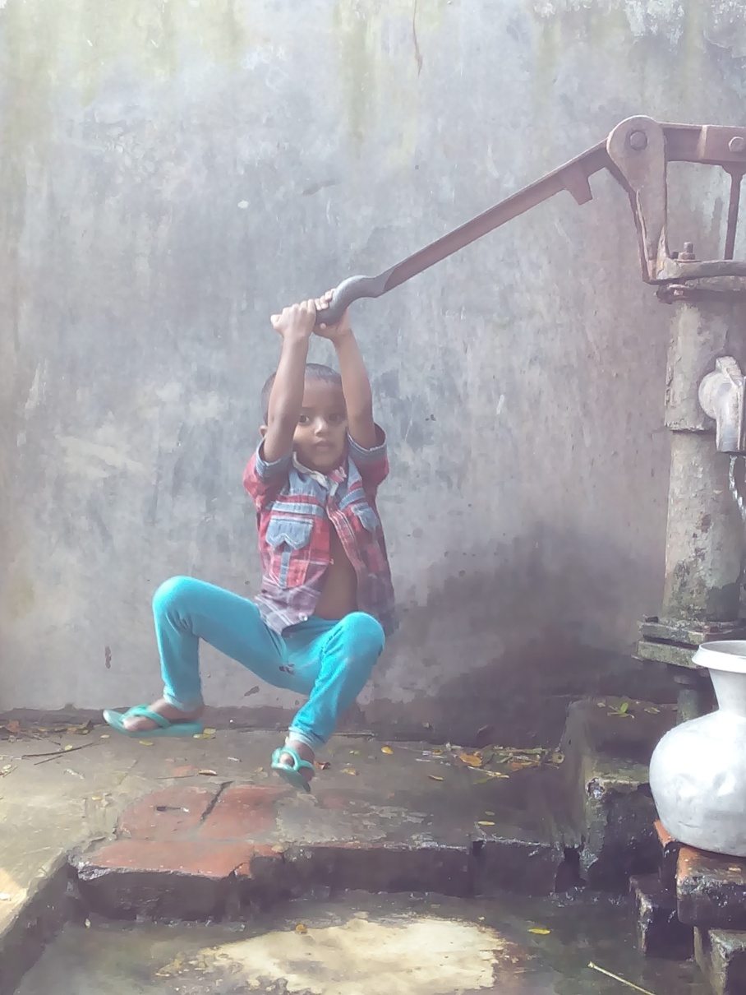
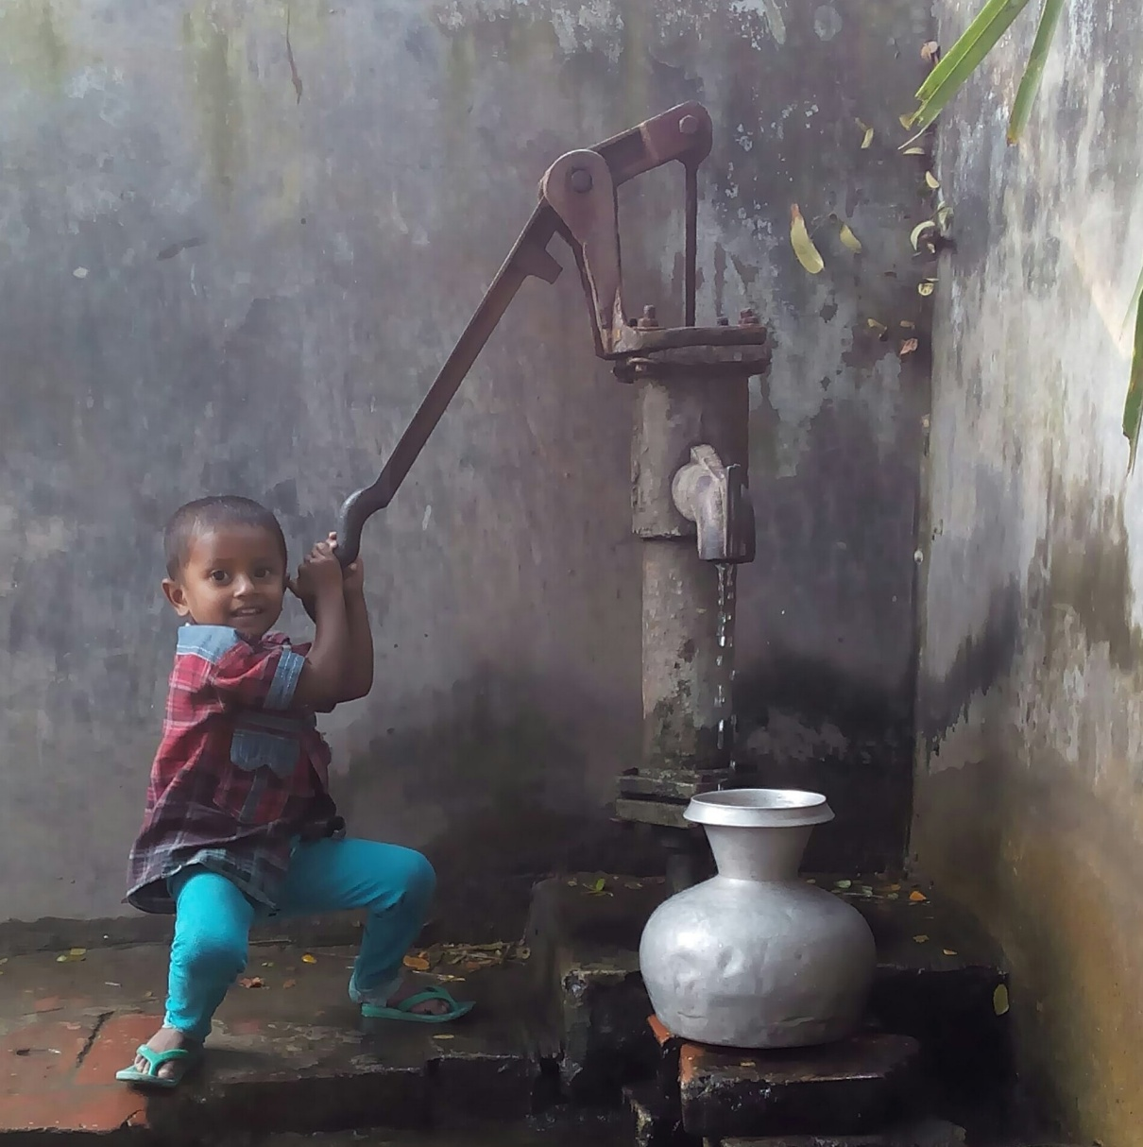
Come out of the Box

Slide 35
Approaching for Future Development
How to develop yourself? Your Commitment/passionate
Area of Development: Knowledge of English, IT, Smartness, and be Communicative
Never demean yourself, Philosophy: just make or mar
We have to love ourselves with all our heart and with all our soul and with all our mind and with all our strength.

Slide 36
Career Development Discourse
Avoiding most common mistakes in English
Use of capital letter
Use of auxiliary verb
Use of s/es
Use of article
Use of many/much/some /amount/number etc.
Spelling and finally
Organization of a sentence

Slide 37
Feedback
Q1: What do you think about our today’s class?
Q2: Can you assess this class? Is it participatory oriented?
Q3: Give your suggestions for making classroom very active.
Please answer through: gg.gg/fhsfeedback
Thank you all with the journey of Bangladesh Studies

