Slide 1
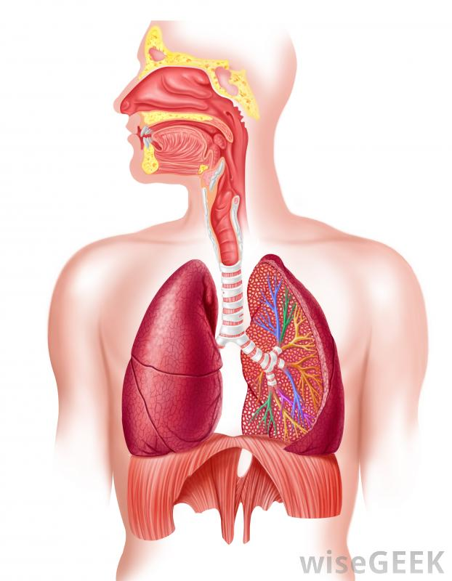
Respiratory system

Slide 2
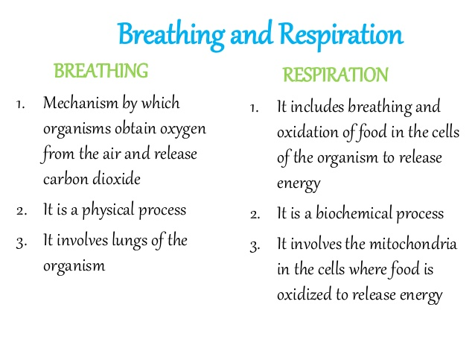

Slide 3
Respiration
A physiological process which means the transport of oxygen from atmosphere to the body cell for oxidation of the ingested food materials and elimination of carbon dioxide and other volatile metabolic end products from the cell to the atmosphere.
Types:
Rates: 10-18 per minute

Slide 4
A.

Slide 6
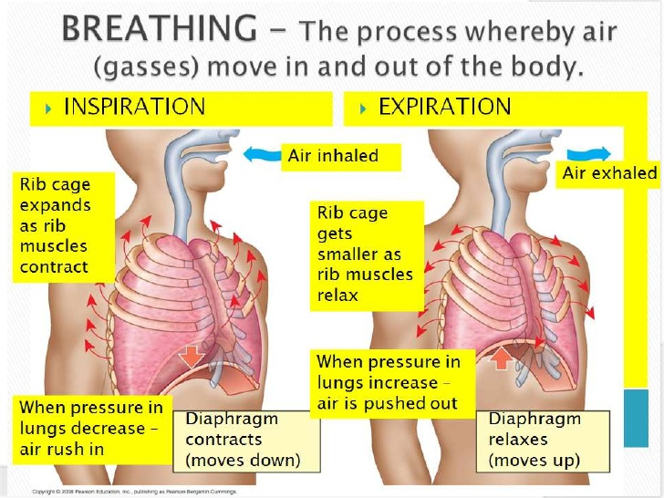
1. Pulmonary ventilation Inspiration and Expiration

Slide 7
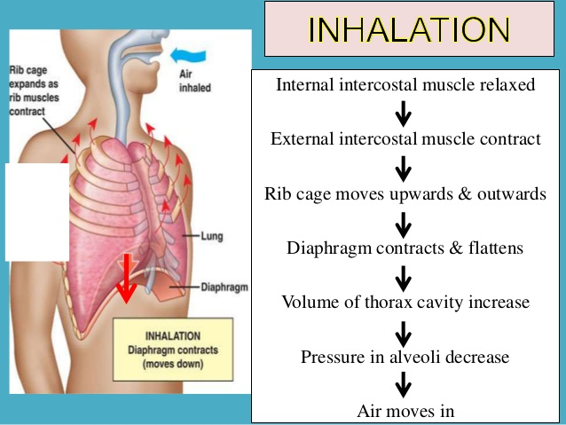
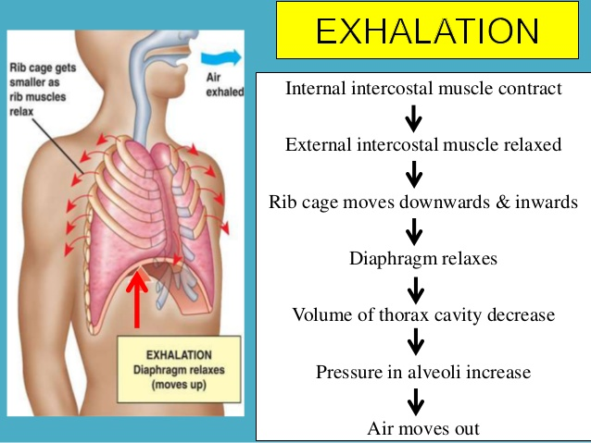

Slide 8
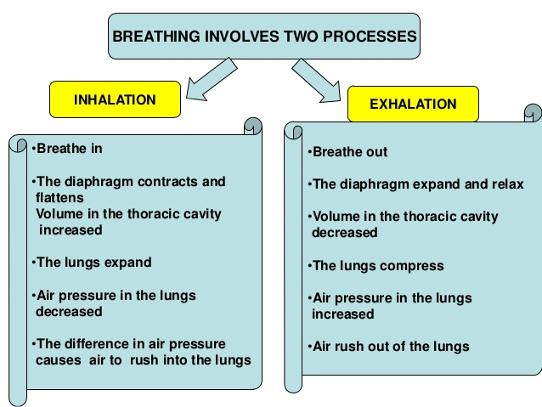

Slide 9
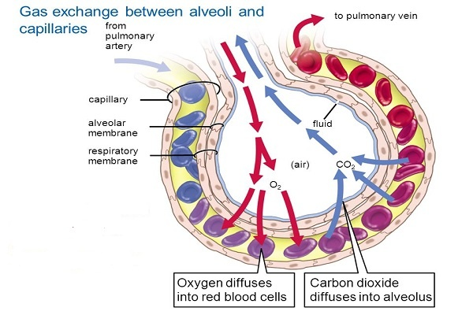
2.

Slide 10
Types

Slide 11
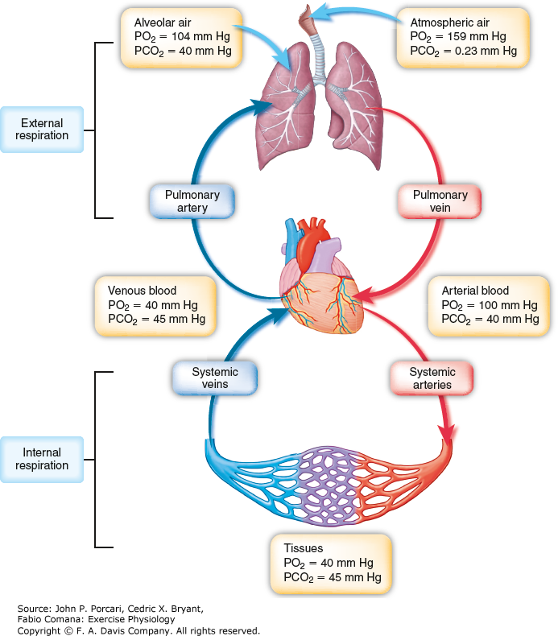

Slide 12
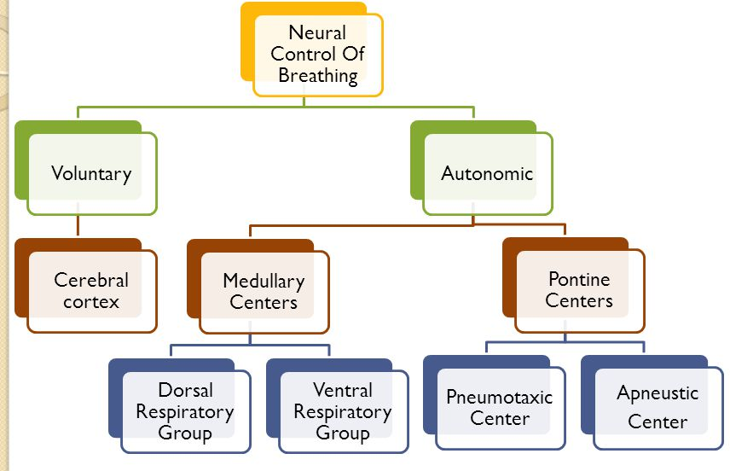
Control inspiration
Control force expiration
Control rate and pattern of breathing
Controls the intensity of inspiration.

Slide 14
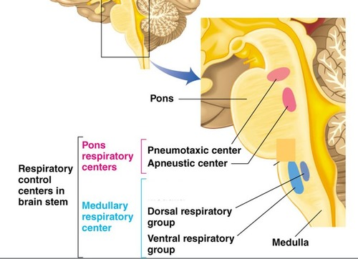

Slide 18
Oxygen transport mechanism
In the lungs, oxygen diffuses from alveolar air into the blood because the venous blood has a lower partial pressure.
The oxygen dissolves in the blood. Only a small amount is carried as a physical solution (0.31 ml per 100 ml). The remainder of the oxygen is carried in chemical combination with the hemoglobin in red blood cells .
Hemoglobin (molecular weight of 68,000) is made from 4 hemes, a porphyrin ring containing iron and globin, a 4 protein chains. Oxygen is bound to the iron for the transport process.
HHb + O2 <=======> HbO2 + H+
Oxyhemoglobin can be caused to release oxygen by the addition of H⁺ ions at the cells. The difference in pH (7.44) of arterial blood and venous blood (pH = 7.35) is sufficient to cause release of oxygen from hemoglobin at the tissue cells.

Slide 21
Carbon dioxide transport mechanism
Carbon dioxide produced in the tissue cells diffuses into the blood plasma.
The largest fraction of carbon dioxide diffuses into the red blood cells. The carbon dioxide in the red blood cells is transported as: dissolved CO₂, combined with hemoglobin, or as bicarbonate,(largest fraction).
The formation of bicarbonate ions, (HCO₃⁻ ) takes place by the following reactions:
Hydration of CO₂: CO₂ + HOH ⬄ H₂CO₃ Dissociation of H₂CO₃: H₂CO₃ ⬄ H⁺ + HCO₃⁻
Bicarbonate diffuses out of the red blood cells into the plasma in venous blood and visa versa in arterial blood.
The change in pH in arterial blood caused by the diffusion of CO₂ out of the blood into the lungs.

Slide 22
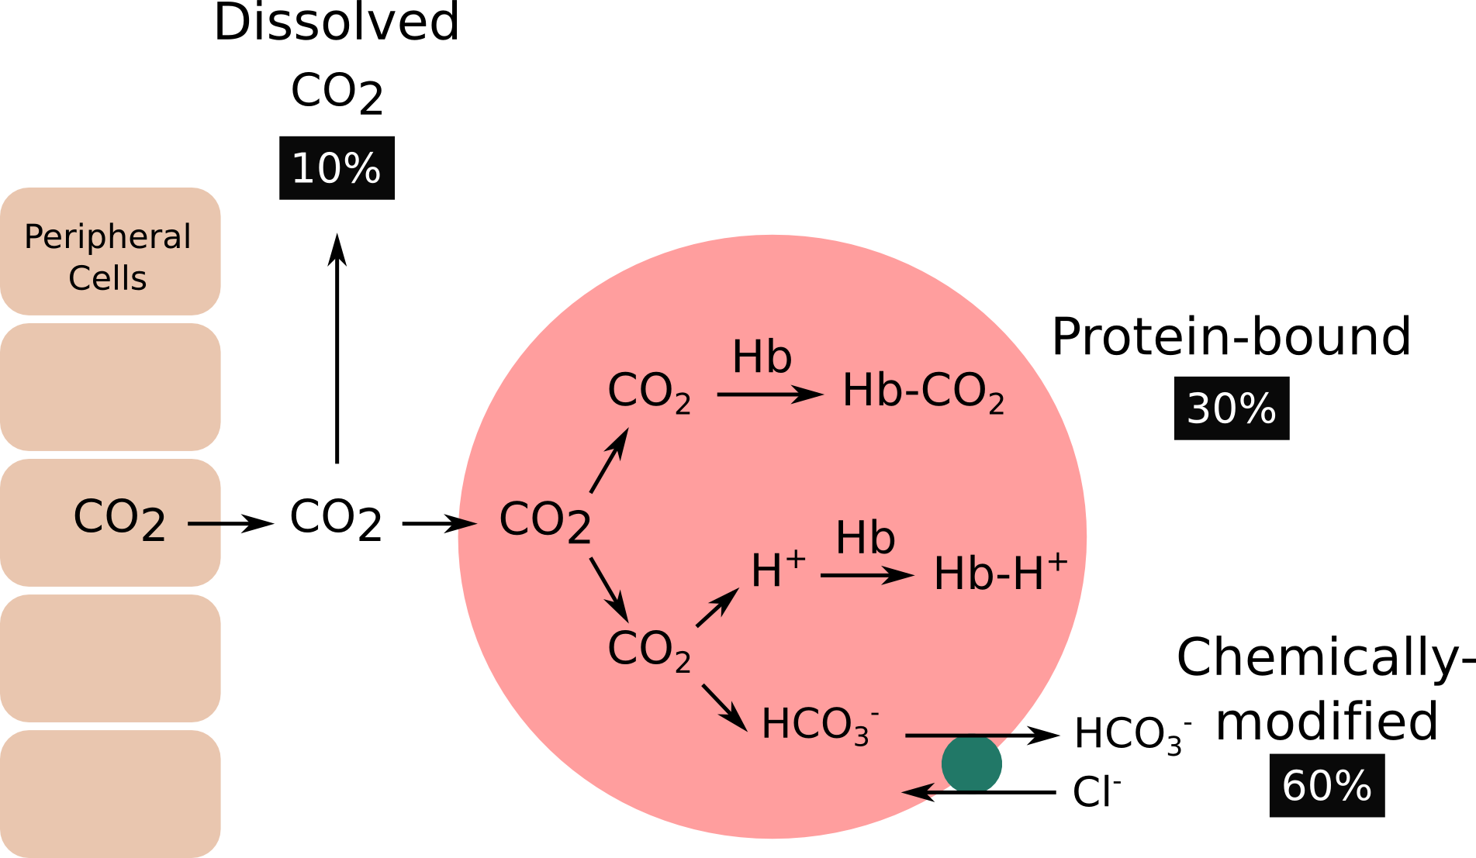

Slide 23
TYPES

