Slide 1
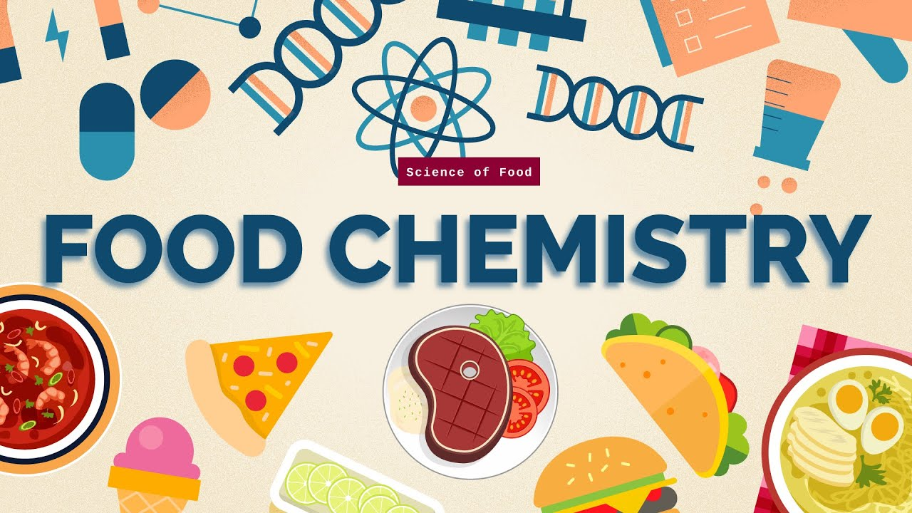
Food Chemistry 0711-2101
DEPARTMENT OF NUTRITION & FOOD ENGINEERING
DAFFODIL INTERNATIONAL UNIVERSITY

Slide 2
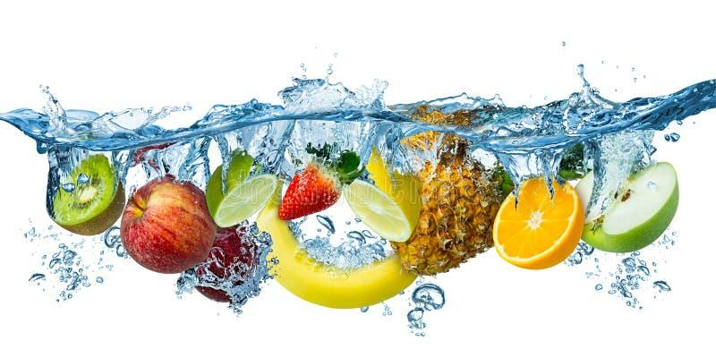
Today’s topic
Water

Slide 3
Lecture objectives
To learn about:
Water, its importance, dietary requirements and sources
Structure, physical properties of water
Phase diagram of water
Types of water
Interaction of Water with Food Components
Effect of Water on Food Stability (water activity, phase transition and WLF equation)

Slide 4
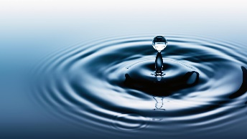
WATER
Water is relatively small inorganic molecule, but organic life is highly dependent on this tiny molecule. It is the only substance on the earth that occurs abundantly in all three physical states (gas, liquid and solid).
Water is essential for life as:
(1) regulator of body temperature
(2) solvent
(3) carrier of nutrients and waste products
(4) reactant and reaction medium
(5) lubricant and plasticizer
(6) stabilizer of biopolymer conformation
(7) facilitator of the dynamic behavior of macromolecules (e.g. catalytic activity)

Slide 5
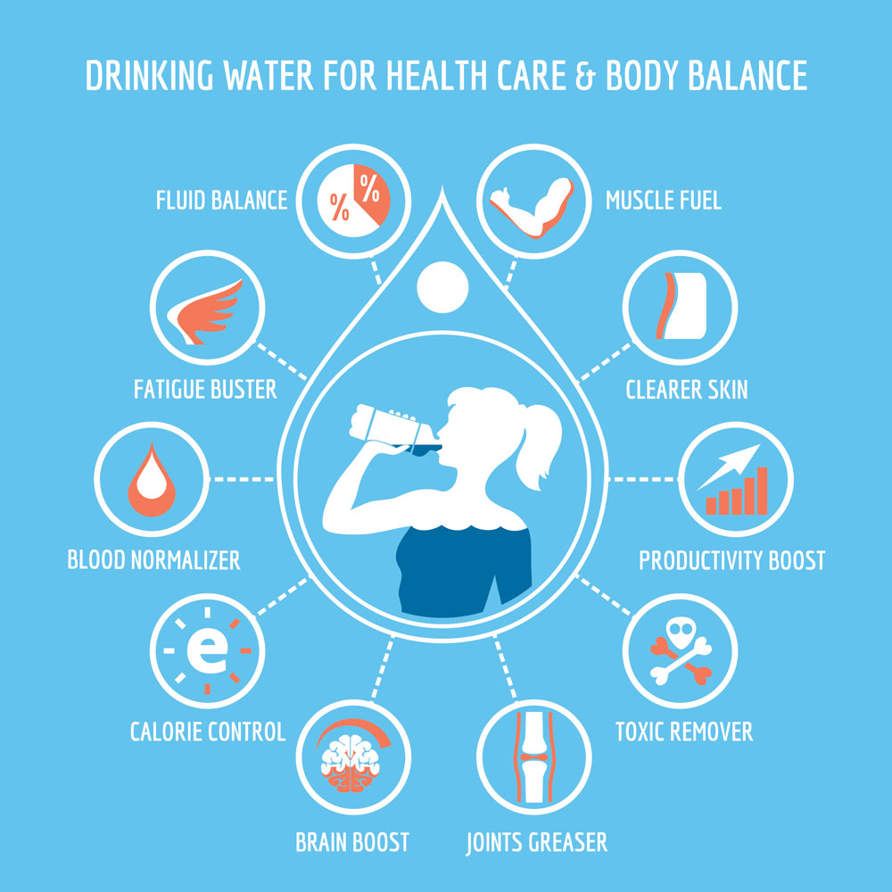
Role and Function of Water in Biological Systems
Water is essential to sustain life in every living organism. Living species contain water as much as 60 to 95% of their total weights. In the case of human beings, about two-thirds weight of the body is water. All the organs, tissues and fluids contain water as a constituent. Only a few parts of the body such as teeth, bones and hair contain very little water. Water, unlike other nutrients, does not undergo any chemical change in the body. It functions mainly as a carrier of nutrients and waste products, as a solvent to dissolve solutes, as a liquid medium for biochemical reactions and to form colloidal suspensions, as a stabilizer of biopolymer conformation and as a determinant of protein activity.

Slide 6
Dietary Requirements of Water
Water is continuously lost from the body in the form of sweat, urine and faeces. Hence replacement of water is necessary continuously. The main sources of water are food and drink. Some nutrients on oxidation in the body produce water, e g. one kg of glucose gives about half-a-litre of water. The amounts of intake and loss of water per day in an adult are shown in Table.
Table: Water intake and loss in human body

Slide 7
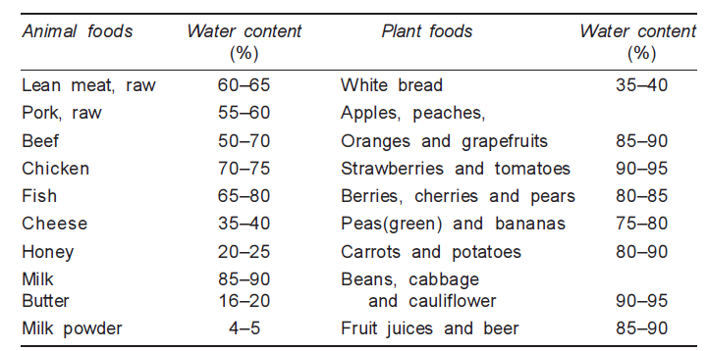
Dietary Sources of Water
Water is the main constituent of most foods. The presence of water in optimal amount is necessary for viability of biological systems and preserving the quality of foods. Each food has its own characteristic water content. The water contents of a few types of foods are shown in Table.
Table: Water content in various food

Slide 8
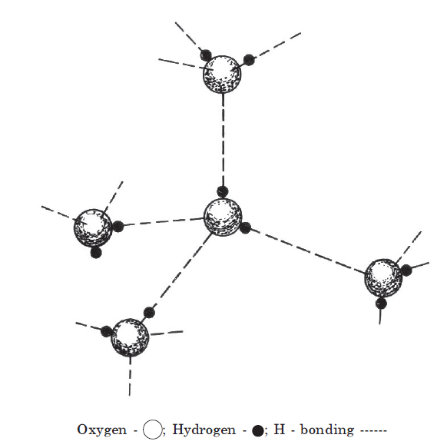
Structure of Pure Water and Ice
The unusual properties of water are attributed to hydrogen bonding The V-shaped structure of water molecule and the polarized nature of the O-H bond result in association of water molecules through intermolecular H-bonding. Each water molecule is H-bonded with a maximum of four other water molecules in a three-dimensional tetrahedral arrangement, as shown in Figure. Extra energy is thus needed to break the intermolecular bonding resulting in larger values of physical constants. Water, with its tetrahedrally directed forces, crystallizes in a Hexagonal tightly packed (HCP) structure. Ice exists in 11 crystalline polymorphic and also in an amorphous or vitreous state. However, the hexagonal ice is stable under normal pressure at 0°C.
Figure: Structure of H-bonded Water Molecules

Slide 9
Physical Properties of Water
The physical constants of water of vital importance to food processing and preservation, include the following
Melting point, boiling point, surface tension, dielectric constant, heat capacity and heat of fusion, vaporization and sublimation- all of which have unusually high values.
Normal viscosity and a moderately low density that has an unusually maximum value at 3.98°C and unusual characteristic of expanding on solidification.
A large thermal conductivity, (1.43 cal/sec cm² °C/cm at 20°C) compared to other liquids and a large thermal conductivity of ice compared to other nonmetallic solids. The thermal conductivity of ice at 0°C is about four times that of water at the same temperature (5.35 cal/sec cm² °C/cm)-thus ice conducts heat at a much faster rate than immobilized water in tissues.
Thermal diffusivity (the rate at which a substance undergoes changes in temperature) of ice (∼0.011 cm³/sec) is nine times that of water (∼0.0014 cm³/sec). This implies that tissues freeze more rapidly than they thaw due to differences in thermal conductivity and diffusivity values of water and ice.

Slide 10
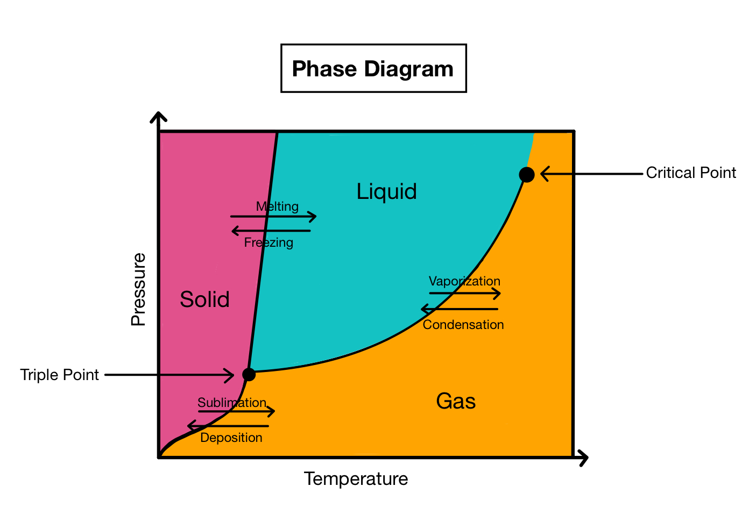
Phase Diagram of Water
Phase diagram is a graphical representation of the physical states of a substance under different conditions of temperature and pressure. A typical phase diagram has pressure on the y-axis and temperature on the x-axis. As we cross the lines or curves on the phase diagram, a phase change occurs. In addition, two states of the substance coexist in equilibrium on the lines or curves.
There are three states of matter: liquid, solid, and gas

Slide 11
Phase Diagram of Water (cont.)
Sublimation is when the substance goes directly from solid to the gas state.
Deposition occurs when a substance goes from a gas state to a solid state; it is the reverse process of sublimation.
Melting occurs when a substance goes from a solid to a liquid state.
Fusion is when a substance goes from a liquid to a solid state, the reverse of melting.
Vaporization (or evaporation) is when a substance goes from a liquid to a gaseous state.
Condensation occurs when a substance goes from a gaseous to a liquid state, the reverse of vaporization.
Critical Point – the point in temperature and pressure on a phase diagram where the liquid and gaseous phases of a substance merge together into a single phase. Beyond the temperature of the critical point, the merged single phase is known as a supercritical fluid.
Triple Point occurs when both the temperature and pressure of the three phases of the substance coexist in equilibrium.

Slide 12
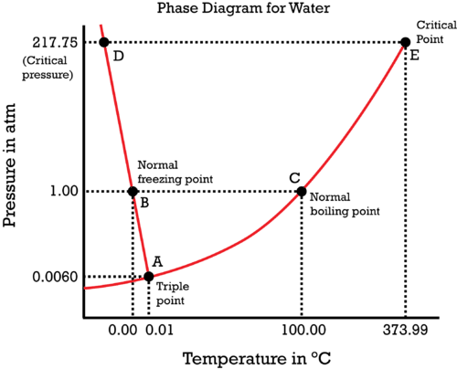
Phase Diagram of Water (cont.)

Slide 13
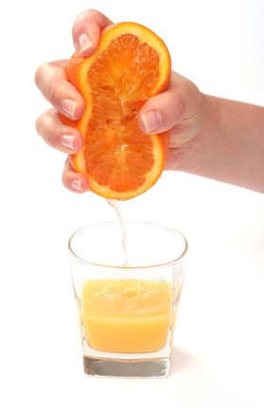
Types of Water
Water presents in food in the form of free, bound, and entrapped water.
Free water is water which can be removed easily from foods just by squeezing, grinding, or pressing, for instance, removing water from orange fruit just by squeezing it.
Bound water is water which cannot be extracted easily because it binds tightly onto water molecules. Thus, this type of water needs particular analysis methods to determine its value in the particular food. An example of bound water is the water present in cacti or pine tree needles; it cannot be squeezed or pressed out; even extreme desert heat or a winter freeze does not negatively affect bound water, and the vegetation remains alive.

Slide 15
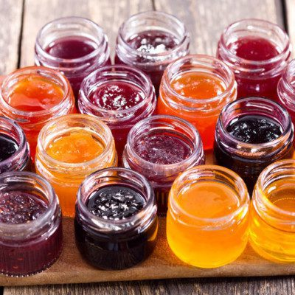
Types of Water (cont.…)
Water may also present as entrapped water in foods such as water in pectin gel or in fruit or vegetable. Entrapped water is immobilized in matrixes, capillaries, or cells, but if released during cutting or damage, it flows freely. Entrapped water has properties of free water and no properties of bound water. Entrapped water in food is often associated with water holding capacity, a term that is frequently employed to describe the ability of a matrix of molecules, usually macromolecules present at low concentration, to physically entrap large amounts of water in a manner that inhibits exudation under the application of an external, often gravitational, force. Familiar food matrices that entrap water in this way include gels of pectin and starch and cells of tissues, both plant and animal.

Slide 16
Interaction of Water with Food Components
1. Macroscopic Level (Water Binding, Hydration, and Water Holding Capacity)
With respect to foods, the terms “water binding” and “hydration” are often used to convey a general tendency for water to associate with hydrophilic substances, including cellular materials. When used in this manner, the terms pertain to the macroscopic level. Although more specialized terms, such as “water binding potential,” are defined in quantitative terms, they still apply only to the macroscopic level. The degree and tenacity of water binding or hydration depends on a number of factors including the nature of the nonaqueous constituent, salt composition, pH, and temperature.
“Water holding capacity” is a term that is frequently employed to describe the ability of a matrix of molecules, usually macromolecules present at low concentrations, to physically entrap large amounts of water in a manner that inhibits exudation. Familiar food matrices that entrap water in this way include gels of pectin and starch, and cells of tissues, both plant and animal.

Slide 17
Interaction of Water with Food Components (cont.)
2. Molecular Level: General Comments
Mixing of solutes and water results in altered properties of both constituents. Hydrophilic solutes cause changes in the structure and mobility of adjacent water, and water causes changes in the reactivity, and sometimes structure, of hydrophilic solutes. Hydrophobic groups of added solutes interact only weakly with adjacent water, preferring a nonaqueous environment.
3. Molecular Level: Bound Water
From a conceptual standpoint it is useful to think of bound water as “water that exists in the vicinity of solutes and other nonaqueous constituents, and exhibits properties that are significantly altered from those of ‘bulk water’ in the same system.” Bound water should be thought of as having “hindered mobility” as compared to bulk water, not as being “immobilized.” In a typical food of high water content, this type of water comprises only a minute part of the total water present, approximately the first layer of water molecules adjacent to hydrophilic groups.

Slide 18
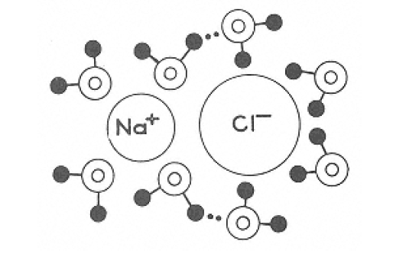
Interaction of Water with Food Components (cont.)
4. Interaction of Water with Ions and Ionic Groups
Ions and ionic groups of organic molecules hinder mobility of water molecules to a greater degree than do any other types of solutes. The strength of water-ion bonds is greater than that of water-water hydrogen bonds, but is much less than that of covalent bonds. The normal structure of pure water (based on a hydrogen-bonded, tetrahedral arrangement) is disrupted by the addition of dissociable solutes. Water and simple inorganic ions undergo dipole-ion interactions. The example in Figure involves hydration of the NaCl ion pair. Only first-layer water molecules in the plane of the paper are illustrated. In a dilute solution of ions in water, second-layer water is believed to exist in a structurally perturbed state because of conflicting structural influences of first-layer water and the more distant, tetrahedrally oriented “bulk-phase” water. In concentrated salt solutions, bulk-phase water would not exist and water structure would be dominated by the ions.
Figure: Likely arrangement of water molecules adjacent to sodium chloride.

Slide 19
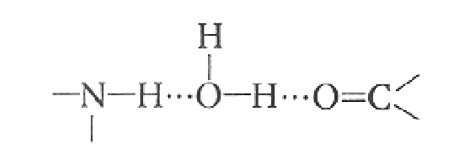
Interaction of Water with Food Components (cont.)
5. Interaction of Water with Neutral Groups Possessing Hydrogen-Bonding Capabilities (Hydrophilic Solutes)
Interactions between water and nonionic, hydrophilic solutes are weaker than water-ion interactions and about the same strength as those of water-water hydrogen bonds. Solutes capable of hydrogen bonding might be expected to enhance or at least not disrupt the normal structure of pure water. However, in some instances it is found that the distribution and orientation of the solute's hydrogen-bonding sites are geometrically incompatible with those existing in normal water. Thus, these kinds of solutes frequently have a disruptive influence on the normal structure of water. Urea is a good example of a small hydrogen-bonding solute that for geometric reasons has a marked disruptive effect on the normal structure of water.
Hydrogen bonding of water can occur with various potentially eligible groups (e.g., hydroxy1, amino, carbony1, amide, imino, etc.). This sometimes results in “water bridges” where one water molecule interacts with two eligible hydrogen-bonding sites on one or more solutes. A schematic depiction of water hydrogen bonding (dashed lines) to two kinds of functional groups found in proteins is shown:
Figure: Hydrogen bonding (dotted lines) of water to two kinds of functional groups occurring in proteins.

Slide 20
Interaction of Water with Food Components (cont.)
6. Interaction of Water with Nonpolar Substances
Inert solutes such as rare gases, hydrocarbons and non-polar groups of such compounds as fatty acids, amino acids and proteins have a structure forming action. They position themselves in the H-bonded clusters of water molecules giving rise to extended array of water molecules and the solute is surrounded by water with an enhanced structure, e.g. protein-water interactions and clathrate hydrates. The stability and solubility of protein aggregates in seeds and emulsifying characteristics of proteins are attributed to protein-water interactions.

Slide 21
Effect of Water on Food Stability
Drying and/or storage at low temperatures are among the oldest methods for the preservation of food with high water contents. Modern food technology tries to optimize these methods. A product should be dried and/or frozen only long enough to ensure wholesome quality for a certain period of time. Naturally, drying and/or freezing must be optimized for each product individually. It is therefore necessary to know the effect of water on storage life before suitable conditions can be selected.
Water Activity
The storage quality of food does not depend on the water content, but on water activity (aw), which is defined as follows:
a_{w} = P/P0 = ERH/100
P = partial vapor pressure of food moisture at temperature T, P₀ = saturation vapor pressure of pure water at T,
ERH = equilibrium relative humidity at T.
The value of a_{w} ranges from 0 to 1.0

Slide 22
Effect of Water on Food Stability (cont.)
The effect of water activity on processes that can influence food quality. Decreased water activity retards the growth of microorganisms, slows enzyme catalyzed reactions (particularly involving hydrolases) and, lastly retards non-enzymatic browning. In contrast, the rate of lipid autoxidation increases in dried food systems. Foods with a_{w} values between 0.6 and 0.9 are known as “intermediate moisture foods” (IMF), dried fruits are as example. These foods are largely protected against microbial spoilage. One of the options for decreasing water activity and thus improving the shelf life of food is to use additives with high water binding capacities (humectants). In addition to common salt, glycerol, sorbitol and sucrose have potential as humectants. However, they are also sweeteners and would be objectionable from a consumer standpoint in many foods in the concentrations required to regulate water activity.

Slide 23
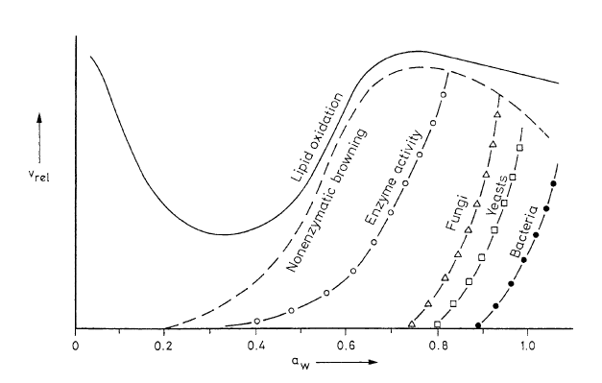
Effect of Water on Food Stability (cont.)
Figure: Food shelf life (storage stability) as a function of water activity

Slide 24
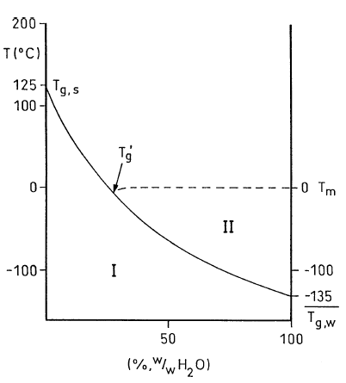
Effect of Water on Food Stability (cont.)
Phase Transition of Foods Containing Water
Water activity is only of limited use as an indicator for the storage life of foods with a low water content. A new concept based on phase transition, which takes into account the change in physical properties of foods during contact between water and hydrophilic ingredients, is better suited to the prediction of storage life.
The physical state of metastable foods depends on their composition, on temperature and on storage time. For example, depending on the temperature, the phases could be glassy, rubbery or highly viscous. The kinetics of phase transitions can be measured by means of differential scanning calorimetry (DSC), producing a thermogram that shows temperature T_{g} as the characteristic value for the transition from glassy to rubbery (plastic). Foods become plastic when their hydrophilic components are hydrated. Thus the water content affects the temperature T_{g}, for example in the case of gelatinized starch.
States: I = glassy; II = rubbery;
T_{g,s} and T_{g,w} = phase transition temperatures of dehydrated starch and water; T_{m} = melting point (ice)
Figure: State diagram, showing the approximate T_{g} temperatures as a function of mass fraction, for a gelatinized starch-water system

Slide 25
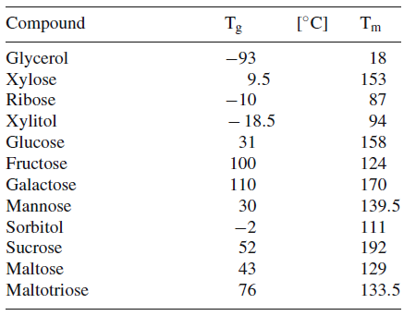
Effect of Water on Food Stability (cont.)
Phase Transition of Foods Containing Water
Table shows the T_{g} of some mono- and oligosaccharides and the difference between melting points T_{m}. During the cooling of an aqueous solution below the freezing point, part of the water crystallizes, causing the dissolved substance to become enriched in the remaining fluid phase (unfrozen water). In the thermogram, temperature T_{g}’ appears, at which the glassy phase of the concentrated solution turns into a rubber-like state.
Table: Phase transition temperature T_{g} and melting point T_{m} of mono- and oligosaccharides

Slide 26
Effect of Water on Food Stability (cont.)
Williams–Landel–Ferry (WLF) Equation
The viscosity of a food is extremely high at temperature T_{g} or T_{g}’ (about 10¹³ Pa.s). As the temperature rises, the viscosity decreases, which means that processes leading to a drop in quality will accelerate. In the temperature range of T_{g} to about (T_{g}+100°C), the change in viscosity follows Williams, Landel and Ferry (the WLF equation):
Viscosity (η) and density (ρ) at temperature T;
viscosity (η_{g}) and density (ρ_{g}) at phase transition
temperature T_{g}; C1 and C2: constants

Slide 27
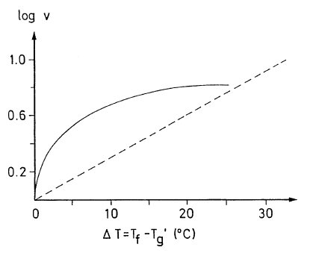
Effect of Water on Food Stability (cont.)
Williams–Landel–Ferry (WLF) Equation
According to the WLF equation, the rate of which in our example water crystallizes in ice cream at temperatures slightly above T_{g}’ rises exponentially
v: crystallization velocity;
T_{f}: temperature in the freezer compartment;
T_{g}’: phase transition temperature.
The Arrhenius kinetics (– – –) is shown for comparison
Figure: Crystallization of water in ice cream

