Slide 1
Nutrition Education and Communication
Sharmin Sultana
Research associate
Department of Public Health
Daffodil International University

Slide 2
Course Objectives:
Explain how a health educator can help people with nutritional problems related to certain health conditions
List the need, rationale and the meaning for Nutrition education.
Identify the behavioral theories, and how it's important to build theoretical education program.
List all nutrition educational needs of different patients populations.
Develop practical skills in communicating nutrition information to target audiences via a range of media.
Develop communication skills; identify personal habits and choices that promote well being.
Identify barriers of communication and find out ways to control them.
Develop strategies to reach nutritional programs to all vulnerable segment of the population

Slide 3
Course Contents:
Public health nutrition
Nutrition education definition, aims, scope and function
Role of Nutrition education
Advantages and limitations of Nutrition education
Definition of Nutrition communication, goal and effectiveness
Different approaches and methods of Nutrition education
Definition, characteristics and components of communication
Barriers of communication
Framework of nutrition Education programs

Slide 4
Assessment strategy:
1) Attendance 10 marks 2) Quiz 10 marks 3) Assignment 10 marks 4) Presentation 5 marks 5) Mid-Term 25 marks 6) Final 40 marks Total 100 Marks

Slide 5
Nutrition=?

Slide 6
Nutrition is the key to Healthy Body and Mind.
The study of various nutrients, their functions, food sources and their effects in human well being is called NUTRITION.
Nutrition science is the area of knowledge regarding the role of food in maintenance of health.

Slide 7
What is Public Health Nutrition?
Public health nutrition is the science and art of preventing disease, prolonging life and promoting health through the medium of nutrition. The aim of those working as public health nutritionists is for everyone to achieve greater health and well-being by making healthier food and nutrition-related choices.

Slide 8
Nutrition Education=?

Slide 9
Nutrition Education is a systematically planned set of activities. Nutrition Education is an essential component to improve the nutritional status of a population and is crucial for the well being of people in general.

Slide 13
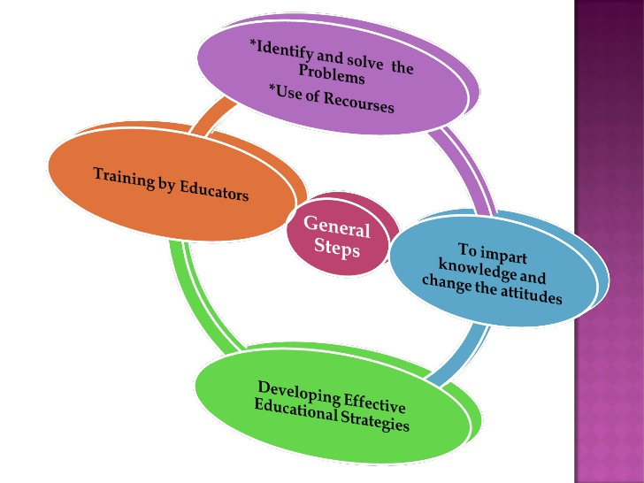

Slide 14
Major functions of nutrition education activities
Increase awareness
Enhancing peoples motivation
Facilitating the ability to take action
Improving environmental supports

Slide 18
Advantages

Slide 19
Limitations

