Slide 1
Cryptography and Network Security
Overview & Chapter 1
Fifth Edition
by William Stallings

Slide 2
Goal to learn
- Computer Security, Network Security, Internet Security
- Security Goal
- Security Attack
- Passive Attack & Active Attack
- Cryptography – Overview
- Basic Terminology
- Public Key – Private Key Cryptography
- Types of Encryption Operations

Slide 3
Network Security
Computer Security - generic name for the collection of tools designed to protect data and to thwart hackers.
Network Security - measures to protect data during their transmission.
Internet Security - measures to protect data during their transmission over a collection of interconnected networks.

Slide 4
Security Goals
Information needs to be hidden from -
Unauthorized access (Confidentiality)
Protected from unauthorized change (integrity)
Available to an authorized entity when it is needed (availability)
Security Goals
Confidentiality
Availability
Integrity

Slide 5
Security Attack
Security Attack
- Snooping
- Traffic Analysis
Threat to Confidentiality
- Modification
- Replaying
- Repudiation
Threat to Integrity
- Denial of Service
Threat to availability

Slide 6
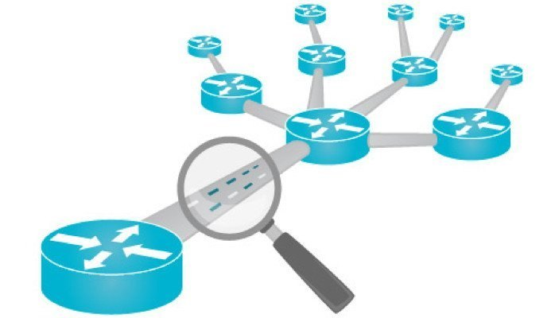
Attacks Threatening Confidentiality
Snooping -
Unauthorized access to or interception of data.
Traffic analysis -
Can find some other type information by monitoring online traffic.
He can find the electronic address (such as e-mail address) of the sender or the receiver.

Slide 7
Attacks Threatening Integrity
Modification
- After intercepting or accessing information, the attacker modifies the information to make it beneficial to himself
Masquerading
- Masquerading or spoofing(trick) happens when the attacker impersonates somebody else.
Replaying
- The attacker obtains a copy of a message sent by a user and later tries to replay it.
Repudiation
- Performed by one of the two parties in the communication: the sender or the receiver.
- The sender of the message might later deny that she has sent the message.
- The receiver of the message might later deny that he has received the message.

Slide 8
Attacks Threatening Availability
It may slow down or totally interrupt the service of a system.
He might send so many bogus requests to a server that the server that the server crashes because of the heavy load.
The attacker might intercept and delete a server’s response to a client, making the client to believe that the server is not responding.

Slide 9
Snooping Attack

Slide 10
Brute Force Attack – Dictionary Attack

Slide 11
DoS Attack

Slide 12
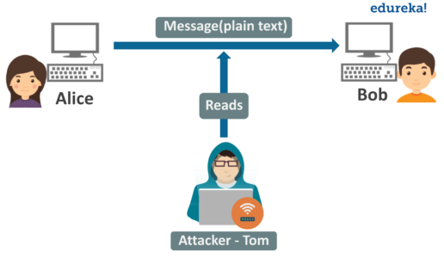
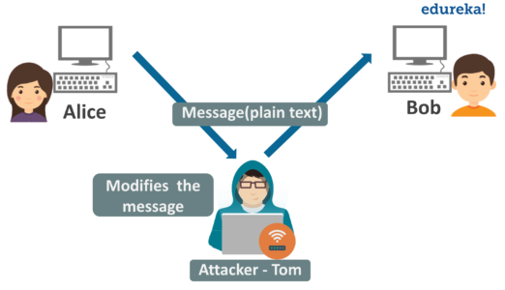
Passive Attacks – Active Attack
A passive attack is a network attack in which a system is monitored and sometimes scanned for open ports and vulnerabilities.
The purpose is solely to gain information about the target and no data is changed on the target.
An active attack attempts to alter system resources or effect their operations. Active attack involve some modification of the data stream or creation of false statement.
Types of active attacks:
masquerade, session replay, denial of service (DoS) attack.

Slide 13
Cryptography

Slide 14
Cryptography
Cryptography is the study of
- Secret (crypto-) writing (-graphy)
Concerned with developing algorithms.
Verify the correctness of a message to the recipient (authentication)
Form the basis of many technological solutions to computer and communications security problems

Slide 15
Some Basic Terminology
plaintext - original message
ciphertext - coded message
cipher - algorithm for transforming plaintext to ciphertext
key - info used in cipher known only to sender/receiver
encipher (encrypt) - converting plaintext to ciphertext
decipher (decrypt) - recovering plaintext from ciphertext
cryptography - study of encryption principles/methods
cryptanalysis (codebreaking) - study of principles/ methods of deciphering cipher-text without knowing key
cryptology - field of both cryptography and cryptanalysis

Slide 16
Cryptographic System
Characterize cryptographic system by:
Type of encryption operations used
substitution / transposition / product
Number of keys used
single-key or private / two-key or public
Way in which plaintext is processed
block / stream

Slide 17
Private-Key / Symmetric Encryption

Slide 18
Public-Key / Asymmetric Cryptography

Slide 19
Encryption Operation - Caesar Cipher
PlainText: cryptography
CipherText: fubswrjudskb
c = E(p) = (p + k) mod (26)‏
p = D(c) = (c – k) mod (26)‏

Slide 20
Playfair Cipher
Encrypt two letters together
Same row– followed letters
ac--bd
Same column– letters under
qw--wi
Otherwise—square’s corner at same row
ar--bq
s
i/j
m
p
l
e
a
b
c
d
f
g
h
k
n
o
q
r
t
u
v
w
x
y
z
PlainText: good day
CipherText: fque ebzy
Key: simple

Slide 21
More Encryption Operations -
- Hill Cipher
- Polyalphabetic Ciphers
- Autokey Cipher

Slide 22
Any Question

