Slide 1
Lecture 14
Cyber Law

Slide 4
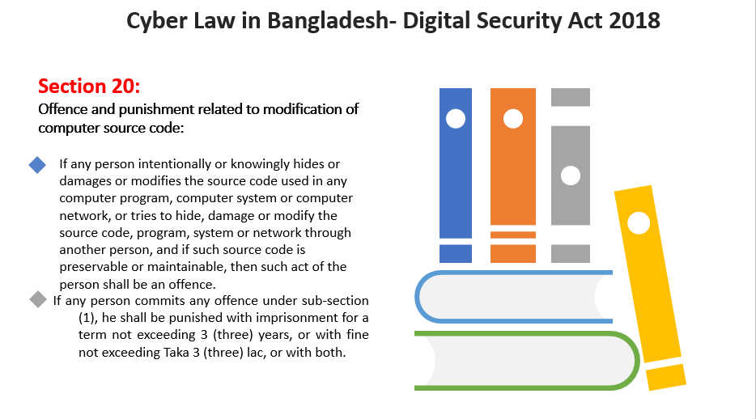

Slide 5
