Slide 1
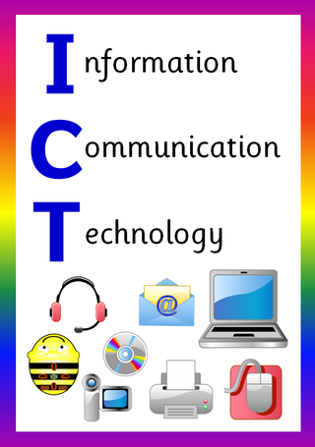
ICT in Business

Slide 2
Processing Data
.

Slide 3
Learning Objectives
In this chapter you will learn about:
Difference between Data and Information
How Computers Represent Data
How Computers Process Data
Factors Affecting Processing Speed
Conversion of Number Systems

Slide 4
The Difference between Data and Information
Data | Information
Data is unprocessed raw facts about a particular entity. | Information is processed form of data.
Data is used as input in the computer. | Information is the output of the computer
Data is not meaningful. | Information is meaningful.
Data is not used in decision-making. | Information is very important for decision-making.
Data is difficult or even impossible to reproduce. For example, if Government lose the data of census, if will be almost impossible to reproduce it. | Information is easier to reproduce if lost. For example, if the list of illiterate citizens is lost, it can be reproduced easily because the data is still stored.

Slide 5
How Computers Represent Data
Computers represent data in the following three forms –
Number System
Bits and Bytes
Text Code

Slide 6
Number System
Number system is categorized into four types −
Binary number system consists of only two values, either 0 or 1
Octal number system represents values in 8 digits.
Decimal number system represents values in 10 digits.
Hexadecimal number system represents values in 16 digits

Slide 7
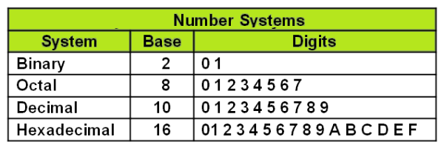

Slide 8
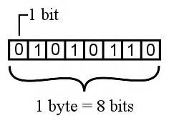
Bits and Bytes
Bits − A bit is a smallest possible unit of data that a computer can recognize or use. Computer usually uses bits in groups.
Bytes − group of eight bits is called a byte. Half a byte is called a nibble.

Slide 9
Text Code
Text code is format used commonly to represent alphabets, punctuation marks and other symbols.
Four most popular text code systems are;
ASCII
Extended ASCII
Unicode
EBCDIC

Slide 10
ASCII
ASCII (pronounced AS-key) stands for the American Standard Code for Information Interchange.
Most commonly used in computers of all types.
ASCII codes. ASCII is an eight-bit code
Specifics characters for values from 0 to 127.

Slide 11
EBCDIC
Extended Binary Coded Decimal Interchange Code.
8 bit code.
Represents 256 symbols.
used in IBM mainframe and midrange systems, but it is rarely encountered in personal computers.

Slide 12
Unicode
Unicode is a universal character encoding standard that assigns a code to every character and symbol in every language in the world
Since no other encoding standard supports all languages, Unicode is the only encoding standard that ensures that you can retrieve or combine data using any combination of languages.

Slide 13
How Computers Process Data
Two components that are located on a computer's motherboard handle data processing in a computer;
Central Processing Unit, or CPU
Memory.

Slide 14
Central Processing Unit (CPU)
It is the brain of computer.
It is also called processor.
It is the most important component of the computer.
Computer can’t work without CPU.
It is located on the mother board.
It carries out most of the work of a computer.
There are two parts of CPU.
Arithmetic Logic Unit (ALU)
Control Unit (CU)

Slide 15
Central Processing Unit (CPU)

Slide 16
Arithmetic Logic Unit (ALU)
Main component of the central processing unit
Known as an integer unit (IU) that is an integrated circuit within a CPU or GPU, which is the last component to perform calculations in the processor.
Performs arithmetic and logic operations.

Slide 17
Arithmetic Logic Unit (ALU)
Logical Operations: The logical operations consist of NOR, NOT, AND, NAND, OR, XOR, and more.
Arithmetic Operations: Although it performs multiplication and division, this refers to bit addition and subtraction. But multiplication and division operations are more costly to make. In the place of multiplication, addition can be used as a substitute and subtraction for division.

Slide 18
Control Unit (CU)
Regulates and integrates the operations of the computer.
Receives the input signal/ information/ instruction from the user and converts into control signals for the execution in the CPU
Controls and directs the main memory, arithmetic & logic unit (ALU), input and output devices, and also responsible for the instructions that are sent to the CPU of a computer
Acts as the central nervous system of a computer system.

Slide 19
Memory
Stores open programs and data
Small chips on the motherboard
More memory makes a computer faster
There are two types of built-in memory:
Permanent or Non-volatile Memory
Nonpermanent or Volatile Memory

Slide 20
Non-volatile Memory
Non-volatile memory (NVM) or non-volatile storage is a type of computer memory that can retain stored information even after power is removed.
In contrast, volatile memory needs constant power in order to retain data.

Slide 21
Volatile Memory
Contents are erased when the system's power is turned off or interrupted.
RAM (Random Access Memory)
When a computer boots up, it loads the operating system into RAM
Loading the operating system and active applications into RAM allows them to run much faster

Slide 22
Factors Affecting Processing Speed
Some of the factors that can affect computer system are;
Registers
RAM
The System Clock
The Bus
Cache Memory

Slide 23
Registers
The CPU contains of small memory areas called registers, which store data and instructions while the CPU processes them.
The size of the registers determines the amount of data with which the computer can work at a one time.
The register’s capacity is in bytes. A register can be of one, two, four, or eight bytes.
Today most PC`s have 32-bit registers, mean the CPU can process four bytes data at one time. Register sizes are rapidly growing to 64 bits. The bigger size of the register increases the performance of the computer.

Slide 24
RAM
The amount of RAM in a PC has a direct effect on the system`s speed.
The more RAM a PC has the more program instructions and data can be held in memory, which is faster than storage on disk.
If a PC does not have enough memory to run a program, it must move data between RAM and the hard disk frequently. This process called swapping, can greatly slow a PC`s performance.

Slide 25
The System Clock
The computer`s system clock sets the pace the CPU by using a vibrating quartz crystal.
A single "tick" of the clock is the time required to turn a transistor off and back on. This is called a clock cycle.
Clock cycles are measured in Hertz (Hz), a measure of cycles per second. If a computer has a clock speed of 300 MHz, then its system clock "ticks" 300 million times every seconds.
The faster a PCs clock runs, the more instructions the PC can execute each second.

Slide 26
The Bus
A bus is a path between the components of a computer. Data and instructions travel along these paths.
The data bus width determines how many bits can be transmitted between the CPU and other devices.
A higher bus width means that the user can carry more data. It increases the performance of the computer.
The address bus runs only between the CPU and RAM, and carries nothing but memory addresses for the CPU to use.
Peripheral devices are connected to the CPU by an expansion bus.

Slide 27
Cache Memory
Cache (pronounced “cash”) memory is high-speed memory that holds the most recent data and instructions that have been loaded by the CPU.
Cache is located directly on the CPU or between the CPU and RAM, making it faster than normal RAM.
CPU-resident cache is called Level-1 (L1) cache. External cache is called Level-2 (L2) cache.
The amount of cache memory has a tremendous impact on the computer`s speed.

Slide 28
End of Chapter
.

