Slide 1
Network Models

Slide 2
Protocols
A protocol is a set of rules that govern data communications. The key elements of a protocol are syntax, semantics, and timing.
o Syntax. The term syntax refers to the structure or format of the data, meaning the order in which they are presented. For example, a simple protocol might expect the first 8 bits of data to be the address of the sender, the second 8 bits to be the address of the receiver, and the rest of the stream to be the message itself.
o Semantics. The word semantics refers to the meaning of each section of bits. For example, does an address identify the route to be taken or the final destination of the message?
o Timing. The term timing refers to two characteristics: when data should be sent and how fast they can be sent. For example, if a sender produces data at 100 Mbps but the receiver can process data at only 1 Mbps, the transmission will overload the receiver and some data will be lost.

Slide 3
Standards
Standards provide guidelines to manufacturers, vendors, government agencies, and other service providers to ensure the kind of interconnectivity necessary in today's marketplace and in international communications.
Example: GSM, EDGE, 3G
Standards Organizations:
IEEE – Institute of Electrical and Electronics Engineering
ITU – International Telecommunication Union
ISO – International Organization of Standardizing

Slide 4
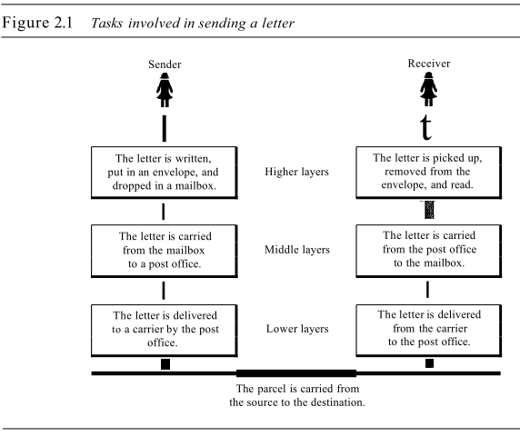
LAYERED TASKS: Real World Example
At the Sender Site
o Higher layer. The sender writes the letter, inserts the letter in an envelope, writes the sender and receiver addresses, and drops the letter in a mailbox.
o Middle layer. The letter is picked up by a letter carrier and delivered to the post office.
o Lower layer. The letter is sorted at the post office; a carrier transports the letter.
The Way
On the way to the recipient's local post office, the letter may actually go through a central office. In addition, it may be transported by truck, train, airplane, boat, or a combination of these.
At the Receiver Site
o Lower layer. The carrier transports the letter to the post office.
o Middle layer. The letter is sorted and delivered to the recipient's mailbox.
o Higher layer. The receiver picks up the letter, opens the envelope, and reads it.

Slide 5
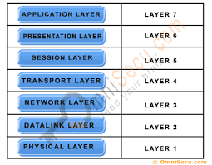
THE OSI MODEL
International Standards Organization (ISO) is a multinational body dedicated to worldwide agreement on international standards.
An ISO standard that covers all aspects of network communications is the Open Systems Interconnection (OSI) model.
ISO is the organization. OSI is the model.

Slide 6
Advantage of Layered Architecture
Each layer defines a family of functions distinct from those of the other layers. In developing the model, the designers identified which networking functions had related uses and collected those functions into discrete groups that became the layers.
By defining and localizing functionality in this fashion, the designers created an architecture that is both comprehensive and flexible.
Most importantly, the OSI model allows complete interoperability between otherwise incompatible systems.

Slide 7
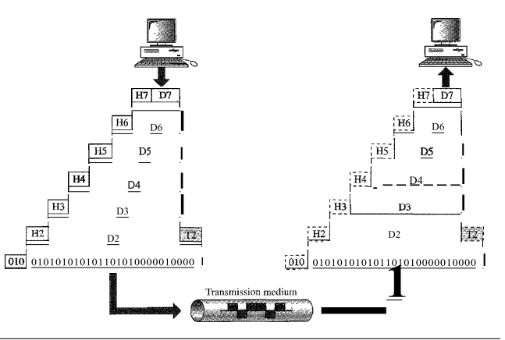
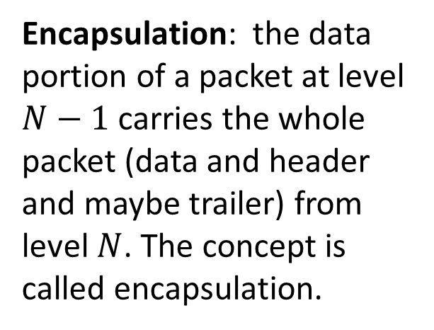
An Exchange Using the OSI Model
At each layer, a header, or possibly a trailer, can be added to the data unit. Commonly, the trailer is added only at layer 2.
Encapsulation: the data portion of a packet at level $N−1$carries the whole packet (data and header and maybe trailer) from level $N$. The concept is called encapsulation.

Slide 8
1) Physical Layer
Physical layer deals with the
Physical characteristics of interfaces between devices and the transmission medium.
Electrical or optical representation of bits with no interpretation.
The transmission rate (the number of bits sent each second) is also defined by the physical layer.
Synchronization of sender and the receiver clocks
Specifies line configuration: Point to point, Multipoint
Defines physical topology: Mesh, Star, Ring, Bus
Specifies transmission mode: simplex, half-duplex, or full-duplex

Slide 9
2) Data Link Layer
Framing: Divides the stream of bits received from the network layer into manageable data units called frames.
Physical addressing: If frames are to be distributed to different systems on the network, a header is added to the frame to define the sender and/or receiver of the frame.
Flow control: If the rate at which the data are absorbed by the receiver is less than the rate at which data are produced in the sender, the data link layer imposes a flow control mechanism to avoid overwhelming the receiver
Error control: Adds mechanisms to detect and retransmit damaged or lost frames
Access control: When two or more devices are connected to the same link, data link layer protocols are necessary to determine which device has control over the link at any given time.

Slide 10
3) Network Layer
Logical addressing: The network layer adds a header to the packet coming from the upper layer that, among other things, includes the logical addresses of the sender and receiver.
Routing: When independent networks or links are connected to create internetworks (network of networks) or a large network, the connecting devices (called routers or switches) route or switch the packets to their final destination.

Slide 11
4) Transport Layer
The transport layer is responsible for process-to-process delivery of the entire message. A process is an application program running on a host. A host is a node which offers information resources, services, and applications to other nodes on the network.
Service-point addressing: Computers often run several programs at the same time. Therefore, data needs to be delivered from a specific process (running program) on one computer to a specific process (running program) on the other. To identify data generated from each process the transport layer header must therefore include a type of address called a service-point address (or port address).
Segmentation and reassembly: A message is divided into transmittable segments, with each segment containing a sequence number. These numbers enable the transport layer to reassemble the message correctly upon arriving at the destination and to identify and replace packets that were lost in transmission.

Slide 12
5) Session Layer
Dialog control: The session layer provides the mechanism for opening, closing and managing a session between end-user application processes. Communication sessions consist of requests and responses that occur between applications. It provides for either full duplex or half-duplex operation.
Synchronization: The session layer allows a process to add checkpoints, or synchronization points, to a stream of data. For example, if a system is sending a file of 2000 pages, it is advisable to insert checkpoints after every 100 pages to ensure that each 100-page unit is received and acknowledged independently. In this case, if a crash happens during the transmission of page 523, the only pages that need to be resent after system recovery are pages 501 to 523. Pages previous to 501 need not be resent.

Slide 13
6) Presentation layer
The presentation layer is responsible for
Translation of data
Compression of data,
Encryption/decryption of data, adds security.

Slide 14
7) Application Layer
Mail Services : This layer provides the basis for E-mail forwarding and storage.
Network Virtual Terminal : An application creates software emulation of a terminal at the remote host allows user to log on.
Access Directory Services : Directory Services is a shared information infrastructure for locating, managing, administering and organizing everyday items and network resources, which can include volumes, folders, files, printers, users, groups, devices, telephone numbers and other objects.
File Transfer, Access and Management: It is a standard mechanism to access files and manages it. Users can access files in a remote computer and manage it. They can also retrieve files from a remote computer.

Slide 15
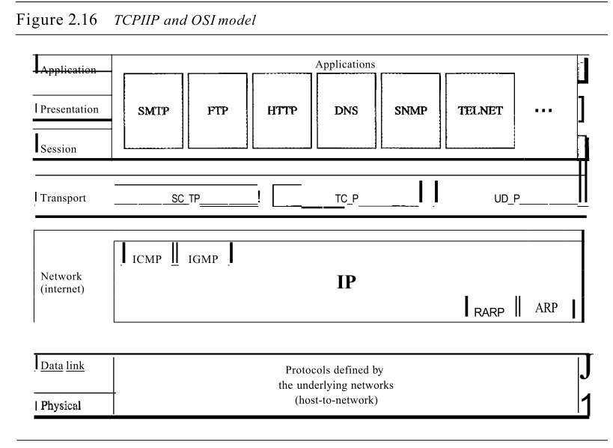
TCP/IP Protocol
Transmission Control Protocol (TCP)
Internetworking Protocol (IP)
The TCP/IP protocol suite was developed prior to the OSI model.
The original TCP/IP protocol suite was defined as having four layers: host-to-network, internet, transport, and application.
Comparing TCP/IP to OSI, we can say that
The host-to-network layer is equivalent to the combination of the physical and data link layers.
The internet layer is equivalent to the network layer, and
The application layer is roughly doing the job of the session, presentation, and application layers
Transport layer in TCP/IP taking care of part of the duties of the session layer.
OSI Model
TCP/IP Protocol
Application
Application
Transport
Internet
Host-to Network

