Slide 1
Translating User Requirements from SRS into UI Design
Fahim Faisal
Lecturer, Dept. of CSE
Daffodil International University

Slide 2
Outline
Introduction
Understanding the SRS
Identifying Key User Roles
Defining User Workflows
Creating Wireframes
Wireframing Process
Wireframe Demo
Gathering Feedback
Iteration and Refinement
Adding Visual Design
Creating Prototypes
InVision Demo
Testing and Validation
Documentation and Handoff

Slide 3
Introduction
User Interface (UI) design is a critical aspect of software development.
Ensuring that the user experience is intuitive, efficient, and enjoyable is absolutely crucial for any software project’s success.
Converting Software Requirement Specifications (SRS) into UI design is a crucial step in the software development process.
Without a clean and well-defined UI, no software can fulfill its objectives, since UI of an application, be it web or mobile, is the first thing that the users see and interact with.

Slide 4
Understanding the SRS
Before starting the UI design process, the Software Requirement Specification (SRS) document must be thoroughly understood. Special attention must be paid to the following:
Functional Requirements: What the software is supposed to do from a user's perspective must be properly understood. Client engagement is a must for defining these requirements.
Non-functional Requirements: Factors like performance, security, and usability must be carefully considered. Usually developers define these requirements.
User Stories and Use Cases: How different types of users will interact with the software must be discussed and considered.

Slide 5
Identifying Key User Roles
The next step is to identify the different user roles outlined in the SRS. This could include administrators, regular users, guests, etc. Understanding these roles help to tailor the UI for the users in order to meet their specific needs and preferences.
The more user roles there are, the more UIs/screens/pages/activities there will be.
For example, if an app offers separate login methods for users and administrators, the there might be two separate login pages.
The color palette and UI components may vary between user segment and admin segment.
Functionalities and features will most certainly vary between the user and admin segments.

Slide 6
Defining User Workflows
The third step is to map out the user workflows based on the functional requirements specified in the SRS.
Activity and sequence diagrams can be of great help in order to visualize the workflows of the user.
Developers must understand the sequence of steps a user will take to accomplish various tasks within the software.
UI components must be listed out from beginning till the end of the workflow and then implemented sequentially.
Buttons, pages, webforms, modals, pop-up boxes, dialog boxes, on-screen alert messages, all can be parts of a user workflow.

Slide 7
Creating Wireframes
Wireframing is an essential step in UI design as it allows developers to visualize the layout and structure of the user interface without getting too involved with design details. Using tools like Sketch, Figma, or Adobe XD, developers should create wireframes for each screen or interface element based on the identified user workflows.
Homepage: Developers should start with the homepage layout, considering what elements should be prominently featured and how users will navigate to other parts of the software.
Navigation: Then developers should design the navigation menu or system to ensure easy access to different features and functionalities.
Forms and Inputs: Then forms should be designed for data input based on the fields specified in the SRS. Validation rules and error handling must be paid special attention.
Buttons and Actions: Then buttons and other interactive elements should be designed based on the actions users need to perform.
Feedback and Notifications: Incorporate elements for providing feedback to users and displaying notifications or alerts.

Slide 8
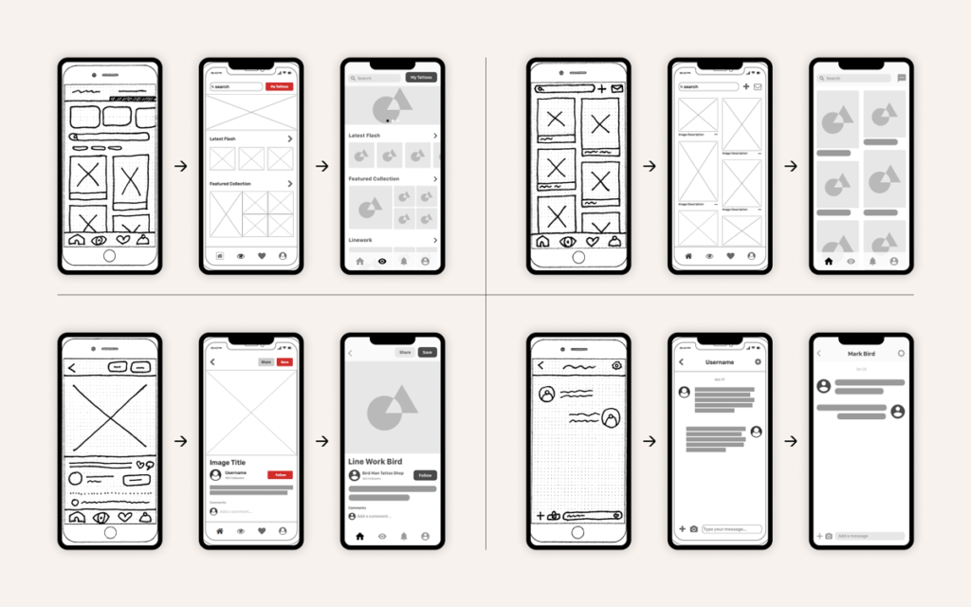
Wireframing Process
Wireframing Size Guidelines:
Smartphone: 1080px wide x 1920px long
Tablet: 8” Tablet – 800px wide x 1280px long or 10” Tablet – 1200px wide x 19200px long
Desktop: 768px wide x 1366px long

Slide 9
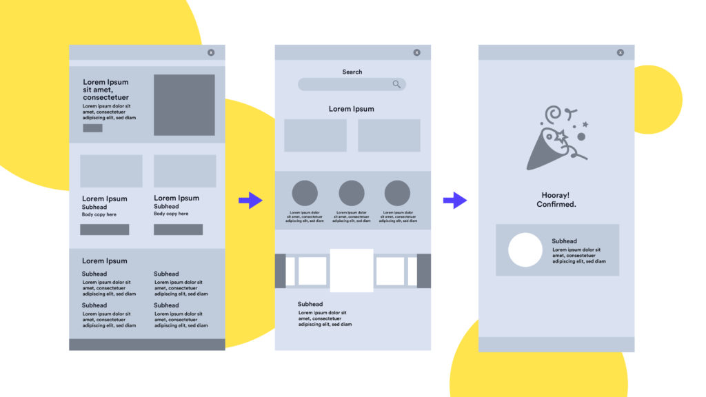
Wireframe Demo

Slide 10
Gathering Feedback
The wireframes must be shared with all the stakeholders, including developers, designers, and end-users if possible.
Developers should gather feedback on the layout, flow, and functionality to ensure alignment with the SRS and user expectations.

Slide 11
Iteration and Refinement
Based on the feedback received, wireframes should have multiple iterations to address any bugs, errors, concerns or suggestions.
Refinements should be made to the UI to improve usability, clarity, and overall user experience.
Versions or iterations of the UI should be released periodically, i.e., at regular intervals.
The feedback mechanism should be robust and comprehensive and there should be provisions for submitting system/error logs for the users.

Slide 12
Adding Visual Design
Once the wireframes are approved, visual design elements should be added in order to enhance the aesthetics of the UI. This includes:
Color Scheme: A color palette should be chosen that aligns with the product brand and creates visual hierarchy.
Typography: Fonts should be selected for headings, body text, and other UI elements that are legible and appropriate for the software's tone.
Icons and Images: Icons and images should be incorporated wherever necessary to aid understanding and add visual interest.

Slide 13
Creating Prototypes
Prototyping tools like InVision or Marvel may be utilized to create interactive prototypes based on the finalized UI designs.
Prototypes allow stakeholders to experience the user interface in a more dynamic way and provide feedback on interactions and transitions.

Slide 14
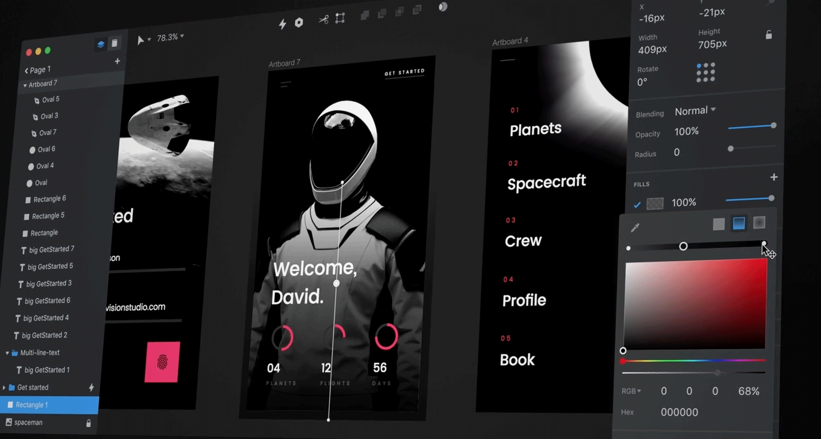
InVision Demo

Slide 15
Testing and Validation
Usability testing should be conducted with real users to validate the UI design.
Feedback should be gathered on ease of use, clarity of instructions, and overall satisfaction.
Feedbacks from users should be used to make final adjustments before handing off the design to developers for implementation.

Slide 16
Documentation and Handoff
The finalized UI design should be documented including all visual assets, specifications, and guidelines.
Clear instructions should be provided in writing for developers in order to ensure accurate implementation of the design.

Slide 17
Questions?

Slide 18
Thank You

