Slide 1
Rural Social Structure
Md. Fouad Hossain Sarker
Associate Professor and Head, Department of Development Studies
Daffodil International University

Slide 2
Objectives of this Class
Providing the definition of Rural Social Structure.
Exploring the significance of rural institutions.
Examining the components and importance of rural institutions.
Exploring the impacts of rural-urban linkages on the development of rural development.

Slide 3
Rural Social Structure
Rural social structure refers to the organization and patterns of social relationships and interactions within rural communities or areas characterized by predominantly agricultural or agrarian economies. It encompasses the various elements that define the social fabric of rural societies, including social hierarchies, roles, norms, customs, institutions, and networks

Slide 4
Significance of studying Rural Social Structure
Socio-economic development: Rural areas often play a crucial role in a country's socio-economic development, especially in agriculture-dependent economies. Understanding the social structure in rural communities helps identify potential obstacles and opportunities for development.
Inequality and social justice: Rural social structures can perpetuate inequalities and social injustices. By studying these structures, researchers and policymakers can pinpoint the root causes of disparities in access to resources, opportunities, and services.
Cultural preservation and change: Rural areas often hold rich cultural traditions and practices that are deeply tied to their social structure.
Community development and empowerment: A comprehensive understanding of rural social structure empowers communities to actively participate in their development.
Environmental sustainability: Rural communities often have close ties to their natural environment, and their social structure influences their interaction with the land and resources. Studying rural social structure helps assess the impact of human activities on the environment and the sustainability of rural practices.

Slide 5
Components of Rural Social Structure (1)
Social Roles and Status: Rural communities often have distinct social roles and hierarchies, such as farmers, landowners, laborers, and community leaders. These roles determine individuals' positions in the social order and influence their access to resources and decision-making power.
Kinship and Family Structure: Rural societies often place significant importance on family and kinship ties. Family relationships and extended family networks can be influential in shaping social interactions and providing support systems.
Community Institutions: Rural communities typically have local institutions that play essential roles in governing social behavior and resolving disputes. These institutions may include community councils, religious organizations, and traditional leadership structures.

Slide 6
Components of Rural Social Structure (2)
4. Social Norms and Customs: Rural social structure is often shaped by cultural norms and customs, which govern various aspects of life, such as marriage, inheritance, and social gatherings. These norms contribute to social cohesion and identity within the community.
5. Economic Relations: In agrarian economies, economic relationships are central to the social structure. These may involve relationships between landowners and agricultural laborers or exchanges of goods and services within the community.
6. Social Networks: Social networks in rural areas play a critical role in sharing information, resources, and support. These networks may be based on kinship, friendships, or common interests.
7. Power and Decision-making: Power dynamics within rural social structures influence decision-making processes, resource distribution, and access to opportunities. Understanding these power structures is crucial for assessing issues of social equity and justice.

Slide 7
Brainstorming session
What do you understand by rural social institutions?

Slide 8
Institutions of Rural Society (1)
Family and Kinship: Family is the foundational social institution in rural communities. Families often have strong ties and play a vital role in providing emotional support and economic security. Extended family networks are prevalent, and kinship relations influence social interactions, marriage practices, and inheritance patterns.
Religion and Belief Systems: Religion holds significant importance in rural areas, with communities often adhering to traditional or indigenous belief systems. Religious institutions serve as centers for social gatherings, moral guidance, and cultural celebrations. They can also play a role in maintaining social cohesion and identity.
Education: Education institutions in rural areas may vary in accessibility and quality compared to urban areas. Schools and educational facilities are crucial for imparting knowledge and skills to the younger generation. Education can be a pathway for social mobility and development within rural communities.
Agricultural Cooperatives: In agrarian economies, agricultural cooperatives serve as social institutions that facilitate collective efforts for farming, marketing, and resource-sharing. They play a crucial role in strengthening rural livelihoods and enhancing economic opportunities.

Slide 9
Institutions of Rural Society (2)
5. Community Organizations: Rural communities often have various community-based organizations that address specific needs and interests. These organizations may focus on issues like healthcare, environment, women's empowerment, or cultural preservation
6. Local Governance and Traditional Leadership: Rural areas may have traditional leadership structures alongside formal governance systems. Local leaders, often respected elders or community chiefs, hold positions of authority and help mediate conflicts, make decisions, and preserve cultural traditions.
7. Social Welfare and Mutual Aid Groups: Informal social welfare networks, such as mutual aid groups, exist in rural areas to provide support during challenging times. These groups offer assistance during emergencies, illnesses, or economic hardships, reinforcing community bonds.
8. Healthcare and Medical Institutions: Rural healthcare facilities and medical institutions are crucial for providing access to healthcare services to the population. Health centers, clinics, and mobile healthcare units are vital for addressing the health needs of rural communities.

Slide 10
Social Stratification
Social stratification refers to the hierarchical arrangement of individuals or groups within a society based on various attributes such as wealth, income, education, occupation, social status, or power. It is a system of ranking individuals or social groups into different strata or layers, with some groups enjoying more privileges, resources, and opportunities while others have limited access to these benefits.

Slide 11
Key Characteristics of Social Stratification
Inequality: Social stratification leads to unequal distribution of resources, opportunities, and rewards among individuals or groups. Some people or classes have more advantages, while others face disadvantages or marginalization.
Social Mobility: Social stratification can impact social mobility, which is the ability of individuals or groups to move up or down the social ladder. In some societies, mobility between social strata is relatively fluid, while in others, it may be more rigid.
Social Classes: Social stratification often results in the classification of people into distinct social classes based on their economic and social standing. These classes may include the upper class, middle class, and lower class, each with its unique characteristics and privileges.
Status and Power: Social stratification affects individuals' social status and their access to power and influence within the society. Higher-ranked individuals or groups often have more control over decision-making processes and resources.
Reproduction of Inequality: Social stratification tends to be self-perpetuating. Privileges and disadvantages are often passed down from one generation to the next, leading to the reproduction of social inequality.
Intersectionality: Social stratification can be influenced by multiple factors, such as race, gender, ethnicity, and age.

Slide 12
Social stratification in rural society
Social stratification in rural society is a hierarchical arrangement of individuals or groups based on various factors, such as landownership, wealth, education, occupation, and social status. This stratification affects the distribution of resources, opportunities, and power within the rural community.

Slide 13
Key aspects and examples of social stratification in rural society (1)
Landownership and Agrarian Class Structure: Landownership is a significant factor in rural social stratification. Large landowners who own extensive and productive landholdings tend to occupy higher positions in the social hierarchy, while small landholders and landless individuals have lower social standing.
Economic Disparities: Social stratification in rural areas often leads to economic disparities. Wealthier individuals or families have access to more resources, better education, and improved living conditions. In contrast, economically disadvantaged individuals may face challenges in accessing basic necessities and opportunities for upward mobility.
Education and Occupational Status: Educational attainment and occupational status contribute to social stratification in rural areas. Individuals with higher levels of education and professional occupations tend to have higher social status and better economic prospects. Conversely, those with limited education and primarily engaged in manual labor may experience lower social standing.
Social Networks and Influence: Social stratification influences the formation of social networks and social capital in rural communities. Higher-ranked individuals or families may have more influential connections, leading to better access to opportunities and resources, while lower-ranked individuals may face limited social connections and networks.

Slide 14
Key aspects and examples of social stratification in rural society (2)
5. Gender and Caste Stratification: In many rural societies, gender and caste also play significant roles in social stratification. Women and individuals from marginalized castes may experience additional layers of discrimination and limited access to resources and decision-making positions.
6. Power and Decision-making: Social stratification affects power dynamics within rural communities. Wealthy landowners and influential individuals often hold more decision-making power and have a greater say in local governance and community affairs.
7. Rural-Urban Divide: Social stratification can contribute to the rural-urban divide, with rural areas experiencing lower access to resources, services, and economic opportunities compared to urban areas. This divide can further exacerbate social inequalities within rural communities.

Slide 15
Example of Social Stratification in Rural Society Based on Land-Ownership
In many rural communities, landownership is a crucial determinant of social stratification. Those who own larger and more productive tracts of land tend to occupy higher positions in the social hierarchy, while landless or small landholding farmers may find themselves at a lower stratum.
Large Landowners: Wealthy landowners with extensive landholdings hold significant economic and social power. They often have access to more resources, such as modern agricultural technology, and can hire labor to work on their farms. Their economic advantage and influence in the community give them a higher social status.
Small Landholders: Farmers with smaller landholdings, while owning some land, may have limited access to resources and face challenges in improving their economic conditions. Their social status might be relatively lower compared to large landowners.
Landless Laborers: Landless individuals who work on the farms of larger landowners as agricultural laborers are often at the bottom of the social stratification. They rely on daily wages and have little control over the means of production. Their economic vulnerability and lack of land ownership result in a lower social status within the community.

Slide 16
Impacts of Landownership on the Aspects of Rural Life
Access to resources and opportunities: Large landowners have more access to credit, inputs, and technology, enabling them to enhance agricultural productivity and income. In contrast, small landholders and landless laborers may struggle to access these resources.
Decision-making power: Large landowners often have more influence over community decisions due to their economic and social standing. They may hold positions of authority in local institutions, further consolidating their power.
Social interactions: Social stratification can lead to the formation of distinct social circles and limited interactions between different strata, affecting social cohesion within the community.
Inequality in benefits: Economic gains resulting from agricultural activities may be disproportionately distributed, with larger landowners benefiting more while smaller landholders and landless laborers may experience lesser gains.

Slide 17
Rural-Urban Linkage
Rural-urban linkage is a multidimensional concept that recognizes the mutual influences and complementarities between rural and urban regions. It is essential for policymakers and planners to consider these linkages when formulating strategies and policies that aim to foster balanced and sustainable development across the entire country or region. Understanding and leveraging rural-urban linkages can lead to more inclusive and integrated approaches to economic, social, and environmental development.

Slide 18
Components of Rural-Urban Linkages (1)
Migration: Rural-urban migration is the movement of people from rural areas to urban centers in search of better job opportunities, education, healthcare, and improved living standards. Conversely, urban-rural migration involves individuals moving back to rural areas or relocating to smaller towns for various reasons.
Economic Interactions: Rural areas often produce agricultural products and raw materials, which are then processed, manufactured, or consumed in urban areas. This flow of goods and services creates economic interdependence between rural and urban regions.
Market Connectivity: Rural producers rely on urban markets to sell their goods and access a broader customer base. Conversely, urban areas depend on rural regions for the supply of agricultural products and other resources.
Technology and Knowledge Transfer: Urban centers tend to be hubs of technological innovation and knowledge dissemination. Rural-urban linkages facilitate the transfer of technology, best practices, and knowledge, benefiting rural development and productivity.

Slide 19
Components of Rural-Urban Linkages (2)
5. Labor Market Dynamics: Rural-urban linkages impact labor markets. Urban areas attract rural migrants seeking better job prospects, while rural regions may benefit from the return of urban-educated individuals bringing new skills and knowledge.
6. Infrastructure Development: Urban areas usually have better infrastructure, including transportation networks, healthcare facilities, and educational institutions. Rural-urban linkages can contribute to the transfer of infrastructure and services to rural areas.
7. Resource Management: Efficient resource management is crucial for sustainable development. Rural-urban linkages can facilitate coordinated efforts to manage resources such as water, energy, and waste in a more sustainable manner.
8. Cultural Exchange and Social Interaction: Rural-urban linkages encourage cultural exchange and social interactions between diverse communities, promoting social cohesion and understanding.

Slide 20
Positive Impacts of Rural-Urban linkages on Rural Development
Economic Growth and Diversification
Improved Market Access for Rural Producers
Knowledge Transfer and Skill Development
Job Opportunities and Income Generation
Education and Skill Development
Reduced Poverty and Inequality
Enhanced Social Services
Cultural Exchange and Social Cohesion

Slide 21
Negative Impacts of Rural-Urban Linkages on Rural Development
Rural-Urban Migration and Brain Drain
Displacement and Land Conversion
Environmental Degradation
Social and Cultural Disruption
Income Inequality
Health and Public Services Challenges
Loss of Agricultural Labor

Slide 22
Way forward to remove the Negative Impacts
Targeted Rural Development Initiatives: Implement targeted development initiatives that focus on the specific needs and challenges of rural communities. These initiatives should aim to improve infrastructure, healthcare, education, and access to basic services, thereby enhancing the overall quality of life in rural areas.
Enhance Local Economic Opportunities: Promote the diversification of rural economies by supporting local industries, agribusinesses, and small-scale enterprises. Investing in value addition to agricultural products and promoting rural entrepreneurship can create job opportunities and boost rural incomes.
Invest in Human Capital Development: Prioritize investments in human capital development through better education and skill development programs in rural areas. Equipping rural residents with relevant skills and knowledge will increase their employability and reduce the need for migration to urban centers.
Empower Rural Governance and Participation: Strengthen local governance institutions and encourage active participation of rural residents in decision-making processes. Local communities should be involved in identifying their development priorities and have a say in the implementation of projects that impact their lives.
Promote Sustainable Land Use and Environmental Conservation: Enforce land use policies that protect agricultural land and natural resources from conversion to urban uses. Encouraging sustainable agricultural practices and environmental conservation measures will help maintain traditional livelihoods and preserve the rural ecosystem.
Support Cultural Preservation: Foster initiatives that promote and preserve rural cultural heritage. Encouraging cultural tourism, artisanal crafts, and traditional practices can help maintain cultural identity and generate economic opportunities for rural communities.
Promote Sustainable Development Practices: Encourage sustainable practices in agriculture, natural resource management, and energy use. Sustainable development practices ensure the long-term well-being of rural communities and protect the environment.

Slide 23
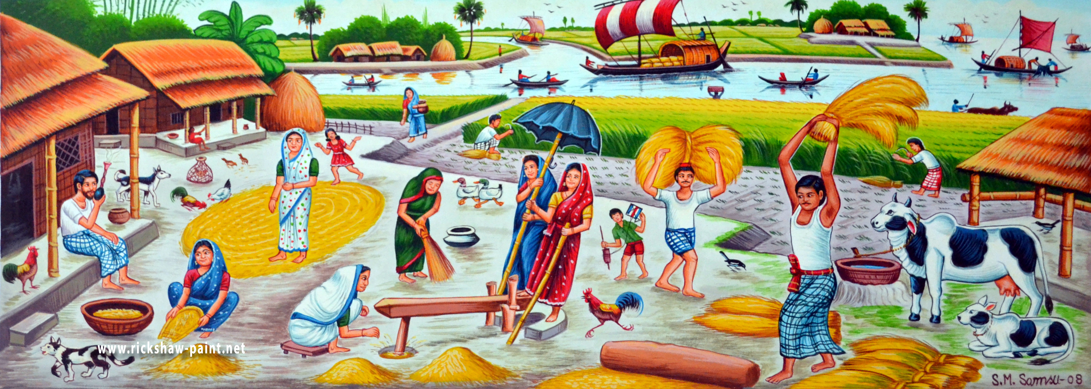
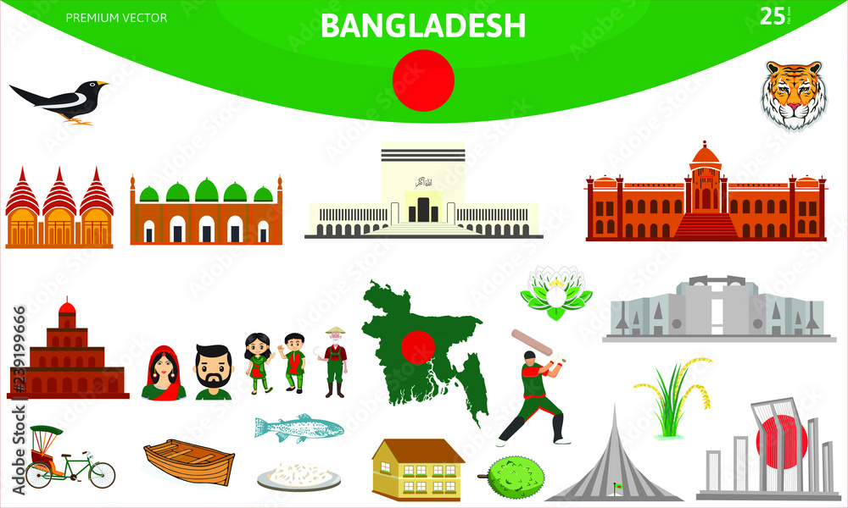
Rural Culture
There can be no culture without society
and there can be no society without culture

Slide 24
Definition of Culture and Rural Culture
Culture: Culture refers to the shared beliefs, values, customs, behaviors, practices, and artifacts that characterize a particular group of people. It encompasses the way of life, traditions, language, art, religion, social interactions, and other aspects that shape the identity of a community. Culture is learned and passed down from one generation to another, influencing how individuals perceive and interact with the world around them.
Rural Culture: Rural culture refers to the specific cultural traits and practices that are prevalent in rural or countryside areas. Rural culture often differs from urban culture due to factors like geographical isolation, close-knit communities, and traditional ways of life.

Slide 25
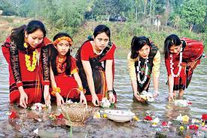
Cultural Development of Bangladesh
The cultural background of Bangladesh is diverse. The original inhabitants of this area were pre-Aryan. After words, they were influenced by Aryan thoughts. Again, this culture is influenced by the ingredients of Muslim culture of Turkey, Arab, Iran and Middle-Asia. Lastly, with the arrival of the Europeans especially the British, A different cultural trend was set. In this way, in course of time, our culture gradually developed with the essence of different cultures

Slide 26
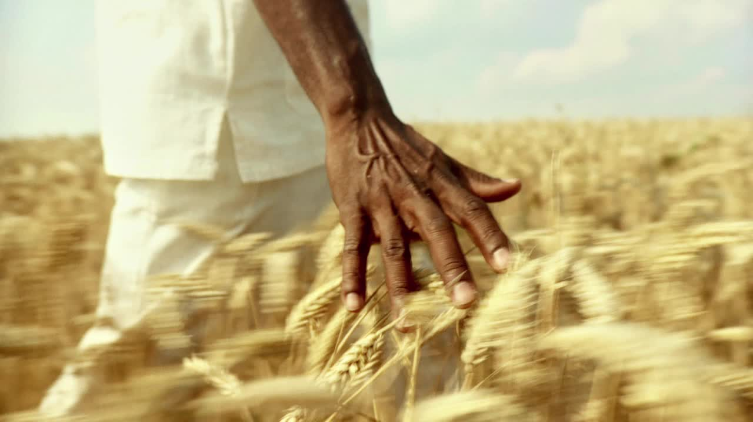
The Importance of Culture in a Rural Society (1)
Identity and Belonging: Culture provides a sense of identity and belonging to individuals within a rural community. It helps people understand their roots, history, and shared values, creating a strong bond among community members.
Preservation of Traditions: Rural cultures often preserve ancient traditions, rituals, and knowledge that have been passed down through generations. These traditions offer a sense of continuity and a connection to the past, maintaining a link between the present and the history of the community.
Social Cohesion: Cultural practices promote social cohesion within rural societies. Shared traditions and norms provide a common framework for interaction, reducing conflicts and promoting a sense of unity among community members.
Community Support: Cultural practices often emphasize community support and mutual aid. In rural areas, where resources and services may be limited, a strong sense of community can provide essential support during times of need, such as in times of illness or natural disasters.
Coping Mechanisms: Cultural practices can serve as coping mechanisms for dealing with challenges and uncertainties. Rituals, music, dance, and storytelling can offer emotional solace and a way to process difficult experiences.
Sustainable Living: Many rural cultures are closely tied to the natural environment, promoting sustainable practices such as organic farming, water conservation, and resource management. These practices are often rooted in traditional ecological knowledge.

Slide 27
The Importance of Culture in a Rural Society (2)
7. Cultural Diversity: Rural societies can be incredibly diverse, each with its own unique cultural practices. This diversity enriches the overall cultural landscape and fosters mutual respect and understanding among different communities.
8. Economic Activities: Cultural practices, such as traditional crafts and art forms, can serve as sources of income and economic empowerment for rural communities. These activities also contribute to the local economy and preserve heritage.
9. Educational Value: Cultural practices often involve storytelling, oral histories, and hands-on learning experiences. These practices provide an informal form of education that passes down knowledge, skills, and wisdom from one generation to the next.
10. Tourism and Cultural Exchange: Rural cultures can attract tourists interested in experiencing authentic traditions and ways of life. This can provide economic opportunities and promote cross-cultural understanding and exchange.
11. Resilience and Adaptation: Culture can foster resilience by providing a foundation for adapting to changing circumstances. When faced with new challenges, rural societies can draw upon their cultural resources to find innovative solutions while maintaining their core values.
12. Health and Well-being: Cultural practices often include physical activities, communal gatherings, and rituals that contribute to the overall well-being of individuals. These practices can promote mental and emotional health as well.

Slide 28
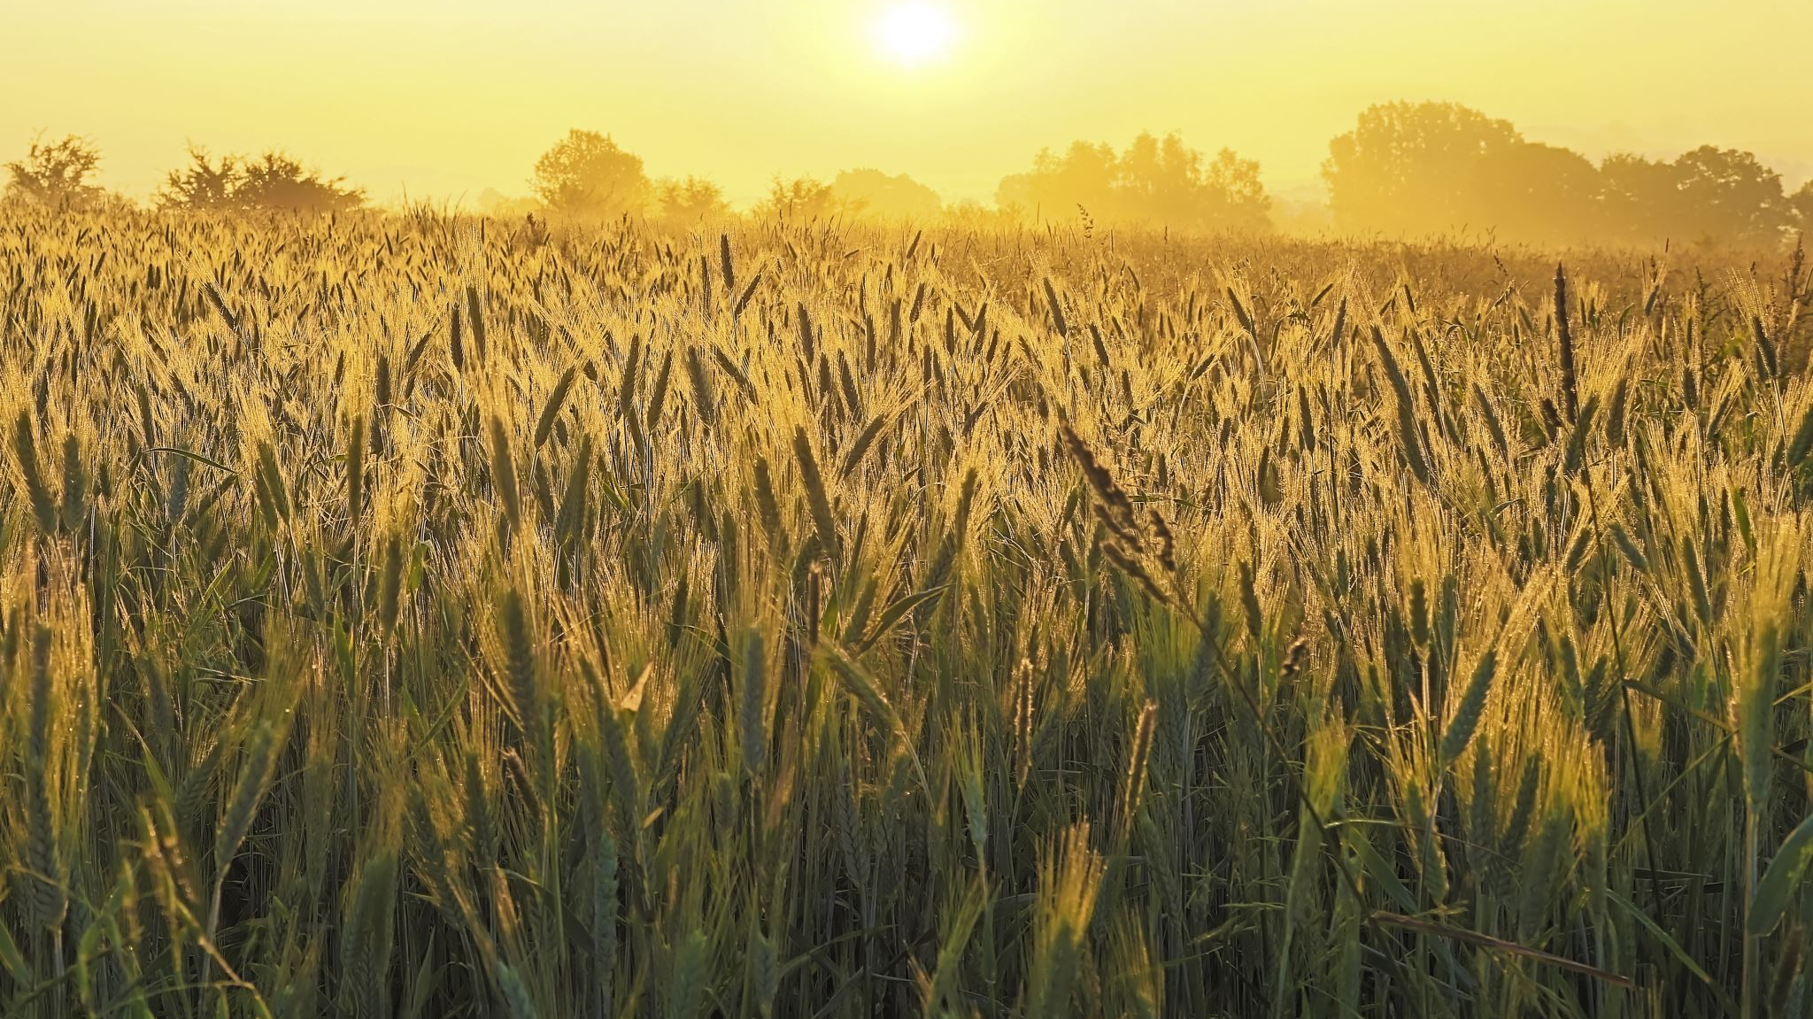
Rural Cultural Elements
Agricultural Practices: Farming and agriculture are often central to rural culture. Practices like crop cultivation, animal husbandry, and traditional farming techniques shape the way of life in rural areas.
Folk Traditions: Rural communities often maintain folk traditions and oral histories that have been passed down through generations. These may include local legends, folk songs, and traditional crafts.
Strong Community Bonds: Rural areas tend to have close-knit communities where neighbors know each other well and provide support during times of need.
Celebration of Harvest: Many rural cultures have festivals or celebrations centered around the harvest season, marking an important cycle of rural life.
Connection to Nature: Rural cultures often have a deep connection to the natural environment, with practices that reflect a reliance on and appreciation for nature.
Slower Pace of Life: Rural areas may have a more relaxed and unhurried way of life compared to the fast-paced urban environment.
Limited Access to Modern Amenities: In some cases, rural areas may have limited access to modern amenities like advanced technology, which can influence the lifestyle and cultural practices of the community.

Slide 29
Rural Cultural Practices (1)
Agricultural Festivals: Bangladesh is primarily an agrarian society, and agricultural festivals are an integral part of rural culture. Events like "Pohela Boishakh" (Bengali New Year) and "Borsha Utshob" (Rain Festival) celebrate the harvest season and the importance of agriculture to the community.
Folk Music and Dance: Folk music and dance are deeply rooted in rural culture. Traditional musical instruments like the "ektara" (single-stringed instrument) and "dhol" (drum) are used to accompany performances that depict local stories, myths, and social themes.
Traditional Crafts: Rural communities in Bangladesh are known for their traditional crafts such as pottery, weaving, and bamboo craft. These skills are often passed down through generations and contribute to the local economy.
Baul and Bhatiali Music: These are unique forms of folk music in Bangladesh. The Baul tradition involves itinerant mystic singers who sing about spiritualism, love, and social issues. Bhatiali music, on the other hand, is often associated with boatmen and reflects their life on the rivers.
Paddy Cultivation: Rice is the staple food in Bangladesh, and paddy cultivation is a central aspect of rural life. The process of planting, nurturing, and harvesting rice involves community cooperation and is often marked by various rituals.

Slide 30
Rural Cultural Practices (2)
6. Additional Clothing: In rural areas, traditional clothing is still commonly worn. Women often wear sarees, while men wear the panjabi and lungi. These clothing choices reflect cultural identity and practicality in the local climate.
7. Religious Festivals: Islam is the predominant religion in Bangladesh, and religious festivals like Eid-ul-Fitr and Eid-ul-Adha are celebrated with great fervor in rural areas. These celebrations involve prayers, feasting, and acts of charity.
8. Village Fairs: Village fairs are a common occurrence in rural Bangladesh. These fairs serve as a platform for buying and selling goods, showcasing traditional crafts, and participating in cultural events, including music and dance performances.
9. Traditional Medicine: In rural areas, traditional forms of medicine, often based on herbal remedies and ancient practices, continue to be used alongside modern medical treatments.
10. Community Bonding: Rural communities in Bangladesh often have strong social bonds. Neighbors and extended families play a crucial role in each other's lives, providing support during events like weddings, funerals, and other significant life milestones.
11. Fishing Culture: Many rural communities in Bangladesh are located near rivers and bodies of water, leading to a strong fishing culture. Fishing techniques, boat-building, and river-based livelihoods are integral parts of rural life.

Slide 31
Can you identify the impacts of globalization on rural culture of Bangladesh?

Slide 32
The Positive Impacts of Globalization on Rural Culture
Cultural Exchange and Enrichment
Economic Opportunities
Access to Information and Education
Empowerment and Advocacy
Skill Exchange and Innovation
Cultural Tourism and Income Generation
Skill Exchange and Innovation
Global Advocacy for Indigenous Rights
Tourism and Cultural Showcasing
Integration of Global Trends

Slide 33
The Negative Impacts of Globalization on Rural Culture
Cultural Erosion: Globalization often introduces external cultural influences that can overpower and replace local traditions and practices. This can lead to a loss of unique cultural identity as rural communities adopt more mainstream and globalized norms.
Language Shift: As global languages such as English become more prominent, there can be a decline in the usage and importance of indigenous languages within rural communities. This shift can result in the loss of linguistic diversity and the cultural knowledge embedded in local languages.
Loss of Traditional Knowledge: As modern technologies and practices are introduced through globalization, traditional knowledge and skills may be marginalized. This can affect various aspects of rural life, including agricultural practices, herbal medicine, and craftsmanship.
Consumerism and Materialism: Globalization often promotes consumerism and materialistic values, which can undermine traditional values that prioritize community, relationships, and sustainable living. This shift can lead to a focus on acquiring material possessions rather than valuing cultural heritage.
Dependency on External Goods: The influx of mass-produced goods from global markets can lead to a decline in local craftsmanship and self-sufficiency.
Social Disruption: Rapid globalization can disrupt traditional social structures and hierarchies within rural communities. Changes in economic opportunities and access to information can lead to tensions and conflicts over resources and power dynamics.
Loss of Cultural Diversity: As global cultural norms and trends become dominant, there is a risk of cultural homogenization. This can lead to the loss of diverse cultural expressions and practices that make each rural community unique.
Marginalization of Indigenous People: Indigenous communities often face the negative impacts of globalization disproportionately. Their traditional practices and livelihoods can be threatened by land encroachments, resource exploitation, and external influences.
Health and Lifestyle Changes: Globalization can introduce new dietary habits, lifestyles, and health issues. These changes may not align with traditional practices, leading to health challenges and undermining traditional methods of well-being.

Slide 34
References
Sociology : C. N. Shankar Rao; 2007.
Introduction to Rural Sociology by Paul L. Vogt.
Rural Sociology by S.L. Doshi.
Introduction to Rural Sociology by Musa Dantani Baba.
Rural Sociology by Shambhu Lal Doshi.
https://uogqueensmcf.com/wp-content/uploads/2020/BA%20Modules/Sociology/1.%20Sociology%20modiles/Year%20three/Semester%201/Rural%20sociology%20handaout%201st.pdf

Slide 35
THANK YOU!

