Slide 1
ANTIDIARRHEAL DRUGS

Slide 2
Any medication which provides symptomatic relief for diarrhea. Diarrhea is the condition of having three or more loose or liquid bowel movements per day.
The most common cause of acute diarrhea is infection--viral, bacterial, and parasitic & also starting a new medication.
Drug-induced diarrhea is very common because many drugs cause diarrhea. The clue to drug-induced diarrhea is that the diarrhea begins soon after treatment with the drug is begun. The medications that most frequently cause diarrhea are antacids and nutritional supplements that contain magnesium.

Slide 3
Examples of medications that commonly cause diarrhea are
nonsteroidal anti-inflammatory drugs (NSAIDs),
chemotherapy medications,
antibiotics,
medications to control irregular heartbeats (antiarrhythmics), and
medications for high blood pressure.
misoprostol,
quinidine,
olsalazine,
colchicine,
metoclopramide, and
cisapride.

Slide 4
Management
In many cases of diarrhea, replacing lost fluid and salts is the only treatment needed. This is usually by mouth – oral rehydration therapy – or, in severe cases, intravenously
Types of drugs that can be used:
Electrolyte solutions are used to replace lost fluids and salts in acute cases.
Antibiotics such as Metronidazole.
Bulking agents like methylcellulose, guar gum or plant fiber are used for diarrhea in functional bowel disease and to control ileostomy output.
Absorbents absorb toxic substances that cause infective diarrhea, methylcellulose is an absorbent.
Anti-inflammatory solutions like Bismuth subsalicylate.
Opioids' classical use besides pain relief is as an anti-diarrheal drug.

Slide 5
Antibiotics
Most episodes of diarrhea are acute and of short duration and do not require antibiotics. Antibiotics are not even necessary for the most common bacterial infections that cause diarrhea. Antibiotics, however, often are used when-
patients have more severe and persistent diarrhea,
patients have additional debilitating diseases such as heart failure, lung disease, and AIDS,
stool examination and testing discloses parasites, more serious bacterial infections (for example, Shigella, or C. difficile, and traveler's diarrhea.

Slide 6
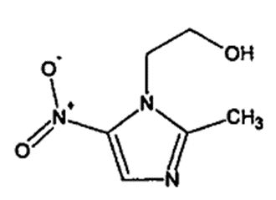
Metronidazole
Metronidazole is 2-Methyl-5-nitroimidazole-1-ethanol, the most useful of a group of antiprotozoal nitroimidazole derivatives. It has been speculated that a reactive intermediates formed on the microbial reduction of the 5-nitro group of metronidazole covalently binds to the DNA of the microorganism triggering the lethal effect.

Slide 7
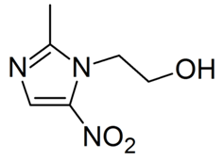
Synthesis of metronidazole
2-Methylimidazole is nitrated to give 2-methyl-4(5)-nitroimidazole, which is in turn alkylated with ethylene oxide or 2-chloroethanol to give metronidazole. 2-Methylimidazole can be prepared via the Debus-Radziszewski synthesis, or from ethylenediamine and acetic acid.

Slide 8
Anti motility agents
Anti-motility medications are drugs that relax the muscles of the small intestine and/or the colon.
Relaxation results in slower flow of intestinal contents.
Slower flow allows more time for water to be absorbed from the intestine and colon and reduces the water content of stool.
Cramps, due to spasm of the intestinal muscles, also are relieved by the muscular relaxation.
Anti motility agents like loperamide is used in the treatment of diarrhea to slow down peristalsis and the passage of fecal material through the bowels - this means that more time is given for water to reabsorb back into the body, which gives a firmer stool, and also means that feces is passed less frequently.

Slide 9
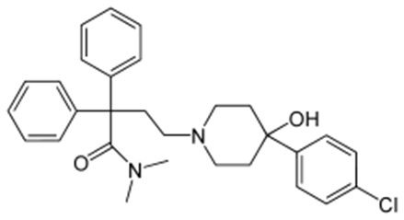
Mechanism of action
Loperamide is an opioid-receptor agonist and acts on the μ-opioid receptors in the myenteric plexus of the large intestine. Loperamide works similarly to morphine, decreasing the activity of the myenteric plexus, which decreases the tone of the longitudinal and circular smooth muscles of the intestinal wall. This increases the time material stays in the intestine, allowing more water to be absorbed from the fecal matter. Loperamide also decreases colonic mass movements and suppresses the gastrocolic reflex.

Slide 10
Synthesis of Loperamide
Loperamide is an antidiarrheal synthesized in 1969 in the lab. of Janssen Pharmaceutical, Beerse, Belgium.
The Janssen synthesis of loperamide HCl is detailed in Fig.1. ἁ(2-Bromoethyl)- ἁ -phenyl benzene acetonitrile is converted through a series of reactions to N-[dihydro-3,3-diphenyl-2(3H)-furanylidene-N-methyl methanaminium bromide and ethyl 4-oxo-1-piperidine carboxylate is converted to 4-(4-chlorophenyl)-4-piperidinol. The condensation of the basic piperidine nitrogen with furanylidene results in the formation of loperamide base, which is then crystallized as the hydrochloride salt.

Slide 11
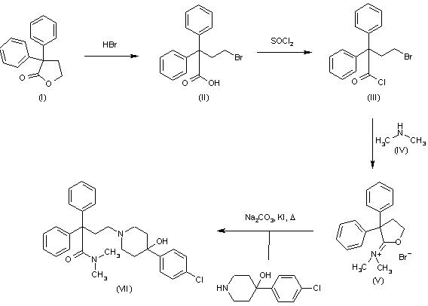
Fig-1

Slide 12
Bismuth compounds
While bismuth compounds decreased the number of bowel movements in those with travelers' diarrhea, they do not decrease the length of illness.
Many bismuth-containing preparations are available around the world. It contains two potentially active ingredients, bismuth and salicylate (aspirin). It is not clear how effective bismuth compounds are, except in traveler's diarrhea and the treatment of H. pylori infection of the stomach where they have been shown to be effective. It also is not clear how bismuth subsalicylate might work. It is thought to have some antibiotic-like properties that affect bacteria that cause diarrhea. The salicylate is anti-inflammatory and could reduce secretion of water by reducing inflammation. Bismuth also might directly reduce the secretion of water by the intestine.

Slide 13
Mechanism of action of Bismuth subsalicylate
Bismuth subsalicylate is used as an antacid and antidiarrheal. The mechanism of action is not well documented, but it is thought to be some combination of the following:
Retarding the expulsion of fluids into the digestive system by irritated tissues, by "coating" them.
Stimulation of absorption of fluids and electrolytes by the intestinal wall (antisecretory action)
As a Salicylate, reducing inflammation/irritation of stomach and intestinal lining through inhibition of prostaglandin G/H Synthase
Reduction in hypermotility of the stomach
Binding of toxins produced by Escherichia coli
Bactericidal action of a number of its subcomponents, including salicylic acid
Bactericidal action via a so-called oligodynamic effect in which small amounts of heavy metals such as bismuth are toxic for a number of microbes.
Weak antacid properties

Slide 14
Opioids
Opioids have agonist actions on the intestinal opioid receptors. opioid receptors have been classified into three major types, μ, δ and κ (c), belonging to the family of the G protein-coupled receptors. These receptors are when activated cause constipation. Drugs such as morphine or codeine, Diphenoxylate can be used to relieve diarrhea this way.

Slide 15
Opioids Used as Antidiarrheal Agents (mechanism)
Structure modification of 4-phenylpiperidines has led to the discovery of opioid analogues that are used extensively as antidiarrheal agents.
Opioid agonists that act on C and δ receptors have a strong inhibitory act ion on the peristaltic reflex on the intestine. This action occurs because endogenous opioid tracts innervate the intestinal wall, where they synapse onto cholinergic neurons.
When opioids are released onto cholinergic neurons, they inhibit the release of acetylcholine and, thus, inhibit peristalsis.
Any C agonist used in medicine causes constipation as a side effect. Most C agonists are not used as antidiarrheal agents because of their potential for abuse and addiction.

Slide 16
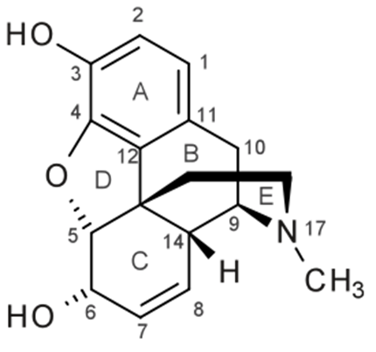
SAR of Opioids
14-alkoxy analogues of naltrindole, naloxindole and naltriben with different benzyloxy substitution in position 14 have been investigated
The character and length of the substituent in position 14 determines the opioid binding affinity.
Introduction of 14-benzyloxy groups resulted in reduced affinity and selectivity for the δ receptor.

Slide 17
The study indicate that position 14 of indolo- and benzofuromorphinans represents a increased δ affinity and/or selectivity. Thus substituent at position 14 has a major impact on the abilities of morphinans to interact with opioid receptors.
The replacement of the N-allyl by an N-cyclopropylmethyl group in position 17 resulted in increased δ affinity without affecting δ receptor selectivity.
Using an allyl, cyclopropylmethyl or cyclobutylmethyl substitution on the 17-nitrogen tends to produce antagonists (or sometimes partial agonists) with the classic opiate derivatives, as well as morphinans and benzomorphans.
If there is a bulky 7-substituent it always produces a partial agonist at least, even if there is a cyclopropylmethyl on the nitrogen (buprenorphine for instance).

Slide 18
Other Antidiarrheal Drugs
The following drugs can also be used to treat diarrhea but only when diarrhea is caused by specific conditions.
Absorbents for infectious diarrhea work by absorbing the toxins produced by infectious agents. Examples: kaolin, pectin and methylcellulose.
Bile acid binding resins form a complex with bile salts to reduce water secretion into the bowels. Examples: cholestyramine.
Octerotride that mimics the digestive hormone somastatin and inhibits bowel motility.

