Slide 1
SE 234: Theory of Computation
SE 234: Lecture 5
Fatama Binta Rafiq (FBR)
Lecturer, Department of Software Engineering

Slide 2
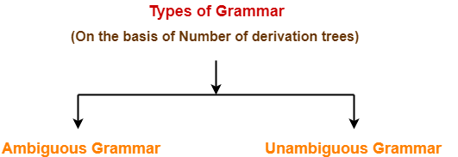
Types of Grammar
On the basis of number of derivation trees, grammars are classified as-
Ambiguous Grammar
Unambiguous Grammar

Slide 3
1. Ambiguous Grammar-
A grammar is said to ambiguous if for any string generated by it, it produces more than one-
Parse tree
Or derivation tree
Or syntax tree
Or leftmost derivation
Or rightmost derivation

Slide 4
Example-
Consider the following grammar-
E → E + E | E x E | id
Ambiguous Grammar
This grammar is an example of ambiguous grammar.
Any of the following reasons can be stated to prove the grammar ambiguous-

Slide 5
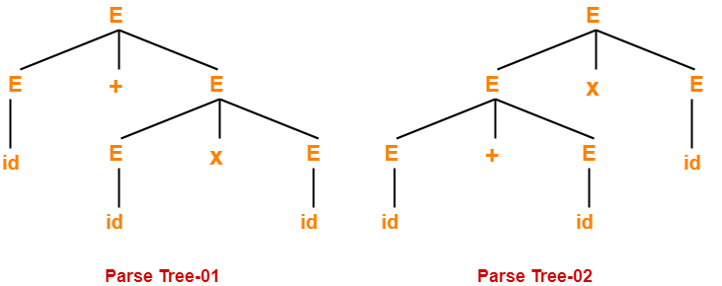
Reason-01:
Let us consider a string w generated by the grammar-
w = id + id x id
Now, let us draw the parse trees for this string w.

Slide 6
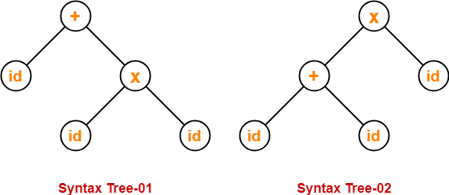
Reason-02:
Let us consider a string w generated by the grammar-
w = id + id x id
Now, let us draw the syntax trees for this string w.
Since two syntax trees exist for string w, therefore the grammar is ambiguous.

Slide 7
Reason-03:
Let us consider a string w generated by the grammar-
w = id + id x id
Now, let us write the leftmost derivations for this string w.
Since two leftmost derivations exist for string w, therefore the grammar is ambiguous.

Slide 8
Reason-04:
Let us consider a string w generated by the grammar-
w = id + id x id
Now, let us write the rightmost derivations for this string w.
Since two rightmost derivations exist for string w, therefore the grammar is ambiguous.

Slide 9
2. Unambiguous Grammar-
A grammar is said to unambiguous if for every string generated by it, it produces exactly one-
Parse tree
Or derivation tree
Or syntax tree
Or leftmost derivation
Or rightmost derivation
Example-
Consider the following grammar-
E → E + T / T
T → T x F / F
F → id
Unambiguous Grammar
This grammar is an example of unambiguous grammar.

Slide 10
Grammar Ambiguity-
There exists no algorithm to check whether any given grammar is ambiguous or not.
This general decision problem is undecidable-
“Whether a grammar is ambiguous or not?”
This is because it can be shown that this problem is equivalent to Post Correspondence Problem.

Slide 11
General Approach To Check Grammar Ambiguity-
To check whether a given grammar is ambiguous or not, we follow the following steps-
Step-01:
We try finding a string from the Language of Grammar such that for the string there exists more than one-
parse tree
or derivation tree
or syntax tree
or leftmost derivation
or rightmost derivation
Step-02:
If there exists at least one such string, then the grammar is ambiguous otherwise unambiguous.

Slide 12
PROBLEMS BASED ON CHECKING WHETHER GRAMMAR IS AMBIGUOUS-
Problem-01:
Check whether the given grammar is ambiguous or not-
S → SS
S → a
S → b

Slide 13
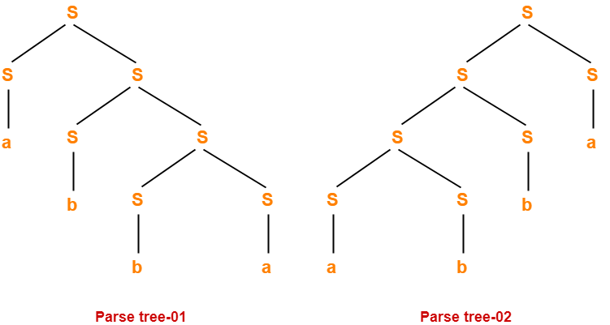
Solution-
Let us consider a string w generated by the given grammar-
w = abba
Now, let us draw parse trees for this string w.
Since two different parse trees exist for string w, therefore the given grammar is ambiguous.

Slide 14
Problem-02:
Check whether the given grammar is ambiguous or not-
S → A / B
A → aAb / ab
B → abB / ∈

Slide 15
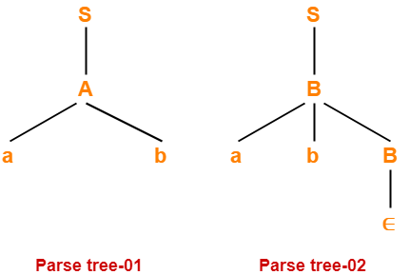
Solution-
Let us consider a string w generated by the given grammar-
w = ab
Now, let us draw parse trees for this string w.
Since two different parse trees exist for string w, therefore the given grammar is ambiguous.

Slide 16
Problem-03:
Check whether the given grammar is ambiguous or not-
S → AB / C
A → aAb / ab
B → cBd / cd
C → aCd / aDd
D → bDc / bc

Slide 17
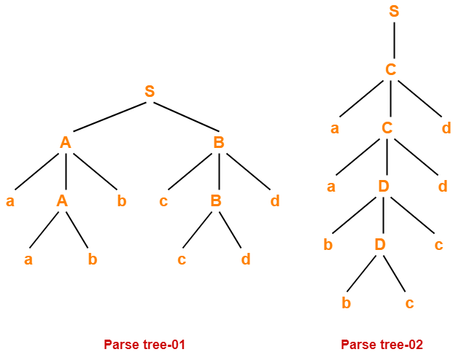
Solution-
Let us consider a string w generated by the given grammar-
w = aabbccdd
Now, let us draw parse trees for this string w.
Since two different parse trees exist for string w, therefore the given grammar is ambiguous.

Slide 18
Problem-04:
Check whether the given grammar is ambiguous or not-
S → AB / aaB
A → a / Aa
B → b

Slide 19
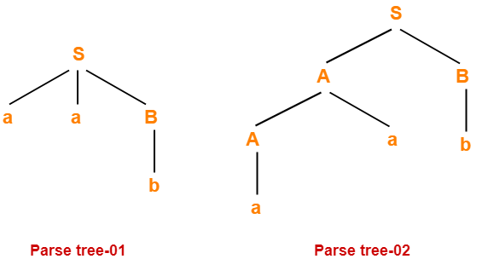
Solution-
Let us consider a string w generated by the given grammar-
w = aab
Now, let us draw parse trees for this string w.
Since two different parse trees exist for string w, therefore the given grammar is ambiguous.

Slide 20
Problem-05:
Check whether the given grammar is ambiguous or not-
E → E + T / T
T → T x F / F
F → id

Slide 21
Solution-
There exists no string belonging to the language of grammar which has more than one parse tree.
Since a unique parse tree exists for all the strings, therefore the given grammar is unambiguous.

Slide 22
Problem-06:
Check whether the given grammar is ambiguous or not-
S → aSbS / bSaS / ∈

Slide 23
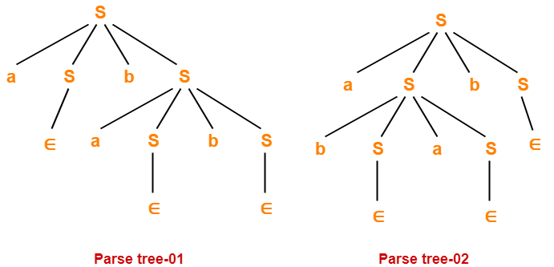
Solution-
Let us consider a string w generated by the given grammar-
w = abab
Now, let us draw parse trees for this string w.
Since two different parse trees exist for string w, therefore the given grammar is ambiguous.

Slide 24
Problem-07:
Check whether the given grammar is ambiguous or not-
R → R + R / R . R / R* / a / b

Slide 25
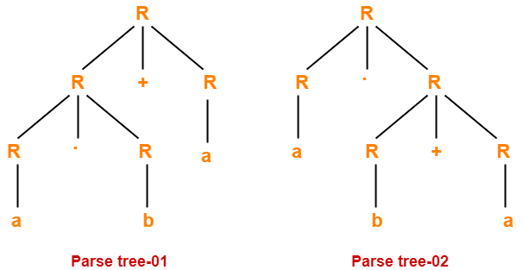
Solution-
Let us consider a string w generated by the given grammar-
w = ab + a
Now, let us draw parse trees for this string w.
Since two different parse trees exist for string w, therefore the given grammar is ambiguous.

