Slide 1
Correlation Analysis
Akibul Islam Chowdhury
Lecturer
NFE, DIU

Slide 2
Correlation
It is a statistical measure that describes the relationship between two or more variables.
It helps us understand how changes in one variable are associated with changes in another variable.
The key idea behind correlation is to determine the degree to which two variables tend to move together or apart.

Slide 4
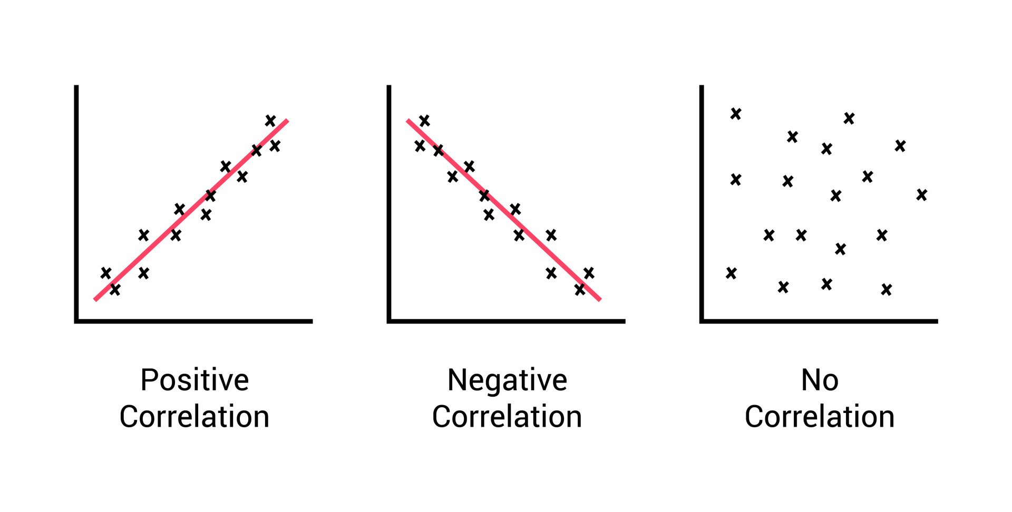
Positive Correlation: This implies that when one variable increases, the other one tends to increase as well, and when one variable decreases, the other one tends to decrease.
Negative Correlation: On the other hand, when two variables have a negative correlation, they move in opposite directions.

Slide 5
1. Simple Correlation or Bivariate correlation:
refers to the statistical relationship between two variables only.
It measures the strength and direction of the linear association between two quantitative variables.
The most common method to quantify the simple correlation between two variables is by using the Pearson correlation coefficient (denoted as "r").
The Pearson correlation coefficient ranges from -1 to +1, where +1 indicates a perfect positive correlation, -1 indicates a perfect negative correlation, and 0 indicates no correlation.

Slide 6
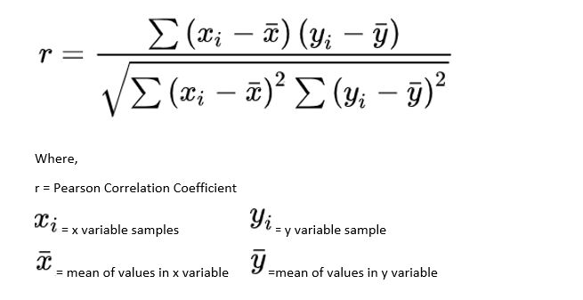

Slide 7
Steps to calculate the Pearson correlation coefficient (r):
Calculate the mean (ˉxˉ) of variable x and the mean (ˉyˉ​) of variable y.
For each data point, subtract the mean of the corresponding variable (x or y) from the data point.
Square each of the differences obtained in step 2.
Multiply the differences obtained for each data point (x and y) and sum up these products.
Take the square root of the sum of the squared differences for variable x and the square root of the sum of the squared differences for variable y.
Divide the sum of the products (from step 4) by the product of the square roots (from step 5).

Slide 8
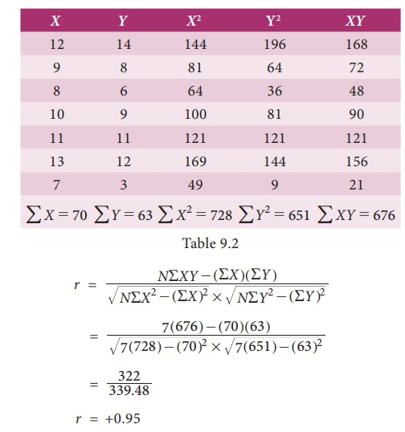

Slide 9
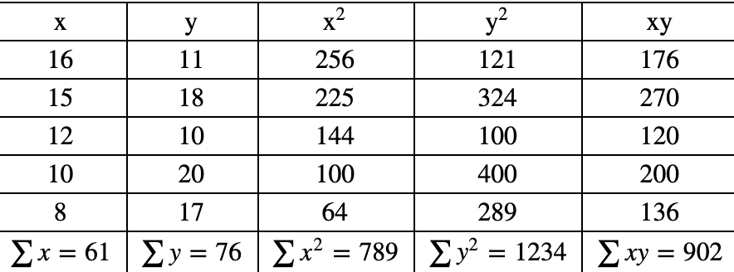
Now calculate Pearson Correlation Coefficient(r) from the following table:

Slide 10
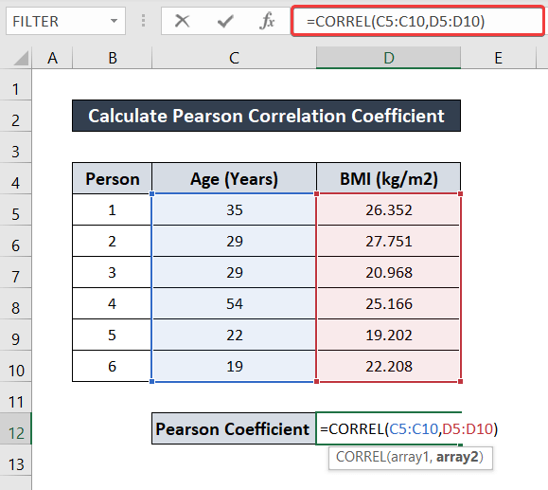
How to calculate Pearson correlation coefficient in excel:

Slide 11
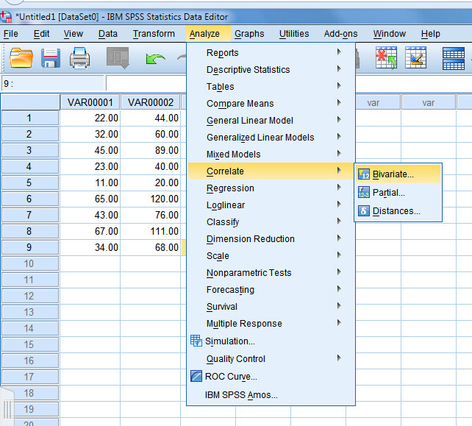
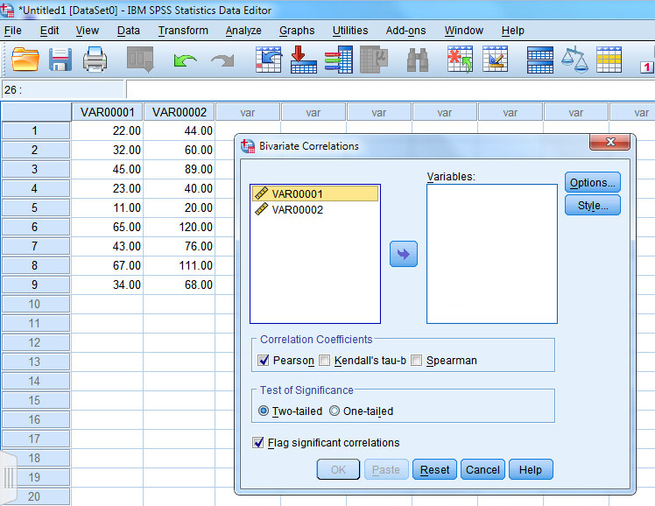
How to calculate Pearson correlation coefficient in SPSS:

Slide 12
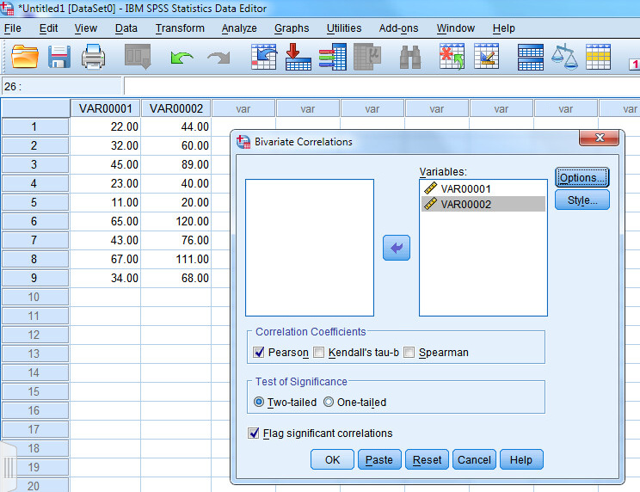
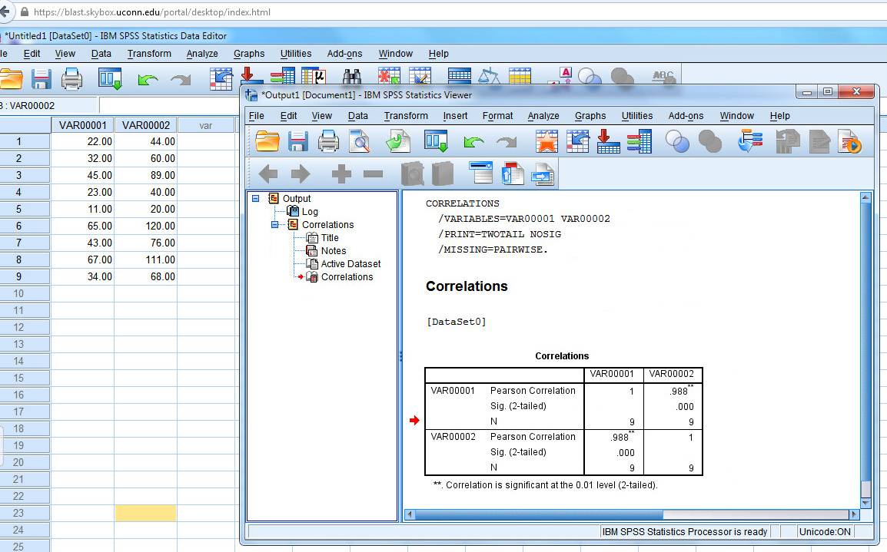
Your output will appear in a separate window. The output shows
Pearson’s correlation coefficient (r=.988),
the two-tailed statistical significance and
the number of pairs (N=9).

Slide 13
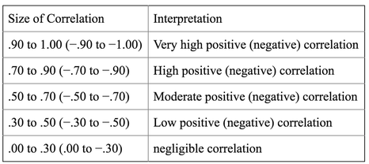
Interpretation of correlation
How to interpret correlation coefficients:
Strength of the Relationship
Direction of the Relationship
Magnitude of the Correlation

Slide 14
Example interpretations:
If the correlation coefficient is +0.85, it indicates a strong positive linear relationship between the two variables.
If the relationship is statistically significant (p < 0.05), you can say that there is strong evidence to suggest that as one variable increases, the other variable tends to increase as well.
Correlation does not indicate causation or capture non-linear associations. So, it should be mentioned.

