Slide 1
Epidemiological studies
Faisal Muhammad
Lecturer & IMPH Coordinator, Department of Public Health, DIU

Slide 2
Learning Objectives:
Randomized Control Trial (RCT)
Community trial
Field trial

Slide 3
Randomized Control Trial
( Abbreviated as RCT )
An epidemiologic experiment in which subjects in a population are randomly allocated in to groups, usually called study group/treatment group/intervention group/Experimental group and control groups/ comparison group/ current group/ Reference group to receive or not to receive an experimental, preventive or therapeutic procedure, maneuver or intervention.

Slide 4
Goal of RCT
Primary Goal
To test whether an intervention works by comparing it to a control condition (usually either no intervention or an alternative intervention).
Secondary Goals
Identify factors that influence the effects of the intervention (i.e., moderators)
Understand the processes through which an intervention influences change (i.e. mediators or change mechanisms that bring about the intervention effect)

Slide 5
RCT
A randomized controlled trial (is a type of scientific (often medical) experiment, where the people being studied are randomly allocated one or other of the different treatments under study. The RCT is the gold standard for a clinical trial.

Slide 7
Randomization
The advantages of proper randomization in RCTs include
"It eliminates bias in treatment assignment," specifically selection bias and confounding.
"It facilitates blinding (masking) of the identity of treatments from investigators, participants, and assessors."
"It permits the use of probability theory to express the likelihood that any difference in outcome between treatment groups merely indicates chance."

Slide 8
Randomization
It is the heart of a control trial.
Randomization entails allocating the available participants to one or another study group.*
One group generally receives intervention (study), other does not or receives different intervention (control).
It is different from Random sampling.
Gives confidence of like being compared to like.
*Jekel’s Epidemiology, Biostatistics, Preventive Medicine, and Public Health

Slide 9
Randomization
Randomization aims at:
Achieving Internal Validity.
Eliminate bias (Selection bias).
Allowing comparability.
Equally distributing the “other” factors which are important but not recognized or
cannot be determined, equally between the two groups.

Slide 10
Methods of Randomization
Various methods are:
Simple Random Allocation
Randomization in groups of Two
Systematic Allocation
Stratified Allocation
All methods assume that an equal number of participants is desired in both groups.

Slide 11
Simple Random Allocation
This is the most elementary form of randomization.
It is usually carried out using:
A random-number table or
A computerized random number generator.
The Advantage of simple randomization is its ease.
The Disadvantage is the possibility of an imbalance between the two groups at any
one point specially if the sample size is small.

Slide 12
Randomization in groups of Two
Also known as Block Randomization.
Block randomization reduces the risk that different numbers of people will be assigned to the Group A (Intervention) and Group B (Control).
At any time, if an even number of patients have been admitted into the study, exactly half would be assigned to Group A and half to Group B.
The order of assignment is randomized.
In randomly permuted blocks, there are several block sizes (e.g., 4, 6, and 8), and the block size and specific order are chosen randomly at the beginning of each block

Slide 13
Systematic Allocation
This method also ensures equal number of participants in experimental and control
groups if even no. of participants take part in the study.
Here, first patient is randomly allocated to a group, next patient goes to alternate group automatically.
Subsequent patients are allocated into groups alternatively.
Being convenient and having statistical advantages makes this method desirable to use whenever possible.
This can also be used for allocating study participants to three, four or more groups.

Slide 14
Stratified Allocation
It is often called Prognostic Stratification.
It is done to ensure that the treatment and control groups are balanced on important prognostic factors that can influence the study outcome (e.g., gender, ethnicity, age, socioeconomic status).
Investigator decides which strata are important and how many stratification variables can be considered given the proposed sample size.
A separate simple or blocked randomization schedule is developed for each stratum.
Large trials often use randomly permuted blocks within stratification groups.

Slide 15
Stratified Randomization
*Epidemiology by Leon Gordis : 4th Edition

Slide 16
Advantages (RCT)
RCTs are considered by most to be the most reliable form of scientific evidence in the hierarchy of evidence that influences healthcare policy and practice because RCTs reduce spurious causality and bias.
Results of RCTs may be combined in systematic reviews which are increasingly being used in the conduct of evidence-based practice.

Slide 17
Disadvantages
Power calculation might demand vast samples size, which require more resources from the investigators.
Validity requires multiple sites, which will be difficult to manage.
Long trial run time may result in the loss of relevance as practice may have moved on by the time the trial is published.
Trials which test for efficacy may not be widely applicable. Trials which test for effectiveness are larger and more expensive.
Results may not always mimic real life treatment situation (e.g. inclusion / exclusion criteria; highly controlled setting).
Randomization requires clinical equipoise: one cannot ethically randomize patients unless both treatments have equal support in the clinical community.
Informed consent is often impossible.
Some research cannot be ethically performed as an RCT (classically, RCT of the effects of parachutes on the survival of sky-divers).

Slide 18
Community trials
Community trials, also called community intervention studies, are (mostly preventive) experimental studies with whole communities (such as cities or states) as experimental units; that is, interventions are assigned to all members in each of a number of communities.
This is appropriate for disease that have their origins in social conditions , which in turn can most easily influenced by intervention directed at group behavior as well as individuals, for example cardiovascular disease.

Slide 19
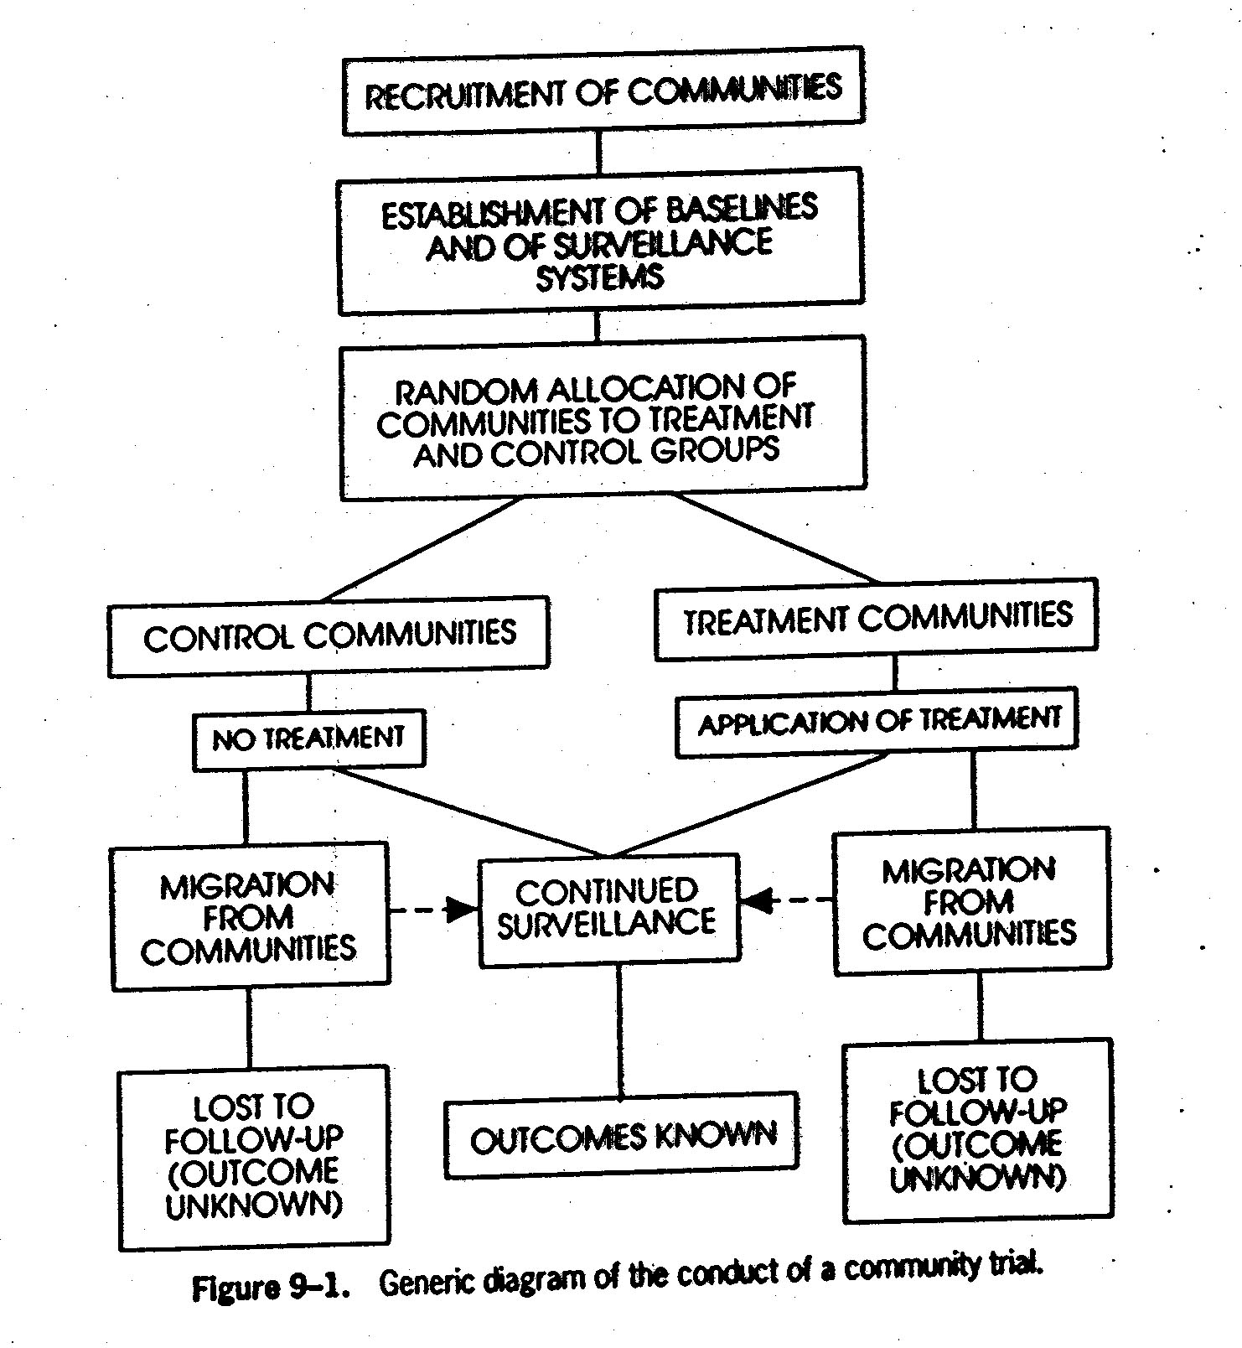

Slide 20
Field trial
This study involves people who are disease free presumed to be at risk . Vaccine trials are example of field trials.
This method can be used to evaluate interventions aimed at reducing exposure without necessarily measuring the occurrence of health effects. The main disadvantage e of this study are that it causes huge undertaking of involving major logistics and financial consideration.

Slide 21
Field Trial
Conducted with healthy individuals in the community as unit of study.
Undertaken in respect of a preventive procedure (e.g. vaccine, sera, chemoprophylaxis, personal protective measures, etc.)
Example: The trial of injectable polio vaccine.
Over a million children, apparently healthy, living in the community, were randomly divided and offered either the vaccine or the placebo; the trial finally provided strong evidence of the efficacy of injectable polio vaccine.

Slide 22
Thank You

