Slide 1
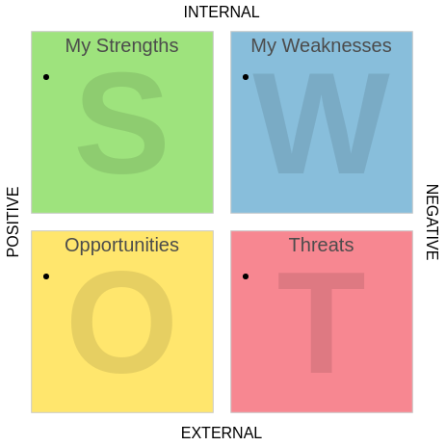

Slide 2
Key Questions of Strengths

Slide 3
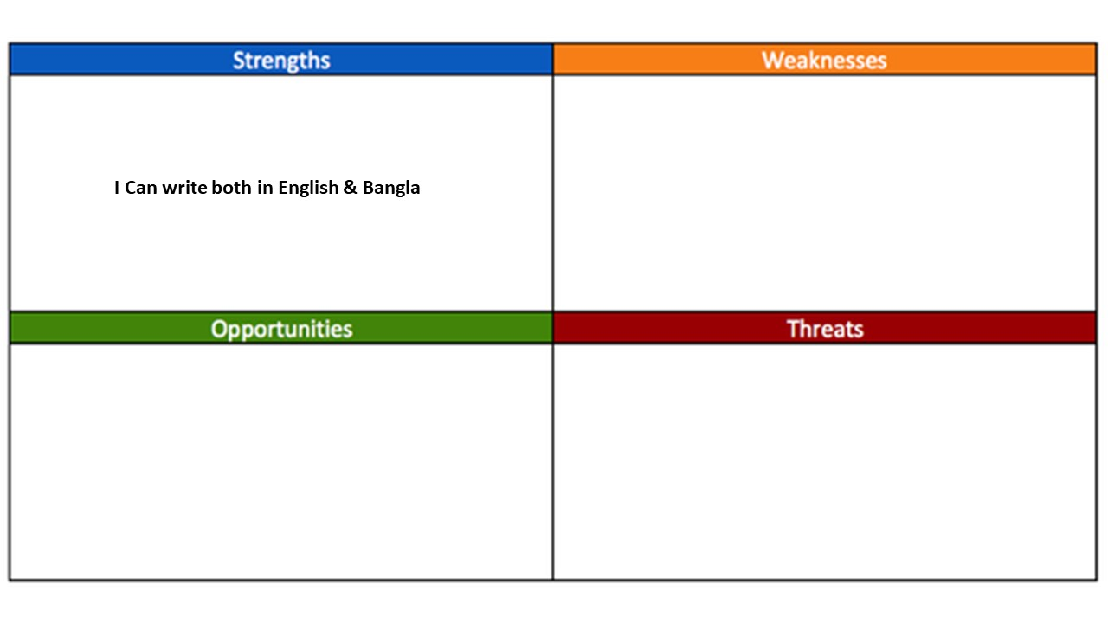
Example of Strength

Slide 4
Key Questions of Weaknesses

Slide 5
Example of Weakness

Slide 6
Key Questions of Opportunities

Slide 7
Example of Opportunities

Slide 8
Key Questions of Threats

Slide 9
Example of Threats

