Slide 1
Demand, Supply & Economic Equilibrium
Chapter 02

Slide 2
Lecture 01

Slide 3
Demand
In economics, Demand is the consumer's desire and ability to purchase a good or service.
It's the underlying force that drives economic growth and expansion.
Without demand, no business would ever bother producing anything.

Slide 4
Determinants of Household Demand
A household’s decision about the quantity of a particular product/output to demand depends on
The price of the product.
The income available to the household.
The household’s amount of accumulated wealth.
The prices of related products available to the household.
The household’s tastes and preferences.
The household’s expectations about future income, wealth, and prices.

Slide 5
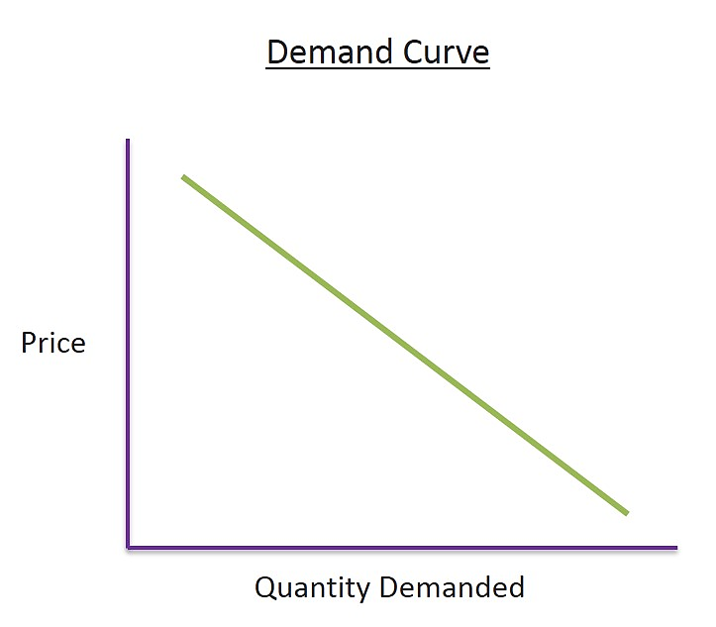
Law of Demand
Price is inversely proportionate to demand, If price increase, demand will decrease.
This is the law of demand.
In microeconomics, the law of demand states that, "conditional on all else being equal, as the price of a good increases, quantity demanded decreases; conversely, as the price of a good decreases, quantity demanded increases”
The demand curve is always downward sloping if other factors being constant.
Function of demand:
Qdx = a-b(Px)

Slide 6
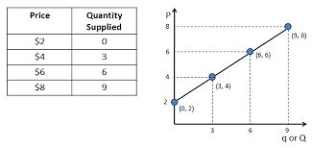
Supply
Supply means the quantities that a seller is willing and able to sell at different prices.
It is obvious that if the price goes up, he will offer more for sale.
But if the price goes down, he will be less interested to sell and will offer less to sell.

Slide 7
Law of Supply
The law of supply states that there is a positive relationship between price and quantity of a good supplied.
Higher price ensures greater quantity of supply.
Function of supply:
Qsx = a+b(Px)

Slide 8
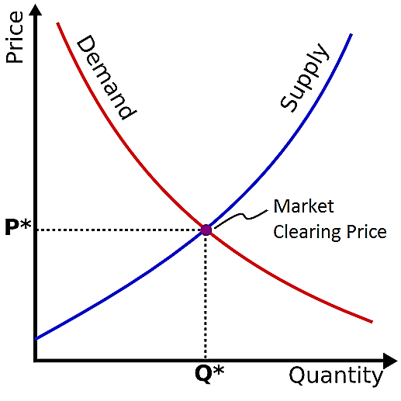
Demand-Supply Curve

Slide 9
Economic Equilibrium
In economics, economic equilibrium is a state where economic forces such as supply and demand are balanced and in the absence of external influences the (equilibrium) values of economic variables will not change.
When equilibrium occurs at the point at which quantity demanded and quantity supplied are equal.

Slide 10
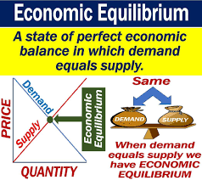

Slide 11
Market Equilibrium
The operation of the market depends on the interaction between buyers and sellers.
When the supply and demand curves intersect, the market is in equilibrium. This is where the quantity demanded and quantity supplied are equal.
The corresponding price is the equilibrium price or market-clearing price, the quantity is the equilibrium quantity.
At equilibrium, there is no tendency for the market price to change.
At this price level, market is in equilibrium. Quantity supplied is equal to quantity demanded ( Qs = Qd).

Slide 12
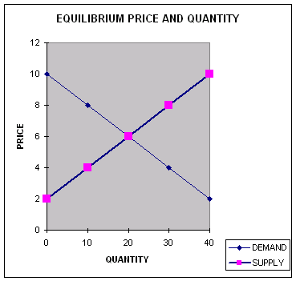
Market Equilibrium

Slide 13
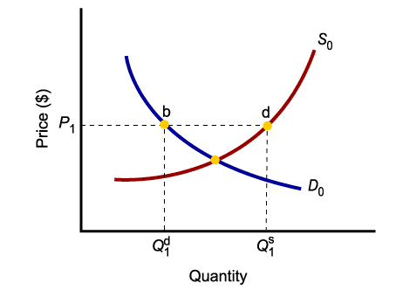
Market Equilibrium
Only in equilibrium, quantity supplied equal to quantity demanded.
At any price level other than P₀, the wishes of buyers and sellers do not coincide.

Slide 14
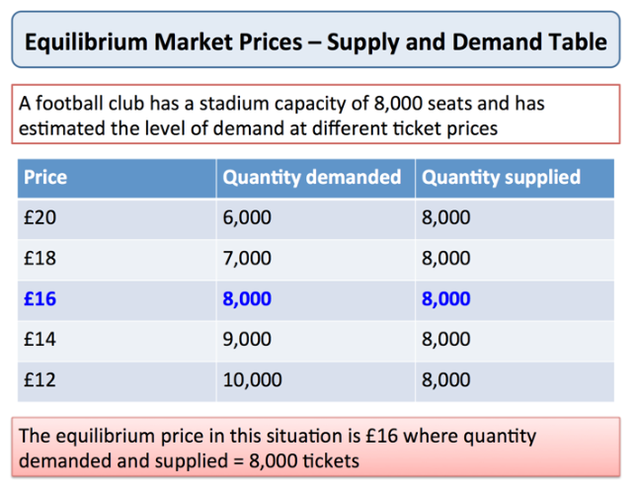

Slide 15
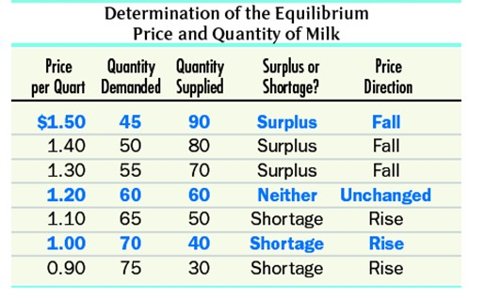

Slide 16
External Influences of equilibrium:
When QS > Qd, it causes Surplus. If Qs increases, Price decreases.
When Qd > Qs, it causes Shortage. If Qd increases, Price increases.

Slide 20
Thank You

