Slide 1
Introduction of Nuclear Power Plant
Dr. Alam Hossain Mondal
Associate Professor, DIU
Contact: 01677080070

Slide 2
Nuclear Power Plant
A generating station in which nuclear energy is converted into electrical energy is known as a nuclear power station
In nuclear power station, heavy elements such as Uranium (U235) or Thorium (Th232) are subjected to nuclear fission in a special apparatus known as a reactor. The heat energy thus released is utilized in raising steam at high temperature and pressure. The steam runs the steam turbine which converts steam energy into mechanical energy. The turbine drives the alternator which converts mechanical energy into electrical energy

Slide 3
Nuclear Power Plant
Advantages
The amount of fuel required is quite small.
A nuclear power plant requires less space as compared to any other type of the same size.
It has low running charges as a small amount of fuel is used for producing bulk electrical energy.
This type of plant is very economical for producing bulk electricity.
It can be located near the load centres because it does not require large quantities of water and need not be near coal mines. Therefore, the cost of primary distribution is reduced.
There are large deposits of nuclear fuels available all over the world.
It ensures reliability of operation.

Slide 4
Nuclear Power Plant
Disadvantages
The fuel used is expensive and is difficult to recover.
The capital cost on a nuclear plant is very high.
The erection and commissioning of the plant requires greater technical know-how.
The fission by-products are generally radioactive and may cause a dangerous amount of radioactive pollution.
Maintenance charges are high due to lack of standardization. Moreover, high salaries of specially trained personnel employed to handle the plant further raise the cost.
Nuclear power plants are not well suited for varying loads.
The disposal of the by-products, which are radioactive, is a big problem. They have either to be disposed off in a deep trench or in a sea away from sea-shore.

Slide 5
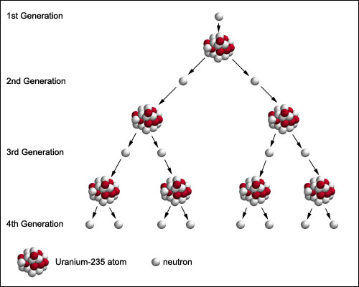
Nuclear Power Plant
Chain Reaction: A chemical reaction or other process in which the products themselves promote or spread the reaction.
the self-sustaining fission reaction spread by neutrons which occurs in nuclear reactors and bombs.
a series of events, each
caused by the previous one.

Slide 6
Nuclear Power Plant
Fission Process/Reaction: Uranium exist as isotopes of U238, U234 and U235 . Out of these isotopes U235 is most unstable. When a neutron is captured by a nucleus of an atom of U 235, it splits up roughly into two equal fragments and about 2.5 neutrons are released and a large amount
of energy is produced. This is called fission process.
Unit of Radioactivity: The curie is a unit of ionizing radiation (radioactivity), symbolized Ci and equal to 3.7 x 10¹⁰ disintegrations or nuclear transformations per second. This is approximately the amount of radioactivity emitted by one gram (1 g) of radium-226. It is the rate of decay of one gram of radioactivity element radium.

Slide 7
Nuclear Power Plant
Fertile Material: It is defined as the material which absorbs neutrons and undergoes spontaneous changes which lead to the formation of fissionable material. U235 and Th232 are fertile materials.

Slide 8
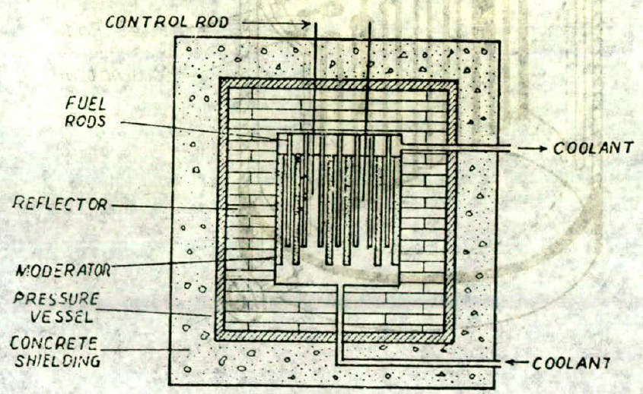
Nuclear Power Plant
Parts of a Nuclear Reactor: A nuclear reactor is an apparatus in which heat is produced due to nuclear fission chain reaction. Parts are as follows: (i) Nuclear Fuel (ii) Moderator (iii) Control Rods (iv) Reflector
(v) Reactors Vessel (vi) Biological Shielding and (vii) Coolant.

Slide 9
Nuclear Power Plant
Nuclear Fuel
Fuel of a nuclear reactor should be fissionable material which
can be defined as an element or isotope whose nuclei can be caused
to undergo nuclear fission by nuclear bombardment and to produce
a fission chain reaction. It can be one or all of' the following U233,
U235 and Pu239. Natural uranium found in earth crust contains three isotopes namely U234, U235 , U238
Out of these U235 is most unstable and is capable for sustaining chain reaction and has been given the name as primary fuel.

Slide 10
Nuclear Power Plant
Fuel element should process the following properties:

Slide 11
Nuclear Power Plant
Moderator: In the chain reaction the neutrons produced are fast moving
neutrons. These fast-moving neutrons are far less effective in
causing the fission of U 235 and try to escape from the reactor.
To improve the utilization of these neutrons their speed is reduced. It
is done by colliding them with the nuclei of other material which is
lighter, does not capture the neutrons but scatters them. Each such
collision causes loss of energy, and the speed of the fast moving
neutrons is reduced. Such material is called Moderator.

Slide 12
Nuclear Power Plant
A moderator should process the following properties:
It should have high thermal conductivity.
It should be available in large quantities in pure form.
It should have high melting point in case of solid moderators and low melting point in case of liquid moderators. Solid moderators should also possess good strength and machinability.
It should provide good resistance to corrosion.
It should be stable under heat and radiation.
It should be able to slow down neutrons.

Slide 13
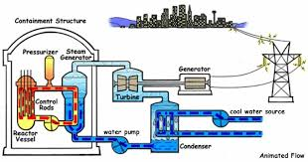
Nuclear Power Plant
Schematic Diagram of Nuclear Reactor

Slide 14
Main Components of Nuclear Power Plant
Nuclear reactor: It is an apparatus in which nuclear fuel (U235) is subjected to nuclear fission. It controls the chain reaction that starts once the fission is done. If the chain reaction is not controlled, the result will be an explosion due to the fast increase in the energy released.
Heat exchanger: The coolant gives up heat to the heat exchanger which is utilized in raising the steam. After giving up heat, the coolant is again fed to the reactor.
Steam turbine: The steam produced in the heat exchanger is led to the steam turbine through a valve. After doing a useful work in the turbine, the steam is exhausted to condenser. The condenser condenses the steam which is fed to the heat exchanger through feed water pump.
Alternator: The steam turbine drives the alternator which converts mechanical energy into electrical energy.

Slide 15
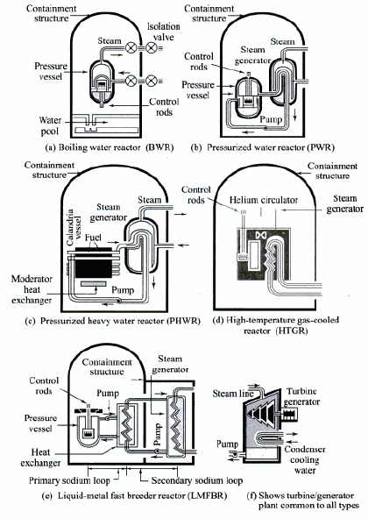
Nuclear Steam Supply Systems (Types of Reactor)

Slide 16
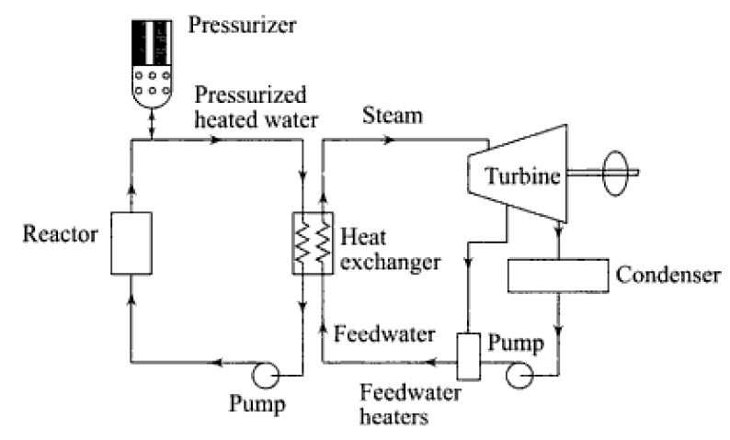
Schematic of PWR Power Plant

Slide 17
Selection of Site for Nuclear Power Station
Availability of water: As sufficient water is required for cooling purposes; therefore, the plant site should be located where ample quantity of water is available, e.g., across a river or by sea-side.
Disposal of waste: The waste produced by fission in a nuclear power station is generally radioactive which must be disposed off properly to avoid health hazards. The waste should either be buried in a deep trench or disposed off in sea quite away from the seashore.
Therefore, the site selected for such a plant should have adequate arrangement for the disposal of radioactive waste.

Slide 18
Selection of Site for Nuclear Power Station
Distance from populated areas: The site selected for a nuclear power station should be quite away from the populated areas as there is a danger of presence of radioactivity in the atmosphere near the plant. However, as a precautionary measure, a dome is used in the plant
which does not allow the radioactivity to spread by wind or underground waterways.
Transportation facilities: The site selected for a nuclear power station should have adequate facilities in order to transport the heavy equipment during erection and to facilitate the movement of the workers employed in the plant.
It becomes apparent that ideal choice for a nuclear power station would be near sea or river and away from thickly populated areas.

Slide 19
Examples: Nuclear Power Station

Slide 20
Examples: Nuclear Power Station

Slide 21
Thank You
Contact: dralam.eee@diu.edu.bd

