Slide 1
Logic Gates & Circuits
Afjal H. Sarower
Dept. of CSE

Slide 2
Logic Gates
Logic gates are electronic circuits that operate on one or more input signals to produce standard output signal
Are the building blocks of all the circuits in a computer
Some of the most basic and useful logic gates are -
AND,
OR,
NOT,
NAND and
NOR gate

Slide 3
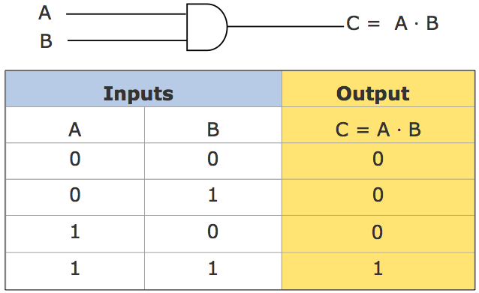
AND Gate
Physical realization of logical multiplication (AND) operation
Generates an output signal of 1 only if all input signals are also 1
AND Gate (Block Diagram Symbol and Truth Table)

Slide 4
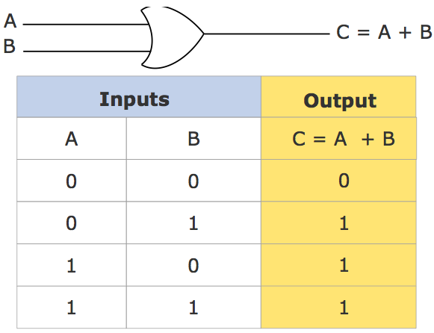
OR Gate
Physical realization of logical addition (OR) operation
Generates an output signal of 1 if at least one of the input signals is also 1
OR Gate (Block Diagram Symbol and Truth Table)

Slide 5
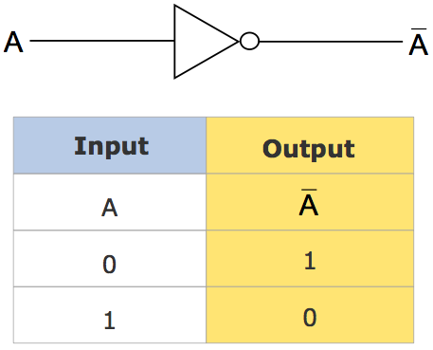
NOT Gate
Physical realization of complementation operation
Generates an output signal, which is the reverse of the input signal

Slide 6
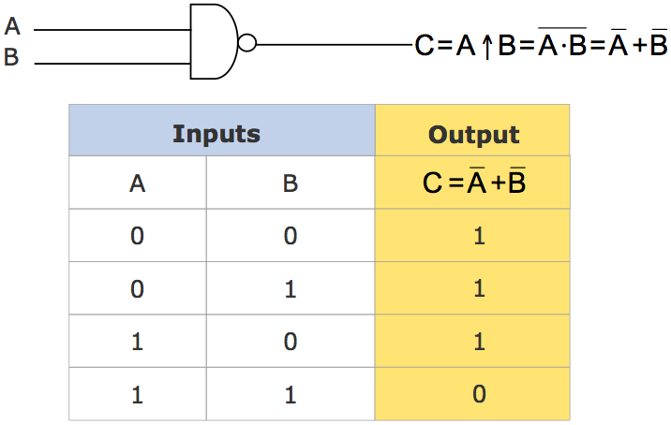
NAND Gate
Complemented AND gate
Generates an output signal of:
1 if any one of the inputs is a 0
0 when all the inputs are 1

Slide 7
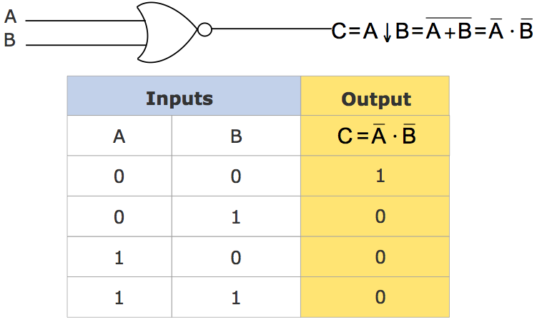
NOR Gate
Complemented OR gate
Generates an output signal of:
1 only when all inputs are 0
0 if any one of inputs is a 1

Slide 8
Logic Circuits
When logic gates are interconnected to form a gating / logic network, it is known as a combinational logic circuit
The Boolean algebra expression for a given logic circuit can be derived by systematically progressing from input to output on the gates
The three logic gates (AND, OR, and NOT) are logically complete because any Boolean expression can be realized as a logic circuit using only these three gates

Slide 9
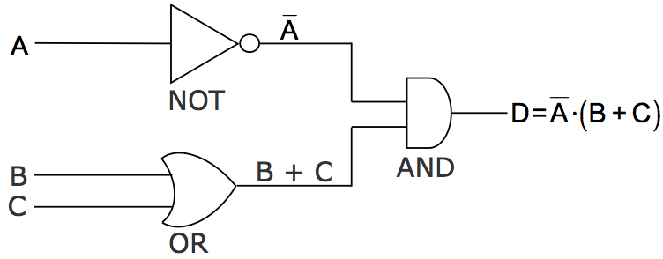
Finding Boolean Expression of a Logic Circuit (Example 1)

Slide 10
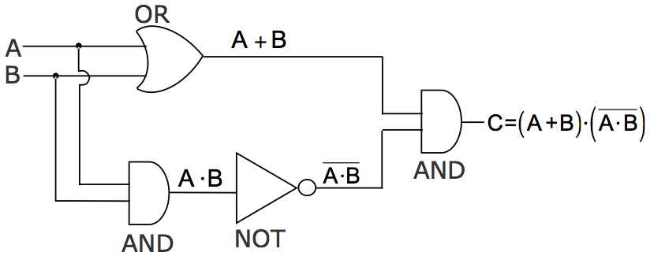
Finding Boolean Expression of a Logic Circuit (Example 2)

Slide 11
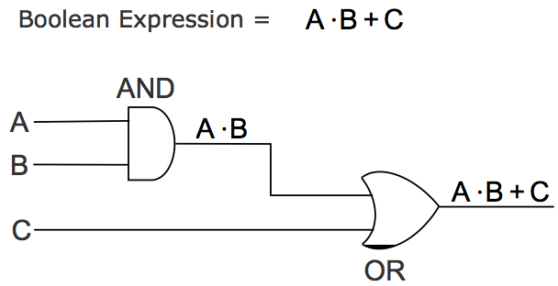
Constructing a Logic Circuit from a Boolean Expression (Example 1)

Slide 12
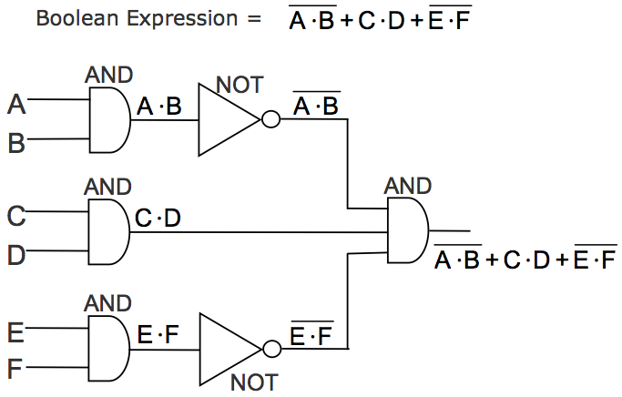
Constructing a Logic Circuit from a Boolean Expression (Example 2)

Slide 13
Universal NAND Gate
NAND gate is an universal gate, it is alone sufficient to implement any Boolean expression
To understand this, consider:
Basic logic gates (AND, OR, and NOT) are logically complete
Sufficient to show that AND, OR, and NOT gates can be implemented with NAND gates

Slide 14
Implementation of NOT, AND and OR Gates by NAND Gates

Slide 15
Universal NOR Gate
NOR gate is an universal gate, it is alone sufficient to implement any Boolean expression
To understand this, consider:
Basic logic gates (AND, OR, and NOT) are logically complete
Sufficient to show that AND, OR, and NOT gates can be implemented with NOR gates

Slide 16
Implementation of NOT, OR and AND Gates by NOR Gates

