Slide 1
Topics: Food Storage
Course Code: NFE 415
Course Title: Food Storage Engineering

Slide 2
What is Storage?
Storage means “a space or a place for storing”
From the modern point of view, Storage is an important marketing function, which involves holding and preserving goods from the time they are produced until they are needed for consumption.
Storage is the art of keeping the quality of agricultural materials and preventing them from deterioration for specific period of time, beyond their normal shelf life.

Slide 3
Why Storage?
The reasons for storage include:
Perishable nature of agricultural & bio-materials
Provision of food materials all year round
Pilling/ provision for large scale processing
Preservation of viability for multiplication.
Prevention of original varieties from extinction (Germ Bank)
Preservation of nutritional quality
Weapon for national stability
Price control and regulation.
Optimization of farmers’ gain / financial empowerment of farmers
Opportunity for export market, etc

Slide 4
Classification of food Based on Perishability
Some foods have longer shelf life than others.
Perishability refers to the quickness with which a food gets spoilt.
Foods can be classified into three groups depending on how long they can be kept without any treatment.
Perishable
Semi-Perishable
Non-Perishable

Slide 5
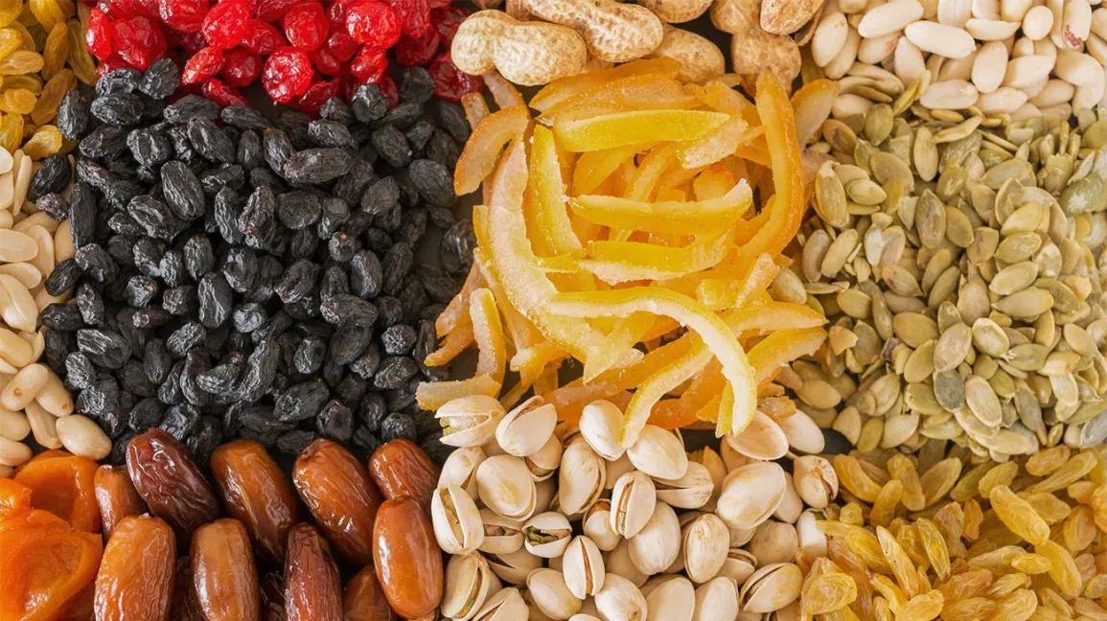

Slide 6
Perishable foods
Perishable foods can be kept at room temperature for only few hours or 1 or 2 days before spoiling.
For example- milk and milk products, meat, fish, poultry, fruits, leafy vegetables and cooked food.
These foods keep well under refrigeration.
Perishable foods contain a high amount of moisture and free water.
These foods contain more than 50% moisture like milk, juices etc.
In general, the most perishable foods contain a high level of protein or have moisture and carbohydrates in them.
Special methods are used to preserve such foods.
The rate of spoilage varies with the temperature, moisture and or dryness of the environment.
These foods can be maximally having the shelf life of one week.

Slide 7
Semi -perishable
Semi -perishable foods can be stored for a couple of weeks or even a month or two without any detectable signs of spoilage.
Temperature and humidity of the environment again affects the shelf stability.
Proper handling and storage can result in fairly long storage without spoilage.
Examples:
All cereal and pulse products like wheat flour, broken wheat, Bengal gram flour,
Fruits like citrus fruits, apples,
Vegetables like pumpkin, roots and tubers, yams, potatoes, onions, garlic etc.
Semi-perishable foods contain moisture more than stable food and less than perishable foods. These items contain about 25-50% moisture content.
Semi-perishable foods have the shelf life of maximum to two months to six months if handled carefully.

Slide 8
Non- perishable/ Stable Food
Non- perishable foods will keep for months or years without spoiling unless handled and stored carelessly.
Examples of such foods are all preserved food products (canned, dried, pickled etc.), whole cereal, pulse and millet grains, oil seeds, nuts, fats and oils, honey, sugar, jaggery, salt, some spices and essence.
Food items contain 15% or less than that moisture content.
Microorganisms require water for their growth. Mold and yeast can grow at low water content.
But these food items contain very less moisture or very less free water for the growth of microorganisms.
Stable foods have the longest shelf life from one year to five years.
This variation in shelf life is due to the structure of food.
Some foods have complex structures that will not allow food to spoil. Microbes cannot penetrate into such foods. These foods include wheat and other cereals at most.

Slide 9
Principles of preservation
In the preservation of foods by various methods, the following principles are involved:
1. Prevention or delay of microbial decomposition
By keeping out microorganism (Asepsis)
By removal of microorganism (Filtration)
By hindering the growth and activity of microorganism ( Low temperature, drying, anaerobic conditions, chemicals)
By killing the microorganism ( Heat of radiation)
2. Prevention or delay the self-decomposition of the food
By destruction or inactivation of enzymes (Blanching)
By prevention or delay of chemical reactions (prevention of oxidation by antioxidant)
3. Prevent the damage cause by insects, animals, mechanical causes etc.

Slide 10
Storage Types: Classifications
Classification of storage types can be based on the following factors:
Duration of Storage
Size or Scale of Storage
Principle of Storage

Slide 11
Classification Based on Duration of Storage
Storage systems are classified in terms of duration of storage as:
Short Term Storage
Medium Term Storage
Long Term Storage

Slide 12
Storage Types (Contd.): Short Term Storage
Stored products in short term storage mostly do not last beyond 6 months
Highly perishable products (such as egg, meat, fish and dairy products) are naturally stored for short term
High loss of quality is associated with highly perishable crops in this storage except controlled systems are used.

Slide 13
Storage Types (Contd.): Medium Term Storage
Medium term storage involves keeping the quality of stored products without appreciable deteriorations for up to 12 months
The quality of such stored products may not be guaranteed after 18 months

Slide 14
Storage Types (Contd.): Long Term Storage
Long term storage can guarantee the quality of stored products beyond 5 years
Germ banks and
some storage systems are known to preserve viability and proximate characteristics of stored materials for decades.

Slide 15
Classification Based on Size or Scale of Storage
Storage systems are classified in terms of size or scale of storage as:
Small Scale Storage
Medium Scale Storage
Large Scale Storage

Slide 16
Storage Types (Contd.): Small Scale Storage
Small scale storage systems have capacity for up to 1 ton, but not beyond
They are mostly used at domestic and peasant levels
They are associated with peasant farmers with small farm holdings.

Slide 17
Storage Types (Contd.): Medium Scale Storage
Medium scale storage can accommodate up to a hundred tons of stored products.
Most of such storage systems are in the capacity range of 2 – 50 tons, with very few having capacity beyond 50 tons.
Some are used in breweries for temporary storage of spent grains

Slide 18
Storage Types (Contd.): Large Scale Storage
Large scale storage can accommodated stored material in 100s and1000s of tons
It is used either for temporary or permanent storage of very large quantity of various products
It has a very high initial cost but eventually reduces overall unit cost of production.

Slide 19
Storage Types (Contd.): Classification Based on Principle of Storage
Storage systems can be classified in terms of principle of operation. These include: • Physical Storage • Chemical Storage • Biological Storage

Slide 20
Storage Types (Contd.): Physical Storage
Physical storage utilizes physical principles to achieve storage and preservation the quality of stored products The physical environment (in terms of moisture content, temperature and relative humidity) within the storage system is mostly controlled or manipulated to retard the activities of agents of deterioration or prevent deterioration. E.g. cold storage or controlled environment

Slide 21
Storage Types (Contd.): Chemical Storage
Chemical storage utilizes chemicals to stop or retard the activities of agents of deterioration The use of chemicals such as wax, actellic, or phosphosene dust or tablet to prevent respiration or insect infestation in stored produce are examples Some chemicals are however poisonous and their uses must be highly monitored, e.g. phosphosene

Slide 22
Storage Types (Contd.): Biological Storage
Biological storage utilizes biological agents, especially micro organism, to stop or retard the activities of agents of deterioration or enhance the shelf life of stored products This is a very good area of the application of bio-technology in agriculture

Slide 23
Factors affecting Crop Storage
The major physical, chemical & biological factors affecting the storage of bio-materials include:
Micro organisms
Insects, mite and pests
Rodents
Environmental factors

Slide 24
Factors affecting Crop Storage (Contd.): Micro organisms
Major micro organism associated with storage include:
Fungi
Bacterial
Yeast

Slide 25
Factors affecting Crop Storage (Contd.): Micro Organisms
The activities of micro organism result in:
Color degradation
Off flavor
Moisture upgrading, wet spot & moldiness
Loss of viability, etc

Slide 26
Factors affecting Crop Storage (Contd.): Insects and Mite
Pests Insects, mites and pests attack both the stored material and wooden components of the storage structure
Weevils are the commonest insects in grains.
They attack seeds and bore through them, and lay eggs in the seeds and storage structures.
They reduce seed weight, quality, nutritional value and viability

Slide 27
Factors affecting Crop Storage (Contd.): Rodents
Rodents are mammals that parasite on stored materials and attack storage structures
They eat germs of grains and waste the remaining parts
They are vectors.
They also contaminate stored materials with their faeces, urine and carcasses.

Slide 28
Factors affecting Crop Storage (Contd.): Environmental
Factors The environmental factors that mostly associated with stored products include:
Temperature
Relative humidity
Equilibrium moisture content

Slide 30
Types of Storage Structures
Broadly, storage structures are classified as:
Traditional Structures: Small sized and short term with high level of infestation. They are mostly made of unrefined local materials
Modern Structures: Mostly large capacity and long term with better regulation of the storage environment. They are made of improved and refined materials

Slide 31
Types of Storage Structures (Contd.): Traditional Structures
These are devices used mostly for short term and small scale storage
Occasionally they include some medium term and medium scale storage devices
They require low level of scientific knowledge to construct, operate and maintain.
They are mostly made of unrefined local materials

Slide 32
Traditional Storage Structures (Contd.)
Traditional storage structures include:
Rhombus
Crib
Barn
Shelf
Pit/ Underground Storage
Plastic Containers
Guard

Slide 33
Traditional Storage Structures (Contd.): Rhombus and Crib
Polythene bag
Earthen pot Rhombus & Traditional Crib: These are used for grain storage, mostly materials in cob.
Rhombus is mostly used in Northern Nigeria while the traditional crib is used in South Western and Eastern Nigeria

Slide 34
Traditional Storage Structures (Contd.): Rhombus and Crib
Rhombus is cylindrical in shape while crib has rectangular shape. They are made of palm font leaf, clay, tree stem and bamboo Major disadvantages are moisture build as a result of rain, and micro organism infestation Sometimes coal or wood heat is introduced at the lower base to ensure drying

Slide 35
Traditional Storage Structures (Contd.): Barn, Shelf and Pit Barn, Shelf & Pit: • These are mostly used for root and tuber crops. Barn and shelf could be suitable for onion & carrot. Barn, shelf and pit are recommended for cassava, yam and cocoyam • These storage structures are affected by environmental conditions

Slide 36
Traditional Storage Structures (Contd.): Others Plastic Containers, Guard, Polythene bag & Earthen pot: • These structures are used at household and peasant levels for the storage of grain. Earthen pots are equally used for storage of fruits such as orange • Though small scale and short term in nature, they are very effective if used under air tight conditions • Items stored in these systems are locally preserved with wood or bone ash or powdered pepper

Slide 37
Modern Storage Structures (Contd.)
Modern storage structures include: • Improved crib • Ware house • Silo • Controlled atmosphere storage system • Refrigeration • Cold storage • Evaporative coolant system (ECS)

Slide 38
Modern Storage Structures (Contd.): Improved Crib
• Hermetic storage • Nitrogen storage Improved Crib: • This structure is an improvement over the traditional crib in terms of design, capacity, construction material and performance. It has upgraded the traditional crib to medium scale storage. Each unit can accommodate 10-20 tons

Slide 39
Modern Storage Structures (Contd.): Ware house Ware house is used for medium but mostly large scale storage for bagged or pilled/ bulk products such as grains, flour, etc Wooden pallets are used for staking. Material handling and ventilation equipments are essential Prevention of roof leakage and water infiltration through the floor are most essential. Water proof materials are used for flooring & proper drainage important

Slide 40
Modern Storage Structures (Contd.): Silo Silo is a cylindrically shaped structure used for bulk storage of shelled grains in large scale and for long term Moisture migration and condensation are major problems of silo. Hence, the need for accessories such as material handling and drying equipments Design, operation and maintenance of silo require high level of skill & technicalities

Slide 41
Modern Storage Structures (Contd.): Silo Classification Silo can be classified on the basis of: • Aeration method/ system • Material of construction • Level of technology sophistication • Structural stability

Slide 42
Modern Storage Structures (Contd.): Silo Classification Based on the aeration method, silo can be classified as: • Mechanical ventilated silo • Controlled atmosphere silo • Hermetic silo • Gas (nitrogen, oxygen, etc) silo

Slide 43
Modern Storage Structures (Contd.): Silo Classification Based on the material of construction, silo can be classified as: • Metal (aluminum, steel, etc) silo • Concrete silo • Wooden silo • Mud silo • composite silo

Slide 44
Modern Storage Structures (Contd.): Silo Classification Based on the level of technology, silo can be classified as: • Conventional silo • Instrumentalised silo • Computerized/ automated silo

Slide 45
Modern Storage Structures (Contd.): Silo Classification Based on structural stability, silo can be classified as: • Deep silo • Shallow silo

Slide 46
Modern Storage Structures (Contd.): Controlled Atmosphere (CA) Storage System Controlled atmosphere storage system is a general classification that include all forms of storage structures that have devices for controlling and monitoring the environmental factors (temperature, relative humidity and moisture) Silo, ware house, refrigeration and cold storage could incorporate controlled atmosphere systems

Slide 47
Modern Storage Structures (Contd.): Refrigeration Refrigeration is a typical CA system that can operate below atmospheric temperature. The evaporator unit of a refrigerator could depress temperature a little below zero degrees through the aid of R12 gas A refrigerator is made up of components such as condenser, evaporator, compressor, throttle pipes, fan, thermostat, etc It is used for the storage of highly perishable crop and food materials

Slide 48
Modern Storage Structures (Contd.): Cold Storage Cold storage is a CA system that can further depress temperature below that of the refrigerator with the aid of R22 gas and maintain temperature below freezing point for a long time It has similar components like the refrigerator but more bulky, expensive and could store for relatively longer time

Slide 49
Modern Storage Structures (Contd.): Cold Storage The unique advantages of cold storage include: • Retardation of respiration and other metabolic activities • Controls ripening, retards aging, softening, texture and color change. Preserves color & texture • Retards moisture loss & wilting • Retards microbial activities & spoilage • Retards sprouting & undesirable growth, etc

Slide 50
Modern Storage Structures (Contd.): Cold Storage The following information are essential in the use of cold storage: • Temperature fluctuations affect temperature sensitive crops. Therefore, keep temperature and storage condition steady and constant • Pre cool fruits to remove field heat before products are transferred into cold store • Avoid storing incompatible products • Ensure adequate ventilation within cold store and use appropriate relative humidity

Slide 51
Modern Storage Structures (Contd.): Evaporative Coolant System (ECS) Evaporative coolant system (ECS) is another CA storage. It slightly depresses temperature below and increases the relative humidity above atmospheric conditions by natural means. It is appropriate for the storage of fruits & vegetables ECS utilizes the principle of evaporation occurring at the surface of a wet material to produce cooling inside. Wetted padded materials are normally used as medium of evaporation

Slide 52
Modern Storage Structures (Contd.): Hermetic Storage Structure Hermetic storage structure prevents air absorption into the stored products in order to disallow metabolic activities of any form by the product, micro organism or insect Consequently, hot spot, wet spot and moisture build in storage systems are prevented

Slide 53
Modern Storage Structures (Contd.): Gas Storage Structure Gas (nitrogen, oxygen, etc) storage structure provides devices that allows essential gas such as nitrogen or oxygen to be introduced and preserved in the system in order to prevent ripening or/ and metabolic activities. Some silo and cold storage structures are provided with such facilities

Slide 54
Modern Storage Structures (Contd.): Design Principles Essential design considerations and parameters for modern storage structures include: • Location & orientation • Systems capacity • System efficiency • Handling methods & equipments • Structural stability & requirements

Slide 55
Nature of Agric./ Bio-materials in Relation to Storage Agric./ bio-material have the following characteristics/ nature in relation to storage: • Living organism • Moisture rich • Ripening process • Bio degradable • Hygroscopic: Shrinkage and swelling occur

Slide 56
Storage of Highly Perishables • Dairy products, meat and fish are highly perishable materials because of their very high level of moisture and high micro organism activities associated with them • Refrigeration and cold storage are mostly recommended for the storage of this category of material
Storage of Fruits and Vegetables • Fruits and vegetables are in the category of perishable agricultural materials • They are also very rich in moisture content and can easily be bruised and wilt quickly • They are the riches natural source of minerals vitamins, and anti oxidants • They cannot tolerate heat and high temperatures. ECS & refrigeration are recommended for their storage
Storage of Roots and Tubers • Root and tuber are tropical crops. They are very rich source of carbohydrate • Care must be taken during harvest to avoid bruise in order to ensure effective storage • Pit storage is recommended for cassava which must be harvested with its stem • Shelf, barn and pit storage are recommended for yam and cocoyam

Slide 57
Strategic Food Reserve This is a national plan supported by policies to provide large scale storage for agricultural and food material to ensure national food sufficiency, stability and price control especially at critical periods (war, famine, disaster, draught, flood, etc) The use of large scale and long term storage structures such as silo, warehouse and cold storage are inevitable for such national plans
Strategic Food Reserve (Contd.) Strategic Food Reserve policies must be all embracing and consider the following factors: • Socio economic factors • Technical factors • Capacity building • Legal implications, etc.

