Slide 1
Pharmaceutical Biotechnology (BPH 421) Galib Muhammad Abrar Ishtiaque Lecturer (Senior Scale) Department of Pharmacy Daffodil International University

Slide 2
Formulation of Biotech Products
CONTENTS
Biotech Products
Formulation of Biotech Products
Excipients Used in Biotech Products
Microbial Considerations
Shelf-life Considerations
Route of Administration Considerations

Slide 3
Biotech Products
Biotech products are commercial products that are synthesized in the biological system using our knowledge and technology.
Most biotech products are protein in nature though there are some drugs available which are not protein.
For example: Human Insulin, Adalimumab, Enfuvirtide.

Slide 4
Formulation of Biotech Products
Formulation is the process by which a drug (active ingredient) is combined with necessary excipients and made into final medicine that can be applied to the patient.
The formulation of biotech products involve the following steps:
Purification of the product obtained from biological system.
Addition of various excipients which stabilize and/or enhance the characteristics of final product.
Sterilization of the product and aseptic filling of the final product into suitable containers.
Freeze drying if the product is to be marketed in the powder form. This may be performed to enhance the shelf-life.

Slide 5
Excipients Used in Biotech Products
Solubility Enhancers
Anti-adhesion and Anti-aggregation Agents
Buffer Components
Preservatives
Antioxidants
Lyoprotectants
Osmotic Agents

Slide 6
Excipients Used in Biotech Products
Excipient | Function | Examples
Solubility Enhancers | Increase the solubility of active protein | Amino acids, Surfactants
Anti-adhesion and Anti-aggregation Agents | Reduce adsorption to the interface and prevent aggregation of the active protein | Albumin, Surfactants
Buffer Components | For the stability of preparation and solubility of active proteins | Phosphate, Citrate
Preservatives | Inhibit microbial growth in vials for multiple dosing | Phenol, Benzyl alcohol
Antioxidant | Prevent oxidation of protein | Ascorbic Acid, Sulphites
Lyoprotectants | These are agents for stabilizing product during storage in the dry form | Sugars
Osmotic Agents | Ensure isotonicity | Sugars, NaCl

Slide 7
Excipients Used in Biotech Products
Solubility Enhancers:
Proteins particularly non-glycosylated proteins have a tendency to aggregate and then precipitate. This aggregation can be of two types:
Physical → Based on hydrophobic interactions between molecules.
Chemical → Aggregation by covalent bonds.
To enhance solubility following excipients can be added:
Surfactants → Sodium dodecyl sulphate.
Surfactants are known to cause protein denaturation, but in small quantity they can increase solubility.

Slide 8
Excipients Used in Biotech Products
Amino acids → Lysine, Arginine
The above figure illustrates how arginine-phosphate increased the solubility of recombinant tPA (tissue plasminogen activator) → Alteplase.

Slide 9
Excipients Used in Biotech Products
Anti-adhesion and Anti-aggregation Agents:
Proteins are usually formulated in aqueous phase. Normally the hydrophobic portion of protein will then be positioned in the core of the structure. But when interface is present following happens:

Slide 10
Excipients Used in Biotech Products
Following compounds are used to prevent this:
1% HSA (Human Serum Albumin) → It has strong tendency to be adsorbed in the interface and are adsorbed in preference to the active protein.
Surfactants and phospholipids → They are also preferentially adsorbed in the interface making it unavailable for protein adsorption.
Same compound can act as anti-adhesion and anti-aggregation agent.

Slide 11
Excipients Used in Biotech Products
Buffer Components:
The common buffers used are phosphate, citrate and acetate.
When choosing a buffer it should be considered whether buffering action is disrupted during processing.
For example in Na₂HPO₄/NaH₂PO₄ buffer, during freeze-drying Na₂HPO₄ crystalizes faster than NaH₂PO₄. Thus pH is changed significantly and may cause aggregation of protein.

Slide 12
Excipients Used in Biotech Products
Preservatives:
The final product is sterilized before shipping. So preservatives should had been unnecessary. But some biotechs are designed to be administered in multiple doses (multi dose injectables). In such case, there is a chance of contamination after first administration. So to minimize microbial growth, preservatives are added.
Preservatives includes:
Phenyl mercuric nitrate
Thimerasol
p-hydroxybenzoic acid
Benzyl alcohol
Chlorobutanol

Slide 13
Excipients Used in Biotech Products
Antioxidants:
Proteins rich in methionine, cysteine, tyrosine and histidine are susceptible to oxidative degradation.
To reduce such a risk air is replaced by inert gases in the container vials.
Antioxidants, such as ascorbic acid (it may again act as oxidant in presence of heavy metal), sodium formaldehyde sulfoxylate can also be used.

Slide 14
Excipients Used in Biotech Products
Lyoprotectants:
These are agents for stabilizing product during storage in the dry form, such as Sugars (not reducing sugars).
Lactose is a reducing sugar. So it reacts with the primary amino groups of protein via the Maillard reaction and form brownish product.
This can occur even at dry state. Thus lactose and other reducing sugars should be avoided (as lyoprotectants).

Slide 15
Excipients Used in Biotech Products
Osmotic Agents:
Parenteral products must be isotonic with the body fluid. Therefore tonicity adjusting agents are added. Usually mono and di-saccharide solutions are used.
These agents may also influence protein stability and solubility.

Slide 16
Microbial Considerations
The possible source of contamination during formulation of biotech products:
The protein extract obtained from the biological system: The production cell (vector) and the culture media may contain pathogenic substances such as viruses and pyrogens, which must be removed from the final product.
Excipients: Sterilized before use.
Equipments: Sterilized before use.
Human factors: PPE is used to minimize contamination.

Slide 17
Microbial Considerations
To pass the microbiological test, a biotech product must be pyrogen-free.
Pyrogen is any substance that can cause fever.
Pyrogens may be exogenous or endogenous.
Exogenous pyrogens are inserted into the body from the outside. Such pyrogens include viruses, fungi, bacteria, etc.
Endogenous pyrogens are produced inside the body. For example, gram (-) bacteria, when lysed inside the body, produce toxins. These are called endotoxins.

Slide 18
Microbial Considerations
The absence of pyrogen in the biotech is assured by the following tests:
Rabbit Test
LAL Test

Slide 19
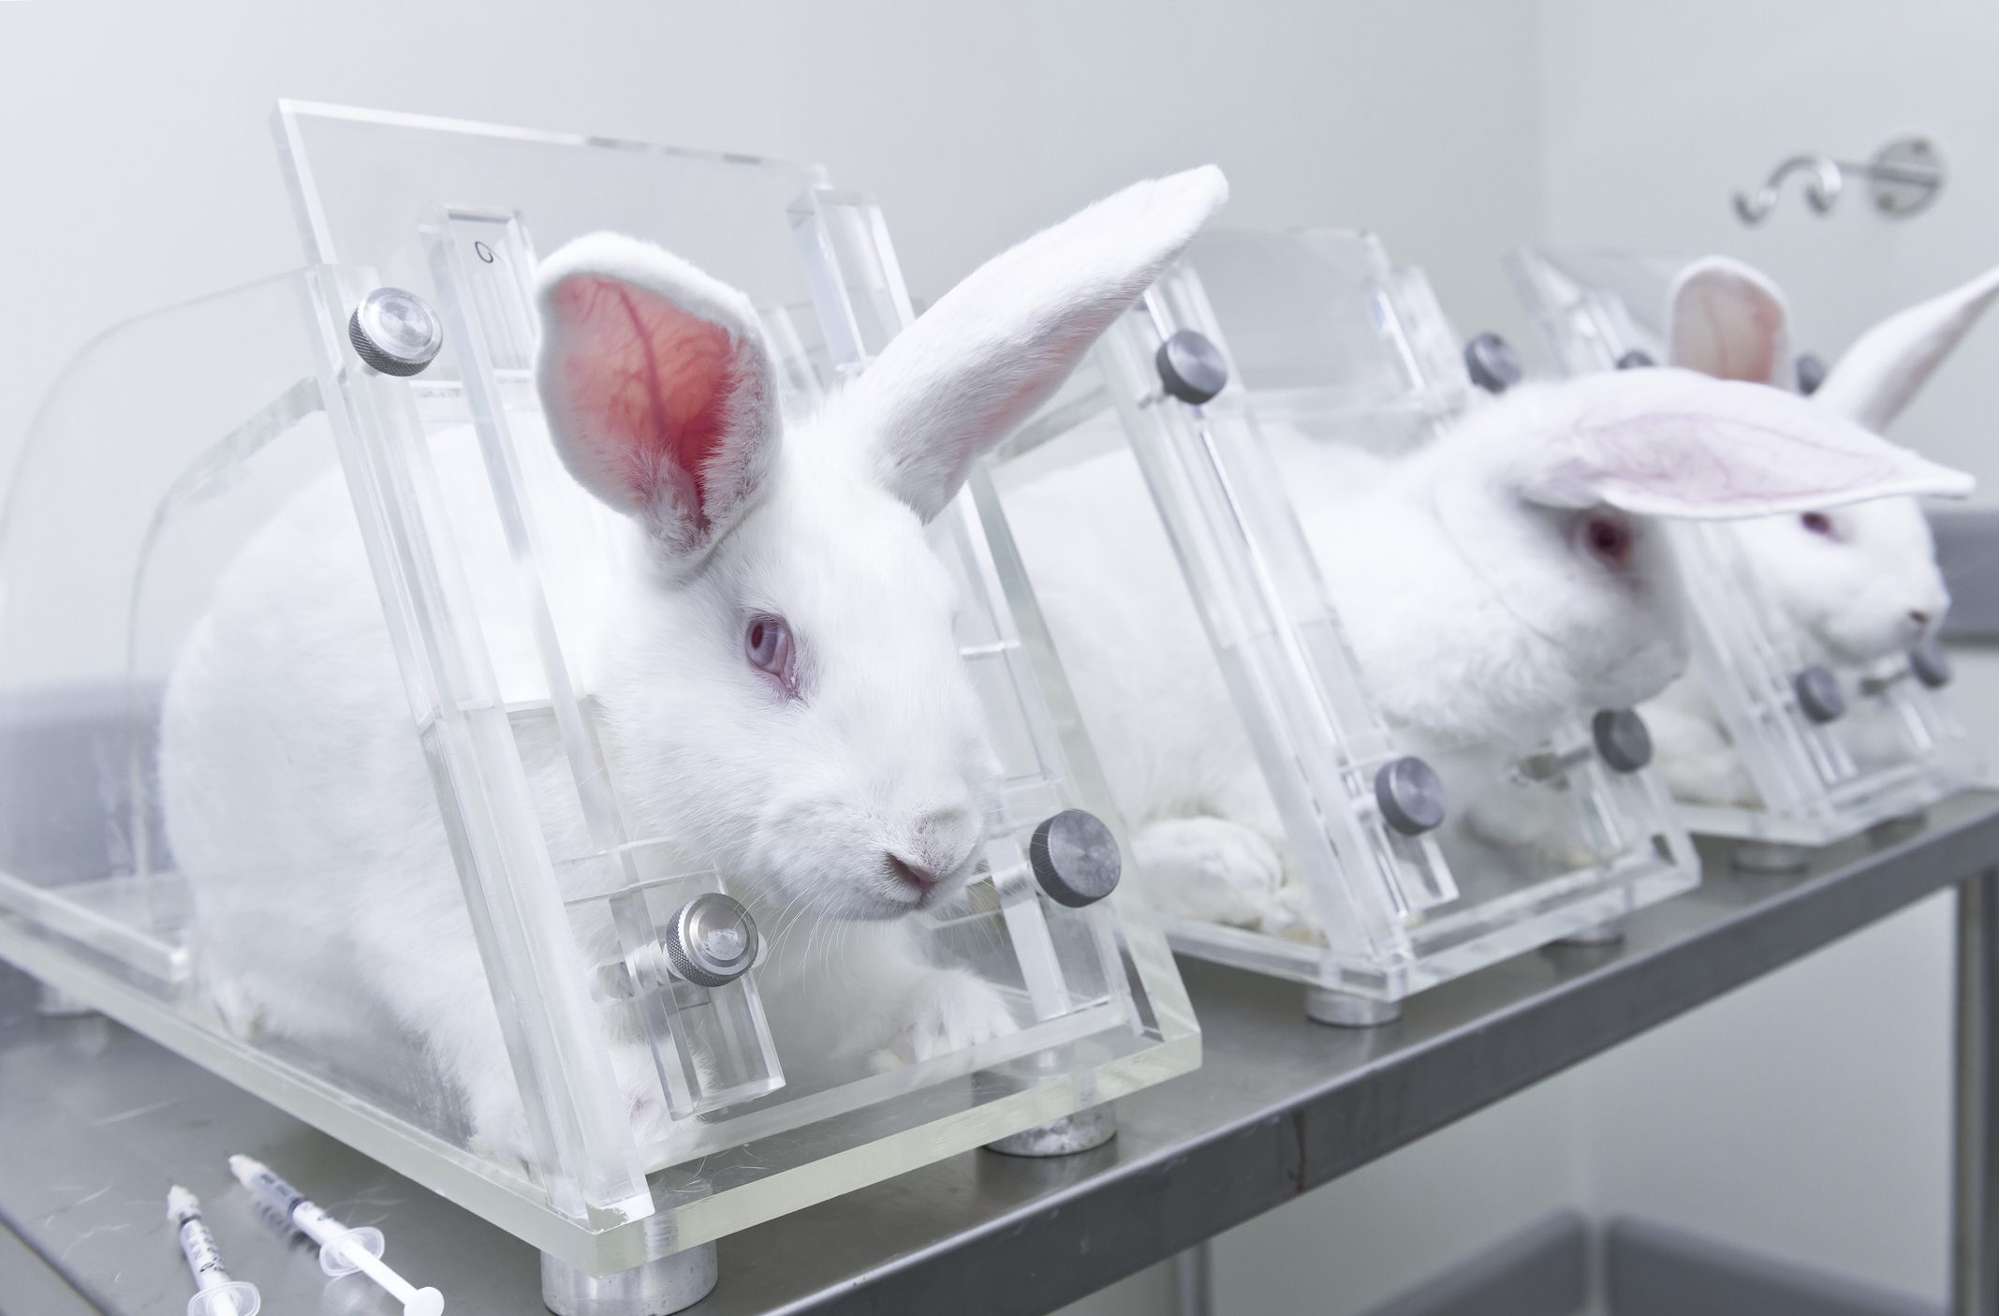
Microbial Considerations
Rabbit Test:

Slide 20
Microbial Considerations
Rabbit Test:
Procedure of the test:
Rabbits exhibit similar threshold pyrogenic response to humans
Control vs Treatment: Group of 3 rabbits
Injection site: Ear vein
The injected volume: About 10 ml per kg of body weight
Record temperature at 30 min intervals for 3 hours
Site of temperature measurement: Rectal
Instrument: Thermometers

Slide 21
Microbial Considerations
Rabbit Test:
Interpretation of the results:
The sample may be judged nonpyrogenic if no single rabbit shows a rise in temperature of 0.5°C or greater above its control temperature.
If this condition is not met, the test must proceed to a second stage. In the second stage, five additional rabbits are given a new preparation of the same test sample as the original three rabbits.
The solution may be judged non-pyrogenic if not more than three of the eight rabbits show individual temperature rises of 0.5°C or more.

Slide 22
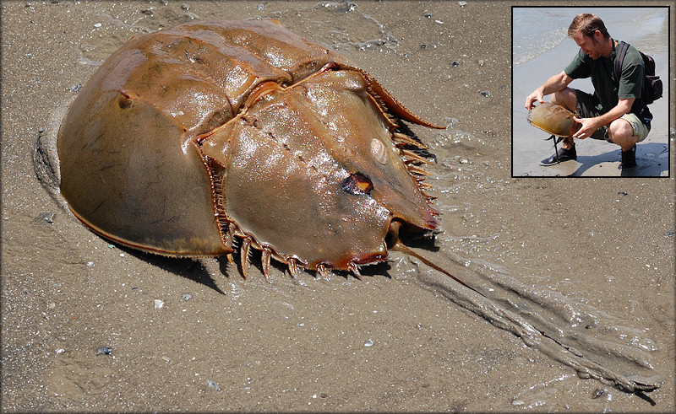
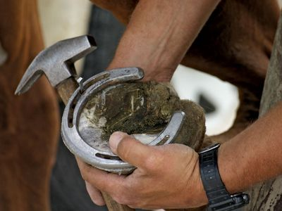
Microbial Considerations
LAL Test:

Slide 23
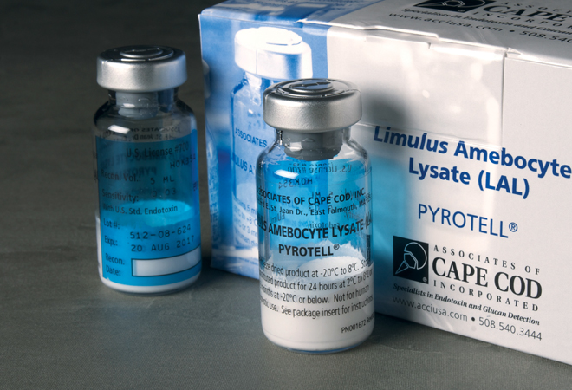
Microbial Considerations
LAL Test:
The test was developed in 1960’s by Dr. Bang and Jack Levin. It is based on clotting rection of horseshoe crab blood to endotoxin.
Limulus: Genera of crab.
Amebocytes: Crab blood cell from which active component is derived.
Lysate: Component is obtained by separating amebocytes from the plasma and lysing them.

Slide 24
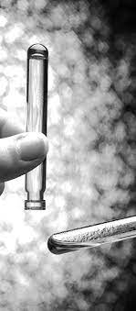
Microbial Considerations
LAL Test:
The basic procedure is the combination of 0.1 ml of test sample with 0.1 ml LAL reagent.
After incubation for 1 hour at 37°C, the mixture is analyzed for the presence of gel clot.
The LAL test is positive if the gel clot maintains its integrity after slow inversion of the test tube containing the mixture. Positive LAL test indicates the presence of endotoxin.
No clotting means a negative result in LAL test, indicating absence of endotoxin.

Slide 25
Shelf-life Considerations
Freeze Drying:
In the freeze-drying process the water is removed by sublimation (direct conversion from solid to gas) and not by evaporation (liquid to gas). The stages of freeze-drying are:
Freezing
Primary Drying
Secondary Drying

Slide 26
Shelf-life Considerations
Freezing:
In this step, the temperature of the product is lowered below the eutectic temperature of the solution (in case of an amorphous mixture, glass transition temperature). The pressure is not changed.
Thus the (free) water will be converted to ice. The temperature is lowered below the eutectic temperature because it is the lowest temperature of the mixture at which freezing occurs. Freezing temperature of water is unreliable here because, in solution depression of freezing point occurs.

Slide 27
Shelf-life Considerations
Primary Drying:
In this step, heat must be supplied for the sublimation (2500 KJ for each gram of ice) to occur. But the temperature is kept below the eutectic or glass transition temperature. This heat is transferred from the shelf (in which the vial containing the product is placed) to the vial. Then it is transferred to the product mass in the vial.
The vapor must be immediately removed, otherwise the pressure will rise. This is done by collecting the vapor in a condenser of lower temperature than the chamber. The temperature is kept below the glass transition or eutectic temperature because otherwise frozen glassy structure will collapse.

Slide 28
Shelf-life Considerations
Secondary Drying:
In this step, the water bound to the protein and excipients is removed. For this purpose, temperature is increased gradually to ambient temperature (say 20⁰C, but may require even higher temperature sometimes) and pressure is kept low.
The gradual increase of temperature in the chamber is to prevent collapse of product.
The secondary drying is continued until the residual water content is 1% or lower.

Slide 29
Route of Administration Considerations
Most common routes of administration are parenteral: IM, SC, IV.
IV administration (Alteplase) is the fastest way where highest concentration can be achieved directly in one of superficial vein.
SC drugs (Anakinra) are administered as bolus in the subcutis.
IM medications (Medroxyprogesterone Acetate) deliver the drug into the muscles.
However, IV administration causes infection, painful/fearful, requires supervisor to administer, irreversible, causes coagulation, and price is high compared to others.
Additionally, the IM or SC site of injection provides prolonged residence time compared to IV administration.
This is why the IM & SC routes are preferred over IV routes for the administration of biotech products.

Slide 30
The End

