Slide 1
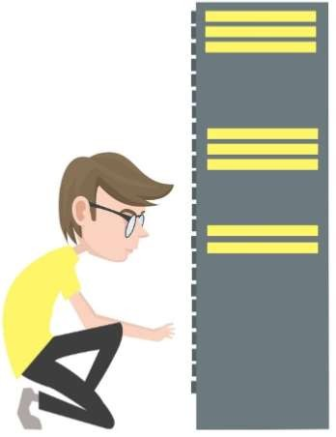
INTRODUCTION TO SERVER

Slide 2
LEARNING OBJECTIVES
Elaborate the concepts of server computing
Determine the typical types of server
Explain the difference between server computer vs workstation.

Slide 3
INTRODUCTION
“Cannot establish connection to server” message of hopelessness for those who are uploading files online, posting photos on Facebook, downloading torrent file from peer network, and streaming videos online. But what is this message all about? What is the server that this message referring to, or in other hand, what is server?

Slide 4
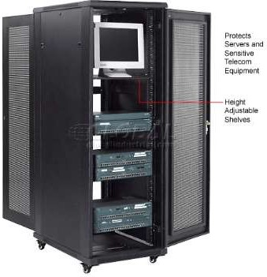
SERVER
It is a physical computer that provide services to all client computers connected to it, allowing them (client
computer) available resources.
to access
information or

Slide 5
SERVER
An entity in the client/server programming model, where the server is a software or a program, running on one or multiple computers, that manages resources and services of the network, while handling requests from different computers to access said resources.
In short, server is a software or hardware that gives services to other hardware and software entity.

Slide 6
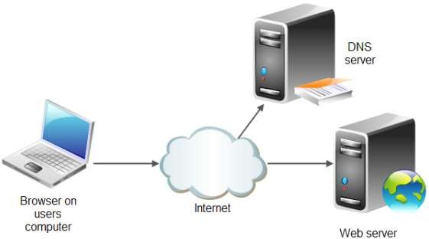
TYPICAL TYPES OF SERVER
Web Servers
The based
internet is on web
servers that respond to requests from clients such as web browsers.

Slide 7
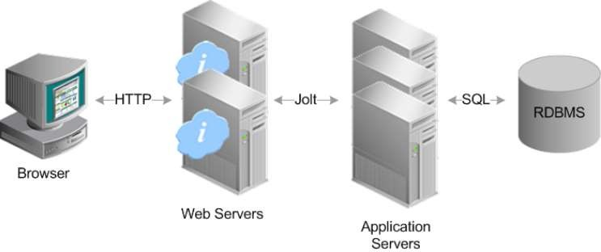
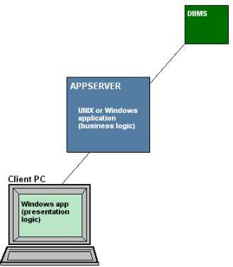
TYPICAL TYPES OF SERVER
Application Server
A server that provides services to applications such as a mobile app.

Slide 8
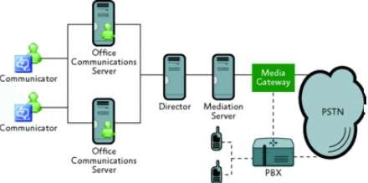
TYPICAL TYPES OF SERVER
Real-time Communication Servers
formerly known as
IRC
still
chat servers or
Servers, and
sometimes referred to as instant messaging (IM) servers, enable large numbers users to exchange information near instantaneously.

Slide 9
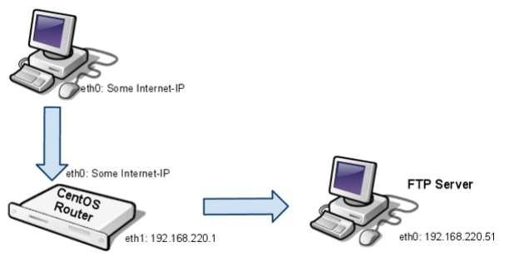
TYPICAL TYPES OF SERVER
FTP Server
One of the oldest of the Internet services, File Transfer Protocol makes it possible to move one or more files securely between computers while providing file security and organization as well as transfer control.

Slide 10
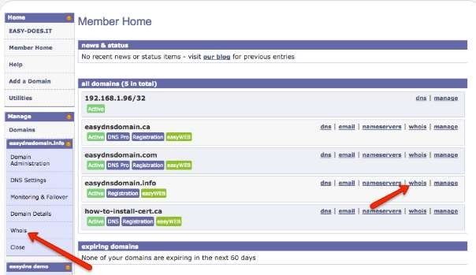
TYPICAL TYPES OF SERVER
Name Server
Servers that
look up such as
addresses mapping a
domain
name to an IP. This is basic infrastructure for networks such as the internet.

Slide 11
TYPICAL TYPES OF SERVER
API – Application Programming Interface
A server that implements functionality for other software by offering an API. APIs just allow applications to communicate with one another.

Slide 12
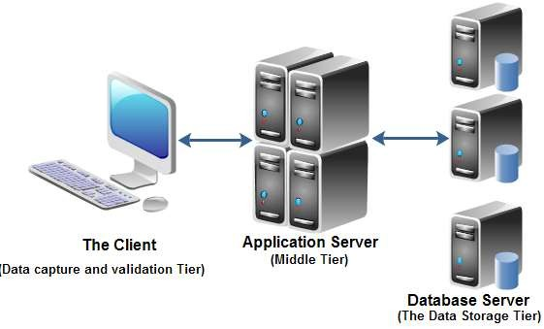
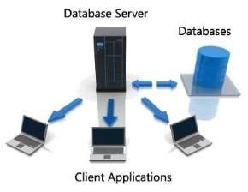
TYPICAL TYPES OF SERVER
Database Server
Provides access to a database. It is a server which uses a database application that provides database services to other computer programs or to computers.

Slide 13
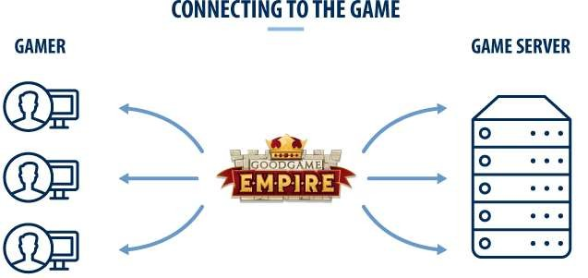
TYPICAL TYPES OF SERVER
Game Server
a server which is the authoritative source of events in a multiplayer video game. The server transmits enough data about its internal state to allow its connected clients to maintain their own accurate version of the game world for display to players.

Slide 14
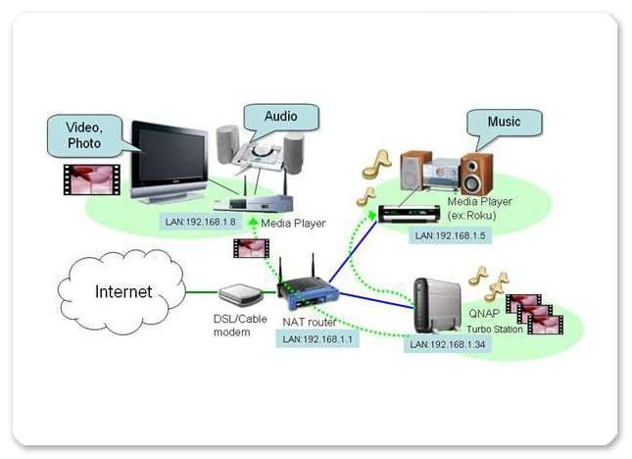
TYPICAL TYPES OF SERVER
Media Server
Delivers media such as streaming video or audio.

Slide 15
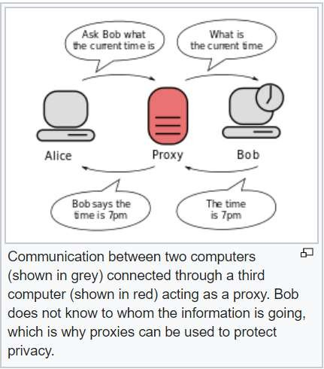
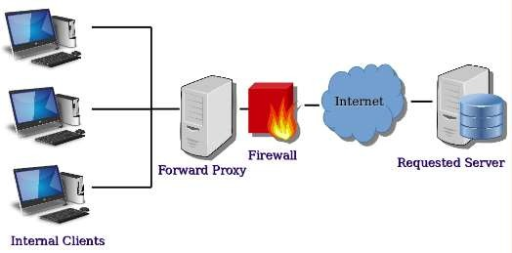
TYPICAL TYPES OF SERVER
Proxy Server
Acts as an intermediary between clients and servers to implement functions such as security, monitoring or anonymization.

Slide 16
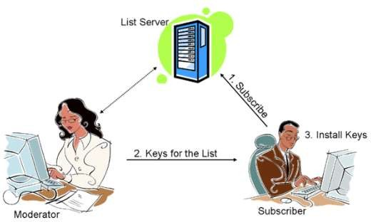
TYPICAL TYPES OF SERVER
List Server
servers offer a way to better manage mailing lists, whether they be interactive discussions open to the public or one-way lists that deliver announcements, newsletters or advertising.

Slide 17
Advantage of using server computer
Server contain more powerful processors than a desktop computer.
Servers support advanced RAM technologies
Have higher storage capacity as multiple disks can be inserted into them

Slide 18
Advantage of using server computer
Manufactured and optimized for 24/7 operation
Built to support multiple user applications and multiple user access
Have multiple NIC Easier to apply security policies

Slide 19
Server vs. Workstation
A server is an application or device that performs service for connected clients as part of client server architecture.
A workstation is a personal computer that is used for high end applications such as graphic design, video editing, CAD, 3-D design, or other CPU and RAM intensive programs.

Slide 20
Thank you

