Slide 1
MPH 5141: Gender & Population Lecture 02: Closing the Gender Gap
Dr. S. M. Rezoun Shafiullah, MBBS, MPH
Department of Public Health
Daffodil International University

Slide 2
Sex and gender
Sex refers to physical realities, while gender refers to economic, social and cultural attributes, roles and opportunities which determine what is expected, allowed and valued in a woman or man and girl or boy.
Characteristics, emotions and behaviors that people generally associate with being male or female - commonly referred to as “masculinity” and “femininity” - are learned from childhood. We behave in ways that others encourage and not in ways that others discourage based on ideas of what it means to be a boy or girl or a man or woman. We are also treated differently because of our sex.
Ideas that we have developed about gender are not fixed, as they evolve through social interactions and vary between cultures and over time

Slide 3
Stereotypes and discrimination
Our society has gender gaps not because of the different innate abilities of males and females but because we expect boys and girls and men and women to also have different desires, to behave differently and to be capable of different achievements.
When we have expectations or feelings about people based on sex or gender, we may reinforce inequality without even realizing it.
Discrimination based on sex or gender (or both characteristics at the same time) can be
1. Direct,
2. Indirect
3. Structural.

Slide 4
Contd.
It is direct when, for example, men and women receive different pay for the same work, or when boys aren’t given the same opportunities as girls in the classroom.
It is indirect when an act, practice or policy that is applied to everyone puts a particular group at an unfair disadvantage. This could occur, for example, if an employer does not allow employees to take their lunch hour after 2:00PM without a valid business reason, because women are more likely to use their lunch hour to pick their children up from school in the afternoon.
Structural discrimination is even more complicated and occurs when a society's major 'structures' - such as the family, government, labour market or education system - consistently disadvantage a particular group through norms, policies and behaviours. This may not be intentional, but when the outcomes for males or females are unjust there is structural discrimination that is separate from, but may be related to, any direct or indirect discrimination in which individuals or groups may engage

Slide 5
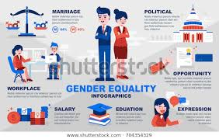
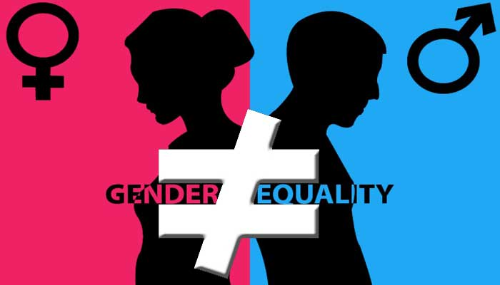

Slide 6
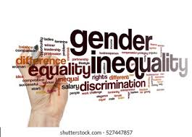
“Overcoming the biases – unseen or otherwise – that are keeping us from closing the gender gap represents an overwhelming economic as well as moral imperative,”
---------------(Professor Schwab, Founder and Executive Chairman of the World Economic Forum, at the launch of its Global Gender Gap Report 2017)

Slide 7
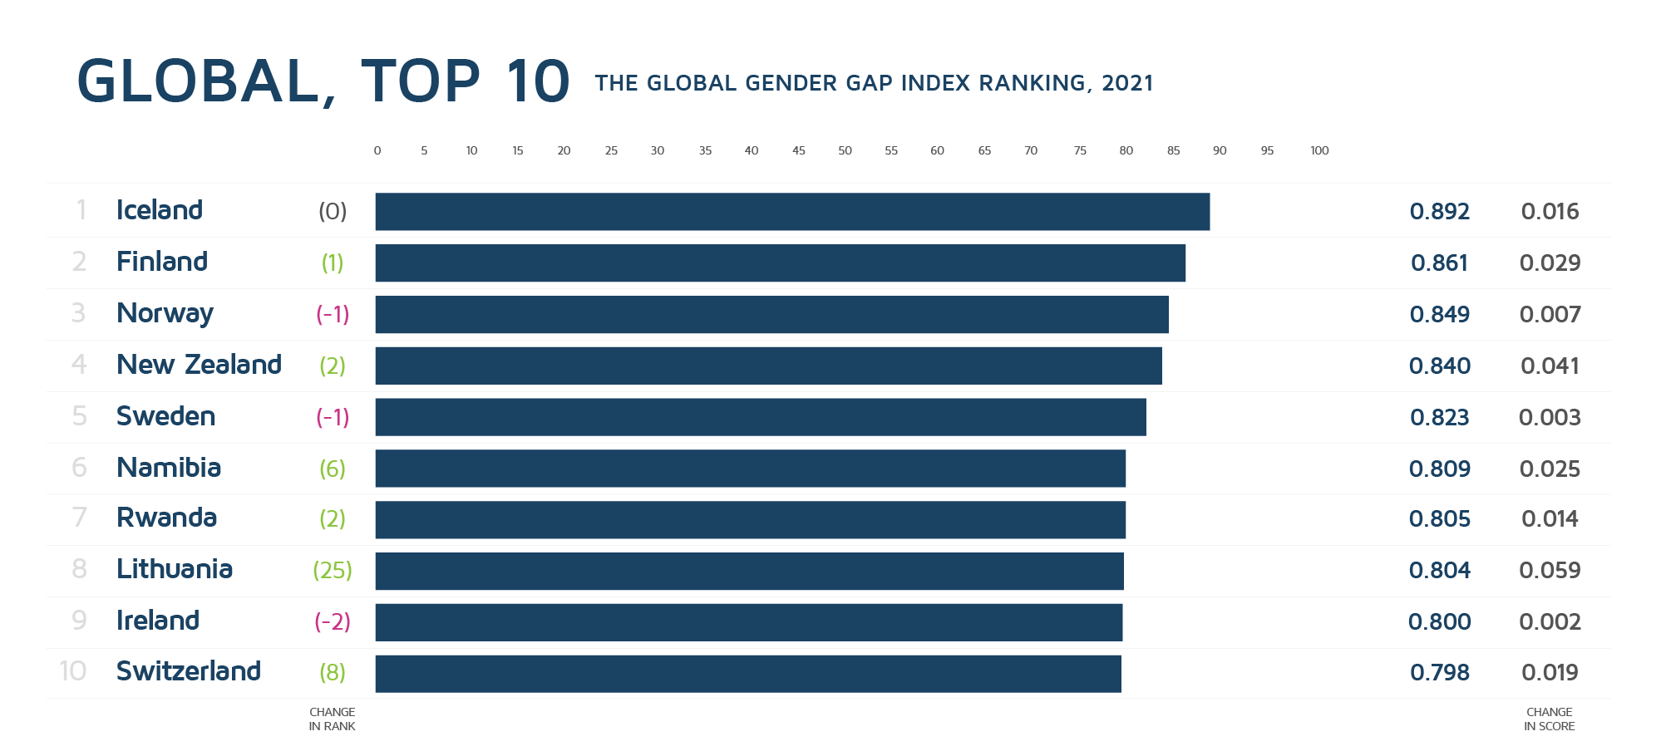

Slide 8
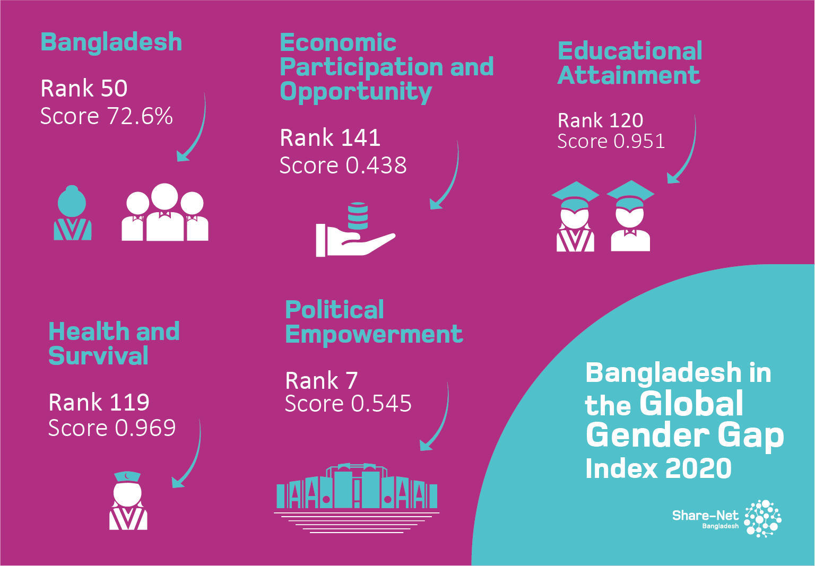

Slide 9
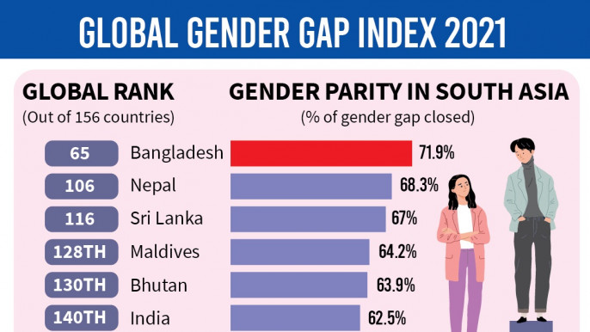

Slide 10
What is the gender gap?
Gap in any area between women and men in terms of their levels of participation, access, rights, remuneration or benefits.
The gender gap is the difference between women and men as reflected in social, political, intellectual, cultural, or economic attainments or attitudes.
The Global Gender Gap Index aims to measure this gap in four key areas: health, education, economics and politics.
So, the gap in economics, for example, is the difference between men and women when it comes to salaries, the number of leaders and participation in the workplace.

Slide 11
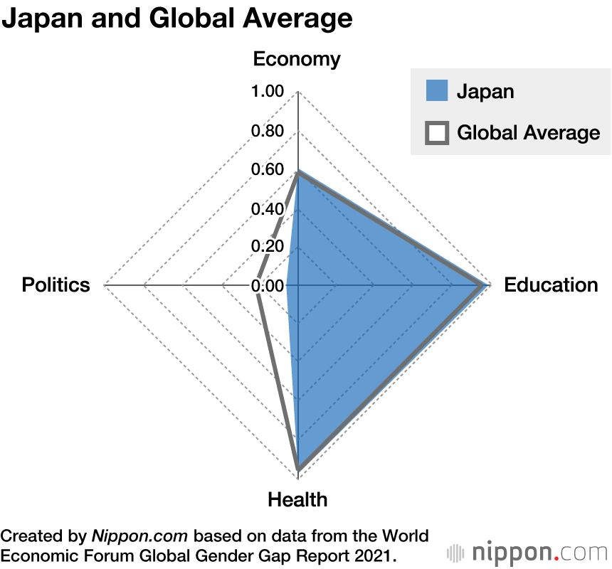

Slide 12
Causes of Gender Inequality
Uneven access to education
Lack of employment equality
Job segregation
Lack of legal protections
Lack of bodily autonomy
Poor medical care
Lack of religious freedom
Lack of political representation
Racism
Societal mindsets
Notes:
https://www.learnhowtobecome.org/career-resource-center/closing-the-gender-pay-gap/

Slide 13
How Gender Inequality Exists?
Girls and boys see gender inequality in their homes and communities every day – in textbooks, in the media and among the adults who care for them.
Parents may assume unequal responsibility for household work, with mothers bearing the brunt of caregiving and chores.
Most low-skilled and underpaid community health workers who attend to children are also women, with limited opportunity for professional growth.
And in schools, many girls receive less support than boys to pursue the studies they choose where the safety, hygiene and sanitation needs of girls may be neglected, eventually barring them from regularly attending class.
Discriminatory teaching practices and education materials also produce gender gaps in learning and skills development.

Slide 14
Contd.
Worldwide, nearly 1 in 4 girls between the ages of 15 and 19 are neither employed nor in education or training – compared to 1 in 10 boys.
Gender inequality turns violent
Some 1 in 20 girls between the ages of 15 and 19 – around 13 million globally – have experienced forced sex in their lifetimes.
Hundreds of millions of girls worldwide are still subjected to child marriage and female genital mutilation
Even though, in early childhood, gender disparities start out small. Girls have higher survival rates at birth.

Slide 15
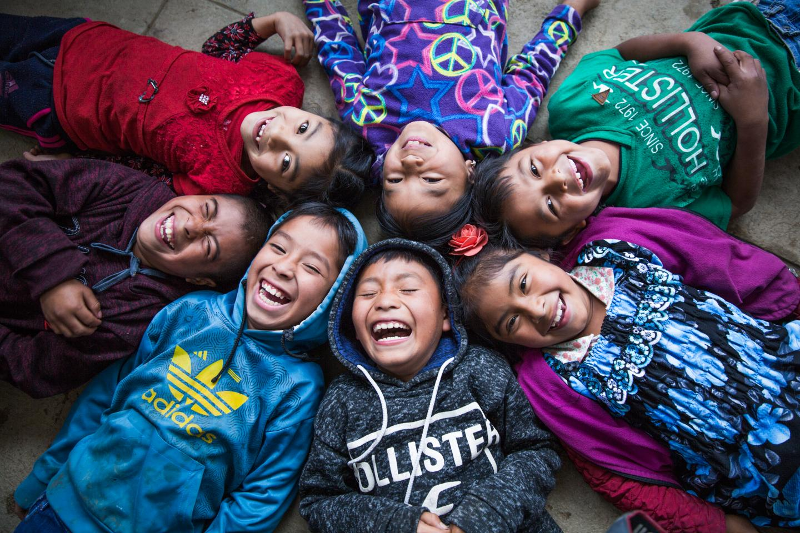
Gender equality
Gender equality is when people of all genders have equal rights, responsibilities and opportunities.
Equal rights and opportunities for girls and boys help all children fulfil their potential.
Everyone is affected by gender inequality - women, men, trans and gender diverse people, children and families. It impacts people of all ages and backgrounds.

Slide 16
Promoting gender equality
By taking a gender perspective and considering these different types of discrimination, we can start to understand the root causes of gender gaps and what types of interventions will close them. In some instances, legislation or policies may be required to prohibit specific discriminatory actions.
Government is committed to upholding the rights of males and females and protecting them from prejudice, discrimination and injustice. The Bill of Rights, Freedoms and Responsibilities recognizes that all people have the right to freely determine their political status and pursue their economic, social and cultural development.
Stereotypes can also hold us back personally if we do not believe we can or should do or achieve certain things just because we happen to be male or female. In order to address structural discrimination and for our society to truly progress, we must all seek to understand how stereotypes and prejudices based on sex and gender affect us in our daily lives and resolve to overcome these biases

Slide 17
Closing gender gaps
Ideas about our gender roles and capabilities are so ingrained that we often see them as “natural”. However, scientific and social research has consistently proven that while there are biological differences between males and females, the way that we are socialized by parents, caregivers, peers, teachers, the media and others is the biggest source of gender differences.
Education is one of the most important tools for ending structural discrimination by breaking stereotypes and prejudices.
When males and females have the same opportunities to achieve important goals and contribute their best efforts there are positive effects for women, men, children, families, the economy and society.
These include decreased reliance on social services, more positive opportunities for all children, lessening negative effects of poor living conditions and poverty, greater productivity and economic growth. Gender equality ensures that individuals are treated fairly, development is human-centred and we are all advancing together.

Slide 18
Key Factors in Closing Gender Gaps
General public policy
● Increase both the quantity and quality of data by gender and improve the evaluation of public policy.
● Strengthen the capacity of governments to apply a gender-responsive approach throughout the public financial management cycle and enhance gender impact
assessments.
● Reform legal frameworks and ensure their enforcement to remove any obstacles to gender equality; prohibit discrimination, combat all forms of pay discrimination; uphold the notion of equal pay for work of equal value; and provide economic support and incentives for individuals, families and communities to change discriminatory attitudes.
● Countries should set realistic targets for women in senior management positions in thepublic service.

Slide 19
Contd.
Employment
● Provide affordable, good-quality childcare for all parents and paid maternity leave for mothers in employment. Encourage more equal sharing of parental leave by, for example, reserving part of paid leave entitlements for the exclusive use of fathers.
● Remove disincentives to paid work created by taxes and benefit systems and ensure that work pays for both parents.
● Address cultural barriers and the stereotyping of women’s roles in society, business and the public sector.
● Countries should introduce targets and measures to monitor progress on female representation on the boards of listed companies.

Slide 20
Contd.
Education
● Get girls more interested in mathematics and science and boys more interested in reading in OECD countries, for example, by removing the gender bias in curricula and raising awareness of the likely consequences of male and female choices of fields of study in their careers and earnings.
● Use apprenticeships to encourage women who have completed their science technology and mathematics (STEM) studies to work in scientific fields.
● Make schools safer and more affordable for girls in developing countries.

Slide 21
Contd.
Entrepreneurship
● Ensure that policies for female-owned enterprises target not only start-ups and small enterprises, but encourage and support the growth ambitions of all existing firms.
● Promote comprehensive support programmes that target female-owned enterprises in high-tech sectors.
● Ensure equal access to finance for male and female entrepreneurs.

Slide 22
The benefits of gender equality Everyone benefits from gender equality.
Gender equality prevents violence against women and girls. The four main drivers of violence against women are:
condoning violence against women
men’s control of decision-making and limits to women’s independence
rigid gender roles and stereotypes
male relationships that emphasize aggression and disrespect towards women
Gender equality is good for the economy
Gender equality is a human right
Gender equality makes our communities safer and healthier. Unequal societies are less cohesive. They have higher rates of anti-social behaviour and violence. Countries with greater gender equality are more connected. Their people are healthier and have better wellbeing.
Notes:
https://www.vic.gov.au/benefits-gender-equality

Slide 23
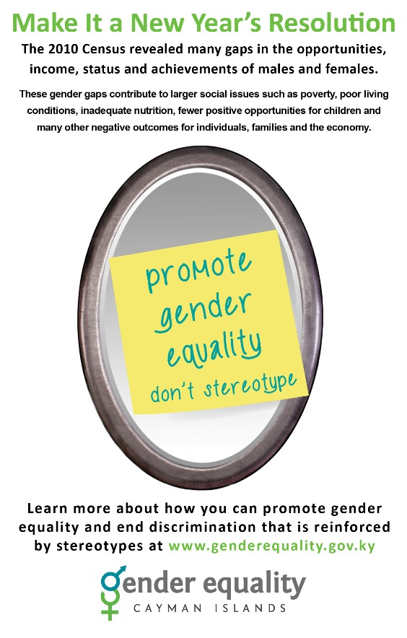
Gender Action Plan 2018-2021 Advancing gender equality and the rights of women and girls is essential to realizing the rights of all children
A roadmap for promoting gender equality
Gender equality means that women and men and girls and boys all enjoy the same rights, resources, opportunities and protections.
Aligned with UNICEF’s Strategic Plan 2018-2021, the Gender Action Plan (GAP) is our roadmap for promoting gender equality in everything we do, as well as in support of achieving the Sustainable Development Goals.

Slide 24
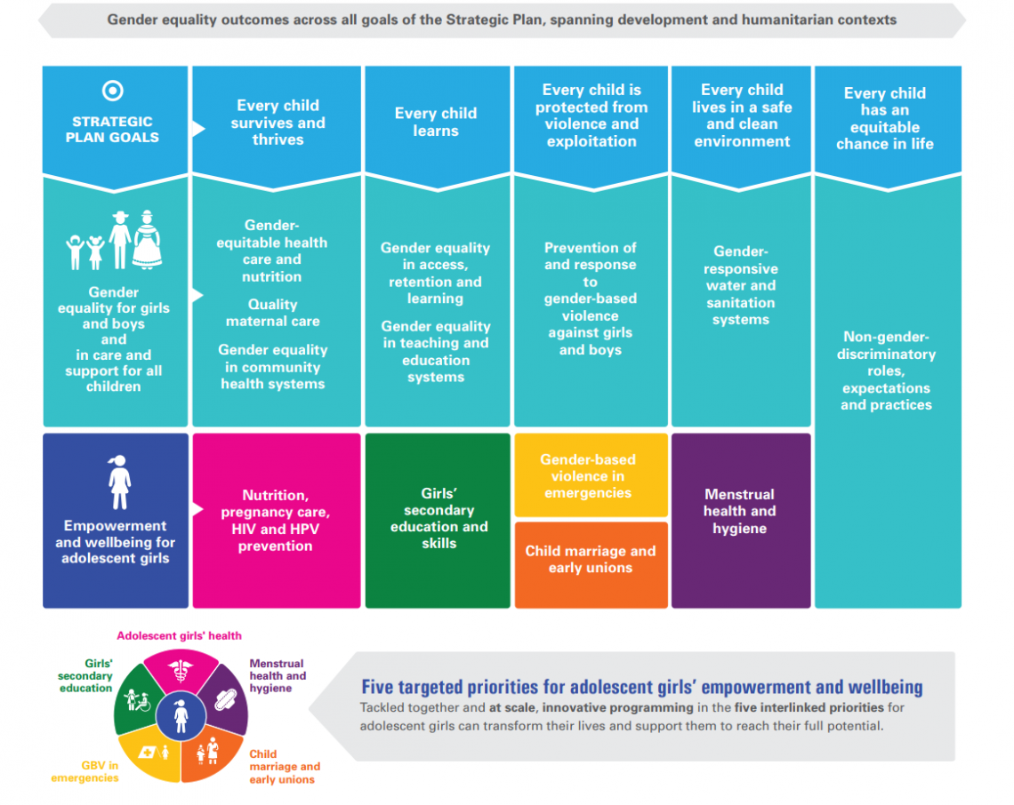

Slide 25
Strategic Plan 2018-2021, the Gender Action Plan (GAP)
Prioritization of the unique needs of adolescent girls by focusing on five interlinked areas to tackle some of the most pressing challenges girls face.
Ending child marriage and protecting girls from multiple risks that limit life opportunities.
Advancing girls’ secondary education with a focus on STEM skills.
Promoting gender-responsive adolescent health, including nutrition, pregnancy prevention and care, and HIV and HPV prevention.
Supporting menstrual health and hygiene.
Preventing and responding to gender-based violence, particularly in humanitarian settings.
Targeted, interlinked investments in these areas can transform vulnerability into opportunities, multiplying the positive effects for girls, their families, and the next generation.

Slide 26
Strategic engagement for gender equality
The strategic engagement for gender equality 2016-2019 is the framework for the European Commission's future work towards full gender equality.
The strategic engagement focuses on the following 5 priority areas:
increasing female labour market participation and economic independence of women and men
reducing the gender pay, earnings and pension gaps and thus fighting poverty among women
promoting equality between women and men in decision-making
combating gender-based violence and protecting and supporting victims
promoting gender equality and women's rights across the world
The strategic engagement sets out objectives in each of these priority areas and identifies more than 30 concrete action

Slide 27
Gender Equality Strategy 2020-2025
The EU Gender Equality Strategy delivers on the von der Leyen Commission’s commitment to achieving a Union of Equality. The Strategy presents policy objectives and actions to make significant progress by 2025 towards a gender-equal Europe.
The goal is a Union where women and men, girls and boys, in all their diversity, are free to pursue their chosen path in life, have equal opportunities to thrive, and can equally participate in and lead our European society.
The key objectives are 1. ending gender-based violence; 2. challenging gender stereotypes; 3. closing gender gaps in the labour market; 4. achieving equal participation across different sectors of the economy; 5. addressing the gender pay and pension gaps; 6. closing the gender care gap and 7. achieving gender balance in decision-making and in politics.
The Strategy pursues a dual approach of gender mainstreaming combined with targeted actions, and intersectionality is a horizontal principle for its implementation.

Slide 28
Thank you

