Slide 1
Lecture: Cost-Benefit Analysis
Bakibillah
Lecturer
DPH, DIU

Slide 2
Economic Evaluation
Economic evaluation is the process of systematic identification, measurement and valuation of the inputs and outcomes of two alternative activities, and the subsequent comparative analysis of these.

Slide 7
CBA
Cost-benefit analysis is a way to compare the costs and benefits of an intervention, where both are expressed in monetary units.

Slide 8
CBA is a tool for making decisions about investing in public health interventions. It helps policymakers make informed decisions by comparing the overall costs of an intervention with societal benefits over time. By comparing costs and benefits in monetary terms, the costs of different program options can be directly compared.
CBA can be used to inform the following types of decisions:
• Should a public health intervention be implemented?
• Which public health intervention should be selected from a list of choices?
• How should public health interventions be prioritized in the context of limited budget?

Slide 9
Cost-benefit comparisons can be expressed as a cost-benefit ratio (benefits/costs) or as net benefits (benefits–costs):
• Cost-benefit ratios demonstrate the savings per dollar of program expenditure.
• Net benefits express the total savings due to the intervention. The intervention should be implemented if net benefits are greater than zero.

Slide 13
Cost-Benefit Analysis infographic text
1-Monetary Valuation. The analysis estimates that the following benefits are worth $40 billion: Direct medical costs averted. Valuation of quality of life gained due to non-fatal heart attacks averted. Valuation of life years gained due to fatal heart attacks averted. Next, the analysis estimates that costs to the industry and consumers are $6 billion.
2- Calculation of Net Benefits – $140 billion in benefits minus $6 billion in costs equals $134 billion in net benefits. Therefore, benefits minus costs equals net benefits.

Slide 14
Benefit-Cost Analysis (BCA)
Compares costs and benefits of an intervention.
Standardizes all costs and benefits in monetary terms.
Lists all costs and benefits over time:
Can have different time lines for costs and benefits.
Can include non-health benefits.
Used primarily in regulatory policy analyses.
Clean Water Act, Clean Air Act.
Increasingly applied to public health.
3

Slide 15
BCA
Benefit-cost analysis is a type of economic evaluation method where the costs of the program or intervention are compared to the benefits of the intervention, and both costs and benefits use the same units: dollars.

Slide 16
CBA
Benefit-cost analysis allows you to consider all costs and benefits over time, even those beyond the length of the intervention. As is often the case with preventive interventions, the costs of the intervention occur in the immediate future and benefits occur in the distant future. With benefit-cost analysis, costs and benefits, regardless of when they occur, are included in the analysis.

Slide 17
,……..Continued
In addition, because all program costs and outcomes are converted into dollars, you can also consider including non-health outcomes associated with an intervention. If you can assign a dollar value to an outcome, you can include it in benefit-cost analysis.
For example, a program designed to increase physical activity among seniors living in an adult residential facility may have the added benefit of improving social or psychological relationships.

Slide 18
……..Continued
Benefit-cost analysis is typically used at the executive level of government when considering regulatory proposals that would be costly to implement but that would have potentially large economic benefits to society. Examples of these regulatory actions are the Clean Air Act and the Clean Water Act. Application of benefit-cost analysis to public health interventions is a more recent phenomenon.

Slide 19
……continued
There are two common summary measures used in a benefit-cost analysis.
The first is a benefit-cost ratio. To find this ratio, divide the program’s net benefits by its net costs. The result is a summary measure that states, “for every dollar spent on program X, Y dollars are saved.”
This type of summary measure is popular with policy makers because it’s easy to understand. If the benefit-cost ratio is greater than 1 dollar, it implies that the program or intervention produces more benefit than it costs.
However, the benefit-cost ratio is somewhat misleading. If you have a negative ratio, in which the program doesn’t save more than it costs, you can’t easily determine whether the negative ratio comes from a negative numerator or a negative denominator. A negative numerator would mean that benefits are listed as “negative costs.” A negative denominator means costs are listed as “negative benefits.”

Slide 20
………..
In other words, it’s easy to manipulate how costs and benefits are described to get the ratio you want. In this same way, the ratio can be manipulated to show a bigger return on investment than really exists, again by labeling costs as negative benefits or labeling benefits as negative costs.
Perhaps a better summary measure for benefit-cost analysis is net benefits, derived by subtracting net costs from net benefits. In this way, programs show a positive return on investment if net benefits are greater than zero. This summary measure is less easily manipulated in terms of how costs and benefits are labeled and thus is the preferred summary measure in benefit-cost analysis.

Slide 21
When to Use CBA
Benefit-cost analysis is used to decide whether to implement one specific intervention or program, which can be determined if net benefits are greater than zero. It can also be used when choosing between competing options. In this case, you would choose the intervention with the highest return on investment or highest net benefit.
Finally, benefit-cost analysis is useful when deciding between a whole set of possible interventions with a limited budget. In this case, the net benefits are determined for all the programs, which are ranked in order of decreasing net benefits, and the budget is spent according to the program ranking until the money is gone.
Because all costs and outcomes are converted into dollars, the objective ranking of programs by net benefits makes it easy for policy makers to spend a limited budget based on the highest return on investment for society.

Slide 22
Assessing Dollar Value of Benefits
Assessing program costs in a benefit-cost analysis follows the same methods discussed in the last module.
Assessing program benefits in a benefit-cost analysis is a little more challenging than assessing program costs. Benefits of an intervention or program can be considered direct, indirect, or intangible.
Direct benefits are those medical expenses saved because of prevention or treatment of the disease or illness.
Indirect benefits are those associated with productivity gains because of prevention or treatment. Examples of indirect benefits include workplace interventions that have the direct intent of improving health outcomes but that may indirectly improve employee productivity, satisfaction, morale, and retention.
Intangible benefits, such as improved psychological health, are also important, but because they are difficult to quantify, they’re considered intangible.

Slide 23
Valuation of Indirect/Intangible Benefits
Human capital approach.
Friction cost method.
Revealed preference.
Stated preference.
7

Slide 24
Steps of CBA: WHO

Slide 25
Cost
The cost measure used in a CBA should summarize the total costs to society of implementing an intervention. They include direct costs and indirect costs. They also include costs that are tangible, that is, they can be counted and measured, and those that are intangible. Costs can represent one-time expenditures on physical equipment or recurring expenditures that should be considered into the future. Refer to Chapter 2 for more information about estimating the total cost of an intervention. Cost information on its own can be useful for evaluating an intervention. Treatment costs can be compared across diseases. Estimates of costs can be used to advocate for resources to reduce the burden of disease. However, by combining costs and benefits, the interventions that maximize the benefits for a level of expenditure can be prioritized.

Slide 26
Benefits
As with costs, all benefits to society should be considered and measured (if possible) for inclusion in a CBA. In this section, we discuss the types of benefits to consider and how to monetize some of these types of benefits.
Direct benefits include avoided medical expenditures resulting from an intervention due to treatment of a condition or by preventing disease and illness. Indirect benefits are less tied to health outcomes and generally include increases in worker productivity due to better health of workers. Improved productivity increases earnings for workers and employers and should be measured as part of a CBA. Intangible benefits include the other quality of life benefits that come from better health. There are several ways to quantify intangible benefits.

Slide 27
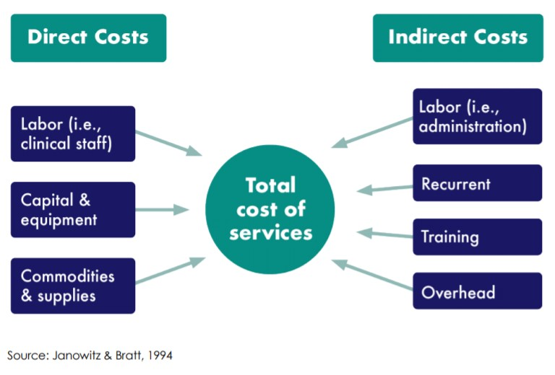
Types of Cost

Slide 28
Capital Costs
Capital costs are considered investment expenses and are treated differently than operating costs. They include expenditures on durable goods or equipment. Capital costs generally have benefits longer than one year. Organizations may have their own local definitions of what is to be included in capital costs and how the rules for financial management and for assessing the current value of these costs should be applied. Capital costs are depreciated over a defined period. Although most capital costs pertain to the purchase of durable assets, the cost of pre-service or one-time in-service training should also be treated as a capital cost, because of its nonrecurrent nature.

Slide 29
Recurrent Costs
Recurrent costs are expenses incurred in the day-to-day provision of services, apart from personnel and commodity and pharmaceutical costs. These may include (for example) building utilities and rent, and transportation and fuel costs. Recurrent costs are relatively simple to calculate when their market price reflects their opportunity price (Janowitz & Bratt, 1994; Elliot & Payne, 2005).

Slide 31
Thank You So Much for Your Attention

