Slide 1
Computer Networks
GAA
Global Access Asia
EIGRP
Professor Dr. A.K.M Fazlul Haque
Electronics and Telecommunication Engineering
(ETE)
Daffodil International University

Slide 2
What is EIGRP
EIGRP (Enhanced Interior Gateway Routing Protocol) is a network protocol that lets router exchange information more efficiently than with earlier network protocols.

Slide 3
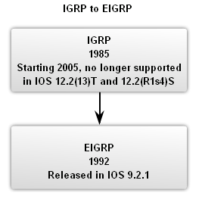
Introduction
EIGRP is an enhanced version of IGRP. The same distance vector technology found in IGRP is also used in EIGRP, and the underlying distance information remains unchanged.
EIGRP has been extended to be network-layer-protocol independent, thereby allowing DUAL to support other protocol suites.

Slide 4
Features of EIGRP
Classless Routing Protocol (VLSM, CIDR).
Faster convergence times and improved scalability.
Multiprotocol support: TCP/IP, IPX/SPX, Appletalk.
Rapid Convergence and Better handling of routing loops – (DUAL).
Efficient Use of Bandwidth.
Partial, bounded updates: Incremental updates only to the routers that need them.

Slide 5
Features of EIGRP (Cont.)
Minimal bandwidth consumption: Uses Hello packets and EIGRP packets by default use no more that 50% of link’s bandwidth EIGRP packets.
PDM (Protocol Dependent Module).
Keeps EIGRP is modular.
Different PDMs can be added to EIGRP as new routed protocols are enhanced or developed: IPv4, IPv6, IPX, and AppleTalk.
Unequal-cost load balancing same as IGRP (unlike OSPF).

Slide 6
EIGRP Terminology
Neighbor table – Each EIGRP router maintains a neighbor table.
Topology table – Every EIGRP router maintains a topology table for each configured network protocol.
Routing table – EIGRP chooses the best routes to a destination from the topology table and places these routes in the routing table.
Successor – A successor is a route selected as the primary route to use to reach a destination.
Feasible successor – A feasible successor is a backup route.

Slide 7
Message/Packet Types
EIGRP uses five message/packet types:

Slide 8
Message/Packet Types (Cont.)
Hello packets:
Used to discover & form adjacencies with neighbors.
Hellos are multicast for neighbor discovery/recovery.
They do not require acknowledgment.

Slide 9
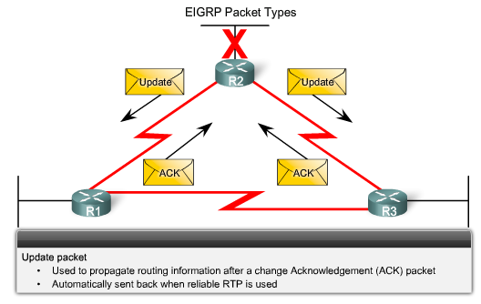
Message/Packet Types (Cont.)
Update packets:
Used to propagate routing information.
Updates are used to convey reachability of destinations.
Update packets are unicast. In other cases, such as a link cost change, updates are multicast.
Updates are always transmitted reliably.

Slide 10
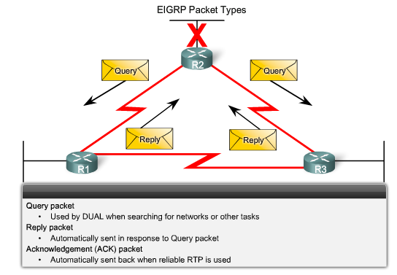
Message/Packet Types (Cont.)
Query packets:
Used by DUAL for searching for networks.
Can use Unicast or Multicast.
Reply packets:
Reply packet can use Unicast only.
Acknowledgement packets:
Used to acknowledge receipt of update, query & reply packets.

Slide 11
EIGRP Message Format
EIGRP Message Format:
EIGRP Header
Data link frame header - contains source and destination MAC address.
IP packet header - contains source & destination IP address.
EIGRP packet header - contains AS number.
Type/Length/Field - data portion of EIGRP message.

Slide 12
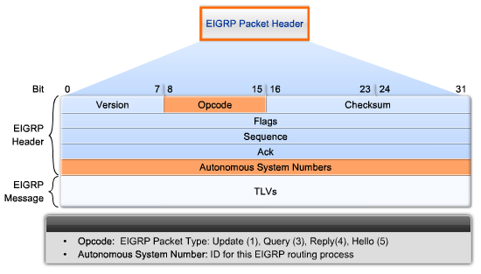
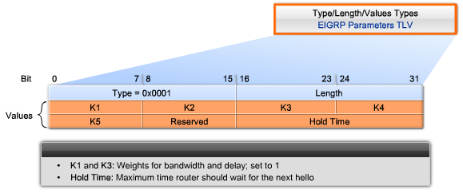
EIGRP Packet Header
EIGRP packet header contains:
Opcode field.
Autonomous System number
EIGRP Parameters contains:
Weights.
Hold time.

Slide 13
Hello Intervals and Default Hold Times
Hello Time: The interval of Hello Packets.
Hold Time: The interval to wait without receiving anything from a neighbor before considering the link unavailable.

Slide 14
EIGRP Bounded Updates
EIGRP only sends update when there is a change in route status.
Partial update:
A partial update includes only the route information that has changed the whole routing table is NOT sent.
Bounded update:
When a route changes, only those devices that are impacted will be notified of the change.
EIGRP’s use of partial bounded updates minimizes use of bandwidth.

Slide 15
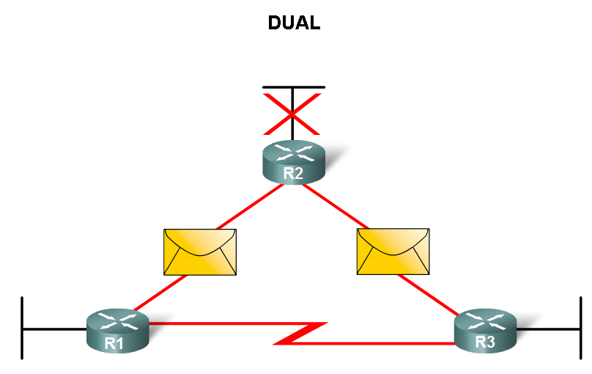
Diffusing Update Algorithm (DUAL)
Diffusing Update Algorithm (DUAL) Purpose
EIGRP’s primary method for preventing routing loops.
Advantage of using DUAL
Provides for fast convergence time by keeping a list of loop-free backup routes.

Slide 16
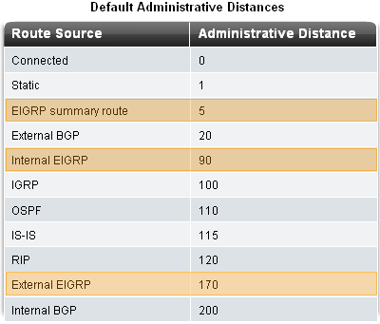
Administrative Distance
Administrative Distance (AD)
Defined as the trustworthiness of the source route
EIGRP default administrative distances
Summary routes = 5
Internal routes = 90
Imported routes = 170

Slide 17
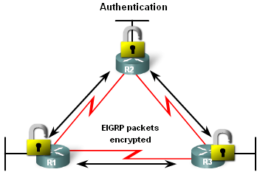
EIGRP Authentication
Authentication
EIGRP can,
Encrypt routing information.
Authenticate routing information.

Slide 18
Summarizing EIGRP Routes: no auto-summary
EIGRP automatically summarizes routes at the classful boundary, the boundary where the network address ends as defined by class-based addressing.

Slide 19
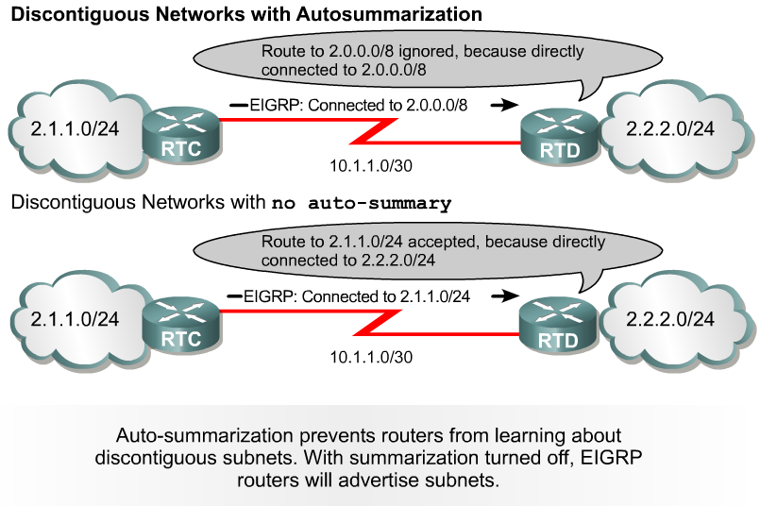
Summarizing EIGRP Routes: no auto-summary (Cont.)
In the presence of discontinuous subnetworks, automatic. summarization must be disabled for routing to work properly.
To turn off auto-summarization, use the following command:
R(config-router)#no auto-summary

Slide 20
EIGRP Metric

Slide 21
EIGRP Metric Calculation

Slide 22
Autonomous System

Slide 23
END

