Slide 1
Introduction to DBMS
Fatema Tuj Johora Lecturer, Department. of CSE,DIU

Slide 2
Topic of discussion
Difference between Data & Information
Definition of Database
DBMS
Application of DBMS

Slide 3
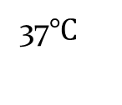
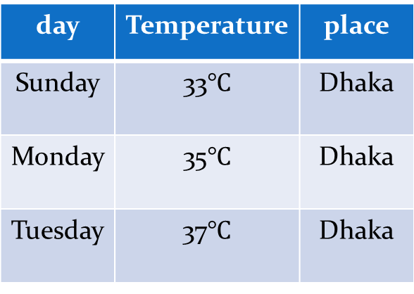
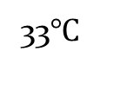
Data & Information
Data is raw, unorganized facts that need to be processed or recorded.
Ex: Text, number, image, video, audio, speech etc.
When data is processed, organized, structured or presented in a given context so as to make it useful, it is called information.
day | Temperature | place
Sunday | 33$℃$ | Dhaka
Monday | 35$℃$ | Dhaka
Tuesday | 37$℃$ | Dhaka
37$℃$
Dhaka
Monday
Sunday
33$℃$

Slide 4
Database
Database is collection of organized and related data.
Ex: YouTube , DIU website etc.
Some example of database
TDB (Traditional Database) store; text, number
MDB (Multimedia Database) store; audio, video, movie etc.
GIS (Geographic Information System)
Satellite etc. store; images
RDB (Real time Database)
Production use. Ex: inventory management system

Slide 5
Data warehouse
A data warehouse is a large collection of business data used to help an organization make decisions.
Large amount of historic data; ex: past hundred years

Slide 6
DBMS and RDBMS
Database Management System or DBMS refers to the technology/ set of programs for storing and retrieving data with efficiency along with appropriate security measures.
RDBMS, Relational Database Management System, is an enhanced version of DBMS.

Slide 7
DBMS RDBMS
DBMS stands for DataBase Management System.
Data is stored as file
Single data can be accessed at a time
No relationship between data
Can not perform normalization
No supports for distributed database
Deals with small amount of data
Example: MS Access
RDBMS stands for Relational DataBase Management System.
Stored as table
Multiple data can be accessed at a time
There is relationship between data
Normalization can be achieved
Supports distributed database
Deals with large amount of data
Example: Oracle, my sql

Slide 8
Database Applications
Database Applications:
Banking: all transactions
Airlines: reservations, schedules
Universities: registration, grades
Sales: customers, products, purchases
Manufacturing: production, inventory, orders, supply chain
Human resources: employee records, salaries, tax deductions
Databases touch all aspects of our lives

Slide 9
Purpose of Database System
Drawbacks of using file systems to store data:
Data redundancy and inconsistency
Multiple file formats, duplication of information in different files
Difficulty in accessing data
Need to write a new program to carry out each new task
Data isolation — multiple files and formats
Integrity problems
Integrity constraints (e.g. account balance > 0) become part of program code
Hard to add new constraints or change existing ones

Slide 10
Purpose of Database System
Atomicity of updates
E.g. transfer of funds from one account to another should either complete or not happen at all
Concurrent access by multiple users
Concurrent accessed needed for performance
Uncontrolled concurrent accesses can lead to inconsistencies
E.g. two people reading a balance and updating it at the same time
Security problems
Database systems offer solutions to all the above problems

Slide 11
Thank you

