Slide 1
Embedded
Controls
CSE334
Md. Ferdouse Ahmed Foysal
Daffodil International University

Slide 2
Embedded Controls
It describes how pervasive information technology will be used in embedded home and automotive settings.
The network includes more and more objects of everyday life. Standard household appliances will soon be able to communicate with one another and with external infrastructure. Heating systems will adapt themselves to the habits of the residents. Power outlets can be deactivated when no valid electrical device is attached to in- crease safety for small children.

Slide 3
Smart Sensors and Actuators
Smart Sensors: By building on the idea of the web camera one can imagine smart sensors. They are built to collect information about their surroundings and are small, self-contained, and connected to a network.
Sensors are available for air temperature, liquid temperature, pressure, and various gasses. Outdoor and indoor motion detectors enhance security systems and light level sensors control lighting installations in the evening.

Slide 4
Smart Sensors and Actuators
Smart Actuators: Smart actuators, on the other hand, accept signals from the network in order to act on their environment accordingly.
Actuators are sometimes just controlled electrical switches that are used for switching lights and appliances on and off.

Slide 5
Smart Control Internal Structure
A transceiver component connects the device with the network. It produces and interprets the physical signals on the network medium and handles the low-level protocols for data transfer.
The control logic is usually a microprocessor that provides the actual intelligence in the device. It interprets the commands from the network, processes them, and sends out the appropriate response. During command processing, the control logic will generally read the sensor level or carry out the requested action. If the network protocol supports asynchronous messaging, it might also be possible for the control logic to generate unsolicited alert messages when critical situations occur.

Slide 6
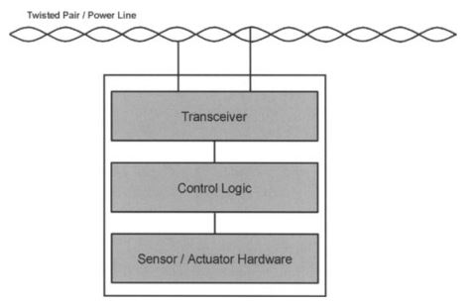
Smart Control Internal Structure
The sensor / actuator hardware either senses its environment or activates motors, solenoids, and the like to carry out an action.

Slide 7
Smart Appliances
The term "smart appliance" refers to devices used to increase comfort or convenience that are endowed with a certain computer intelligence and networking capability. These devices are useful not only in the home, but also in many service settings such as restaurants and hotels. Examples of smart appliances include refrigerators, freezers, stoves, microwave ovens, was hitting machines, and heating units.

Slide 8
Smart Appliances
The Smart Clock: Your alarm dock also knows some very interesting information about you - when you plan to get out of bed in the morning. The alarm dock could make this information available to other house-hold appliances to enable them to maximize energy efficiency while at the same time maintaining your comfort.

Slide 9
Smart Appliances
Heating, Ventilation, and Air Conditioning: The living room would be heated in the evening until the television is turned off and the lights are all turned out.

Slide 10
Smart Appliances
Smart thermostat: A smart thermostat could also exchange information with other household appliances. The temperature information could be made available to the television set for display.

Slide 11
Appliances and Home Networking
There are a number of different possibilities for networking smart appliances, and at present it is completely unclear which, if any, of these ideas will win out.

Slide 12
Residential Gateway
The consumer would address the residential gateway, authenticate herself, and then communicate with the intended appliance. The residential gateway would block access by unauthorized callers.

Slide 13
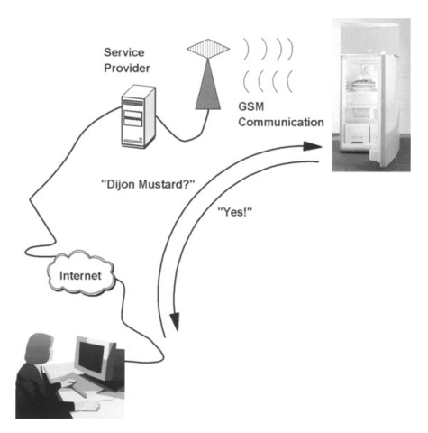
Cellular Communication
This scenario call for each appliance to have its own cell phone number. The consumer would browse the web site of a service provider, who would dial up the refrigerator and obtain the
requested information.

Slide 14
Pervasive Computing in vehicles
For a couple of years, there has been an emerging demand for new electronic systems in automobiles. Controllers, computers, and invehicle networks collaborate to make driving easier, safer, and more comfortable.
Sensors are detecting all possible parameters, like rainfall, pressure in the tires, or intensity of sunshine. All this data is transmitted to different processing units in a car, which trigger an action if required. For instance, wipers are activated automatica11y as so on as rain starts. A warning can be displayed on the dashboard, when the tire pressure is below a minimum threshold. And the air conditioning can increase its cooling, if the car is exposed to extreme sunshine.

Slide 15
Pervasive Computing in Vehicles
Beside safety equipment, which helps to avoid accidents or protect the passengers, there are manifold convenience features. These have in common that they replace manually operated parts by electronic modules, such as motors and switches. Instead of letting the driver crank the window, automatic window openers take over that job. Mirrors, seats, and door locks can be easily operated using a panel

Slide 16
Pervasive Computing in Vehicles
Powertrain controllers: Powertrain and transmission controllers adjust the engine and the gear for best performance. These sophisticated systems apply powerful 32-bit processors running modern real-time operating systems. They process sophisticated algorithms, which help to make the engine more efficient, save fuel, and minimize emissions.
Antilock braking: The antilock braking system comprises a smart controller, which surveys the rotation of all four wheels and the motor, as well as the speed and gear of the vehicle. If the controller detects a mismatch of these parameters, the associated brakes are inactivated for a short duration.

Slide 17
Pervasive Computing in Vehicles
Tire pressure sensors: There are two different ways to determine the tire pressure. The first method uses a controller that calculates a change in the tire pressure from the vehicle speed and the tire rotation speed. All of these parameters can be retrieved from the antilock braking system. The second method applies a sensor within the tire, which is connected wirelessly to the car's body electronics.
Airbag: The airbag is another good example of how multiple electronic subsystems collaborate: The pre-crash sensor triggers the airbag activation process. A dedicated sensor inactivates the airbag, if a children's seat occupies the front seat. Additional sensors detect, if the passenger sits in an improper position, in which the airbag could cause more harm than benefits. F or example, if a person puts his feet on the dashboard or leans his head against the side windows, the system will detect an "Out-of-Position" situation and will not inflate the airbag.

Slide 18
Pervasive Computing in Vehicles
Adaptive cruise control: The adaptive cruise control pays attention to the traffic in front of the vehicle. An infrared sensor detects other vehicles in front, and reduces or increases speed automatically in order to keep a minimum distance and avoid collisions.
Keyless entry: There are several approaches for keyless access. Contactless smart Keyless entry cards and other devices replace the traditional key and offer additional functionality.

Slide 19
Acknowledgements
These slides contain material developed and copyright by:
Pervasive Computing Handbook - Uwe Hansmann

