Slide 1
Entrepreneurship Development
BUS 304
Module- 2
From the idea to Opportunity:
Brainstorming & Idea Generate

Slide 2
Learning Outline
Rocket Pitch and generate Idea

Slide 3
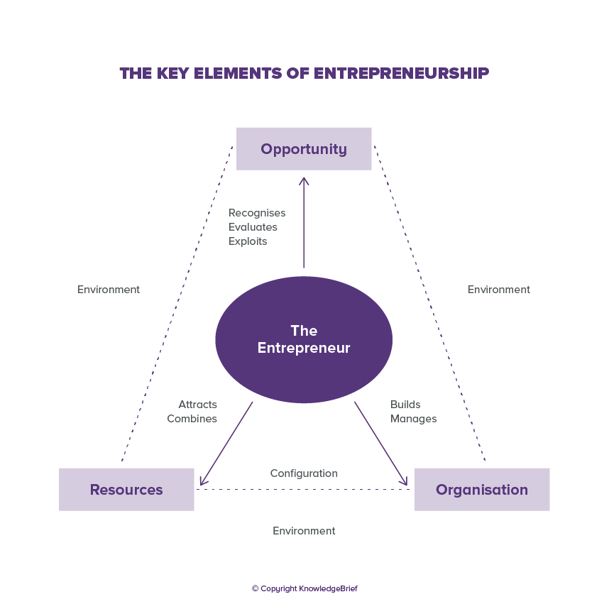
Think and Generate idea

Slide 4
Think and Generate idea

Slide 5
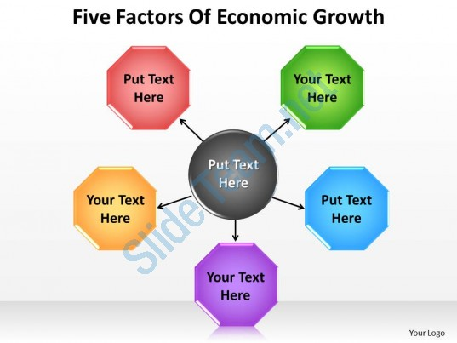
Think and Generate idea

Slide 6
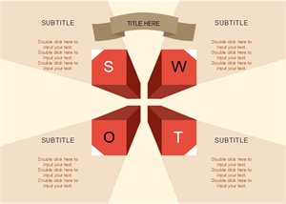
Identify Your best strength & Opportunity Find your Weakness & Threat; Throw it to a bean

Slide 7
Think about….
Business plan including…. 1. Executive Summary 2. Context and Idea 3. Company's Mission-Vision, Objective or Goal 4. Management Structure i. Organisation chart ii. Roles and responsibilities 5. Marketing Plan & Strategy i. Marketing analysis ii. Competitor analysis iii. Marketing Plan iv. Marketing Strategy 6. Organisational Plan and strategy i. Business Model ii. Business Strategy 7. Financial plan and Revenue model i. Invest plan ii. Return on Investment 8. Execute and Operational plan

