Slide 1
Micro-credit & Rural Development
A/Prof. Md. Fouad Hossain Sarker
Department of Development Studies
Daffodil International University

Slide 2
Learning Objectives and Outcomes
Make a conceptual understanding of micro-credit, Microfinance, and rural development
Share the success stories and features of microfinance
Identify the aims of microcredit and how it works
Understand the historical background, suppliers, and clients of it
Identify the key roles and prior research of this field for a comprehensive understanding
Sharing some pieces of evidence for understanding the impact/role of it.
Find out the key problems and challenges that need to be addressed immediately
Make a debate for future directions and sustainable development

Slide 3
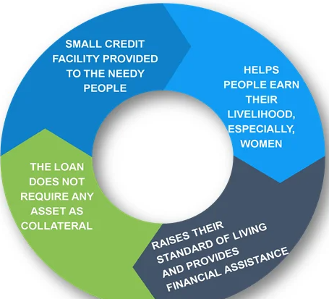
Micro-credit
Microcredit is a tiny credit facility provided to needy people with limited earning capacity. Borrowers who are unemployed, lack assets, and have a poor credit history are eligible for the loan. It includes only credit activities.
According to Dr. Muhammad Yunus, “small loans could make a big difference in their lives. We started to give micro-credit to villagers, which meant providing small loans to the marginalized communities without any extravagant securities”.

Slide 4
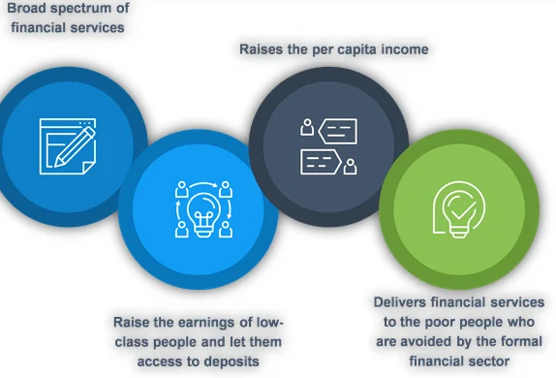
Microfinance
Microfinance includes a wide range of financial services that are offered to individuals belonging to low-income groups who are unable to access traditional banking services and related financial products. The program is accessible to anybody experiencing extreme poverty, no matter where they live. It includes credit activities and non-credit activities like savings, pension, insurance, etc.

Slide 5
Rural Development
Rural development is the betterment in the totality of life for rural people. It is the process of improving the quality of life and economic well-being of people living in relatively isolated and sparsely populated areas. Its actions are mainly aimed to the social and economic development of the rural areas.
Indicators of Rural Development
Changes in agricultural productivity.
Changes in rural employment, unemployment and under employment
Changes in the income of different income groups
Changes in the distribution of power, influence and participation.
Changes in literacy, schooling, literacy rate and life expectancy
Changes in values, believes and attitudes of members of state agencies as well as the rural policymaking.

Slide 6
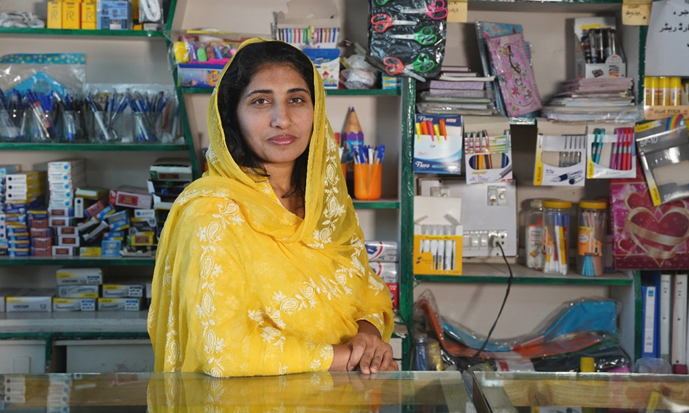
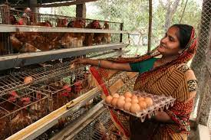
Success Stories of Microfinance
Microfinance is game changer of my life….
---Shaheda Khatun

Slide 7
Features of Microfinance
Prefer women customers over men
Provides tiny loans for short terms
Prefer saving over borrowing
Provides financial services to rural people
Borrowers are from the low-income group
Loans are offered without security
Loans are generally taken for income generation purpose

Slide 8
Aims of Micro Credit
Poverty Reduction
(the original aim) through financial inclusion
Protection against income volatility (insurance)
Raising domestic savings in lowest income countries
Sustainable finance for new enterprises
Gender Empowerment
Microfinance has long been used in developing countries to help poor entrepreneurs who cannot access mainstream finance.

Slide 9
What Does Micro-Credit Do?
It promotes credit as a human right.
It is aimed towards the poor, particularly poor women.
It is based on ‘trust’, not on legal procedures and system.
It is offered to create self-employment, income-generating activities and housing for the poor, as opposed to consumption.
It was initiated as a challenge to conventional banking which rejected the poor by classifying them as ‘not creditworthy’.
It provides service on the door-step of the poor based on the principle that the people should not go to the bank, the bank should go to the people.
It gives high priority to building social capital.

Slide 10
Evolution & Trends
Microfinance existed in this country in one form or another for a long time.
Prof. Muhammad Yunus made the breakthrough with his action research in Jobra village of Chittagong in 1976 and then in Tangail in 1979.
Established Grameen Bank in 1983.
“Grameen credit” is collateral-free, pro-women credit system.
Today Grameen Bank is predominantly (90%) owned by the rural poor whom it serves with 2,565 branches (July, 2011).
Yunus & Grameen Bank received Nobel peace prize in 2006.
Mohammad Yunus, Bangladeshi Social Entrepreneur, Banker, Economist who was awarded Noble Peace Prize for founding the Grameen Bank and pioneering the concept of Microfinance.

Slide 11
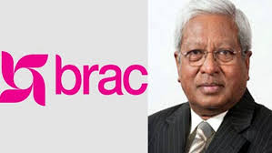
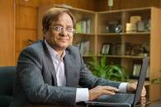
Evolution & Trends (Cont.)
Sir Fazle Hasan Abed established BRAC in 1972 for relief & rehabilitation operations following liberation war. It began community development in 1973 & microfinance in 1974. BRAC has many “credit-plus” programs on health, education, legal services.
ASA was founded by Md. Shafiqual Haque Choudhury in 1978 & was registered in 1979. ASA is the most efficient in operation.
All these 3 MFIs perform international operations and occupy three-fourth of the industry. Some other large MFIs are Proshika, BURO, TMSS, SSS, Shakti, Uddipan, PMUK, JCF.

Slide 12
Evolution & Trends (Cont.)
Specialized institutions, Government & commercial banks also retails microcredit. Major players in the field:
Palli Karma-Sahayak Foundation (PKSF) was established in 1990. It implements its programs through its 250 member institutions with wholesale microfinance & training.
Microcredit Regulatory Authority (MRA) was established in 2006 for licensing & monitoring microfinance institutions. It has given licenses to about 550 MFIs so far.
Institute of Microfinance (InM) was also established in 2006 as an independent research & training organization. It does not have a microfinance program.

Slide 13
Suppliers of Microcredit
The principal microcredit service providers in Bangladesh are usually categorized into four major groups:
NGOs
Specialized Institutions
Commercial Banks with microcredit programs
Administrative ministries or divisions
Although there are thousands of NGOs throughout the country offering micro credits, many of them are very small in loan portfolio or number of borrowers, and the majority of micro credit clients are being served by four huge Microcredit institutions, namely Grameen Bank, BRAC, ASA and Govt. agencies & BRDB. The World Bank estimates that in 2005 the four institutions combined account for 86% of all active borrowers and over 90% of all outstanding loans in the Bangladesh Microcredit sector.

Slide 14
Clients of Microcredit
Typical microcredit clients are poor and low-income people that do not have access to other formal financial institutions.
Microcredit clients are often self-employed, household-based entrepreneurs.
Their diverse “microenterprises” include small retail shops, street vending, artisanal manufacture, and service provision.
In rural areas, micro entrepreneurs often have small income-generating activities such as food processing and trade; some but far from all are farmers.
Most clients below the poverty line are in the upper half of the poor. It is clear, however, that some MFIs can serve clients at the higher end of the bottom half.
Women often comprise the majority of clients.

Slide 15
Role of Microfinance in Rural Development
Poverty reduction
Women Empowerment
Credit to rural poor
Mobilization of Resources
Promotes Savings and banking habits
Economic Growth
Social and Economic Justice

Slide 16
Prior Research Works
Dowla, A., & Alamgir, D. (2003). From microcredit to microfinance: evolution of savings products by MFIs in Bangladesh. Journal of international Development, 15(8), 969-988.
Bakhtiari, S. (2006). Microfinance and poverty reduction: some international evidence. International Business & Economics Research Journal (IBER), 5(12).
Altay, A. (2007). The challenge for global women poverty: Microfinance (or microcredit) as a solution for women poverty in Turkey. In International Conference on Globalization and Its Discontents (pp. 4-21).
Hulme, D. (2009). The story of the Grameen bank: From subsidized microcredit to market based microfinance. In Microfinance (pp. 163-170). Routledge.
Chowdhury, A. (2009). Microfinance as a poverty reduction tool: a critical assessment.
Duvendack, M., Palmer-Jones, R., Copestake, J. G., Hooper, L., Loke, Y., & Rao, N. (2011). What is the evidence of the impact of microfinance on the well-being of poor people?
Nawaz, N., Jahanian, A., & Manzoor, S. W. (2012). Empowering women through microcredit: A case study of Tameer microfinance bank, Bahawalpur. Journal of Economics and Sustainable Development, 3(6), 17-21.

Slide 17
Prior Research Works
Ayodele, A. E., & Arogundade, K. (2014). The impact of microfinance on economic growth in Nigeria. Journal of Emerging Trends in Economics and Management Sciences, 5(5), 397-405.
Ullah, I., & Khan, M. (2017). Microfinance as a tool for developing resilience in vulnerable communities. Journal of Enterprising Communities: People and Places in the Global Economy, 11(2), 237-257.
Asad, A., Hameed, W. U., Irfan, M., Jiang, J., & Naveed, R. T. (2020). The contribution of microfinance institutes in women-empowerment and role of vulnerability. Rev. Argent. Clín. Psicol, 29, 223-238.
Shafique, O., & Siddique, N. (2020). The impact of microcredit financing on poverty alleviation and women empowerment: An empirical study on Akhuwat Islamic microfinance. PalArch's Journal of Archaeology of Egypt/Egyptology, 17(8), 548-562.
Kandie, D., & Islam, K. J. (2022). A new era of microfinance: The digital microcredit and its impact on poverty. Journal of International Development, 34(3), 469-492.
Wu, B., Cui, Y., & Jiang, Y. (2022). The role of microfinance in China’s rural public health: Evidence from the anti-poverty microcredit program. International Journal of Environmental Research and Public Health, 19(17), 10872.

Slide 18
Impact of Microfinance in rural areas-1
The World Bank's 2008 Poverty Assessment has two findings in this context-
First, Microfinance has expanded more in areas that were poorer, presumably because the better-off geographical areas were covered in the previous decade.
Second, the reduction in poverty in rural Bangladesh has been much more in upazilas where microfinance membership increased more rapidly.
Microfinance has positive impact on Women Empowerment, Consumption Smoothing, and to some extent, in Building Assets.

Slide 19
Impact of Microfinance in rural areas-2
1. Socio-economic Development
Access to finance & breaking Mahajans’ circles
Helps mitigating seasonal hunger & shocks
Promotes employment & productivity
Facilitates savings & builds up asset
Empowers women
Fertility transition & contraceptive use
Self-employment, favorable agricultural contract
Migration
Rural power structure

Slide 20
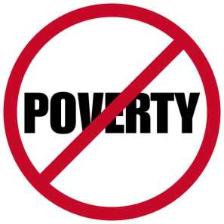
Impact of Microfinance in rural areas-3
2. Poverty Alleviation
Improved access and efficient provision of savings, credit and insurance facilities. In particular, can enable the poor to smooth their consumption.
Government, NGOs and other financial institutions have introduced to reduce poverty.
Microfinance by provident small loans and savings facilities to those who are excluded from commercial financial services has been developed as a key strategy for reducing poverty throughout the world.
Empowers individuals to start small businesses, increasing income.
Reduces reliance on subsistence farming.

Slide 21
Impact of Microfinance in rural areas-4
3. Women Empowerment
In rural areas women living below the poverty line are unable to realize their potential. Microfinance programs are currently being promoted as a key strategy for simultaneously addressing both poverty alleviation and women’s empowerment. The self-help groups (SHGs) of women as source of microfinance have helped them to take part in development activities.
Enhances financial inclusion for rural women.
Fosters economic independence.
https://www.youtube.com/watch?v=9OPY5U0CWwI&ab_channel=UNDPBangladesh

Slide 22
Women in Social Structure
Men
Social Structure
The Difference
Women

Slide 23
Women: The Victims of Social Injustice
Empowerment of women has always been a puzzling scenario for the development experts.
Although women constitute half of the world population, social injustice creates considerable hurdles for them to come to an equal level with men.
In Bangladesh, like many other developing countries, women’s access to positions of influence and power is limited.

Slide 24
Women: The Silent Partner of Development
Most of the women live in rural areas of Bangladesh, where majority of them play a major role in the areas of management of crops, livestock, fisheries, biological diversity, energy and family.
Even though the economic contribution of rural women is substantial, it is largely unacknowledged.
In addition to their productive work, the traditional division of labor gives women the primary responsibility for such domestic chores as cleaning, cooking, childcare, fetching water and so on.

Slide 25
Microcredit and Rural Women Empowerment
Microcredit
Independent Income
Greater Control on household economy
Economic Empowerment

Slide 26
Microcredit Strengthens Women’s Decision Making Power within the Household
Participation in Decision Making Process
Gaining More Resources
Becoming Empowered
Microcredit and Mobility of Rural Women
Microcredit Programs require weekly meetings
To attend these meetings, women have to move within the village or travel far from the village

Slide 27
Microcredit Facilities Women Better Health
Women achieve economic power through microcredit
Women also possess the responsibility of family hygiene in rural areas
Becoming empowered, women can take care of the sanitation system and family hygiene
Thus better health and nutrition status can be achieved
Achieving Better Health

Slide 28
4. Economic diversification is the process of shifting an economy away from a single income source toward multiple sources from a growing range of sectors and markets.
Impact of Microfinance in rural areas-5
Micro-credit encourages the borrowers for income diversification
Microcredit Decreases Overgrazing and Deforestation
The Borrowers of Micro-credit invest their income into various activities which in turn reduces pressure on environment

Slide 29
5. CREDIT TO RURAL AREA
Impact of Microfinance in rural areas-6
Credit is an important instrument for rural development. Most of the agricultural chores still depend on manual labour. The investment in rural areas has been on a low which effectively results in low output and productivity in all kind of activities. A capital infusion for a jump in productivity in reference to both agricultural and non-agricultural activities can be achieved by reforming credit and banking system.
For Example, Dr. Yunus lent US$27 of his money to 42 women in the village, who made a profit of BDT 0.50 (US$0.02) each on the loan. Thus, Yunus is credited with the idea of microcredit. In December 1976, Yunus finally secured a loan from the government Janata Bank to lend to the poor in Jobra.

Slide 30
6. Economic Growth
Impact of Microfinance in rural areas-7
Due to easy availability of finance.
Low interest rates.
Proper utilization of resources.
Women empowerment.
Expand of small business.
Increase in personal income.
Improvement in individual life-style.

Slide 31
7. Social Justice
Impact of Microfinance in rural areas-8
By providing equal rights to women.
By opening Banks in rural areas.
Provide loan to small businessman in rural area.
Provides all types of services.

Slide 32
Key Features of Micro-Credit
Accessibility:
1. Low security requirements
2. Easily accessible in remote rural areas
Interest Rates:
1. Generally higher due to higher risk
2. Lower than informal moneylenders
Group Lending:
1. Promotes community responsibility
2. Enhances repayment rates

Slide 33
How Does Micro-finance works?
Targeted Design
Research and Innovation
Client Protection & Customer Service
Agami App: Brac has introduced “Agami App” to give support to targeted group of microfinance.

Slide 34
Microfinance in Bangladesh
More than 45 years have passed since Bangladeshi economist and social entrepreneur Muhammad Yunus pioneered the idea of microfinance. Yunus went on to found the microfinance organization, Grameen Bank, which received the Nobel Peace Prize in 2006. The Prize was awarded for the Bank’s efforts to create “economic and social development from below,” as well as its contribution to exponential growth in the microfinance services sector. This growth still comprises mostly of microcredit offerings, but now also includes other areas such as savings, insurance and pensions.

Slide 35
Evidence: Role of Microfinance-1
According to the findings by BIDS, “Microcredit participation by females is shown to have wider ranging effects on household welfare than male participation does. For example, while female participation improves household total income, non-farm income, total expenditure, non-food expenditure, and lowers poverty, male participation enhances only non-farm income. Female participation increases total income by 15.8%, non-farm income by 22.6%, and total expenditure by 4.5%, thereby lowering moderate poverty by 5.1 percentage points. On the other hand, male participation increases non-farm income by 42%. Obviously, household income from the non-farm sector benefits more from microcredit participation than does the income from the farm sector.

Slide 36
Evidence: Role of Microfinance-2
The number of microfinance institutions serving a village has had a significant impact on both farm and non-farm incomes, albeit a larger one on the latter. An additional MFI in the village increases non-farm enterprise income by about 63%, compared to 20% for self-employed farm income. This is to be expected, given that the members of MFIs in rural Bangladesh have often used such funds to embark on small-scale non-farm enterprise activities (Khandker 1998; Sen et al. 2007).
Among the different policies, Khandker and Koolwal (2010) found that access to microfinance gave disproportionate benefits to the poorest households relative to the rest of the distribution. Microfinance institutions encourage non-farm activities among the participants (Khandker, 1998), and as workers move into non-farm employment, higher wage rates in agriculture can result. The rise in agricultural wages is likely to benefit poorer households.

Slide 37
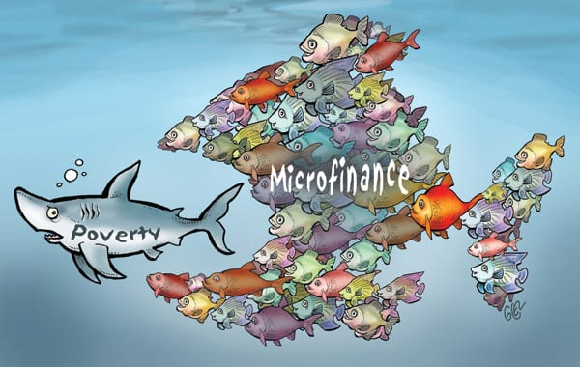
Challenges of Microfinance
High interest rate and high transaction cost
Strict repayment schedule
Barriers for conventional banking
Inadequate investment in Agriculture and Rural Development.
Low level of technical understanding of banking and finance
Coercive collection practices by some lenders
No innovative Mix of products by microfinance institution.

Slide 38
Debate on Microfinance/Microcredit
Some people believe that microfinance/microcredit plays an important role in reshaping rural development, while others argue that it damages the rural development ecology. What are your thoughts on this statement?

Slide 39
Reference
Economic and Social Development of Bangladesh: Miracle and Challenges.
Number and Narratives in Bangladesh’s Economic Development; written by Rashed Al Mahmud Titumir.

