Slide 1
Introduction to epidemiology
Mr. Faisal Muhammad
Lecturer & IMPH Coordinator, Department of Public Health, DIU

Slide 2
Objectives
At the end of the session the students will be able to :
What is ‘’Epidemiology’’?
Summarize the historical context of epidemiology
Scope of epidemiology and common epidemiological terms
To know about modern epidemiology and evolution of epidemiology
What is epidemiology of health?

Slide 3
The word ‘’epidemiology’’
The word Epidemiology has come from the three Greek words: Epi , Demos and Logos.
Epi means ‘ on’ or ‘upon’, Demos means people or population and logos means words ‘the study of’, which is a very old dating back to the 3rd century B.C. Thus epidemiology means study of what happens to the people.
Epidemiology is the study of how often diseases occur in different groups of people and why. Epidemiological information is used to plan and evaluate strategies to prevent illness and as a guide to the management of patients in whom disease has already developed.

Slide 4
Epidemiology: Definition
Epidemiology is the study of distribution and determinants of health related states and events in a specified population and application of this studies to control of health problems.
--Principles of Epidemiology, CDC

Slide 5
Study
As you study this definition , refers to the description of these terms below:
Study- Epidemiology is a scientific discipline, sometimes called “the basic science of public
health.” It has, at its foundation, sound methods of scientific inquiry.

Slide 6
Distribution
Distribution- Epidemiology is concerned with the frequency and pattern of health events in a population. Frequency includes not only the number of such events in a population, but also the rate or risk of disease in the population. The rate (number of events divided by size of the population) is critical to epidemiologists because it allows valid comparisons across different populations.
Pattern refers to the occurrence of health-related events by time, place, and personal characteristics.
• Time characteristics include annual occurrence, seasonal occurrence, and daily or even hourly occurrence during an epidemic.
• Place characteristics include geographic variation, urban-rural differences, and location of worksites or schools.
Personal characteristics include demographic factors such as age, race, sex, marital status, and socioeconomic status, as well as behaviors and environmental exposures

Slide 7
Determinants
Determinants: Epidemiology is also used to search for causes and other factors that influence the occurrence of health-related events. Analytic epidemiology attempts to provide the Why and How of such events by comparing groups with different rates of disease occurrence and with differences in demographic characteristics, genetic or immunologic make-up, behaviors, environmental exposures, and other so-called potential risk factors.
Under ideal circumstances epidemiologic findings provide sufficient evidence to direct swift and effective public health control and prevention measures.

Slide 8
States and events
States- The condition of health , diseases, disability, discomfort, dissatisfaction, health needs, health demands, health activities, health care utilizations, lifestyles , etc.
Events – The vital events like birth , death, marriage, divorce , migration , etc, accidents like road traffic accidents, warts, flood, poisoning , nuclear explosion etc.

Slide 9
Specified population
Specified population – Population in a defined geographical area with a specific characteristics.

Slide 10
Application
Epidemiology is more than “the study of.” As a discipline within public health, epidemiology provides data for directing public health action. Similarly, an epidemiologist uses the scientific methods of descriptive and analytic epidemiology in “diagnosing” the health of a community, but also must call upon experience and creativity when planning how to control and prevent disease in the community.
This can be done by informing health policy makers to take necessary action on some problem revealed by the study by providing intervention.
The researcher can also experiment on a group of people by certain intervention measures to bring about desired change in those people.

Slide 11
Control
Control of health problems :
If distribution and cause of any health related matter is known , we can control the problems created from that particular health related state and event.

Slide 12
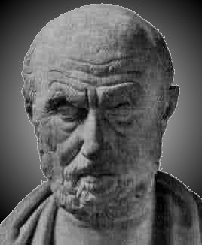
History of Epidemiology
Hippocrates (460-377 B.C)
Idea that disease might be associated with physical environment ‘’ On air, water and places ‘’

Slide 13
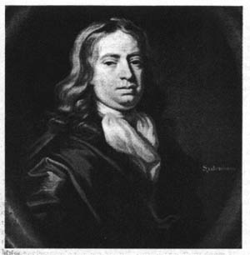
Thomas Sydenham (1624-1689)
Recognized as a founder of clinical medicine and epidemiology.
Emphasized detailed observations of patients & accurate recordkeeping.

Slide 14
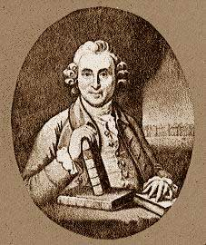
James Lind (1700’s)
Designed first experiments to use a concurrently treated control group

Slide 15
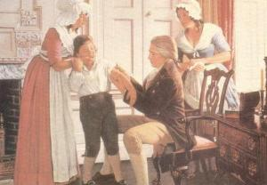
Edward Jenner (1749-1823)
Pioneered clinical trials for vaccination to control spread of smallpox
Jenner's work influenced many others, including Louis Pasteur who developed vaccines against rabies and other infectious diseases

Slide 16
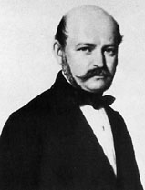
Ignas Semmelweis (1840’s)
Pioneered hand washing to help prevent the spread of septic infections in mothers following birth

Slide 17
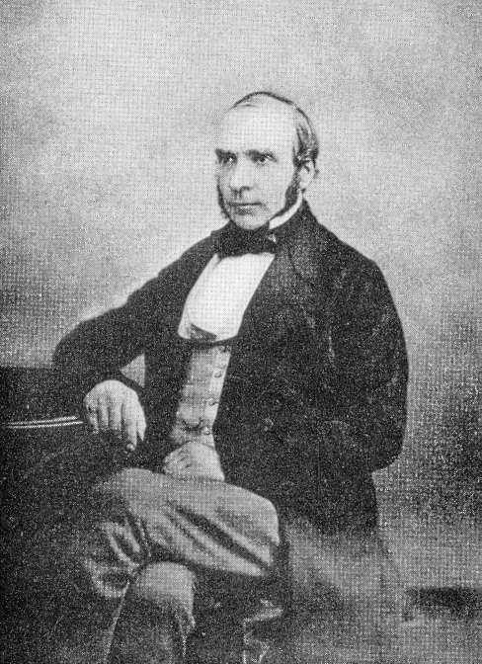
John Snow (1813-1858)
Father of epidemiology
Careful mapping of cholera cases in East London during cholera epidemic of 1854
Traced source to a single well on Broad Street that had been contaminated by sewage

Slide 18
Typhoid Mary & George Soper
Mary Mallon, a cook responsible for most famous outbreaks of carrier-borne disease in medical history
Recognized as carrier during 1904 N.Y. typhoid fever epidemic
When source of disease was traced, Mary had disappeared only to resurface in 1907 when more cases occurred
Again Mary fled, but authorities led by George Soper, caught her and had her quarantined on an island
years later

Slide 19
, In 1910 the health department released her on condition that she never accept employment involving the handling of food
Four years later, Soper began looking for Mary again when two new epidemics broke out; Mary had worked as a cook at both places
She was found and returned to North Brother Island, where she remained the rest of her life until a paralytic stroke in 1932 led to her slow death.
six

Slide 20
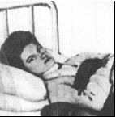
Typhoid Mary

Slide 21
Future Challenges
Instant global transmission of pathogens
Population overcrowding
Ease of travel
Importation of foods

Slide 22
Concept of epidemiology
Over two thousand years ago Hippocrates gave us the earliest impression about epidemiology ‘s content or approach in his treatise on ‘’ air, water and places’’.
Thereafter evolution of epidemiological concepts have taken place through work of different scientists over different periods.
These works generated ideas which lead to development of present day epidemiological concepts and methods have developed from four central ideas. These are:
1. Observation: that human diseases is related to man’s environment – as postulated by Hippocrates.
2. Counting: of natural phenomenon may be educative as demonstrated by John Graunt 1962 in his analysis of Bills Of mortality.
3. Natural experiments : can be utilized to investigate etiology and mechanism of disease process – as illustrated by John Snow (1854) in his investigation work on Cholera in London.
4. Experiments on man : Under certain conditions , can also be used for this purpose – as was the case in experiment by Fletcher (1905) on effect of cured rice on prevalence of Beriberi in kuala lampur prison.

Slide 23
Epidemiology :concerned
Basic science concerned with the pattern of diseases frequency in human population.
Not only the disease, disability and health but also with more positive health states and with the men to improve health.
Facts of life occurring in human population.
The study of health services used by the population and to measure their impact.
Epidemiology is often concerned with the well being of society as a whole than with the well being of individuals

Slide 24
Purpose of epidemiology
To provide a basis for developing disease control and prevention measures for groups at risk . This translate into developing measures to prevent or control disease.

Slide 25
Aims of epidemiology
To describe the distribution and magnitude of health and disease problems in human population.
To identify etiological factors (risk factors) in the pathogenesis of diseases.
And provide data essential to planning , implementation and evolution of services for the prevention, control and treatment of disease and to the setting up of priorities among those services.

Slide 26
Epidemiology of health
Epidemiology of health is the study of distribution and determinants of health itself or in other words , to study the factors related with two factors:
a) in the absence of disease condition , for example small pox and the another.
b) in the absence of a disease in a community in spite of presence and exposure to specific risk factor responsible for the causation of the said disease.
Therefore if all the diseases were eliminated , the epidemiology continue to study about the determinants of health to promote the health status of population. For example , small –pox has been eradicated from the world , but surveillance of small pox is still continuing.

Slide 27
Modern epidemiology
Modern epidemiology deals with , in addition to chronic diseases, the other health related states that is not a medical condition but can give rise to health consequences.
The concept has started with the search for non –communicable diseases and its horizon towards genetic epidemiology, pharmaco-epidemiology, immuno-epidemiology, social epidemiology etc.
Modern epidemiology has entered the most exciting phase of its evolution. By identifying risk factors of the chronic diseases, evaluating treatment modalities and health services, it has provided new opportunities for prevention, treatment , planning and improving effectiveness and efficiency of health services.

Slide 28
Use of epidemiology
1. To determine which in the three possible sets of disease factors, host , agent and environment , are important in the occurrence of specific disease or class of disease, the extent to which those factors are important and the manner in which they interact.
2. To study the occurrence of disease in a population for purposes of community diagnosis and prognosis.
3. To describe the epidemiology of disease or class of disease.
4. To measure risk.
5. To study the occurrence of disease or death with time as variable. Such a study is referred to as a historical study.
6. To aid the search for cause of a disease.
7.In disease prevention and control.
8.To aid the identification of clinical syndrome.
9. To aid the detection of pre symptomatic and latent disease.
10. In administrative medicine and operational research

Slide 29
Thank You

