Slide 1
WELCOME To…
To Basic concepts of Probability

Slide 2
Chapter Goals
Define probability.
Describe the classical, empirical, and subjective approaches to probability.
Explain the terms experiment, event, outcome, permutations, and combinations.
Define the terms conditional probability and joint probability.
Calculate probabilities using the rules of addition and rules of multiplication.
Apply a tree diagram to organize and compute probabilities.
Calculate a probability using Bayes’ theorem.

Slide 3
1
2
3
Approaches to assigning probability
Contents
about
Basic of probability
Basic terminology:
Experiment, event, outcome

Slide 4
Definitions
A probability is a measure of the likelihood that an event in the future will happen. It can only assume a value between 0 and 1.
A value near zero means the event is not likely to happen. A value near one means it is likely.
Probability is the study of randomness and uncertainty.
In the early days, probability was associated with games of chance (gambling). 3

Slide 5
How do we describe probability?
You can describe the probability of an event with the following terms:
certain (the event is definitely going to happen)
likely (the event will probably happen, but not definitely)
unlikely (the event will probably not happen, but it might)
impossible (the event is definitely not going to happen)

Slide 6
Probability
Definitions
The probability of an event is a number that measures the relative likelihood that the event will occur.
The probability of event A [denoted P(A)], must lie within the interval from 0 to 1:
0 < P(A) < 1
If P(A) = 0, then the event cannot occur.
If P(A) = 1, then the event is certain to occur.

Slide 7
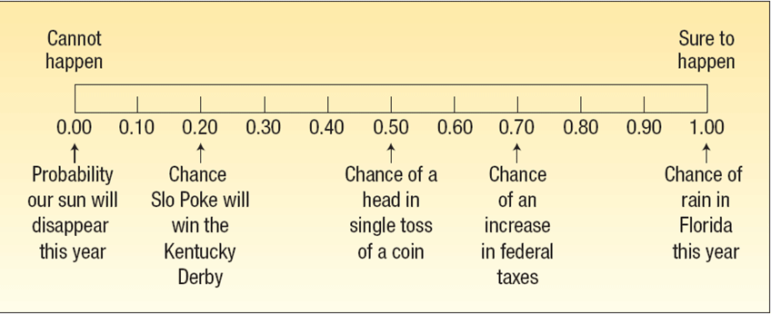
Probability Examples

Slide 8
How do we express probabilities?
Usually, we express probabilities as fractions.
The numerator shows the POSSIBLE number of ways an event can occur.
The denominator is the TOTAL number of possible events that could occur.
P(E)= Probability of an event
When, P(E) =0, An event that is uncertain to happen
P(E) =1, An event that is certain to happen
Formula:
P(E)= $\frac{\text{POSSIBLE} \text{number} \text{of} \text{ways} \text{an} \text{event} \text{can} \text{occur}}{\text{TOTAL} \text{number} \text{of} \text{possible} \text{events}}$

Slide 9
Definitions continued..
An experiment is the observation of some activity or the act of taking some measurement.
An outcome is the particular result of an experiment.
An event is the collection of one or more outcomes of an experiment.

Slide 10
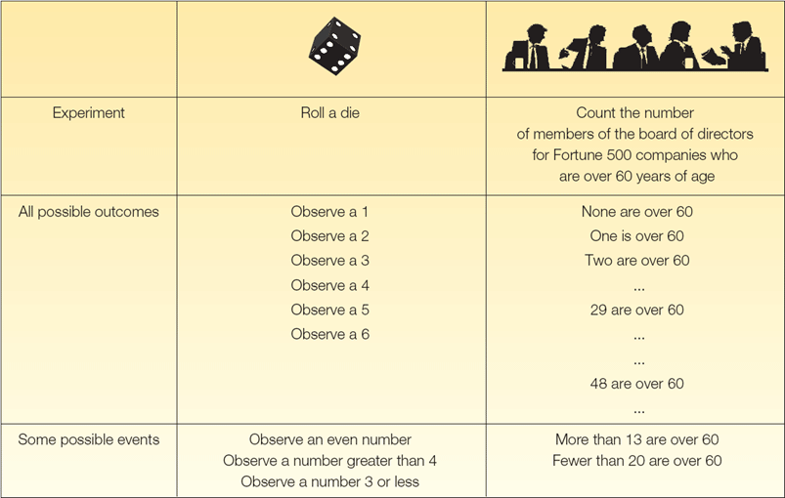

Slide 11
Assigning Probabilities
Three approaches to assigning probabilities
Classical
Empirical
Subjective

Slide 12
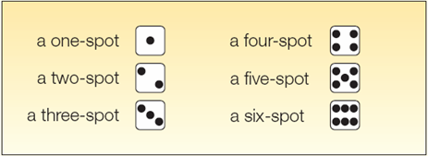
Classical Probability
Consider an experiment of rolling a six-sided die. What is the probability of the event “an even number of spots appear face up”?
The possible outcomes are:
There are three “favorable” outcomes (a two, a four, and a six) in the collection of six equally likely possible outcomes.

Slide 13
Empirical Probability
The empirical approach to probability is based on what is called the law of large numbers. The key to establishing probabilities empirically is that more observations will provide a more accurate estimate of the probability.

Slide 14
Empirical Probability - Example
On February 1, 2003, the Space Shuttle Columbia exploded. This was the second disaster in 113 space missions for NASA. On the basis of this information, what is the probability that a future mission is successfully completed?

Slide 15
Subjective Probability - Example
If there is little or no past experience or information on which to base a probability, it may be arrived at subjectively.
Illustrations of subjective probability are:
1. Estimating the likelihood the New England Patriots will play in the Super Bowl next year.
2. Estimating the likelihood you will be married before the age of 30.
3. Estimating the likelihood the U.S. budget deficit will be reduced by half in the next 10 years.

Slide 16
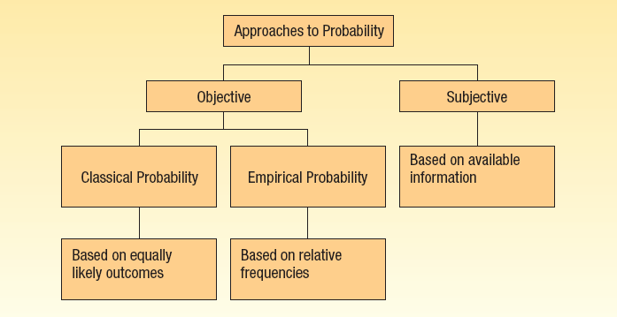
Summary of Types of Probability

