Slide 1
void and voidable agreement

Slide 2
Understanding the meaning of void and agreement
Void : In Law, void means of no legal effect. An action, document, or transaction which is void is of no legal effect whatsoever: an absolute nullity—the law treats it as if it had never existed or happened.
Agreement : The act of agreeing or of coming to a mutual arrangement. the state of being in accord. an arrangement that is accepted by all parties to a transaction. a contract or other document delineating such an arrangement. unanimity of opinion; harmony in feeling: agreement among the members of the faculty.

Slide 3
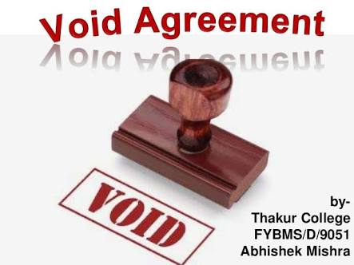
What is void agreement?
A void Agreement cannot be enforced by law.An agreement to carry out an illegal act is an example of a void agreement. For example, a contract between drug dealers and buyers is a void contract simply because the terms of the contract are illegal. In such a case, neither party can go to court to enforce the contract.

Slide 4
Why void agreement cannot be enforced by law?
Void Agreement :-Void Contract means that a contract does not exist at all. The law can not enforce any legal obligation to either party especially the disappointed party because they are not entitled to any protective laws as far as contracts are concerned.

Slide 5
Laws for void agreeemenrt
There are certain laws for every agreement which are enforceable by law.
I have listed down in my understanding of those laws as bellow:
Restraints of marriage are usually void if they are general or unlimited in scope.
If a man and woman agrees to marry each other , the contract is undoubtably good however if one person decided to not marry at all or marrying anybody and there is no obligation on that person , the contract is will be considered as void.
If anyone commits to an agreement with any party which poses threat/restriction to a lawful business then that agreement would be considered as void agreement.
A law cannot be altered for the interest of a particular individual.
Any law whose meaning is vague or cannot be understood is void.
An agreement will be void if it stands on the base of game or the result of any uncertain event.
Any contract which is based on something which is impossible , is also void.
Any agreements whose conditions involving something which are illegal also void.

Slide 6
EXPRESSLY DECLARED VOID AGREEMENT
There are certain agreements, which are expressly declared to be void. They are as follows: (1) Agreement by a minor or a person of unsound mind.[Sec(11)] (2) Agreement of which the consideration or object is unlawful[Sec(23)] (3) Agreement made under a bilateral mistake of fact material to the agreement[Sec(20)] (4) Agreement of which the consideration or object is unlawful in part and the illegal part can not be separated from the legal part [Sec(24)] (5) Agreement made. without consideration.[Sec(25)] (6) Agreement in restraint of marriage [Sec(26)] (7) Agreement in restrain of trade [Sec(27)] (8) Agreement in restrain of legal proceedings[Sec(28)] (9) Agreements the meaning of which is uncertain [Sec(29)] (10) Agreements by way of wager [Sec(30)] (11) Agreements contingent on impossible events [Sec(36)] (12) Agreements to do impossible acts [Sec(56)]

Slide 7
Illegal agreementP
An illegal agreement under the common law of contract, is one that the court will not enforce because the purpose of the agreement is to achieve an illegal end. The illegal end must result from performance of the contract itself.

Slide 8
Is there any difference between unlawful agreement and illegal agreement?
There is a difference between illegal and unlawful agreements. Illegal agreements are those consideration or object of which is not legal as well as punishable in nature for example, agreement to murder someone. ... Hence, every illegal agreement is unlawful but every unlawful agreement is not illegal.

Slide 9
Voidable agreement
A voidable agreements is one which can be avoidable, set aside by some of the parties to it.
For example: Shila forces Mila to agree to a a contract for the sale of Mila's car to Shila. This contract can be avoidable by Mila. In that case Shila cannot enforce the contract but Mila if she so desire, can enforce it against Shila.

Slide 10
Typical grounds for a contract being voidable include coercion, undue influence, misrepresentation or fraud. A contract made by a minor is often voidable, but a minor can only avoid a contract during his or her minority status and for a reasonable time after he reaches the age of majority. After a reasonable period of time, the contract is deemed to be ratified and cannot be avoided.^{[1]} Other examples would be real estate contracts, lawyer contracts, etc.

